Slide 1
Ongoing
Lead Evaluator Training
2012-2013
Day 3

Slide 2
Agenda
[always] Aligning RTTT
Growth and Value-Added Update
21st Century Readiness and APPR
Evidence Collection
Inter-rater agreement and reliability
Growth-Producing Feedback
Notes:
Review the agenda.

Slide 3
Agenda
x
[always] Aligning RTTT
Growth and Value-Added Update
21st Century Readiness and APPR
Evidence Collection
Inter-rater agreement and reliability
Growth-Producing Feedback
Notes:
Review the agenda.

Slide 4
Agenda
EMERGENCY
Research Update
Evidence Collection
SLO Summative Help
Summative Evaluation
Growth-Producing Feedback
The Start of the Second Half
Notes:
Review the agenda.

Slide 5
Lead Evaluator Training
Original
New York State Teaching Standards and Leadership Standards
Evidence-based observation
Application and use of Student Growth Percentile and VA Growth Model data
Application and use of the State-approved teacher or principal rubrics
Application and use of any assessment tools used to evaluate teachers and principals
Application and use of State-approved locally selected measures of student achievement
Use of the Statewide Instructional Reporting System
Scoring methodology used to evaluate teachers and principals
Specific considerations in evaluating teachers and principals of ELLs and students with disabilities
Notes:
These are the “nine” official goals of Lead Evaluator Training.

Slide 6
Lead Evaluator Training
Ongoing
From the Review Room: “Describe the process by which evaluators will be trained and the process for how the district will certify and re-certify lead evaluators. Describe the process for ensuring
inter-rater reliability. Describe the duration and nature of such training.”
Notes:
This is where ongoing training is mentioned in the Review Room.

Slide 7
Lead Evaluator Training
Ongoing
Continue to collect evidence
Use collected evidence to rate teachers on a rubric (with feedback)
Manage the new system
Employ growth-producing feedback to increase the quality of teaching
Implement the Reform Agenda (RTTT)
Notes:
Our local goals for Lead Evaluator Training, in addition to the required components.

Slide 8
Lead Evaluator Training
Ongoing
Continue to collect evidence
Use collected evidence to rate teachers on a rubric (with feedback)
Manage the new system
Employ growth-producing feedback to increase the quality of teaching
Implement the Reform Agenda (RTTT)
Notes:
Our local goals for Lead Evaluator Training, in addition to the required components.

Slide 9
Warm-Up

Slide 10
What’s One Thing…
Think of one thing you did that you feel GOOD about in the last two weeks related to Professional Practice (APPR)
See if you can think of something that you didn’t do LAST year
Each person takes a turn to share
Go around at your table group

Slide 11
Research Update:
Measures of Effective Teachers
(MET)

Slide 12

Measures of Effective Teaching

Slide 13
Measures of Effective Teaching
The research confirmed that, as a group, teachers previously identified as more effective caused students to learn more.
Groups of teachers who had been identified as less effective caused students to learn less.
Circular logic warning!!!

Slide 14
Measures of Effective Teaching
Adding lessons and observers increases the reliability of classroom observations.
Student perception surveys and classroom observations can provide meaningful feedback to teachers.
Implementing specific procedures in evaluation systems can increase trust in the data and the results.
Each measure adds something of value.
A balanced approach is most sensible when assigning weights to form a composite measure.
There is great potential in using video for teacher feedback and for the training and assessment of observers.

Slide 15
Evidence Collection

Slide 16
Evidence Collection
Watch the mini-observation (Gallegos)
Collect evidence
Focus on environment
  Standard 4 (Teaching Standards and NYSUT)

Slide 17
Evidence Collection
Rate the teacher on Standard IV (NYSUT).
As prompted in polleverywhere, text your rating
Where were you, compared to
  Others in the room
  (inter-rater agreement)
  The facilitator
  (inter-rater reliability)

Slide 18
SLOs and
Summative Assessment

Slide 19

SLO Summative Resources
Posted at APPR microsite:
Checklist
Proctor Attestation
Scorer Attestation
Sample Student Roster
Remember: BALANCE!

Slide 20

Quick break

Slide 21
Preparing for the
Summative Evaluation

Slide 22

Summative Evaluation
At your table, generate a list of everything you are going to need to be able to do your summative evaluations and End-of-the-Year Meetings.

Slide 23
Summative Evaluation
SLO scoring conversion
LAT scoring conversion
Rubric scaling to 60 points
Total Score > HEDI scale
Growth-Producing Feedback
PD recommendations
Improvement Plan Requirements

Slide 24
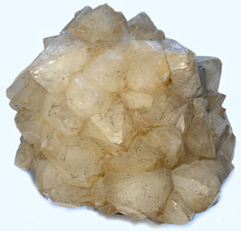
SLO/LAT Scoring Conversion
Figure out the score this teacher would get on her LAT. It is the same process as for an SLO.

Slide 25
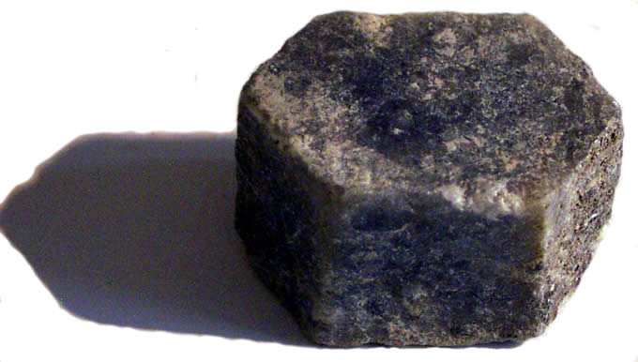
Multiple Measures Scoring
Figure out the score this teacher would get on her 60%. Use the final scores provided and your district’s APPR plan.

Slide 26
Total Summative Score
What would the score be for the teacher?
HEDI?

Slide 27
Total Summative Score
What professional development would you recommend for this teacher for next year?

Slide 28
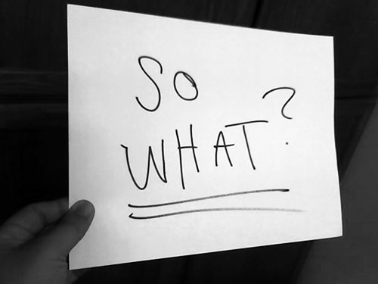

Slide 29
Preparing for the
End-of-the-Year Meeting

Slide 30
Meeting Plan (or Map*)
What will be your agenda for these meetings?
As a table, make a plan!

Slide 31
Improvement Plan
What would you want to see in the improvement plan?

Slide 32

Growth-Producing Feedback
With your neighbor, plan your conversation with the teacher

Slide 34
Culture

Slide 35
Culture Reminder
There will be an impact on school culture
It may be more pronounced than we have experienced so far

Slide 36
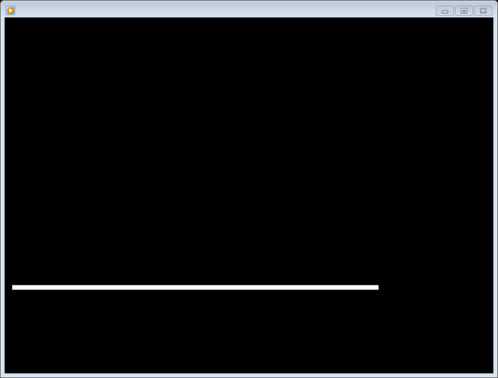
Culture Reminder
Leadership responsibilities
Focus on future, not the romanticized past

Slide 37
The Second Half

Slide 38
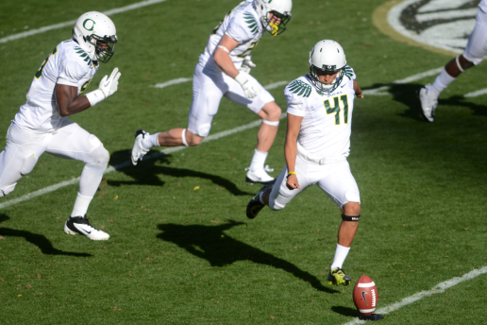
2nd Semester
Individually, start to map out your second half of the year.
If you already have a map, use it
Share with your partner and table

Slide 39
Next Time

Slide 40
Final 2012-12 Session
March 25th in Syracuse
March 26th in Cortland
Agenda will include
  Evidence Collection and
  Growth-Producing Feedback
  21st Century Readiness mini-lesson
  Summative Evaluations

Slide 41
Ongoing
Lead Evaluator Training
2012-2013
Day 3

