Slide 1
Lead Evaluator Training
2015-2016 Ongoing Training
Day 2

Slide 2
Welcome to Day 2
Lead Evaluator Training
Agenda Review

Slide 3
Nine Required Components
3012-c
3012-d
New York State Teaching Standards and Leadership Standards
Evidence-based observation
Application and use of Student Growth Percentile and VA Growth Model data
Application and use of the State-approved teacher or principal rubrics
Application and use of any assessment tools used to evaluate teachers and principals
New York State Teaching Standards and Leadership Standards
Evidence-based observation
Application and use of Student Growth Percentile method
Application and use of the State-approved teacher or principal rubrics
Application of assessment tools the district employs

Slide 4
Nine Required Components
3012-c
3012-d
Application and use of State-approved locally selected measures of student achievement
Use of the Statewide Instructional Reporting System
Scoring methodology used to evaluate teachers and principals
Specific considerations in evaluating teachers and principals of ELLs and students with disabilities
Application and use of State-approved locally selected measures of student growth
Use of the Statewide Instructional Reporting System
Scoring methodology used by the state and the district
Specific considerations in evaluating teachers and principals of ELLs and students with disabilities

Slide 5
Our Components
Managing the APPR (especially in d)
Connecting it to Learning
Increasing the likelihood that it makes a difference

Slide 6
Agenda
Changes: §3012-c and §3012-d
Mini-Lesson: Professional Capital
Evidence Collection & Scoring (with feedback)
Summative Evaluation (in light of the changes)
Notes:
Review the agenda.

Slide 7
Warm Up Activity
Discuss:
What is one good conversation you had with a teacher about instruction in the last few weeks?
What made it good?

Slide 8
APPR “Transition”
§3012-c and §3012-d
Slides updated 1.24.16

Slide 9
Emergency Action
At their December 2015 meeting, the Board of Regents [again] took emergency action
Introduced APPR transition scores and ratings for 2015-16 through 2018-19.
This was in response to the Governors’ Common Core Commission recommendation #21.
Both §3012-c and §3012-d were impacted.

Slide 10
“Transition” Period
During the transition period, LEAs must calculate both original and transition scores and ratings.
The results of grades 3-8 ELA/math State assessments and any State-provided growth scores must be excluded from the transition score/rating calculations.
State-provided growth scores and the original scores and ratings must still be provided for advisory purposes.
Notes:
9-12 can’t use building wide measure (i.e., principal growth score) but can still use SLOs with the Regents exams
Can still use NYSAA and NYSELAT
Target setting with NYSAA-there will be a conversion chart, continue to target set as you have before

Slide 11
2015-16 in “Transition” Period
Continue to calculate scores and ratings pursuant to the approved APPR plan.
Also calculate transition scores and ratings that exclude the results of 3-8 ELA/math State assessments and any State-provided growth scores.
Transition scores are based upon the remaining subcomponents of the APPR that are not based on the grade 3-8 ELA or math State assessments or a State-provided growth score on Regents exams.
Notes:
The Department anticipates returning to the Board of Regents at its February 2016 meeting with proposed regulatory changes that will provide districts implementing APPR plans pursuant to Education Law §3012-d during the 2015-16 school year the same protections that the new transition regulations provide districts implementing APPR plans pursuant to Education Law §3012-c during the 2015-16 school year.

Slide 12
Rest of the “Transition” Period
Transition scores and ratings will be determined based upon the remaining subcomponents of the APPR that are not based on the grade 3-8 ELA or math or State-provided growth scores.
Where no scores or ratings in the subcomponents of the Student Performance Category can be generated, an alternate SLO must be developed using assessments approved by the Department that are not 3-8 ELA and math State assessments.
Notes:
It is assumed all will be at 3012(d)
If already approved 3012(d) the department will being releasing a form, an addendum to come into compliance with these requirements. The form will require signatures

Slide 13
“Transition” Period
Assessment options include:
  4 and 8 State Science assessments
  Regents examinations
  State-approved third-party assessments
  State-approved district, regional, or BOCES-developed assessments
During the transition period, common branch teachers will not be required to have at least one math and one ELA SLO.
Alternate SLOs may utilize district-wide measures
Notes:
District measure still can’t use 3-8 ELA and/or math
Currently only state assessments are to be used for a building-wide/school/group or team measure. This change is being considered by the department
*In order for third-party and locally-developed assessments to be used for evaluations under Ed. Law §3012-d, an application must be submitted to the Assessment RFQ. The Department is reviewing these applications in an expedited manner and the requirements for assessments for use with SLOs were revised on September 18, 2015 to significantly reduce the amount of information that applicants need to provide.
For 2016-17 and forward-3rd grade teachers still have to set a SLO using the 3rd grade ELA and math test. They will also need another student performance measure that does not include the 3-8 ELA and/or math assessments
3012(d) 4-8 ELA and math (2016-17, 2017-18, 2018-19)
Overall: transition SLO that does not use the state 3-8 ELA or math assessments
Original (state provided growth score): state-provided growth score and an alternate SLO
“You are still expected to implement your plan as approved. In the plan you had approved you attested that there will be back-up SLOs for 3-8 ELA and math. Even though you will not be using these scores for transition scores, you are still required to have them for the advisory score reasons during the transition period”

Slide 14
Waivers
Hardship Waivers will be automatically renewed for all districts that are currently implementing a §3012-c APPR plan pursuant to a Hardship Waiver that was approved by the November 15, 2015 deadline.

Slide 15
§3012-d Plans
Districts must still have a §3012-d APPR plan approved by the Department by September 1, 2016 to maintain eligibility for State aid increase.
Districts should submit their §3012-d APPR plans by July 1, 2016 to ensure approval by September 1, 2016.
The APPR portal is being updated for the 2016-17 school year to accommodate entry of alternate SLOs during the transition period.
Notes:
3012(d) plan to SED by July 1 to get approval by Sept 1
Alternate SLO form, for those with approved 3012(d) plans will be available in March

Slide 16
§3012-d Plans
If your district/BOCES already has an approved §3012-d APPR plan you do not need to be revise it for the 2015-16 school year.
You will have to submit a supplemental form describing the alternate SLOs that will be used during the transition period so that you do not need to re-open the entire APPR plan.
Notes:
3012(d) plan to SED by July 1 to get approval by Sept 1
Alternate SLO form, for those with approved 3012(d) plans will be available in March

Slide 17
Employment Decisions
For all employment related decisions and TIP/PIP determinations, districts/BOCES must use the overall composite transition rating.
Notes:
Eligibility to appeal of original scores is actually higher than transition scores will be locally determined.

Slide 18
Reporting Implications
Both the original and transition scores and ratings will be reported to SED.
The reporting template will be changed.

Slide 19
Parent Requests for Scores
Both the original composite score and the overall transition composite score will be reported if requested
Include an explanation of the transition score/rating.
Public Data Access Site will report both original and transition ratings.

Slide 20
§3012-c

Slide 21
For Most in §3012-c
20%
Student
Growth
60%
Multiple Measures
20%
Student
Achievement
20 + 20 + 60

Slide 22
For Some Teachers
X
20%
Student
Growth
60%
Multiple Measures
20%
Student
Achievement
(20 + 60) x 100/80
Notes:
This is also applicable to principal receiving a growth score from the state or other teachers tied to a growth-derived 3-8 score

Slide 23
For Few Teachers
X
20%
Student
Growth
X
60%
Multiple Measures
20%
Student
Achievement
(60) x 100/60
Notes:
This is if both 20%s and any back-up SLOs are based on state 3-8 scores

Slide 24
§3012-d

Slide 25
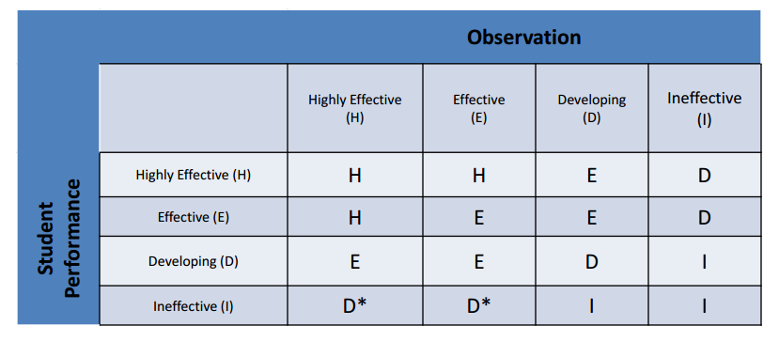
For Most in §3012-d
Notes:
This is if both the performance measure and any back-up SLOs are based on state 3-8 scores or derived from a state-provided growth score

Slide 26
For Some in §3012-d
X

Slide 27

Three-Minute Pause

Slide 28
It Could Be Worse

Slide 29
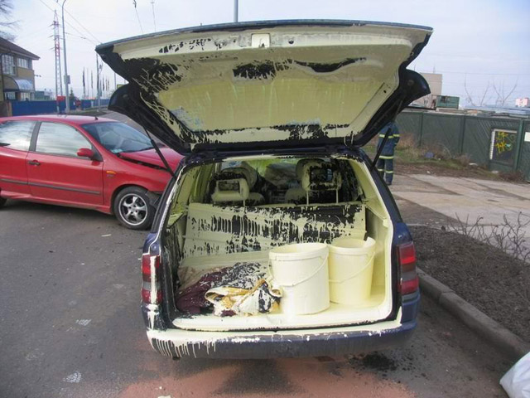

Slide 30
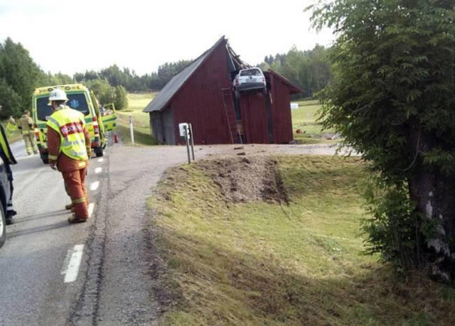

Slide 31
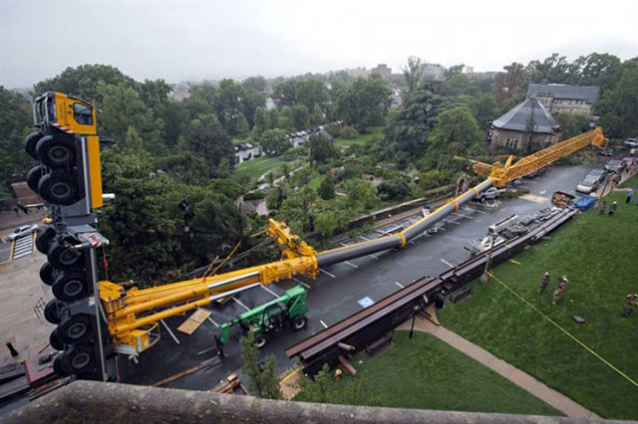

Slide 32
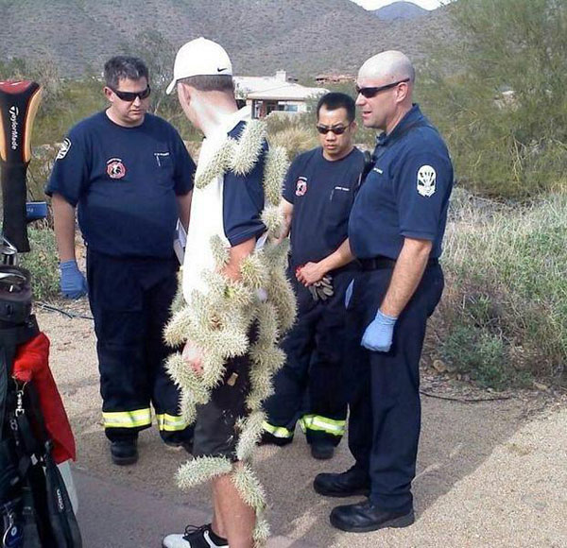

Slide 33
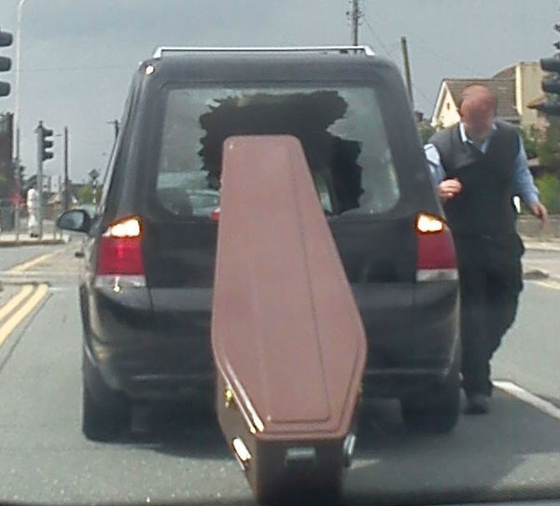

Slide 34
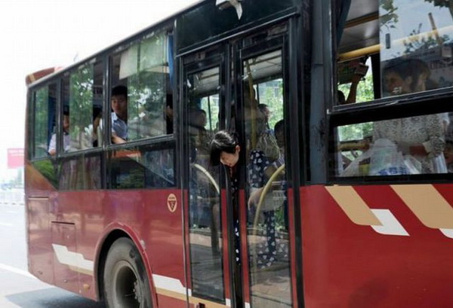

Slide 35
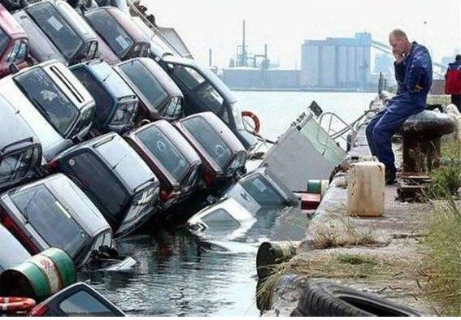

Slide 36
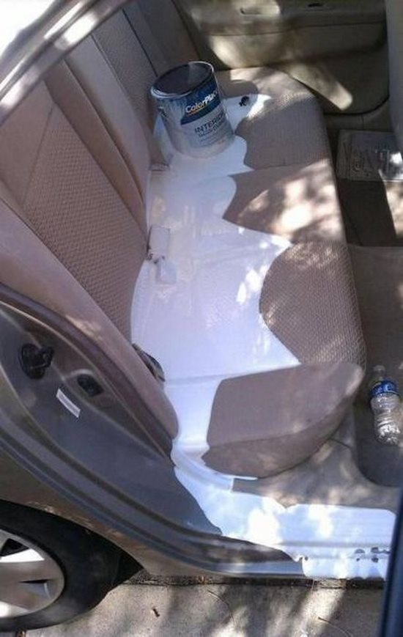

Slide 37


Slide 38
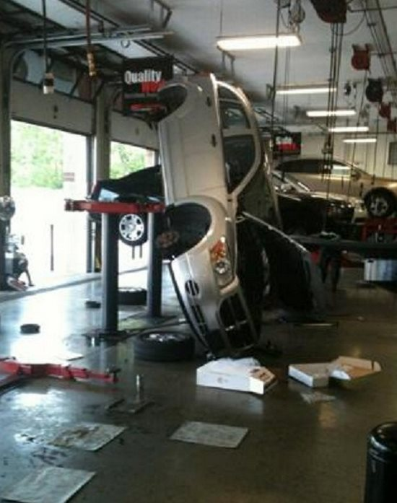

Slide 39


Slide 40
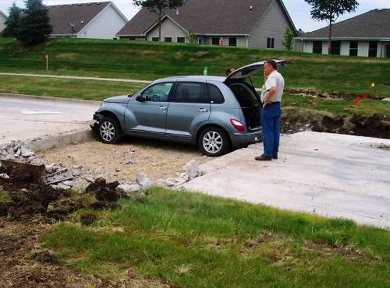

Slide 41


Slide 42
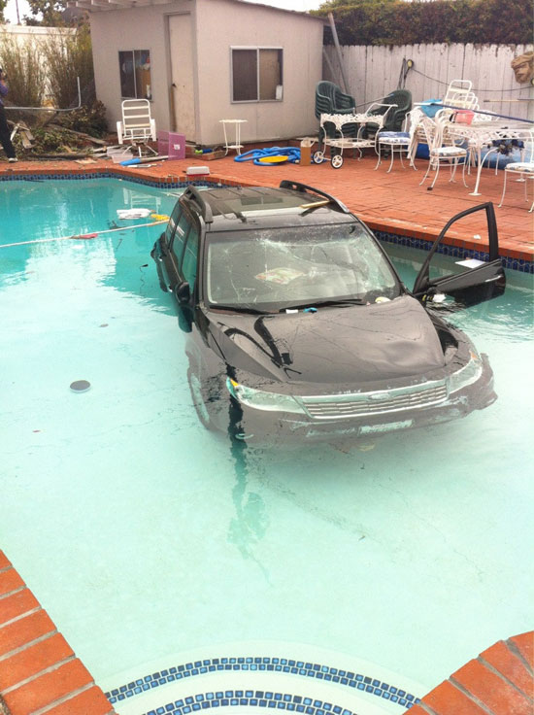

Slide 43


Slide 44
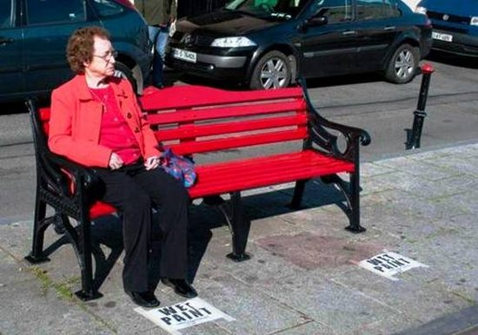

Slide 45


Slide 46
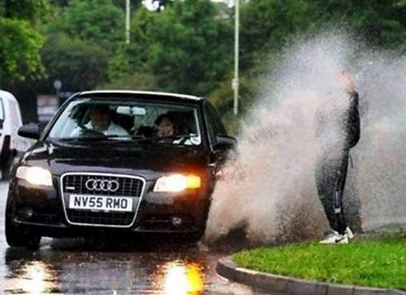

Slide 47
APPR that Works:
Professional Capital

Slide 48
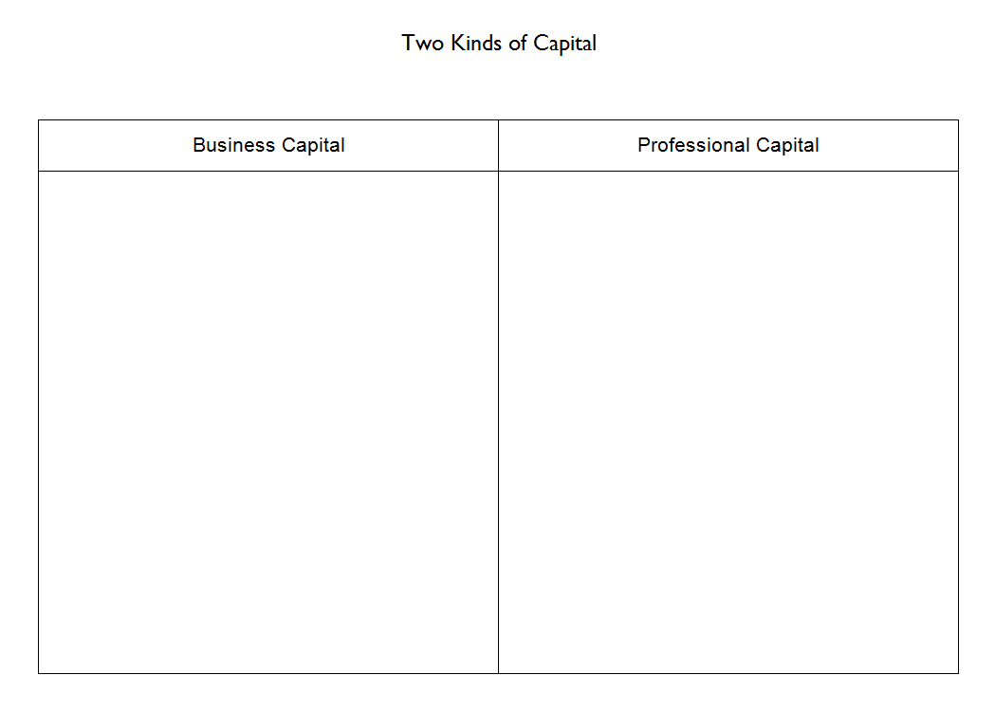
A Capital Idea
Divide into pairs
Read about the two kinds of capital
Together,
fill in the chart

Slide 49
Two Assumptions About Teaching
Business Capital | Professional Capital
may be emotionally demanding but it is technically simple. is a quick study requiring only moderate intellectual ability. is hard at first, but with dedication can be mastered readily. should be driven by hard performance data about what works and where best to target one’s efforts. comes down to enthusiasm, hard work, raw talent, and measurable results. is often replaceable by online instruction. | is technically sophisticated and difficult. requires high levels of education and long periods of training. is perfected through continuous improvement. involves wise judgment informed by evidence and experience. is a collective accomplishment and responsibility. maximizes, mediates, and moderates online instruction.

Slide 50

Professional Capital

Slide 51
Human Capital (the quality of the individual)
+
Social Capital (the quality of the group)
+
Decisional Capital (growing wisdom & competencies of educators)

Slide 52
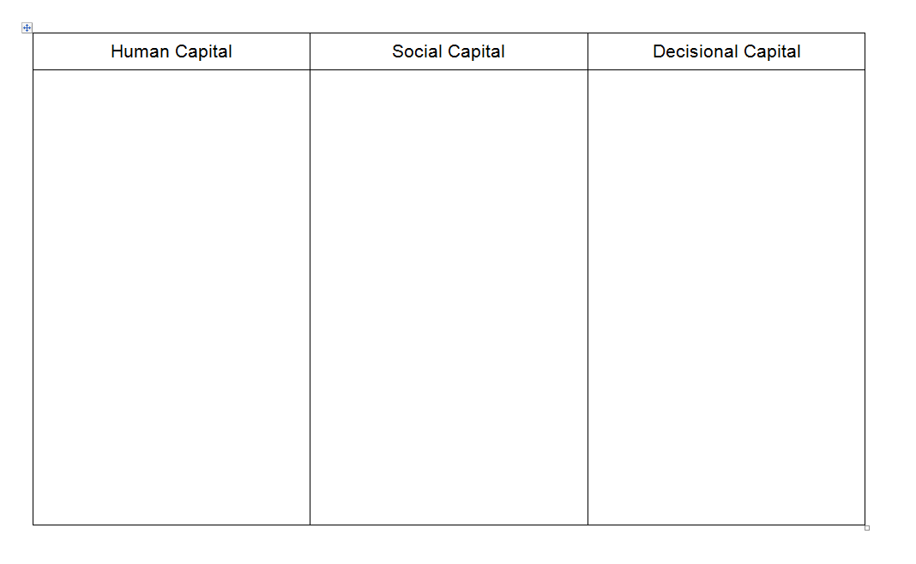

Hear It From Andy
Take notes during the video

Slide 53
Human Capital | Social Capital | Decisional Capital
Qualifications Knowledge Preparation Skills Emotional Intelligence | Trust Collaboration Collective responsibility Mutual assistance Professional networks Push, pull and nudge | Judgment Case Experience Practice Challenge & Stretching Reflection

Slide 54
PC Inventory
Take the Human Capital section of the Fullan & Hargreave’s Principal Professional Capital Survey
At your table, talk about “so what?”

Slide 55
PC Inventory
Take the Social Capital section of the Fullan & Hargreave’s Principal Professional Capital Survey
At your table, talk about “so what?”

Slide 56
PC Inventory
Take the Decisional Capital section of the Fullan & Hargreave’s Principal Professional Capital Survey
At your table, talk about “so what?”

Slide 57
PC Inventory
Districts are suggested to take the responses from all of their principals to create a “heat map”
Suggestion to principals: Do this with your teachers using Fullan & Hargreave’s Teacher Professional Capital Survey

Slide 58
Three-Minute Pause

Slide 59
Guidelines for Districts and School Leaders
Promote professional capital vigorously and courageously
Professional capital involves a change of culture in your school and in your district.

Slide 60
Guidelines for Districts and School Leaders
Secure leadership stability and sustainability
Stable and sustainable leadership prospers when there are incentives of recognition, support, reward and in the most troubled communities, encouraging principals and system leaders to stay rather than move up and move on.

Slide 61
Guidelines for Districts and School Leaders
Know your people: understand their culture
Professional Capital is about leaders taking the time to know their people and what their people do, and to know how to bring out the best from those people collectively.

Slide 62
Guidelines for Districts and School Leaders
Beware of contrived collegiality
Ultimately, developing professional capital is about helping people to help themselves and to help their students more effectively; it is not about manipulating them into complying with externally imposed requirements or delivering someone else’s vision.

Slide 63
Guidelines for Districts and School Leaders
Be evidence informed, not data driven
Don’t overload yourself with data so that you have no room as a community to think about anything else. Remember: the point of data is to know your students.

Slide 64
Three-Minute Pause

Slide 65
Evidence Collection Practice

Slide 66
Evidence Collection Practice
Science Lesson
Watch it (mini)
Collect evidence, clean it up, sort, etc.
Score on the provided rubric: Classroom environment focus
Check out inter-rater reliability

Slide 67
Standard IV: Learning Environment
Teachers work with all students to create a dynamic learning environment that supports achievement and growth.

Slide 68
Element IV.1
Teachers create a mutually respectful, safe, and supportive learning environment that is inclusive of every student.
Teachers are caring and respectful in their interactions with students.
Teachers embrace student diversity as an asset in the classroom.
Teachers recognize and reinforce positive interactions among students.
Teachers create a climate of acceptance and respect.
Teachers create an environment where students show responsibility to and for one another.

Slide 69
Element IV.2
Teachers create an intellectually challenging and stimulating learning environment.
Teachers encourage students to set high standards and expectations for their own performance.
Teachers motivate students to initiate their own learning and strive to achieve challenging learning goals.
Teachers promote students’ curiosity and enthusiasm for learning.
Students are actively engaged in learning.
Students openly express their ideas.
Students show pride in their work and accomplishments

Slide 70
Element IV.3
Teachers manage the learning environment for the effective operation of the classroom.
Teachers establish, communicate, and maintain clear standards and expectations for student behavior.
Teachers develop, implement, and adapt routines and procedures to manage activities and transitions.
Teachers facilitate instructional groupings to maximize student participation, cooperation, and learning.
Students exhibit respectful classroom interactions.

Slide 71
Element IV.4
Teachers organize and utilize available resources (e.g., physical space, time, people, technology) to create a safe and productive learning environment.
Teachers arrange and adapt the physical environment to accommodate individual and group learning needs and to celebrate student accomplishments.
Teachers ensure that all students have equitable access to available resources and technologies.
Teachers effectively use the services and skills of available volunteers and paraprofessionals.
Teachers know and implement policies and procedures to ensure student safety.

Slide 72

Evidence Collection Practice

Slide 73
Feedback
What kind of feedback would you provide this teacher?
Discuss at your table.
Plan, especially, your opening line.

Slide 74
Preparing for the
Summative Evaluation

Slide 75
Preparing for the
Summative Evaluation
TRANSITION

Slide 76
Summative Evaluation
SLO scoring conversion
LAT scoring conversion
Rubric scaling to 60 points
Total Score > HEDI scale
Growth-Producing Feedback
PD recommendations
Improvement Plan Requirements

Slide 77
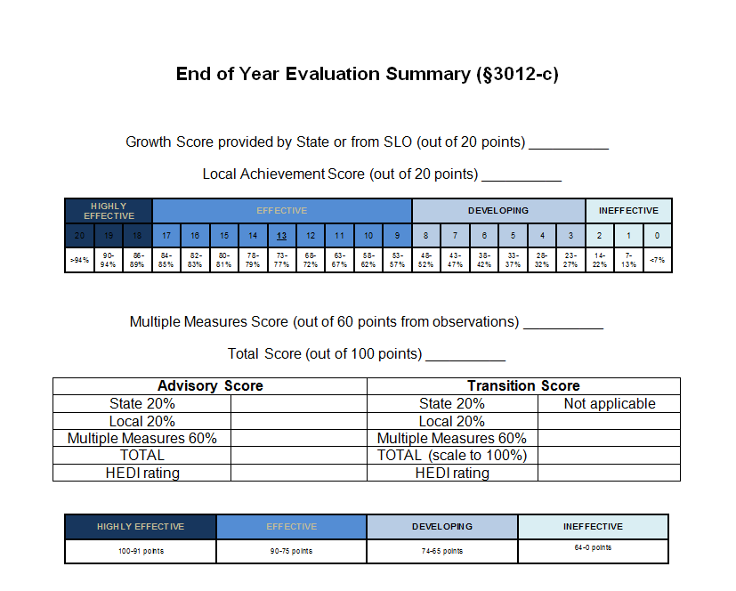
C in Transition

Slide 78
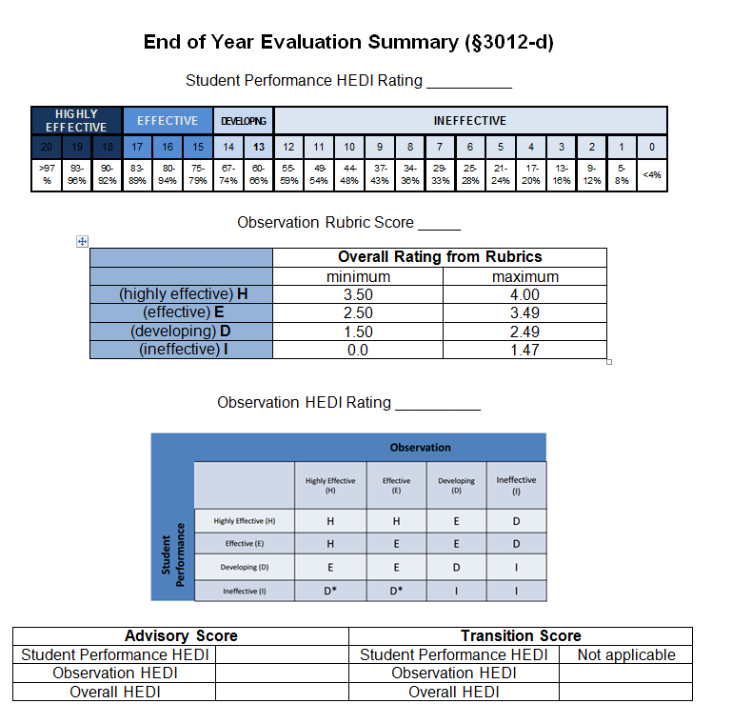
D in Transition

Slide 79
Closure:
Messaging the Transition

Slide 80
3x3 Messaging Example
In a situation such as bullying or hazing:
Nothing is more important to us than our student’s safety and well-being.
We have policies and procedures to ensure an environment of respect.
We respond promptly to any and all concerns raised by students and adults.

Slide 81
Messaging
It’s what we always say; you always say it no matter what.
Using messaging is not natural.
You can use it to manage any important or challenging conversation.
Notes:
This is based on the training provided by EMA to OCM BOCES superintendents in September, 2015

Slide 82
Messaging
For the messaging to work, the message must be:
Written
Honed
Vetted
Learned
Practiced
Notes:
This is based on the training provided by EMA to OCM BOCES superintendents in September, 2015

Slide 83

Messaging
Messaging follows a 3x3 form:
Three (exactly) messages (assertions, lofty claims, or even statements of values)
Each with three (or more) proof points (facts, statistics, anecdotes)
Notes:
This is based on the training provided by EMA to OCM BOCES superintendents in September, 2015

Slide 84
Your Three-Point Message:
Teacher Evaluation, APPR & Transition
1.
2.
3.

Slide 85
Next Session
March 22, 2016, 8:30a - 11:30a, McEvoy 701, Cortland (register)
March 22, 2016, 12:30p - 3:30p, McEvoy 701, Cortland (register)
March 21, 2016, 8:30a - 11:30a, Rodax 8 Conference Rooms, Henry Campus, Syracuse (register)
March 21, 2016, 12:30p - 3:30p, Rodax 8 Conference Rooms, Henry Campus, Syracuse (register)

