Slide 1
Lead Evaluator Training
2014-2015 Ongoing Training
Day 2

Slide 2
Welcome Back!
[re]Orientation
Lead Evaluator Training
Agenda Review

Slide 3
Lead Evaluator Training
Year 1
New York State Teaching Standards and Leadership Standards
Evidence-based observation
Application and use of Student Growth Percentile and VA Growth Model data
Application and use of the State-approved teacher or principal rubrics
Application and use of any assessment tools used to evaluate teachers and principals
Application and use of State-approved locally selected measures of student achievement
Use of the Statewide Instructional Reporting System
Scoring methodology used to evaluate teachers and principals
Specific considerations in evaluating teachers and principals of ELLs and students with disabilities
Notes:
These are the “nine” official goals of Lead Evaluator Training.

Slide 4
Lead Evaluator Training
Ongoing
From the Review Room: “Describe the process by which evaluators will be trained and the process for how the district will certify and re-certify lead evaluators. Describe the process for ensuring inter-rater reliability. Describe the duration and nature of such training.”
Notes:
This is the language about ongoing Lead Evaluator Training.

Slide 5
Lead Evaluator Training
Ongoing
Continue to collect evidence
Use collected evidence to rate teachers on a rubric (with feedback)
Manage the new system
Employ growth-producing feedback to increase the quality of teaching
Implement the Reform Agenda (RTTT)
Notes:
Our local goals for Lead Evaluator Training.

Slide 6
Lead Evaluator Training
Ongoing
Or, to basically increase the likelihood that all of this can make a difference.
Notes:
Our local goals for Lead Evaluator Training.

Slide 7
Agenda
Warm-Up Activity
Evidence Collection
Scoring (with feedback)
Post-Observation Feedback
Feedback for you on the process
Notes:
Review the agenda.

Slide 8
Rate the Teacher
Think about your teachers. Approximately what percent are:
Highly Effective?
Effective?
Developing?
Ineffective?

Slide 9
Rate the Teacher
Think about the summative evaluations for your teachers. Approximately what percent was:
Highly Effective?
Effective?
Developing?
Ineffective?

Slide 10
Rate the Teacher
Notes:
“No Common Opinion on the Common Core” by Michael Henderson, Paul Peterson, and Martin West in Education Next, Winter 2015 (Vol. 15, #1, p. 8-19),

Slide 11
Rate the Teacher
Notes:
“No Common Opinion on the Common Core” by Michael Henderson, Paul Peterson, and Martin West in Education Next, Winter 2015 (Vol. 15, #1, p. 8-19),

Slide 12
Rate the Teacher
Notes:
2012-2013 results from https://data.nysed.gov/evaluation.php?year=2013&state=yes&report=appr

Slide 13
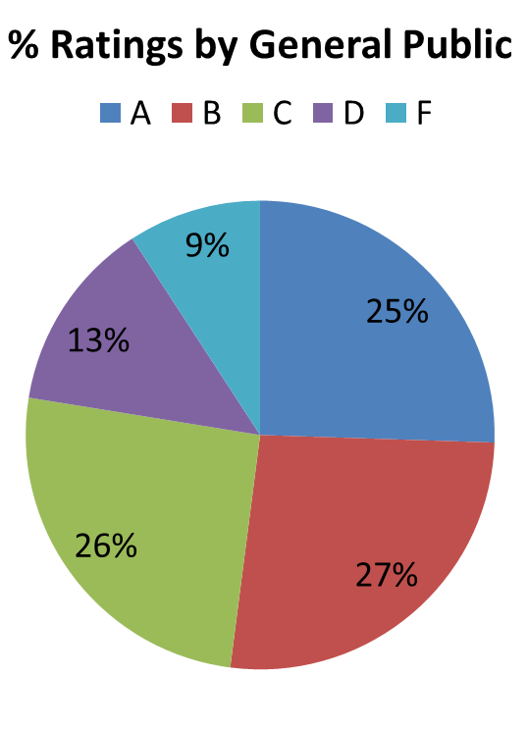
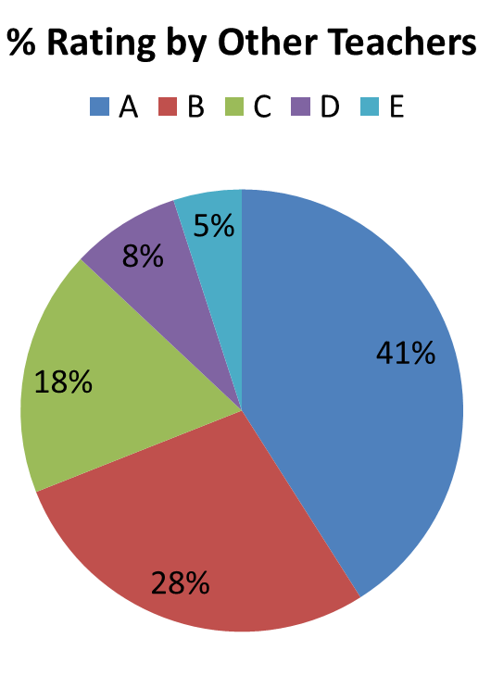
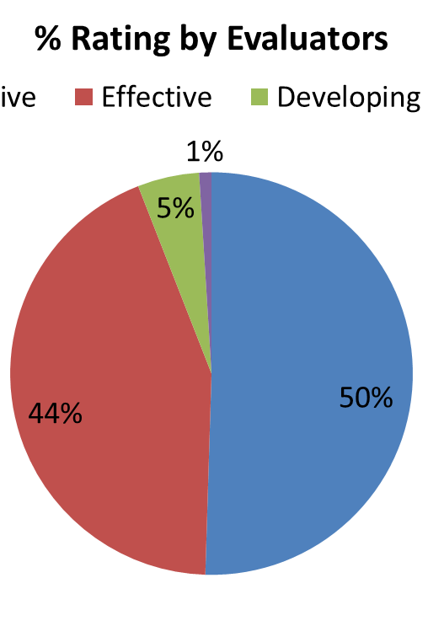
Rate the Teacher

Slide 14
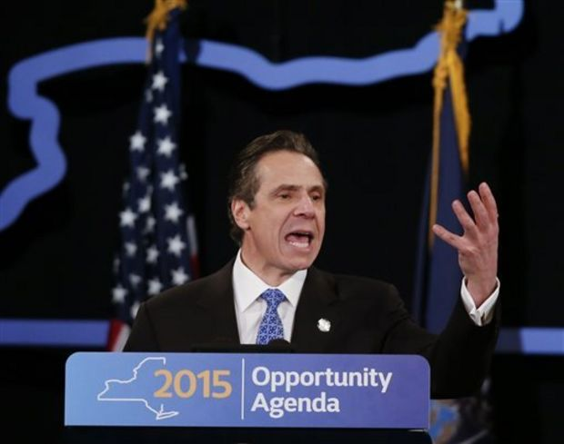
Rate the Teacher
Are
you
surprised?

Slide 15

Rate the Teacher
What does this mean for APPR in your school and district?

Slide 16
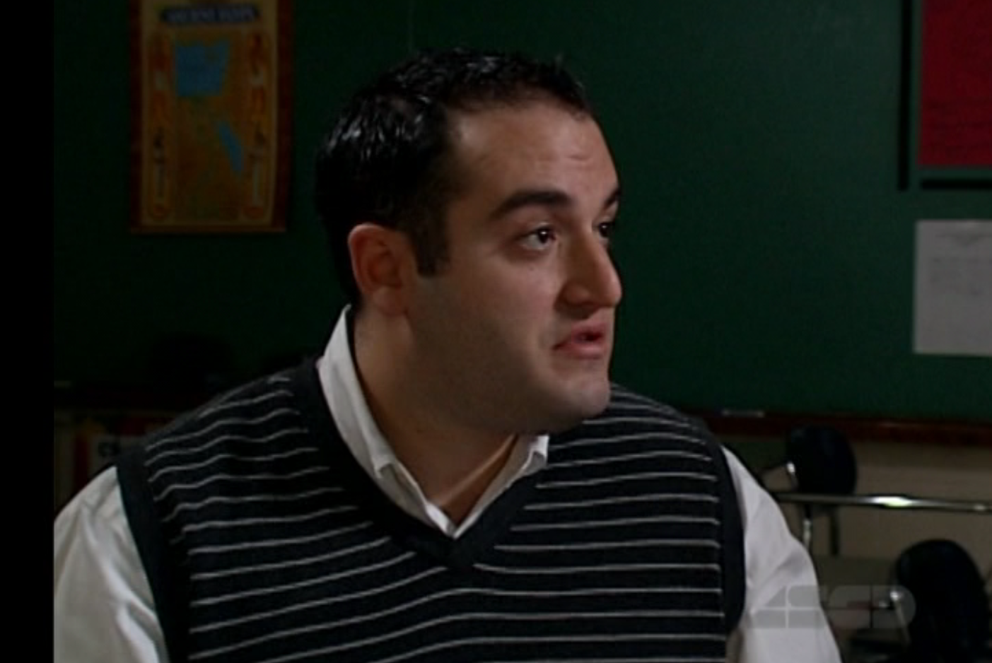
Our Teacher
Mr. Greenburgh
6th Grade Math Teacher
Notes:
Review the agenda.

Slide 17
Beginning of the Year

Slide 18
The Year at a Glance
Beginning of the Year
Ongoing
End of the Year
Beginning of the year meeting
Standards I and II
SLO and
local (LAT) target setting
Evidence Submission by
Teacher
Evidence Collection
Sharing the evidence
Feedback Conversations
Evidence from the year collected
Compare collected evidence to the rubric
Summative score determination and communication

Slide 19
Artifacts
Flip through the Beginning of the Year Artifacts to refresh your memory.
LAT
Lesson Plan
Unit Plan
Schedule
Getting to Know You
Other Artifacts
Beginning
of the Year

Slide 20
“Middle” part of the Year

Slide 21
The Year at a Glance
Beginning of the Year
Ongoing
End of the Year
Beginning of the year meeting
Standards I and II
SLO and
local (LAT) target setting
Evidence Submission by
Teacher
Evidence Collection
Sharing the evidence
Feedback Conversations
Evidence from the year collected
Compare collected evidence to the rubric
Summative score determination and communication

Slide 22
The Year at a Glance
Beginning of the Year
Ongoing
End of the Year
Beginning of the year meeting
Standards I and II
SLO and
local (LAT) target setting
Evidence Submission by
Teacher
Evidence Collection
Sharing the evidence
Feedback Conversations
Evidence from the year collected
Compare collected evidence to the rubric
Summative score determination and communication

Slide 23
Feedback Conversations
Collect evidence from the classroom
Prepare to meet with teacher
Evaluator talks with the teacher

Slide 24
Feedback Conversations
Collect evidence from the classroom
Prepare to meet with teacher
Evaluator talks with the teacher

Slide 25
Feedback Conversations
Collect evidence from the classroom
Prepare to meet with teacher
Evaluator talks with the teacher

Slide 26
Feedback Conversations
Collect evidence from the classroom
Prepare to meet with teacher
Evaluator talks with the teacher

Slide 27
Evidence Collection
Watch the lesson
Collect evidence
Clean Up Evidence
Sort Evidence
Score the evidence (only Standard 3 or Domain 3) WITH A PARTNER
Score yourself – leave behind at table

Slide 28
Evidence Collection
First… look at the lesson plan…

Slide 29
Evidence Collection
Watch the lesson
Collect evidence
Clean Up Evidence
Sort Evidence
Score the evidence (only Standard 3 or Domain 3) WITH A PARTNER
Score yourself – leave behind at table

Slide 30
The Year at a Glance
Beginning of the Year
Ongoing
End of the Year
Beginning of the year meeting
Standards I and II
SLO and
local (LAT) target setting
Evidence Submission by
Teacher
Evidence Collection
Sharing the evidence
Feedback Conversations
Evidence from the year collected
Compare collected evidence to the rubric
Summative score determination and communication

Slide 31
Feedback Conversations
Collect evidence from the classroom
Prepare to meet with teacher
Evaluator talks with the teacher

Slide 32
Prepare for Feedback
What do you do before you meet with the teacher?
Share the evidence
Look at student work
Review previous artifacts and documentation
Consider your feedback
Plan the conversation

Slide 33
Prepare for Feedback
Looking at some student work
In the Lesson section of the
folder you will find student work
At your table, look at the work and discuss it. What does it tell you? What questions do you want to ask the teacher?
Lesson

Slide 34
Prepare for Feedback
Consider your feedback
What kind of feedback do you want to give?
What approach will you take?
Where on the coaching continuum do you want to be?
Practice your active listening
Pt. 1
Pt. 2

Slide 35
Prepare for Feedback
Consider your feedback
Constructive feedback suggestions

Slide 36
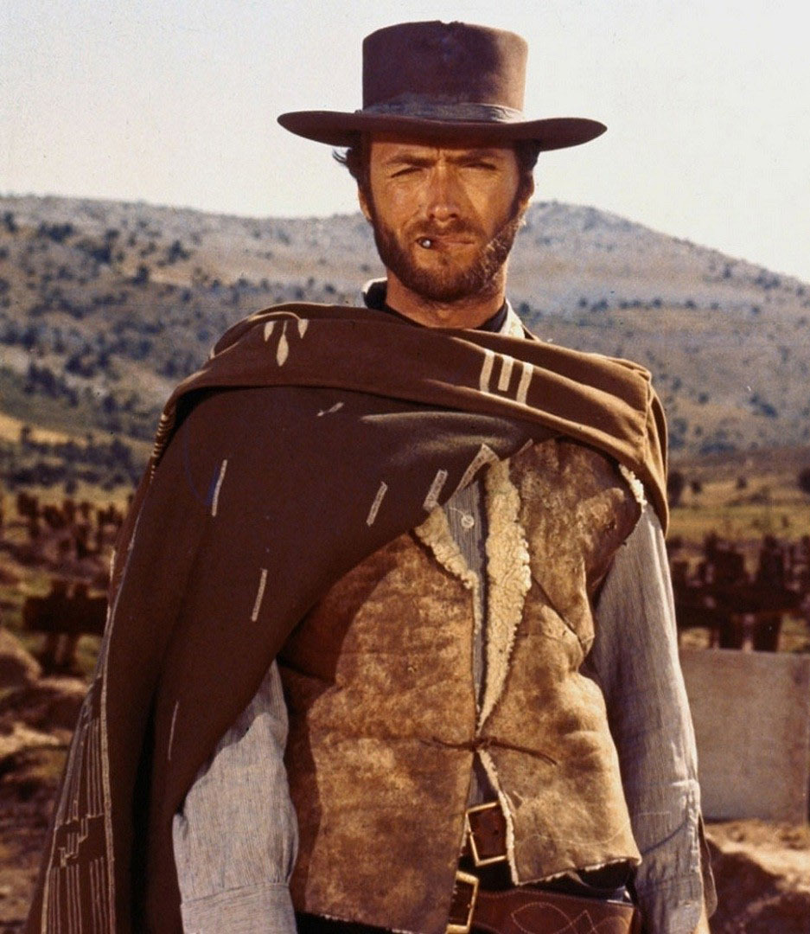
Prepare for Feedback
Consider your feedback
Sort the cards into three piles (good, bad, and ugly)
Go through the “bad” cards and turn them into “good”

Slide 37
Feedback Conversations
Collect evidence from the classroom
Prepare to meet with teacher
Evaluator talks with the teacher

Slide 38
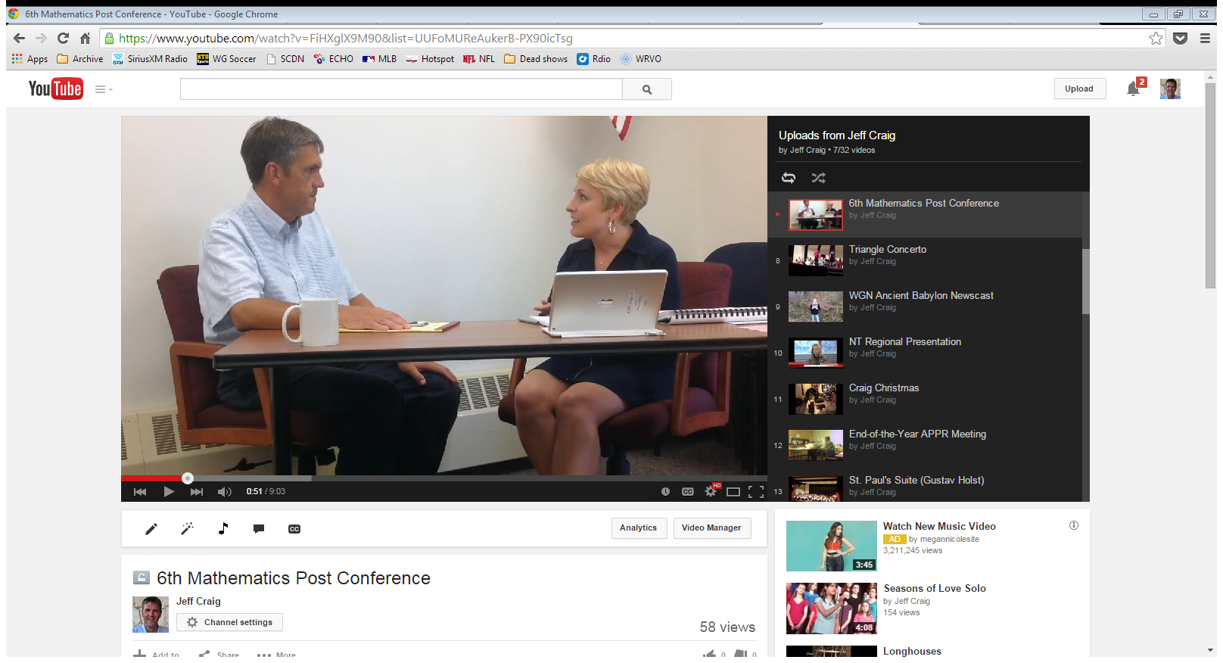
Watch the Conversation
v
Principal talks with the teacher
Take notes about the conversation

Slide 39
Conversation Debrief
Principal talks with the teacher
Debrief the conversation with a neighbor
  What did the principal focus on?
  What was her opening line?
  What did she want the teacher to do in the future?
  Where on the coaching continuum did the principal operate?

Slide 40
Conversation Debrief
What does this mean for you and your feedback conversations?

Slide 41
Instructional Leadership

Slide 42
Continuous Improvement
Why would you collect feedback from teachers after the process was complete?
Model reflection and continuous improvement orientation
Collect data to improve your own practice
Express your interest in their input

Slide 43
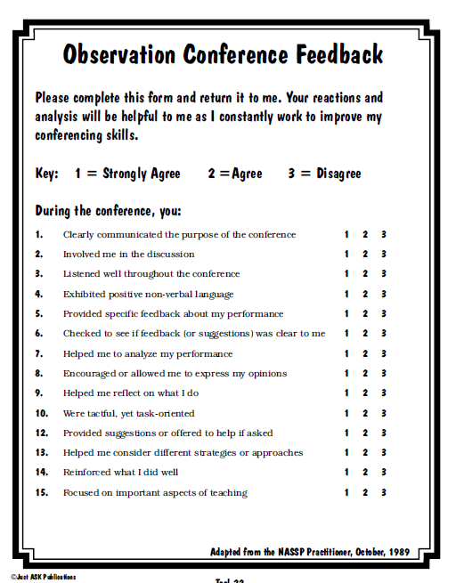
Continuous Improvement
Examples
Have shared the end-of-the-year survey with you in the past (at end of the year APPR resources page)
Take a look at Paula
Rutherford’s tool

Slide 44
Next Session
March 26th in Cortland
March 27th in Syracuse
Agenda will include
  Evidence Collection
  Preparing for end-of-the-year
  Instructional leadership

Slide 45

Housekeeping
Leave organized folder and contents at table (pile)
Leave your answer sheet at the table (pile)
Leave the red answer key at the table (pile)

Slide 46
Lead Evaluator Training
2014-2015 Ongoing Training
Day 2

