Slide 1
Lead Evaluator Training
2012-2013 Ongoing Training
Day 2

Slide 2
Agenda
What’s the Buzz?
Mini-lesson: Data-Driven Instruction
Checking in with Kim
Evidence-based Evaluation
  Evidence Collection
  Sorting
  Rating including “right answers”
The Follow-Up Conversation
Notes:
Review the agenda.

Slide 3
Lead Evaluator Training
Year 1
New York State Teaching Standards and Leadership Standards
Evidence-based observation
Application and use of Student Growth Percentile and VA Growth Model data
Application and use of the State-approved teacher or principal rubrics
Application and use of any assessment tools used to evaluate teachers and principals
Application and use of State-approved locally selected measures of student achievement
Use of the Statewide Instructional Reporting System
Scoring methodology used to evaluate teachers and principals
Specific considerations in evaluating teachers and principals of ELLs and students with disabilities
Notes:
These are the “nine” official goals of Lead Evaluator Training.

Slide 4
Lead Evaluator Training
Ongoing
From the Review Room: “Describe the process by which evaluators will be trained and the process for how the district will certify and re-certify lead evaluators. Describe the process for ensuring
inter-rater reliability. Describe the duration and nature of such training.”
Notes:
This is where ongoing training is mentioned in the Review Room.

Slide 5
Lead Evaluator Training
Ongoing
Continue to collect evidence
Use collected evidence to rate teachers on a rubric (with feedback)
Manage the new system
Employ growth-producing feedback to increase the quality of teaching
Implement the Reform Agenda (RTTT)
Notes:
Our local goals for Lead Evaluator Training, in addition to the required components.

Slide 6
Checking in
Since Last Time

Slide 7

We’re Not in Kansas Anymore
Talk in schools – has it changed at all?

Slide 8
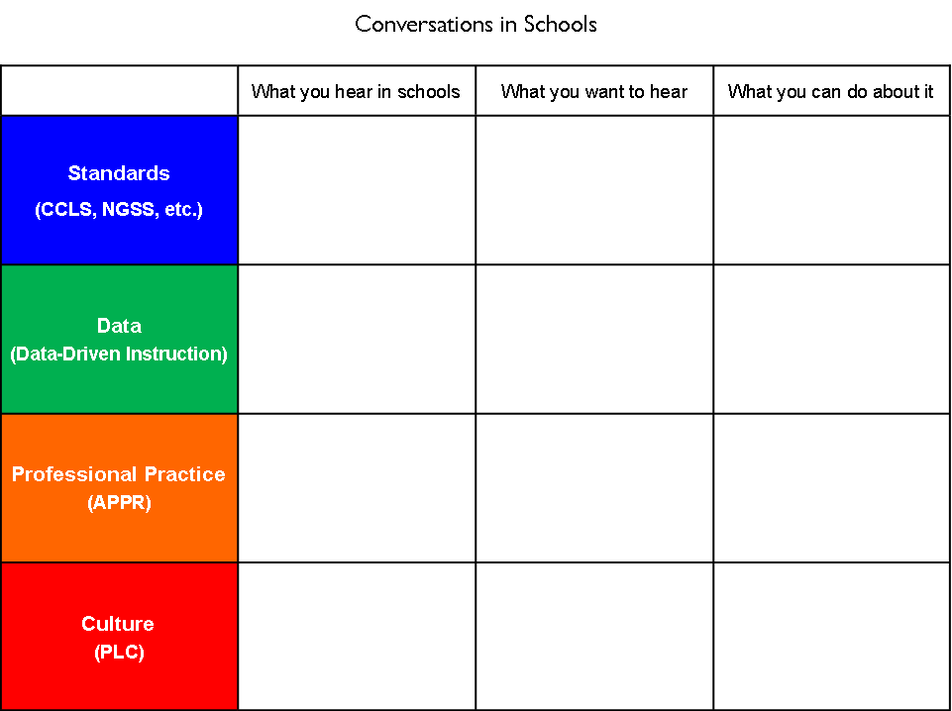
We’re Not in Kansas Anymore
What’s the talk in school?
What do you want it to be?
What can you do
to get it there?

Slide 9
Mini-lesson:
Data-Driven Instruction

Slide 10
Professional
Practice
Standards
Data
Culture

Slide 11
Data

Slide 12
It’s always been here…

Slide 13
ITBS
Report Cards
Unit Tests
State Tests
Letters
Performance
Quizzes
Terra Nova
Attendance
Reports
Samples
Notebook
Regents
Inventories
Essay
Anecdotal
Performance
Unit Tests
Scores
Logs
Homework
Pictures
Journals
Posttest
RCT
Rubrics
Conferences
Pretest
PET
Checklists
Interview

Slide 14
It’s not really the data

Slide 15
It is
about
what we
do about
data

Slide 16
Common
Interim
Assessments

Slide 17
give the
test
make
the
test
analyze
the
work
do something about it

Slide 18
every
6-8
weeks

Slide 19
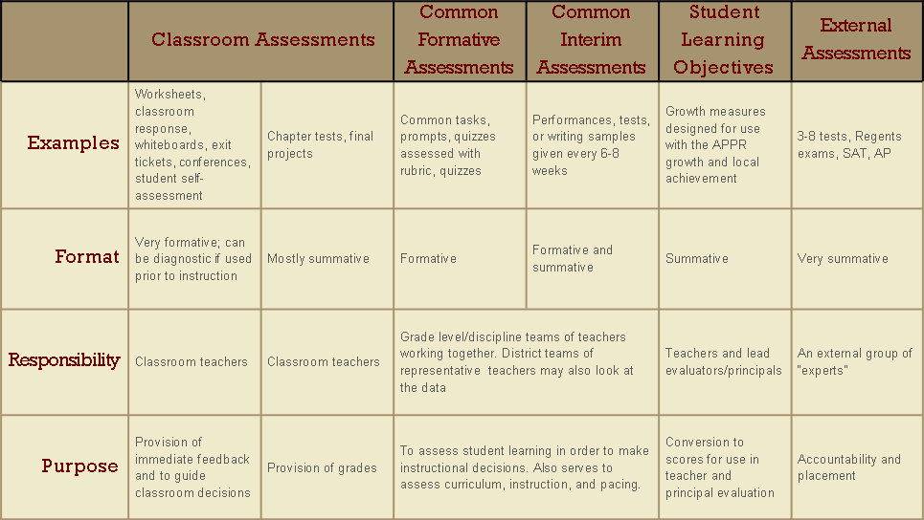
Balanced Assessment
Notes:
HO: “Balanced Assessment System”
The chart shows the variety of assessments we use, as well as the purpose of each. Here we see that Common Formative and Common Interim Assessments are similar, but Common Interim Assessments are regularly spaced out and calendared during the course of the school year. They can be used both formatively and summatively.

Slide 20
Balanced Assessment
BE STRATEGIC!
Notes:
HO: “Balanced Assessment System”
The chart shows the variety of assessments we use, as well as the purpose of each. Here we see that Common Formative and Common Interim Assessments are similar, but Common Interim Assessments are regularly spaced out and calendared during the course of the school year. They can be used both formatively and summatively.

Slide 21
Interim Assessments and DDI
Interim Assessment Design and Implementation
Understand the relationship of common interim assessments and Data Driven Instruction (DDI) as part of Race to the Top
A calendar of an interim assessment schedule
Understand and engage in a process for creating an interim assessment
One completed interim assessment for your course
Outcomes

Slide 22
Interim Assessments and DDI
Interim Assessment Design and Implementation
Understand the relationship of common interim assessments and Data Driven Instruction (DDI) as part of Race to the Top
A calendar of an interim assessment schedule
Understand and engage in a process for creating an interim assessment
One completed interim assessment for your course
BE STRATEGIC!
Outcomes

Slide 23
SLO
baseline
SLO
Summative Assessment
Formative Assessment
Formative Assessment
Formative Assessment
Formative Assessment
Formative Assessment
How does this all fit together?
After establishing the most important learning for your course with the SLO, periodically measure student progress toward that goal throughout the school year.
Notes:
The WHY slide: after establishing the most important learning for your course with the SLO, periodically measure student progress toward that goal throughout the year with CFAs.
Formative Assessments serve as a map or GPS on the learning journey. They may be spaced out over the course of the school year so that students are formatively assessed at approximately 6-8 week intervals.

Slide 24
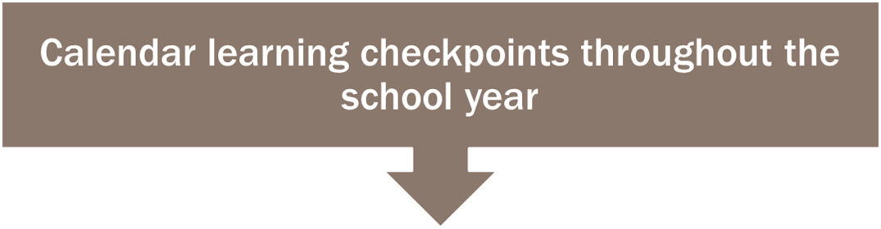
SLO
baseline
SLO
Summative Assessment
November 1
December 12
January 30
March 6
April 24
Calendar Learning Checkpoints
Notes:
The following dates have been selected as learning checkpoints for the interim assessments

Slide 25
Common
Formative
Interim
Assessment
Common
Formative
Interim
Assessment
Common
Formative
Interim
Assessment
September
June
UNIT
UNIT
UNIT
UNIT
UNIT
UNIT
SLO Baseline
Common
Formative
Interim
Assessment
Common
Formative
Interim
Assessment
SLO Summative
Notes:
Here is another slide that illustrates the big picture of how the SLO acts as bookends to the instruction over the course of the year. As instruction ensues, so does periodic learning check points that assess students progress toward the year end summative learning goals.

Slide 26
Common
Formative
Interim
Assessment
Common
Formative
Interim
Assessment
Common
Formative
Interim
Assessment
September
June
UNIT
UNIT
UNIT
UNIT
UNIT
UNIT
SLO Baseline
Common
Formative
Interim
Assessment
Common
Formative
Interim
Assessment
SLO Summative
Notes:
These Common Formative Assessments are spaces out across the year at approximately every 6-8 weeks

Slide 27
Common
Formative
Interim
Assessment
Common
Formative
Interim
Assessment
Common
Formative
Interim
Assessment
September
June
UNIT
UNIT
UNIT
UNIT
UNIT
UNIT
SLO Baseline
Common
Formative
Interim
Assessment
Common
Formative
Interim
Assessment
SLO Summative
Notes:
These assessment are standards based and may not rely on the content specifically. They are not necessarily a summative assessment, but they are used formatively to assess students’ progress toward the larger year-end learning goals.

Slide 28
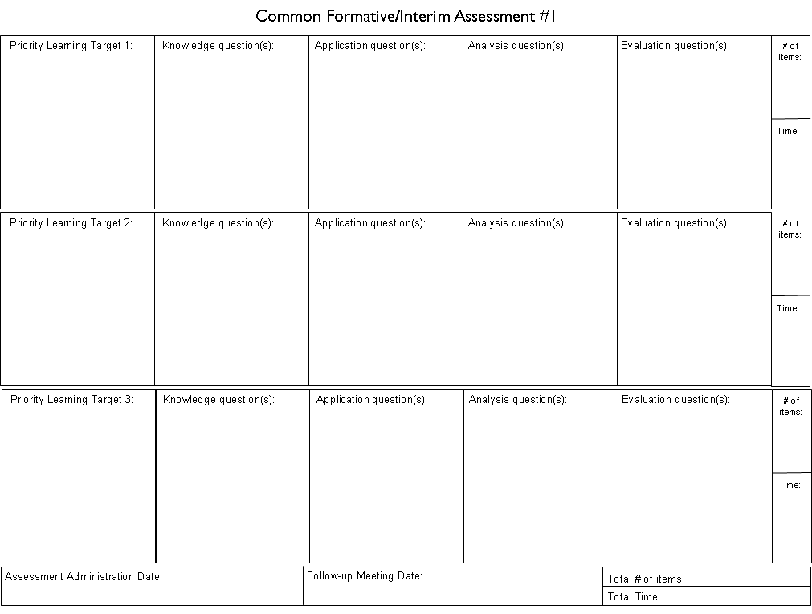
READY! FIRE! AIM!
First: Lay out your targets for the year
Second: Make the first assessment (including calendaring the assessment(s) and scheduling the follow-up meeting)

Slide 29
GETTING TO WORK…

Slide 30
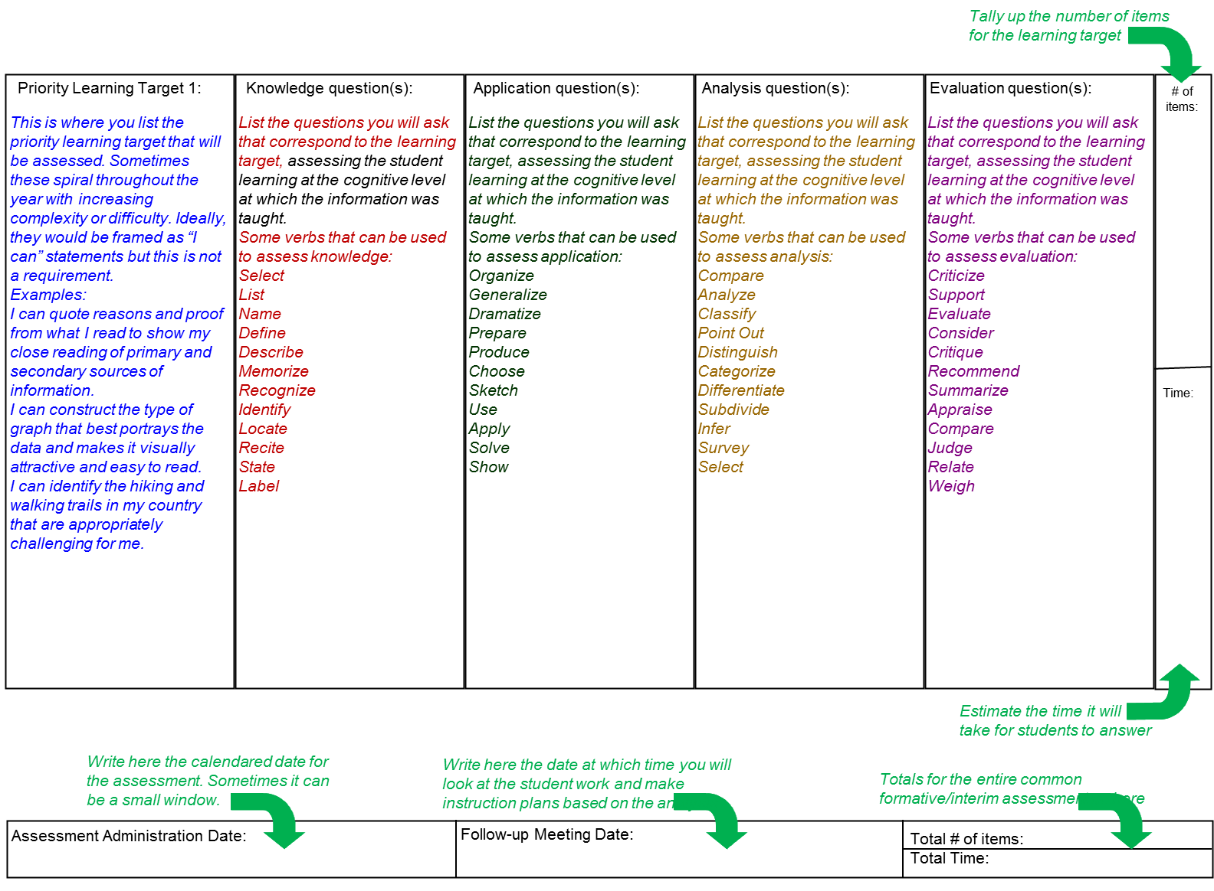
Lay out the learning targets
for ALL of the common formative/interim assessments and THEN make the actual assessments.

Slide 31
Find/make items that match the learning targets. You might not have all four types for each target, but “aim high” on Bloom’s

Slide 32
Keep a tally of your items and estimate the time. Think: GOLDILOCKS!

Slide 33
Your assessment totals go here. Think: GOLDILOCKS!

Slide 34
Calendar the COMMON assessment administration.

Slide 35
When will you meet to look at the student work AND make instructional plans based on your analysis?

Slide 37

break

Slide 38
Management

Slide 39
The Year at a Glance
Beginning of the Year
Ongoing
End of the Year
Beginning of the year meeting
Standards I and II
SLO and
local (LAT) target setting
Evidence Submission by
Teacher
Evidence Collection
Sharing the evidence
Feedback Conversations
Evidence from the year collected
Compare collected evidence to the rubric
Summative score determination and communication

Slide 40
The Year at a Glance
Beginning of the Year
Ongoing
End of the Year
Beginning of the year meeting
Standards I and II
SLO and
local (LAT) target setting
Evidence Submission by
Teacher
Evidence Collection
Sharing the evidence
Feedback Conversations
Evidence from the year collected
Compare collected evidence to the rubric
Summative score determination and communication

Slide 41
Checking In w/ Kim
Read Kim’s latest column in Education Week.
What do you agree with?
What do you disagree with?
What works for you?
What doesn’t work for you?

Slide 42
Evidence

Slide 43
The Year at a Glance
Beginning of the Year
Ongoing
End of the Year
Beginning of the year meeting
Standards I and II
SLO and
local (LAT) target setting
Evidence Submission by
Teacher
Evidence Collection
Sharing the evidence
Feedback Conversations
Evidence from the year collected
Compare collected evidence to the rubric
Summative score determination and communication

Slide 44
Evidence Collection
Watch the video
Collect evidence
Focus on instruction
  Standard III (Teaching Standards and NYSUT)
  Domain 3 (Danielson)

Slide 45
Evidence Collection
Label the evidence provided to you
Use Standards (or refer to Danielson)

Slide 46
Evidence Collection
Rate the teacher on Standard 3.
As prompted in polleverywhere, text your rating
Where were you, compared to
  Others in the room
  (inter-rater agreement)
  The facilitator
  (inter-rater reliability)

Slide 47

Growth-Producing Feedback
With your neighbor, plan your conversation with the teacher

Slide 48
Agenda
√
What’s the Buzz?
Mini-lesson: Data-Driven Instruction
Checking in with Kim
Evidence-based Evaluation
  Evidence Collection
  Sorting
  Rating including “right answers”
The Follow-Up Conversation
√
√
√
√
Notes:
Review the agenda.

Slide 49
Next Session
January 30th in Syracuse
January 29th in Cortland
Agenda will include
  Evidence
  Ongoing Growth-Producing Feedback

