Slide 1
Lead Evaluator Training
2015-2016 Ongoing Training
Day 1

Slide 2
Welcome Back!
[re]Orientation
Lead Evaluator Training
Agenda Review

Slide 3
Nine Required Components
3012-c
3012-d
New York State Teaching Standards and Leadership Standards
Evidence-based observation
Application and use of Student Growth Percentile and VA Growth Model data
Application and use of the State-approved teacher or principal rubrics
Application and use of any assessment tools used to evaluate teachers and principals
New York State Teaching Standards and Leadership Standards
Evidence-based observation
Application and use of Student Growth Percentile method
Application and use of the State-approved teacher or principal rubrics
Application of assessment tools the district employs

Slide 4
Nine Required Components
3012-c
3012-d
Application and use of State-approved locally selected measures of student achievement
Use of the Statewide Instructional Reporting System
Scoring methodology used to evaluate teachers and principals
Specific considerations in evaluating teachers and principals of ELLs and students with disabilities
Application and use of State-approved locally selected measures of student growth
Use of the Statewide Instructional Reporting System
Scoring methodology used by the state and the district
Specific considerations in evaluating teachers and principals of ELLs and students with disabilities

Slide 5
Our Components
Managing the APPR (especially in d)
Connecting it to Learning
Increasing the likelihood that it makes a difference

Slide 6
Agenda
3012-d Review (as promised in our waiver applications)
Mini-Lesson: Teacher and Principal scores from SED
Messaging APPR
Our Learning (article choice)
Important and Observable
Evidence Collection & Scoring (with feedback)
Notes:
Review the agenda.

Slide 7
Warm Up Activity
Most Important:
What are the most important things that a teacher does?
Talk about this at your table
List these things on the organizer

Slide 8
APPR: §3012-d
As Adopted by Emergency Action
June, 2015
Slides updated 10.29.15

Slide 9
Emergency Action
The Board of Regents took emergency action on June 15, 2015.
A few small changes were made in September after public comment period.
These slides are not official. They are meant to provide local guidance.

Slide 10
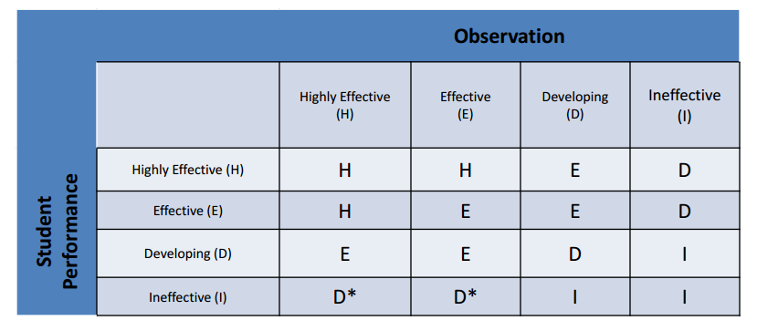
The Matrix
Scores from rubrics have to be converted to H-E-D-I levels for the matrix.
Notes:
* If the state-provided score is ineffective and an additional growth component is included and also ineffective the teacher can be rated no higher than ineffective.

Slide 11
The Matrix
Scores from rubrics have to be converted to H-E-D-I levels for the matrix.
Notes:
* If the state-provided score is ineffective and an additional growth component is included and also ineffective the teacher can be rated no higher than ineffective.

Slide 12
Student Performance Half
State-provided growth scores primarily for 4-8 grade ELA and math teachers
and/or
SLOs that are consistent with the state’s goal setting process. These will be based on one year’s worth of growth on an approved assessment
and/or
School-wide, team, or linked results.

Slide 13
Student Performance Half
An additional/optional growth measure can be locally negotiated, consistent across district:
A teacher-specific score based on a particular level of the state test,
School-wide growth score linked to state-provided school score,
School-wide, group, or team growth score that is locally computed, or
A growth score based on a state designed approved assessment (SLO/LAT).
Notes:
The threshold for demonstrating the ability to show growth is higher on these supplemental measures. Even state tests have to be submitted with a description of how they can show growth.

Slide 14
Assessment Approval
There are two lists:
Approved List of Assessments to be used with SLOs (includes commercial and district-developed assessments)
Approved List of Supplemental Assessments to be used with Growth Models (more rigorous documentation of Growth)
Notes:
* growthiness is a technical term ☺

Slide 15
Student Performance Half
This chart describes the weighting parameters:
 | Permissible Statewide Range
 | Minimum | Maximum
Mandatory subcomponent | 50% | 100%
Optional subcomponent | 0% | 50%

Slide 16
The Matrix
Scores from rubrics have to be converted to H-E-D-I levels for the matrix.
Notes:
* If the state-provided score is ineffective and an additional growth component is included and also ineffective the teacher can be rated no higher than ineffective.

Slide 17
The Matrix
Scores from rubrics have to be converted to H-E-D-I levels for the matrix.
Notes:
* If the state-provided score is ineffective and an additional growth component is included and also ineffective the teacher can be rated no higher than ineffective.

Slide 18
The Observation Portion
At least two observations, one of which has to be unannounced.
Total amounts, frequency, direction, and communication plans are worked out locally.
This is similar to the way it’s been done.

Slide 19
The Observation Portion
At least one observation has to be completed by the principal or other trained administrator.
At least one observation has to be completed by an impartial, independent trained evaluator. This observer cannot be assigned to the same school building as the teacher.*
Notes:
* Rural districts might be able to apply for a waiver to relax the BEDS code requirement. Geographic distances might be the determining factor.

Slide 20
The Observation Portion
If using peer observers:
The district chooses the peer evaluator
The peer evaluator must be trained
The peer evaluator must have been rated as H or E in the previous year

Slide 21
The Observation Portion
Scores from observers will be scaled within these parameters:
 | Permissible Statewide Range
 | Minimum | Maximum
Principal or trained administrator | 80% | 90%
Independent Observer | 10% | 20%
Peer Observation | O% | 10%

Slide 22
The Matrix
Scores from rubrics have to be converted to H-E-D-I levels for the matrix.
Notes:
* If the state-provided score is ineffective and an additional growth component is included and also ineffective the teacher can be rated no higher than ineffective.

Slide 23
The Matrix
Scores from rubrics have to be converted to H-E-D-I levels for the matrix.
Notes:
* If the state-provided score is ineffective and an additional growth component is included and also ineffective the teacher can be rated no higher than ineffective.

Slide 24
The Matrix
Scores from rubrics have to be converted to H-E-D-I levels for the matrix.
Notes:
* If the state-provided score is ineffective and an additional growth component is included and also ineffective the teacher can be rated no higher than ineffective.

Slide 25
The Matrix
Principals, too
Scores from rubrics have to be converted to H-E-D-I levels for the matrix.
Notes:
* If the state-provided score is ineffective and an additional growth component is included and also ineffective the teacher can be rated no higher than ineffective.

Slide 26
Student Performance for Principals
Most principals will receive a growth score from the state. These principals must have a back-up SLO in case a score doesn’t come.
Other principals will use an SLO.
An optional growth measure can be chosen locally (like the teachers).

Slide 27
Principals “Observation”
One observation shall be conducted by the principal's supervisor.
A second observation shall be conducted by one or more impartial independent evaluators. This observer may be employed by the district but not assigned to the principal’s building (see next slide).

Slide 28
Principals “Observation”
A principal’s supervisor (i.e., the Superintendent) is a district employee and therefore assigned to a different BEDS code as the principal being evaluated—therefore it is possible for the same administrator to serve as both the supervisor and impartial evaluator for the purpose of school visits.
Notes:
See Section H of the §3012-d APPR Guidance document for more information.

Slide 29
The Observation Portion
Scores from observers will be scaled within these parameters:
 | Permissible Statewide Range
 | Minimum | Maximum
Supervisor | 80% | 90%
Independent Observer | 10% | 20%
Peer Observation | O% | 10%

Slide 30
The Matrix
Principals, too
Scores from rubrics have to be converted to H-E-D-I levels for the matrix.
Notes:
* If the state-provided score is ineffective and an additional growth component is included and also ineffective the teacher can be rated no higher than ineffective.

Slide 31
APPR: §3012-d
Additional Regulations

Slide 32
Training
Evaluators and Lead Evaluator training components:
NYS Teaching Standards
Evidence-based observation techniques
Application and use of student growth percentile method
Application of approved rubrics
Application of assessment tools the district employs
Application of any locally select measures of student growth
Use of the statewide reporting system
Scoring methodology used by the state and the district
Specific considerations in evaluating teachers and principals of ELLs and SWDs

Slide 33
Improvement Plans
The content of improvement plans will be determined by superintendent rather than through bargaining or negotiations.
Required for ineffective or developing
In place by October 1st
Include: areas in need of improvement, timeline, assessment of improvement

Slide 34
Corrective Action
The law requires an examination of APPR and score distributions. SED will have the option of imposing a Corrective Action Plan if there are significant discrepancies.
Previously, Corrective Action could not impinge on anything that had been bargained.
Corrective Action can now be asserted even over things that were bargained.

Slide 35
Plan Approval
The Review Room has been revised:
More drop-downs
More prescription
It is taking less time and fewer iterations to get to approval

Slide 36
Plan Approval
Lots of Superintendent Attestations:
Back-up SLOs are in place
All targets are 1 year’s growth
All targets are reviewed and approved
A process to monitor SLOs is in place

Slide 37
Plan Approval
In our BOCES, these districts have been approved so far:
Homer
Jamesville-DeWitt
West Genesee
Another is in process
Notes:
As of 9.11.15

Slide 38
Hardship Waivers
If documented good faith (reason, negotiating, and training) efforts are not fruitful, a waiver will be granted. Districts that receive the waiver would be exempt from the November 15th deadline.
District would then target March 1st for a new plan approval. If not going to get a new plan approved by March 1st, the implementation of which wouldn’t be required until 2016-2017.
Notes:
OCM BOCES will be providing evidence of all who are enrolled in training to be submitted for hardship waiver application.

Slide 39
2016-2017 Implementation
Submit your new plan on “March 2nd” if you want it to apply to next year.
Apply for a second waiver, just in case the queue is long.
It is possible that a new hardship reason could be not switching from c to d in the middle of the year, but not yet approved as a reason.
Notes:
It doesn’t have to be exactly march 2nd, but wait until March 2nd to submit.

Slide 40
Wait or Go?
Reasons to Go | Reasons to Wait
General dissatisfaction with §3012-c scheme SLO process in §3012-c is cumbersome and time consuming (lots of unnecessary pretests) Artifact portion of §3012-c is taxing and its elimination would ease burden on teachers and lead evaluators Worried about implications of switching over in the middle of the year Present system is just not good | Waiting for assessment approval In the midst of an assessment audit (such as from last year’s regional project) and waiting for that audit to be completed Worried about implications of switching over in the middle of the year Relationships aren’t quite ready Why hurry from one imperfect system to another Suspect that the rules could change [again]

Slide 41

Three-Minute Pause

Slide 42
Principal and Teacher Scores from the State

Slide 43
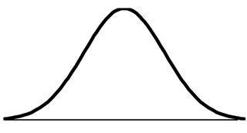
mean
Ineffective
Range (6.7%)
Highly Effective
Range (6.7%)
Developing
Range (9.2%)
Effective Range (77.4%)
SD = -1.5
SD = -1
SD = 0
SD = +1.5
SD = +2
6%
16%
50%
94%

Slide 44
SGPs to MGPs for Teachers
Ms. Smith’s Class
 | SGP | Enrollment Duration | Attendance | Enrollment x Attendance
Student A | 45 | 80% | 90% | .72
Student B | 40 | 100% | 95% | .95
Student C | 55 | 50% | 80% | N/A
Student D | 60 | 100% | 90% | .90
Student E | 40 | 100% | 75% | .75
To measure teacher performance, we find the mean growth percentile (MGP) for her students, which is the weighted average of the SGPs. In this case:
  Step 1: (.72*45)+(.95*40)+(.90*60)+(.75*40) = 154.4
  Step 2: .72+.95+.90+.75 = 3.32
  Step 3. 154.4 / 3.32 = 46.5
Ms. Smith’s mean growth percentile (MGP) is 46.5, meaning on average her students performed as well or better than almost 47 percent of similar students.
**Teachers need at least 16 SGPs attributed to them in order for an MGP to be reported

Slide 45
SGPs to MGPs for Principals
To measure principal performance, we find the mean growth percentile (MGP) for all her students who were enrolled on BEDS day and assessment day. To find a principal’s mean growth percentile, take the average of SGPs in the school:
Step 1: 45+40+70+41 = 196
Step 2. 196/4 = 49.
Principal Jensen’s mean growth percentile (MGP) is 49, meaning on average her students performed as well or better than 49 percent of similar students.
Principal Jensen’s School
 | SGP | BEDS-Assessment Day Enrollment
Student Q | 45 | Yes
Student R | 40 | Yes
Student S | 70 | Yes
Student T | 60 | No
Student U | 41 | Yes
Same minimum sample size requirements (16 student scores) for principals as for teachers.

Slide 46
GREs for Principals
Simplified Illustrative Example
Principal’s score on this metric is 0.2. On average, students at this school are passing 0.2 Regents Exams more than similar students statewide. A zero represents average or effective results.
Student | Number of Regents Passed This Year For This Student | Number of Regents Passed This Year by Similar Students | Difference
Jessica | 1 | 1 | 0
Tyler | 2 | 2 | 0
Ashley | 1 | 2 | -1
Emily | 3 | 2 | 1
Jacob | 3 | 2 | 1
Total Difference (Sum of Differences) |  |  | 1
Average Difference (Total Difference/Number of Students) |  |  | 1/5 = .2
NOTE: 0 means student or school achieved the average (or “effective”) result compared to similar students statewide.

Slide 47
MGPs and Statistical Confidence
MGP
87
84
Lower Limit
90
Upper Limit
Confidence Range
New York State Education Department (NYSED) provides a 95 percent confidence range, meaning we can be 95 percent confident that an educator’s “true” MGP lies within that range. Upper and lower limits of MGPs will be used when classifying educators into HEDI categories.
An educator’s confidence range depends on a number of factors, including the number of student scores included in his or her MGP and the variability of student performance in the class or school.

Slide 48
Distribution of HEDI Labels
State-Provided Teacher and Principal Scores
mean
Ineffective
Range (6.7%)
Highly Effective
Range (6.7%)
Developing
Range (9.2%)
Effective Range (77.4%)
SD = -1.5
SD = -1
SD = 0
SD = +1.5
SD = +2
6%
16%
50%
94%
Notes:
Note: The actual proportion of educators receiving each rating can vary slightly from the distribution in this chart, after the confidence ranges are applied. The final label is based both on what HEDI category an educator’s MGP falls in and the upper and lower limits of their confidence ranges.

Slide 49
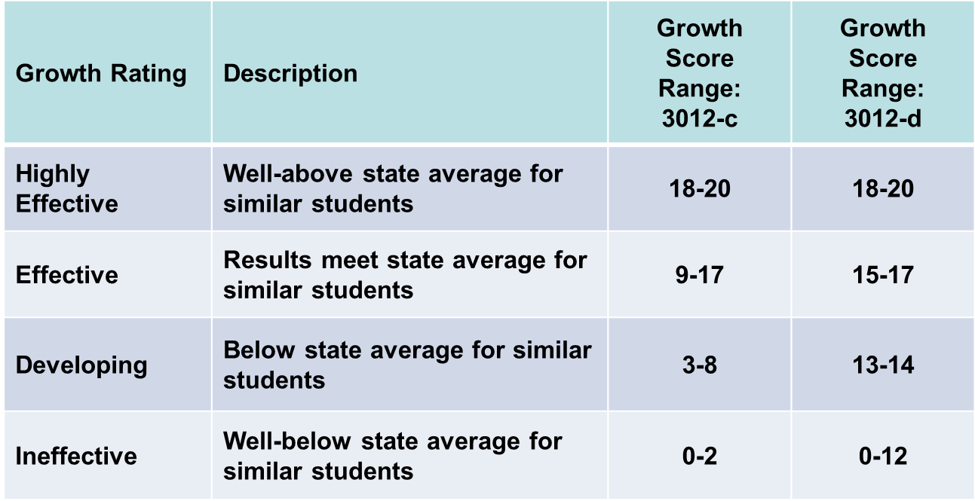
Assigning Points to HEDI Labels

Slide 50
mean
Assigning Points to HEDI Labels
Previous Distribution
0 1 2
3 4 5 6 7 8
9 10 11 12 13 14 15 16 17
18 19 20
Ineffective
Range (6.7%)
Highly Effective
Range (6.7%)
Developing
Range (9.2%)
Effective Range (77.4%)
SD = -1.5
SD = -1
SD = 0
SD = +1.5
SD = +2
6%
16%
50%
94%

Slide 51
mean
Assigning Points to HEDI Labels
Future Distribution
0 1 2 3 4 5 6 7 8 9 10 11 12
13 14
15 16 17
18 19 20
Ineffective
Range (6.7%)
Highly Effective
Range (6.7%)
Developing
Range (9.2%)
Effective Range (77.4%)
SD = -1.5
SD = -1
SD = 0
SD = +1.5
SD = +2
6%
16%
50%
94%

Slide 52
§3012-c to § 3012-d Scoring Bands
 | 3012-c Bands |  | 3012-d Bands
HEDI Points | Min MGP | Max MGP | Min MGP | Max MGP
0 | 9 | 28 | 9 | 22
1 | 29 | 31 | 23 | 24
2 | 32 | 35 | 25 | 25
3 | 28 | 35 | 26 | 26
4 | 36 | 36 | 27 | 27
5 | 37 | 37 | 28 | 28
6 | 38 | 38 | 29 | 29
7 | 39 | 39 | 30 | 30
8 | 40 | 41 | 31 | 31
9 | 36 | 43 | 32 | 32
10 | 44 | 45 | 33 | 33
11 | 46 | 48 | 34 | 34
12 | 49 | 50 | 35 | 35
13 | 51 | 52 | 28 | 37
14 | 53 | 55 | 38 | 41
15 | 56 | 57 | 36 | 48
16 | 58 | 60 | 49 | 55
17 | 61 | 69 | 56 | 69
18 | 67 | 68 | 67 | 68
19 | 69 | 72 | 69 | 72
20 | 73 | 97 | 73 | 97
KEY | Description
Ineffective | Well-below state average for similar students
Developing | Below state average for similar students
Effective | Results meet state average for similar students
Highly Effective | Well-above state average for similar students
*For illustrative purposes only. 3012-d scoring bands were not in place for most teachers during 2014-15. The minimum and maximum MGPs associated with each point range may change in future years based on the MGPs of teachers statewide.

Slide 53
Three-Minute Pause

Slide 54
A Year at a Glance

Slide 55
Year at a Glance (§3012-c)
Beginning of the Year
Ongoing
End of the Year
Beginning of the year meeting
Standards 1 and 2
SLO and
local (LAT) target setting
Evidence Submission by
Teacher
Evidence Collection
Sharing the evidence
Feedback Conversations
Evidence from the year collected
Standards 6 and 7
Compare collected evidence to the rubric
Summative score determination and communication

Slide 56
Year at a Glance (§3012-d)
Beginning of the Year
Ongoing
End of the Year
Beginning of the year meeting
Standards 1 and 2
SLO and
local (LAT) target setting
Evidence Submission by
Teacher
Evidence Collection
Sharing the evidence
Feedback Conversations
Evidence from the year collected
Standards 6 and 7
Compare collected evidence to the rubric
Summative score determination and communication

Slide 57
Messaging APPR

Slide 58

Evaluation has to be about “Getting Better”

Slide 59
3x3 Messaging Example
In a situation such as bullying or hazing:
Nothing is more important to us than our student’s safety and well-being.
We have policies and procedures to ensure an environment of respect.
We respond promptly to any and all concerns raised by students and adults.

Slide 60
Messaging
It’s what we always say; you always say it no matter what.
Using messaging is not natural.
You can use it to manage any important or challenging conversation.
Notes:
This is based on the training provided by EMA to OCM BOCES superintendents in September, 2015

Slide 61
Messaging
For the messaging to work, the message must be:
Written
Honed
Vetted
Learned
Practiced
Notes:
This is based on the training provided by EMA to OCM BOCES superintendents in September, 2015

Slide 62

Messaging
Messaging follows a 3x3 form:
Three (exactly) messages (assertions, lofty claims, or even statements of values)
Each with three (or more) proof points (facts, statistics, anecdotes)
Notes:
This is based on the training provided by EMA to OCM BOCES superintendents in September, 2015

Slide 63
Your Three-Point Message:
Teacher Evaluation and APPR
1.
2.
3.

Slide 64
Our Learning

Slide 65
Article Pick & Gist
Take a glance at the articles at your table
Each person picks one that they are interested in reading (arm-wrestle if needed)
Take your article to the section of the room; read it
Discuss within article group
Agree on the “gist” to report back
Go back to original seat, report the “gists”

Slide 66
Important & Observable

Slide 67
Important & Observable
Get out the organizer you filled in for today’s warm-up
Label the middle column as “observable?”
Write Yes or No or Maybe in the middle column for each of the things you listed
Label the right column as “How it might be observable”
Write down one way each for each item

Slide 68
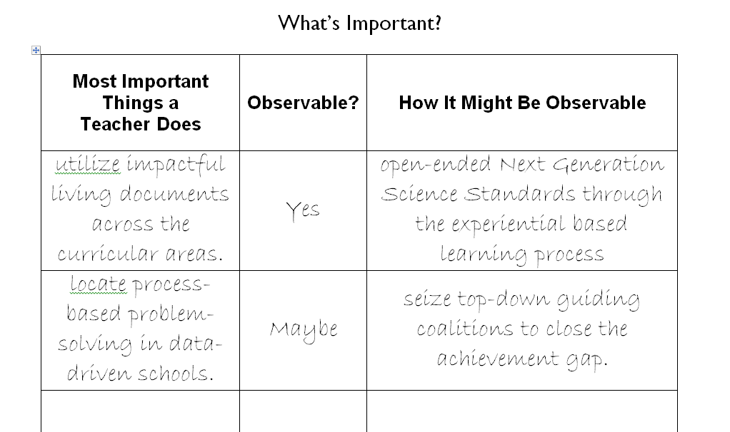
Important & Observable

Slide 69
Evidence Collection Practice

Slide 70

There are three priorities in the Teaching Standards
Engagement
Constructivism
21st Century
Readiness
PRIORITIES
Notes:
NOTES

Slide 71

Three “Gates” for Effective Teacher Evaluation
Fairness
Reliability
Validity
Notes:
NOTES

Slide 72
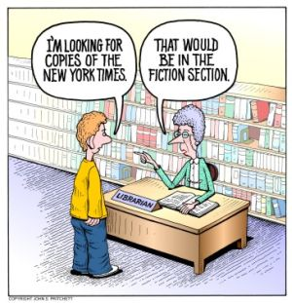
Other Threats to Observer Accuracy
Assessor bias
Leniency
Central Tendency
“Halo” or “Horns”
Effect
Notes:
NOTES

Slide 73
COLLECT
DATA
(Evidence)
SORT TO
ALIGN
WITH YOUR
FRAMEWORK
Interpret:
Clarify
Conclusions
NO!
Impact on learning…
Support needed…
Notes:
NOTES

Slide 74
Conversation,
Questions &
Discussion
COLLECT
DATA
(Evidence)
Respect &
Rapport
Conclusions
Impact on learning…
Support needed…
Notes:
NOTES

Slide 75
Evidence Collection Practice
Elementary Math Lesson
Watch it
Collect evidence, clean it up, sort, etc.
Score on the provided rubric
Check out inter-rater reliability

Slide 76

Evidence Collection Practice

Slide 77
Closure

Slide 79
Next Session
February 2, 2016, 8:30a - 11:30a, McEvoy 701, Cortland (register)
February 2, 2016, 12:30p - 3:30p, McEvoy 701, Cortland (register)
February 1, 2016, 8:30a - 11:30a, Rodax 8 Conference Rooms, Henry Campus, Syracuse (register)
February 1, 2016, 12:30p - 3:30p, Rodax 8 Conference Rooms, Henry Campus, Syracuse (register)

