Slide 1
Lead Evaluator Training
2014-2015 Ongoing Training
Day 1

Slide 2
Welcome Back!
[re]Orientation
Lead Evaluator Training
Agenda Review

Slide 3
Lead Evaluator Training
Year 1
New York State Teaching Standards and Leadership Standards
Evidence-based observation
Application and use of Student Growth Percentile and VA Growth Model data
Application and use of the State-approved teacher or principal rubrics
Application and use of any assessment tools used to evaluate teachers and principals
Application and use of State-approved locally selected measures of student achievement
Use of the Statewide Instructional Reporting System
Scoring methodology used to evaluate teachers and principals
Specific considerations in evaluating teachers and principals of ELLs and students with disabilities
Notes:
These are the “nine” official goals of Lead Evaluator Training.

Slide 4
Lead Evaluator Training
Ongoing
From the Review Room: “Describe the process by which evaluators will be trained and the process for how the district will certify and re-certify lead evaluators. Describe the process for ensuring inter-rater reliability. Describe the duration and nature of such training.”
Notes:
This is the language about ongoing Lead Evaluator Training.

Slide 5
Lead Evaluator Training
Ongoing
Continue to collect evidence
Use collected evidence to rate teachers on a rubric (with feedback)
Manage the new system
Employ growth-producing feedback to increase the quality of teaching
Implement the Reform Agenda (RTTT)
Notes:
Our local goals for Lead Evaluator Training.

Slide 6
Lead Evaluator Training
Ongoing
Or, to basically increase the likelihood that all of this can make a difference.
Notes:
Our local goals for Lead Evaluator Training.

Slide 7
Agenda
2014-2015: What do you want?
Artifact Review
Evidence Collection
Scoring (with feedback)
School-wide data from the rubric
Planning PD for the year
Notes:
Review the agenda.

Slide 8
Warm Up Activity
Model Standards-Based:
NYS Teaching Standards
Translate into “I Can” statements

Slide 9
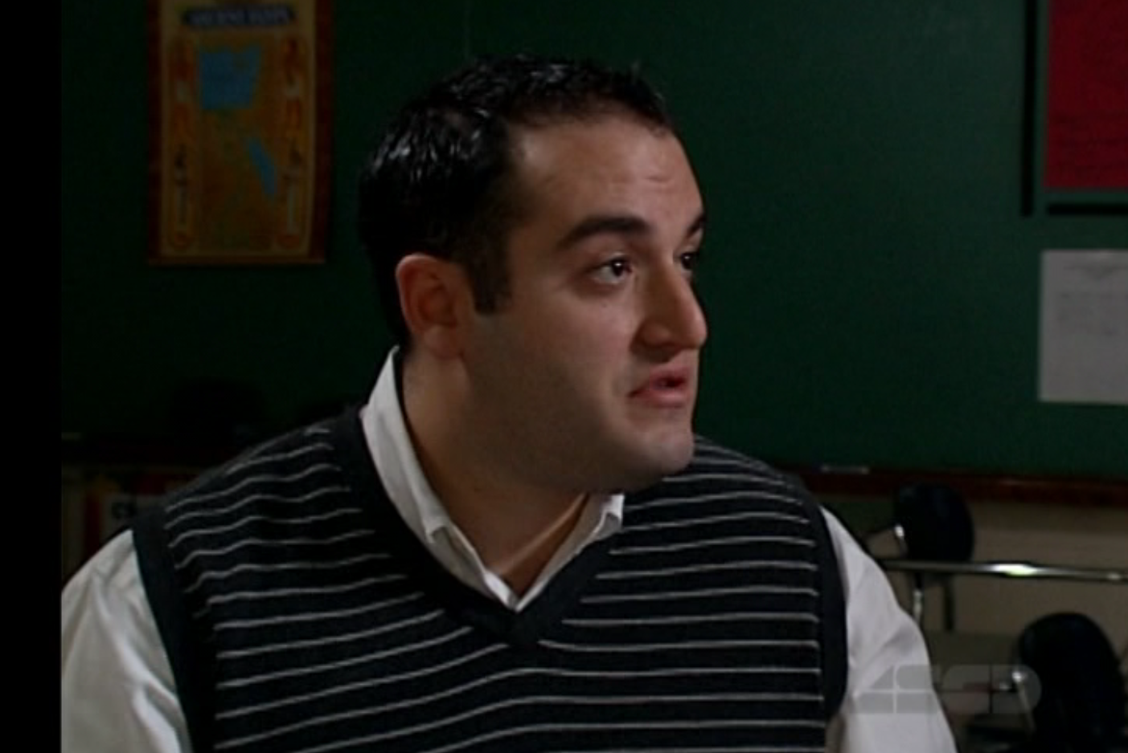
Introduction
Mr. Greenburgh
6th Grade Math Teacher
Notes:
Review the agenda.

Slide 10
Beginning of the Year

Slide 11
The Year at a Glance
Beginning of the Year
Ongoing
End of the Year
Beginning of the year meeting
Standards I and II
SLO and
local (LAT) target setting
Evidence Submission by
Teacher
Evidence Collection
Sharing the evidence
Feedback Conversations
Evidence from the year collected
Compare collected evidence to the rubric
Summative score determination and communication

Slide 12
Artifacts
For Teaching Standards 1 & 2 (FFT Domain 1), what kind of artifacts are helpful?
LAT
Lesson Plan
Unit Plan
Schedule
Other items

Slide 13
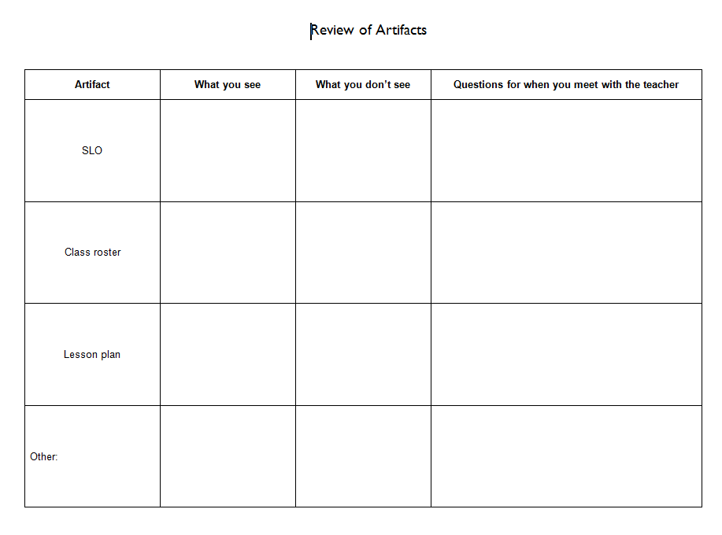
Review of Artifacts
Take a look at the artifacts in the folder.
What do you see?
What is missing?
What questions do
you have for the
teacher?

Slide 14
Your Teachers
Do you have specific goals in mind for your teachers? Or, do you just start from scratch for each one?

Slide 15
“Middle” part of the Year

Slide 16
The Year at a Glance
Beginning of the Year
Ongoing
End of the Year
Beginning of the year meeting
Standards I and II
SLO and
local (LAT) target setting
Evidence Submission by
Teacher
Evidence Collection
Sharing the evidence
Feedback Conversations
Evidence from the year collected
Compare collected evidence to the rubric
Summative score determination and communication

Slide 17
Break
Read the lesson plan
Read the organizer
Take a break
Be ready to collect evidence

Slide 18
The Year at a Glance
Beginning of the Year
Ongoing
End of the Year
Beginning of the year meeting
Standards I and II
SLO and
local (LAT) target setting
Evidence Submission by
Teacher
Evidence Collection
Sharing the evidence
Feedback Conversations
Evidence from the year collected
Compare collected evidence to the rubric
Summative score determination and communication

Slide 19
The Year at a Glance
Beginning of the Year
Ongoing
End of the Year
Beginning of the year meeting
Standards I and II
SLO and
local (LAT) target setting
Evidence Submission by
Teacher
Evidence Collection
Sharing the evidence
Feedback Conversations
Evidence from the year collected
Compare collected evidence to the rubric
Summative score determination and communication

Slide 20
Preconference Meeting
Evidence Collection
Watch the conference
Collect evidence about teacher
Take some notes about observers

Slide 21
Preconference Meeting
Evidence Collection
Watch the conference
Collect evidence about teacher
Take some notes about observers
Look at the rubric… think about how you would score it BUT DON”T ACTUALLY SCORE IT.
THEN:

Slide 22
Agreement & Reliability
Talk at your table about the evidence you collected.
Talk about the questions the observers asked of the teacher.
THEN:

Slide 23
Pre-Conference Questions
Some questions work better than others.
Look at the question suggestions. Which ones might have worked well in the pre-conference?

Slide 24
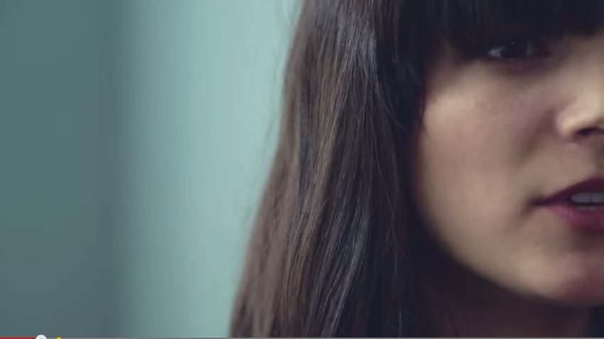
Pre-Conference Questions
Questions are important…
But listening is important, too.

Slide 25
Instructional Leadership

Slide 26

Planning the Year
The instructional leadership you provide should be based on
District goals
RTTT/Reform Agenda
Needs of your staff
Shared vision
Your “shifts”

Slide 27
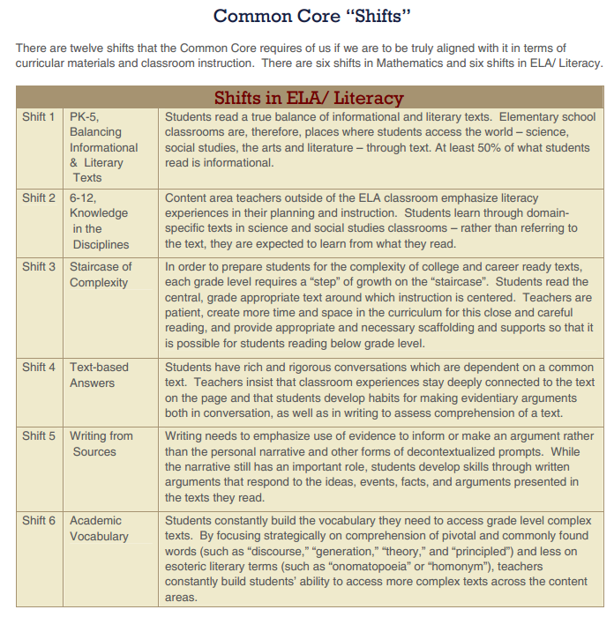
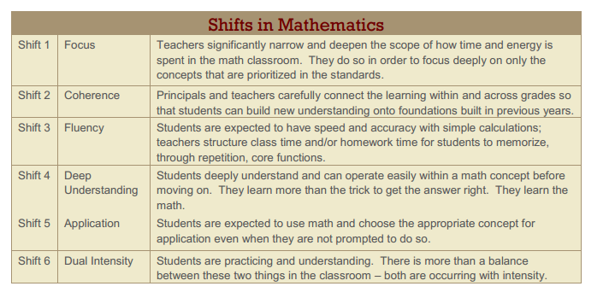
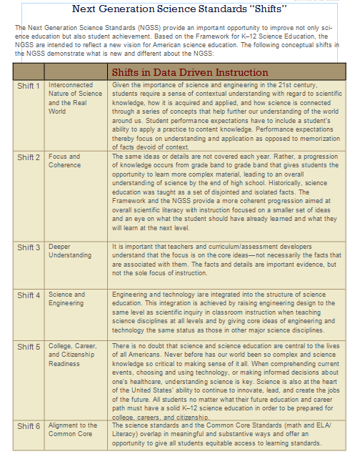
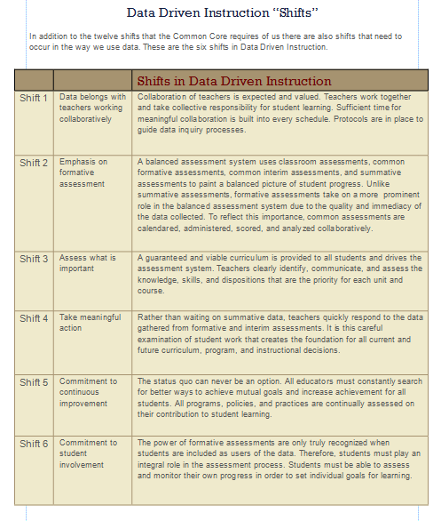
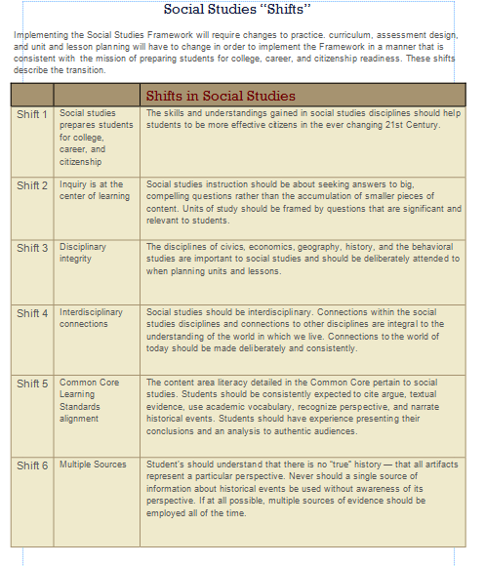
Shifts

Slide 28
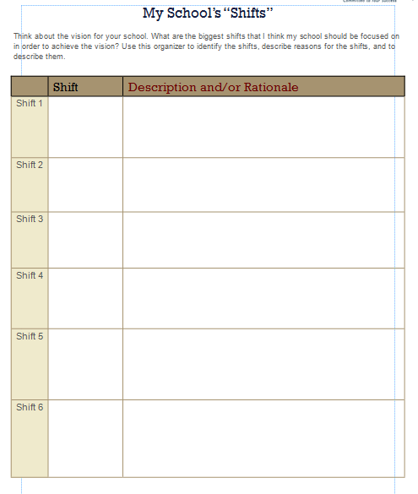
Shifts
What are the “shifts” you’d like to take place at your school?

Slide 29
Interest Groups
Choose one of the initiatives/emphases that are posted around the room that you are working on or thinking about.
Move the chairs to form a group and talk about the initiative. Share your efforts and your thoughts.

Slide 30
Planning the Year
Have you looked at last year’s rubrics (and maybe even the year’s before, too):
Electronic platforms do this for you
Otherwise, tally marks might be the way to go

Slide 31
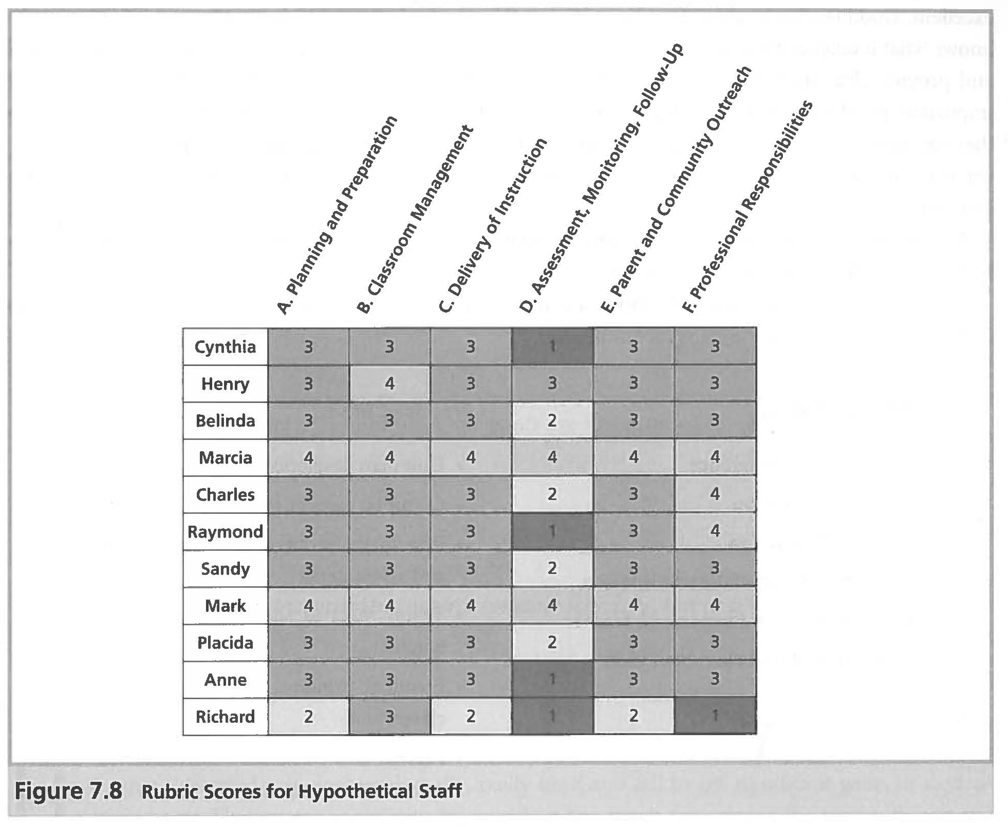
Kim Marshall Example
Notes:
This is from Rethinking Teacher Supervision, 2nd ed, p. 155

Slide 32
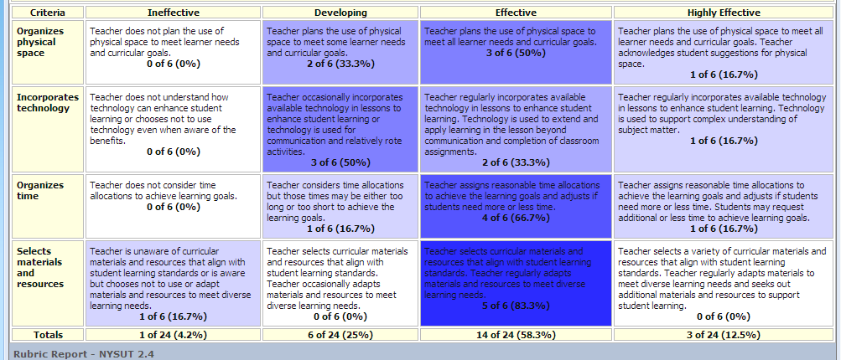
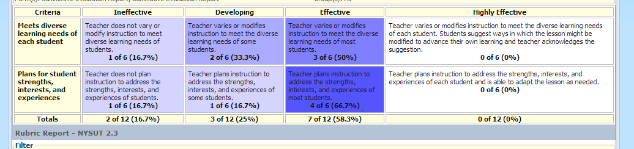
OASYS Example

Slide 33
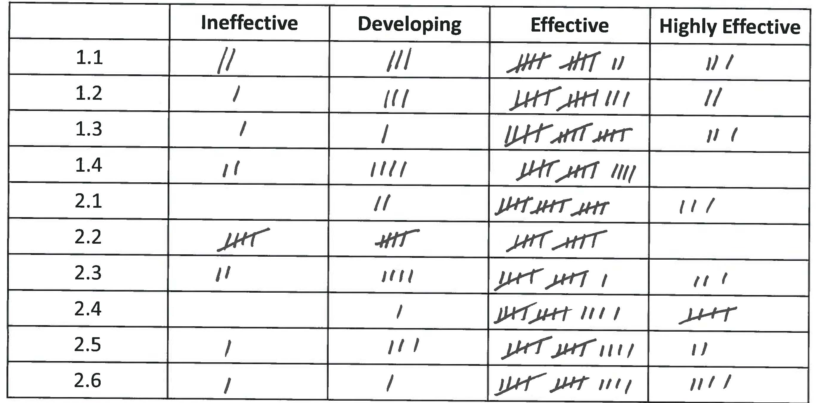
Low Tech Example

Slide 34
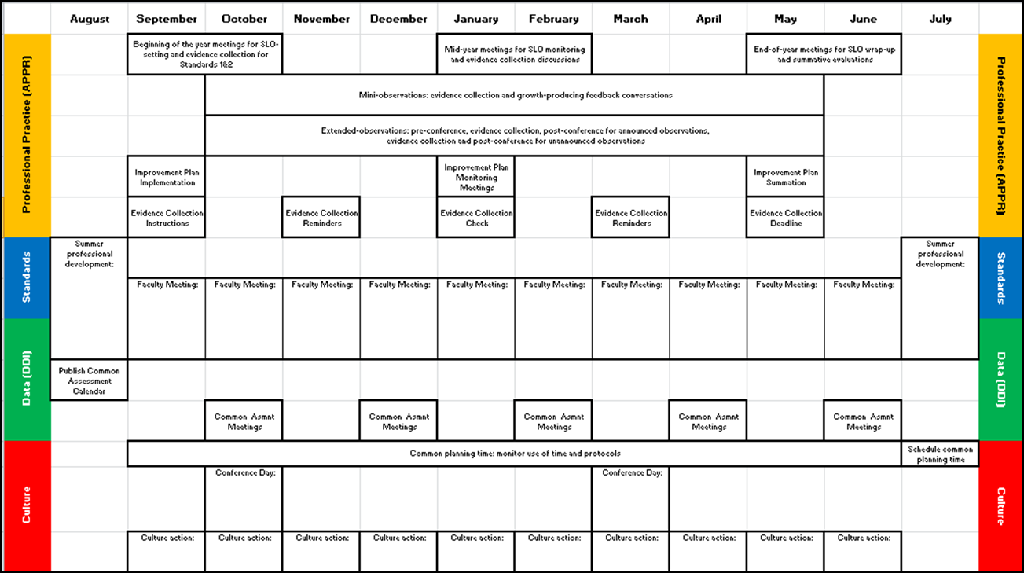
Planning the Year
Faculty meetings
Assessment meetings
Culture actions
Notes:
NOTES

Slide 35
Systems Thinking
Notes:
http://www.youtube.com/watch?v=0VqTwnAuHws (3:21)

Slide 36
Communication
How will your staff know what you want for them?
Don’t forget the rational, or “why” for everything.
Share the plan with them!

Slide 37
Next Session
January 26th in Cortland
January 27th in Syracuse
Agenda will include
  Evidence Collection (observation)
  Agreement and Reliability
  Growth-Producing Feedback (with a video of a post-conference)

Slide 38
Housekeeping
Leave folder and contents at table (pile)
Leave your answer sheet at the table (pile)
Leave the red answer key at the table (pile)

