Slide 1
Lead Evaluator Training
2012-2013 Ongoing Training
Day 1

Slide 2
Welcome Back!
[re]Orientation
Lead Evaluator Training
Agenda Review
Notes:
We’ve made a few changes to the registration process – hopefully avoiding those confusing reminders from MLP. Just sign up for the “day” and choose AM or PM with your feet.

Slide 3
[re]Orientation
On the Inside
On the Outside
What are you most worried about?
What are you most uncertain about?
As a leader, what are you saying to your staff?
What are you doing to portray the right balance of security and anxiety?
Notes:
The point here is to get people refocused on Lead Evaluator Training by first having them share a little bit about what they’ve been doing. With this prompt, it emphasizes how important it is as leaders that we lead with a positive attitude and approach. As leaders we have to be hopeful and confident and share ownership and responsibility of the changes even if we are not 100% on board with all of them.

Slide 4
Lead Evaluator Training
Year 1
New York State Teaching Standards and Leadership Standards
Evidence-based observation
Application and use of Student Growth Percentile and VA Growth Model data
Application and use of the State-approved teacher or principal rubrics
Application and use of any assessment tools used to evaluate teachers and principals
Application and use of State-approved locally selected measures of student achievement
Use of the Statewide Instructional Reporting System
Scoring methodology used to evaluate teachers and principals
Specific considerations in evaluating teachers and principals of ELLs and students with disabilities
Notes:
These are the “nine” official goals of Lead Evaluator Training.

Slide 5
Lead Evaluator Training
Ongoing
From the Review Room: “Describe the process by which evaluators will be trained and the process for how the district will certify and re-certify lead evaluators. Describe the process for ensuring inter-rater reliability. Describe the duration and nature of such training.”
Notes:
This is the language about ongoing Lead Evaluator Training.

Slide 6
Lead Evaluator Training
Ongoing
Continue to collect evidence
Use collected evidence to rate teachers on a rubric (with feedback)
Manage the new system
Employ growth-producing feedback to increase the quality of teaching
Implement the Reform Agenda (RTTT)
Notes:
Our local goals for Lead Evaluator Training.

Slide 7
Agenda
Beginning of the Year Meetings
Mini-lesson: Mathematics
Time Management
Evidence-based Evaluation
  Evidence Collection
  Sorting
  Rating
Notes:
Review the agenda.

Slide 8
Beginning of the Year Meeting

Slide 9
The Year at a Glance
Beginning of the Year
Ongoing
End of the Year
Beginning of the year meeting
Standards I and II
SLO and
local (LAT) target setting
Evidence Submission by
Teacher
Evidence Collection
Sharing the evidence
Feedback Conversations
Evidence from the year collected
Compare collected evidence to the rubric
Summative score determination and communication

Slide 10
The Year at a Glance
Beginning of the Year
Ongoing
End of the Year
Beginning of the year meeting
Standards I and II
SLO and
local (LAT) target setting
Evidence Submission by
Teacher
Evidence Collection
Sharing the evidence
Feedback Conversations
Evidence from the year collected
Compare collected evidence to the rubric
Summative score determination and communication

Slide 11
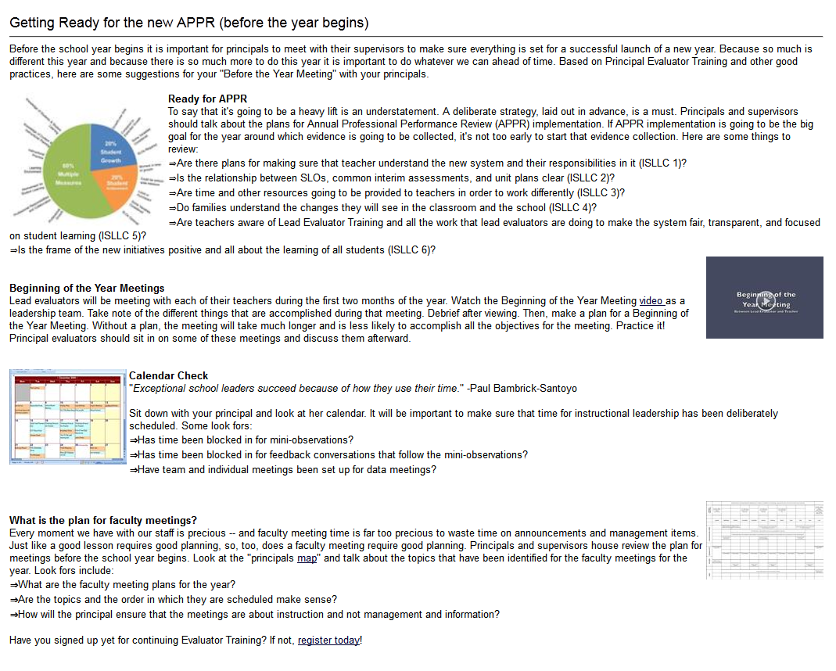
Beginning of the Year
  Beginning of the year meeting
  Standards I and II
  SLO and
  local (LAT) target setting
Notes:
Visit the resources on the page. Go through them.
.

Slide 12
Guiding Questions:
Beginning of the Year
  Beginning of the year meeting
  Standards I and II
  SLO and local (LAT) target setting
  As a table group, identify the questions you might ask during the meeting
Notes:
Distribute the organizer and questions.

Slide 13
Guiding Questions:
Beginning of the Year
  Beginning of the year meeting
  Standards I and II
  SLO and local (LAT) target setting
  As a table group, identify the questions you might ask during the meeting
  Watch it
  Debrief
Notes:
Watch video. What are the “take-aways?”

Slide 14
Meet Ms. Montoya
Your goal is to plan for and conduct a “beginning of the year” meeting
With a partner, plan the meeting. Do you want a shared agenda? Pre-meeting reflection questions?
Notes:
This simulation is designed to help evaluators prepare for the Beginning of the Year meetings they will soon be holding. This scenario is truncated because it does not include LATs because districts are doing so many different things at the local level.
Partners plan for the meeting. Then, partners match up with another set at their table and one set does the role play while the other watches and afterward provides feedback.

Slide 15
Mini-lesson:
Mathematics

Slide 16
Math Walk
You will need:
  Sample assessment items
  Common Core Learning Standards
You might also need:
  preApril/postApril
  Math emphases
Notes:
Before beginning the actual activity, make sure that everyone understand the resources available to them at the table.

Slide 17
Math Walk
Select one sample assessment item from a lower grade test
With the corresponding grade’s standards in front of you, discuss that item and its annotation with your colleague. What is it measuring? What choices did the item writer make?
Trace one of those measured standards backwards to lower grades. What is happening in those grades in that same standard? How does it build through P-2?
Focus now on 2nd grade. How would you measure student knowledge/skill? In that standard for 1st grade?
So What? Does this mean for your math program?

Slide 18
Math Walk - continued
Trace that same standard up to 8th grade
Look at the higher grade sample items and see how it plays out in those questions
So What? are the instructional and programmatic implications?

Slide 19
Time Management

Slide 20
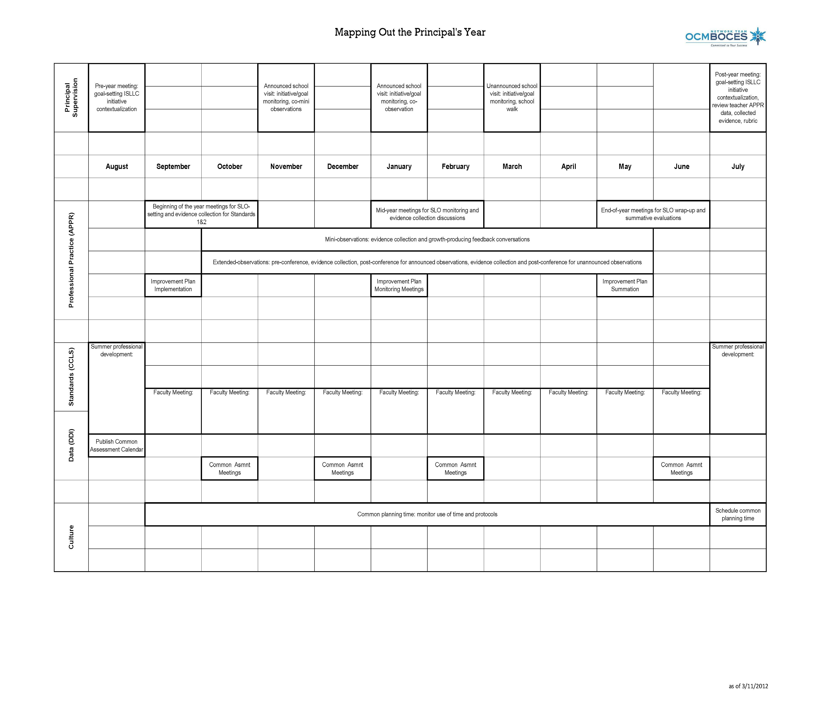
Looking At the Year
Notes:
NOTES

Slide 21
Time Allocation

Slide 27
Time Management
Get out your calendars.
Have you blocked off time for classroom visits? Meeting with teachers? Attendance at team meetings to monitor data-driven instruction?

Slide 28
Time Management
Talk at your table about how you are scheduling and blocking out time.
What systems do you have in place to protect time in your calendar?

Slide 29
Evidence

Slide 30
Evidence Collection
Watch the video
Collect evidence
Focus on environment
  Standard IV (Teaching Standards and NYSUT)
  Domain 2 (Danielson)

Slide 31
Evidence Collection
Label the evidence provided to you
Use Standards (refer to Danielson)

Slide 32
Evidence Collection
Rate the teacher on Standard 4.
As prompted in polleverywhere, submit your rating
Where were you, compared to
  Others in the room
  (inter-rater agreement)
  The facilitator
  (inter-rater reliability)

Slide 33
Agenda
√
Beginning of the Year Meetings
Mini-lesson: Mathematics
Time Management
Evidence-based Evaluation
  Evidence Collection
  Sorting
  Rating
√
√
√

Slide 34
Next Session
November 19th in Syracuse
November 20th in Cortland
Agenda will include
  Evidence
  Time management
  Ongoing Growth-Producing Feedback

