Slide 1
Teacher and Principal Evaluation
Annual Professional Performance Review (APPR)
Regulations adopted by Board of Regents on May 16, 2011

Slide 2
Classroom teachers
Annual Evaluation
100 point scale
Highly Effective
Effective
Developing
Ineffective

Slide 3
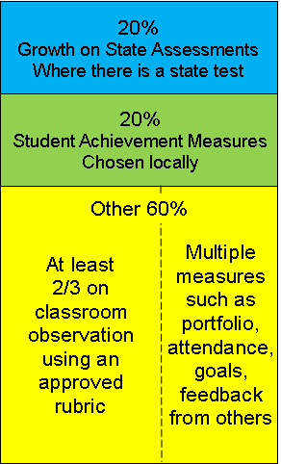
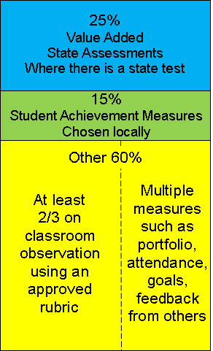
Classroom teachers
When Value-Added is implemented

Slide 4
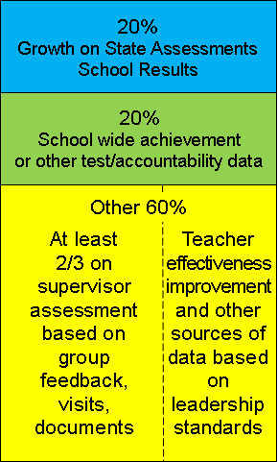
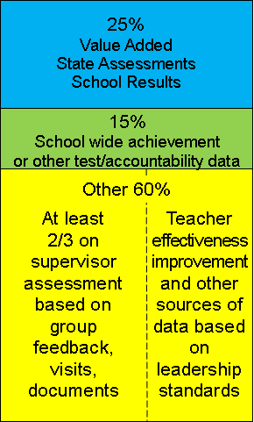
Principals
When Value-Added is implemented

Slide 5
Scoring and Rating
 | Student Growth 20% | Achievement 20% | Other 60% | Composite
Ineffective | 0-2 | 0-2 | Ranges determined locally | 0-64
Developing | 3-11 | 3-11 |  | 65-74
Effective | 12-17 | 12-17 |  | 75-90
Highly Effective | 18-20 | 18-20 |  | 91-100

Slide 6
Evaluator Training
Required training
Lead-evaluator certified to evaluate
All evaluators trained to observe and/or evaluate
Ongoing training and monitoring

Slide 7
APPR Plan Requirements
Describe process
Describe tools
Describe reporting
Describe support
Describe training
Describe timing
Describe appeals
Posted to web by 9.1.11

Slide 8
When and Who?
Phase-In
Math and ELA 4-8 2011-2012
Everyone else 2012-2013
Everyone else sooner if possible
Unless specifically addressed by a labor agreement signed prior to July 1, 2010

