Slide 1
What’s Special About Special Education
Janel Payette
Coordinator RSE TASC

Slide 2


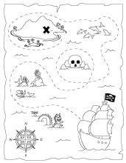
The Common Core is the DESTINATION, not the journey.
Stated another way: It’s the WHAT, not the HOW.
Notes:
Read slide….For the next 15 minutes, we’ll look at the “how” in relation to students with disabilities.

Slide 3
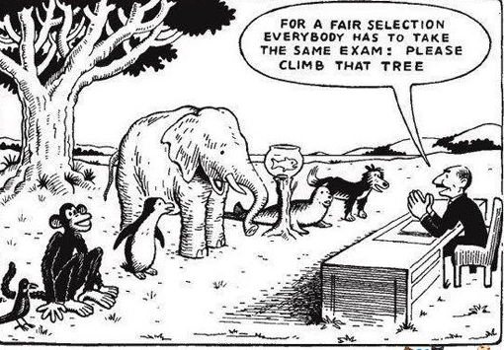
Notes:
The “how” for students with disabilities will look differently based on individual needs and unique learning characteristics.
So while the goal for all students is the same, the methods for getting there need to be purposefully chosen and specially designed.
The provision of specially designed instruction to students with disabilities is embedded within NYSED Part 200 regulations
Take a moment at your table and choose an animal. Think about the animals unique needs and talk about accommodations, modifications, equipment, technology or strategies you would use to help the animal you chose reach the goal of climbing up the tree. 2 min. report out 1 minute.
Essentially, in simple terms this is what we are doing when we talk about specially designed instruction

Slide 4
Specially Designed Instruction
“The How”
Adapting, as appropriate to the needs of an eligible student, the content, methodology, or delivery of instruction to address the unique needs that result from the student’s disability; and to ensure access of the student to the general curriculum, so that he or she can meet the education standards that apply to all students.
200.1(vv)
Notes:
Specially designed Instruction is at the core of special education.
It’s what makes special education special.
Specially Designed Instruction is the “how” for students with disabilities to meet the educational standards that apply to all students. This is the NYS part 200 regulatory definition of SDI.

Slide 5
Specially designed instruction Operational Definitions
Adapting: making changes matched to student need or condition
Content: knowledge and skills that comprise curriculum to be mastered
Methodology: actions by the teacher intended to produce or facilitate learning which includes the art and science of instruction
  (ex: teaching strategies including pacing, promoting active student engagement, positive classroom management – best practice and explicitly taught although not necessarily specially designed instruction)
Delivery of instruction: teaching that results in access to, participation in, and progress in the curriculum for students with disabilities
  (ex: explicit instruction of learning strategies, task analysis, pre-teaching essential vocabulary, re-teaching specific skills or concepts, etc.)
Notes:
If we take apart the definition of specially designed instruction we see that special education teachers must address all of these specific components when making instructional decisions for students with disabilities.

Slide 6
Specially Designed Instruction critical elements
Individualized
Based upon assessed needs of student
Documented in the Individualized Education Program (IEP)
Combination of specific instructional supports & supplemental supports

Slide 7
Specially designed instruction can encompass different combinations of a variety of provisions for students with disabilities in order to meet their individual needs:
Accommodations-environmental changes and the way we deliver instruction
Modifications-changes made to the curricular content or skills
Specialized equipment and/or adaptive technology-item, piece of equipment, or product system that is used to increase, maintain, or improve the functional capabilities of a student with a disability.
Strategy Instruction –Explicitly teaching students about strategies and how and when to use strategies, helping students identify personally effective strategies and supporting them as they make strategic behaviors part of their learning schema
Notes:
Based upon individual student need, often specially designed instruction involves a combination of accommodations, modifications, assistive tech, specialized equipment, strategy instruction.
These provisions are provided across the continuum of services.

Slide 8
Continuum of Services
General Education Setting
Direct Consultant Teacher
Indirect Consultant Teacher
Resource Services
Special
Class
*Integrated Coteaching
Related Services
H/O
Notes:
These provisions are consistent across special education services. You have a hand out on your table that outlines in more detail the components of each of these services.

Slide 9
SDI
Differentiated Instruction
Universal Design for Learning
SDI is adapting, as appropriate to the needs of an eligible student, the content, methodology, or delivery of instruction to address the unique needs that result from the student’s disability; and to ensure access of the student to the general curriculum
Explicit Direct Instruction and Scaffolding
DI is an educational philosophy that values that all students have unique needs. Here, you will start to see some differences in instruction based on students’ interests, readiness, or learning styles. These differences are based on data collected by the teacher. In the provision of effective instruction, differentiation occurs for the benefit of maximizing the learning of all students.
UDL is a set of principles for curriculum development and delivery of lessons that support the learning of all students with a variety of learning styles. It gives all individuals equal opportunities to learn by minimizing barriers to learning in order to provide access to all student learning styles and needs in the classroom. The “root of good, effective instruction for all students.
Notes:
This slide represents SDI in the larger context of education.
Specially Designed Instruction is above and beyond both of these things. It is what becomes absolutely necessary in order to support the needs of students with disabilities beyond “good, effective instruction”. Based on individual IEP needs, this is where you will start to identify visible differences in classroom instruction for particular students.
All students regardless of …
Explicit Instruction & Scaffolding are used throughout any and all of these concepts.

Slide 10
Differentiated Instruction | Universal Design for Learning | Scaffolding
all students regardless of differences in ability access different avenues to acquiring content; to processing, constructing, or making sense of ideas; to developing teaching materials In the course of instruction need to differentiate instruction | select goals, methods, assessment and materials in a way that will minimize barriers and maximize flexibility 1. Recognition learning, provide multiple, flexible methods of presentation 2. strategic learning, provide multiple, flexible methods of expression and apprenticeship. 3. affective learning, provide multiple, flexible options for engagement | provision of sufficient support to promote learning of new concepts and skills for all students The type and amount of support needed is dependent on the needs of the students during the time of instruction (e.g. the teacher may identify hints or cues to help the student reach an even higher level of thinking. ) Overlaps with teaching strategies
Specially Designed Instruction intentionally planned and implemented with fidelity based on identified needs of individual students with disabilities that are absolutely necessary for access, participation and progress in the general education curriculum. H/O
Notes:
Just for your additional information and reference. There is a handout on the table that takes a deeper look at the elements deeper look at all of the elements and how they fit together.

Slide 11
UDL, Differentiated Instruction, Scaffolding, Specially Designed Instruction
Sam has a voice to text program that he learns to edit after dictation
Several students have parts of their pre-writing graphic organizer completed for them as an extended model
Students use one of three topics of varying difficulty as a basis for their writing
Every student may use the word processor and is responsible for editing.
Notes:
In a very simple example. Please take a look at each of these scenarios and at your table identify which one is UDL, DI, Scaffolding or SDI. 2 min. I give the answers

Slide 12
We provide Specially Designed Instruction through Explicit Instruction
  Explicit Instruction is:
  Structured, systematic
  Effective researched-based methodology for teaching academic skills and content. In particular for students with disabilities and novice learners
  Includes instructional design and delivery procedures (I do, we do, you do)
  Characterized by a series of scaffolds, explanations, demonstrations, and supported practice with embedded feedback.
Notes:
As we saw in the pyramid, We are able to deliver the provisions of specially designed instruction through Explicit Instruction. Explicit instruction is

Slide 13
Anatomy of an Explicit Lesson
Introduction
  Objectives posted and shared
  Activating of prior knowledge
  Check for Understanding
Active Teaching – part 1
  Modeling (I do it)
  Show and Tell
  Check for understanding
Active Teaching – part 2
  Guided Practice (we do it)
  Prompts – physical, verbal, visual
  Levels of scaffolding (tell, ask, remind
  them what to do)
Active Teaching – part 3
a. Independent Practice (you do it)
Lesson Closure
Notes:
Within an explicitly designed lesson Specially designed instruction is inserted

Slide 14
RSE TASC Walkthrough Tool
Supportive Accessible Classroom Environment
  Management
  Positive Classroom Climate
  Physical Organization
Explicit Instruction
  Explicit Instruction Teaching Functions
  Explicit Instruction Elements
Specially Designed Instruction
  Specially Designed Instruction: Direct Instruction of Targeted Skills, Accommodations, Re-Teaching H/O
Notes:
As a network the RSE TASC has developed a walkthrough tool that all specialists use as an initial data point when entering schools. While initially it focuses on what is occurring in classrooms. The main purpose is to look at trends that are occurring across the school.
The walkthrough tool encompasses classroom environment, explicit instruction and specially designed instruction
The tool was developed using the RSE TASCS’ Quality indicator guide and the work of Anita Archer, Charles Hughs, John Hollingsworth and Sylvia Ybarra. We have also conducted a crosswalk of the tool with the NYSED teaching standards.

Slide 15
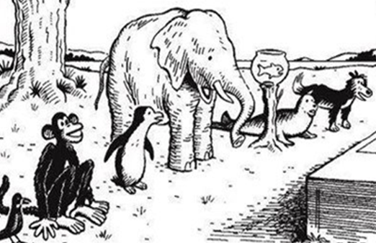

Specially Designed Instruction
Explicit Instruction and Scaffolding
UDL
Differentiating Instruction
Notes:
So if we as educators are successful in our endeavor. We should be able to provide accommodations modifications, special equipment, and strategy instruction to support students in being successful.

Slide 16
Resources and references
Archer, Anita & Hughs, Charles (2011). Explicit Instruction, New York, NY: Guilford Press.
Crocket, L., Jukes, I., Churches, A. (2011). Literacy is Not Enough:
21st Century Fluencies for the Digital Age. Thousand Oaks, CA: Corwin Press.
Hollingsworth, John & Ybarra, Silvia (2009). Explicit Direct Instruction, Thousand Oaks,
CA: Corwin Corwin Press.
Mastropieri, M.A., & Scruggs, T.E. (2005). Effective Instruction for Special Education
(3rd Ed.). Austin, TX: Pro Ed.
Willingham, D. (2009). Why Don’t Students Like School? San Francisco, CA:
Jossey-Bass.
Willis, J. (2006). Research-Based Strategies to Ignite Student Learning. Alexandria, VA:
Association for Supervision and Curriculum Development.

Slide 17
Thank you!
Janel Payette
jpayette@ocmboces.org

