Slide 1
Science Leadership Network
November 14, 2013

Slide 2
Our discussion today…
Disciplinary Literacy
Standards for Literacy in Science
Sources of Informational Text

Slide 3

What is Disciplinary Literacy?
Disciplinary literacy requires a focus on:
the specialized ways of creating, communicating, and evaluating knowledge in a particular discipline → disciplinary knowledge
finding solutions to particular problems with reading and writing disciplinary texts that take into account disciplinary knowledge
reading and writing multiple texts to build knowledge and critical thinking.

Slide 4

What does that mean for teaching?
Students need to be let in on the “secrets” of reading and writing science that experts have learned over years of practice.
Teaching students these disciplinary approaches to reading and writing will improve content knowledge, motivation, and reading.

Slide 5
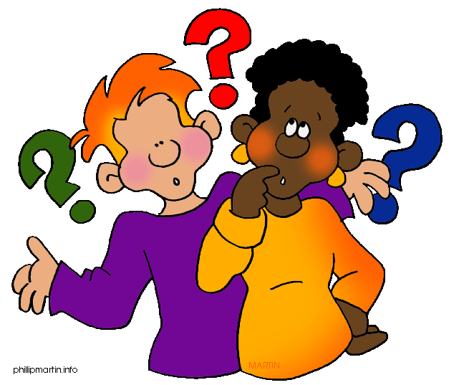
What makes science different?
Underlying beliefs about what science is
Inquiry practices
Overarching frameworks
Text structures
Discourse structures
Other considerations

Slide 6
Underlying Beliefs
Science is an attempt to build understandings of the physical and designed worlds.
Scientific findings are tentative and subject to revision.
Science knowledge is constructed over time and is influenced by and, in turn, influences:
  Technology
  Theories and patterns of understanding
  Cultural norms
Science knowledge is socially constructed, using peer critique and public dissemination to create scientific explanations that are based on sound empirical data.
The Nature of Science from NGSS
Notes:
Unlike historians, scientists create knowledge through experimentation and systematic observation. The findings of experiments are somewhat dependent upon the quality of the instrumentation, the design, and the statistical analysis. However, these variables are all decided upon prior to the actual experiment. The findings are generalizable to other experiments under the same conditions. Although chemists are not uncritical readers, we found that the chemists we studied did have more confidence than historians in the utility of the knowledge that had been created; they believed they could use that knowledge to predict what would happen under similar conditions. What is important to them in reading, consequently, was a full understanding of the way in which an experiment took place and the processes the experiment uncovered. Gaining that full understanding required them to think about the phenomenon being presented in prose, to visualize it, and to manipulate it in formulas and equations.
ancillaries: Ancilaries to what? The chemists were most interested in the transformation of information from one form to another. That is, when reading prose, they were visualizing, writing down formulas, or if a diagram or a chart were on the page, going back and forth between the graph and the chart. One chemist explained, “They give you the structure, the structure of the sensor is given, so I was looking at the picture as I was reading, and I tried to relate what was in the picture to what they were saying about how mercury binds to one part of the molecule.” This explanation, corroborated by the chemists’ other comments, helped us to understand that in chemistry, different or alternative representations (e.g., pictures, graphs or charts, text, or diagrams) of an idea are essential for a full understanding of the concepts. These various representations are processed recursively as reading progresses.

Slide 7
The Nature of Science
Scientific investigations use a variety of methods.
Scientific knowledge is based on empirical evidence.
Scientific knowledge is open to revision in light of new evidence.
Scientific models, laws, mechanisms, and theories explain natural phenomena.

Slide 8
The Nature of Science
Science is a way of knowing.
Scientific knowledge assumes an order and consistency in natural systems.
Science is a human endeavor.
Science addresses questions about the natural and material world.
                from NGSS, 2013

Slide 9

Inquiry Practices
Scientific knowledge is built by:
Developing coherent, logical explanations, models or arguments from evidence
Advancing and challenging explanations
Converging/corroborating evidence
Comparing/integrating across sources (and representations)
Evaluating sources and evidence

Slide 10
Overarching Frameworks
National Science Education Standards (2004)
College Board (2009)
Systems, order and organization
Evidence, models and explanation
Change, constancy and measurement
Evolution and equilibrium
Form and function
Evolution
Scale
Equilibrium
Matter and energy
Interaction
Form and function
Models and explanations, evidence and representations.

Slide 11
Text Structures
Cause/Effect/Correlation
Problem/Solution/Findings
Proposition/Support
Sequence/Process/Chronology
Goal/Action/Outcome
Description/Definition
Comparison
Enumeration/Exemplification
Problematic Situation
Refutation

Slide 12
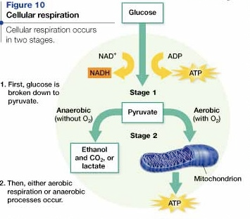
Other Structures in Text
Multiple Representations
Diagrams
Equations
Charts
Tables
Videos
Simulations
Flowcharts
Models
Verbal (oral and written)

Slide 13

Types of Text
Raw data
Bench notes, field notes, journals or logs
Peer-reviewed journal articles
Personal communications such as interviews, letters, emails, conversations
Integrative pieces: Chapters in handbooks, advances in science series and reviews, popular press articles
Press releases, news briefs, and online articles
Science fiction
Textbooks
Trade books
Websites and blogs

Slide 14
Discourse Structures
The language of science includes
Distinctive grammatical structures such as nominalizations and passive voice (A conclusion was reached that… A similar experiment was carried out…)
Technical and specialized expressions
  Latin and Greek roots
  Common meaning vs. scienctific meaning
  Abstract concepts

Slide 15
Discourse Structures
The language of science includes
Signals of the degree of certainty, generalizability, and precision of statements
Argumentation → evidence is used to support knowledge claims, and scientific principles and methods are used as warrants.

Slide 16

Other Considerations
Misconceptions about science/scientific processes
Obstacle of lack of background knowledge
Abstract concepts, challenging vocabulary—both domain-specific and general

Slide 17
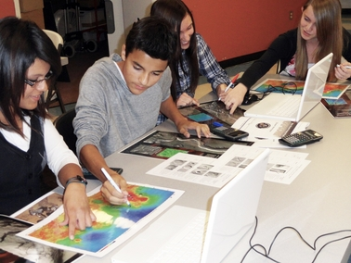
Students need to read and write different kinds of texts
They need to read:
Journal articles
Trade magazines
Proposals
Lab reports
Equipment specifications
They need to write:
Explanations
Lab reports
Proposals
Articles

Slide 18
What students need to know about science literacy
Text provides knowledge that allows prediction of how the world works
Full understanding of experiments or processes
Close connections among text, graphs, charts, formulas
Strategies of corroboration and transformation
Technical, abstract, dense, tightly knit language
Nominalization (turning processes into nouns)
Focus on causation
Notes:
The chemists were most interested in the transformation of information from one form to another. That is, when reading prose, they were visualizing, writing down formulas, or if a diagram or a chart were on the page, going back and forth between the graph and the chart. One chemist explained, “They give you the structure, the structure of the sensor is given, so I was looking at the picture as I was reading, and I tried to relate what was in the picture to what they were saying about how mercury binds to one part of the molecule.” This explanation, corroborated by the chemists’ other comments, helped us to understand that in chemistry, different or alternative representations (e.g., pictures, graphs or charts, text, or diagrams) of an idea are essential for a full understanding of the concepts. These various representations are processed recursively as reading progresses.
Unlike historians, chemists create knowledge through experimentation. The findings of experiments are somewhat dependent upon the quality of the instrumentation, the design, and the statistical analysis. However, these variables are all decided upon prior to the actual experiment. The findings are generalizable to other experiments under the same conditions. Although chemists are not uncritical readers, we found that the chemists we studied did have more confidence than historians in the utility of the knowledge that had been created; they believed they could use that knowledge to predict what would happen under similar conditions. What is important to them in reading, consequently, was a full understanding of the way in which an experiment took place and the processes the experiment uncovered. Gaining that full understanding required them to think about the phenomenon being presented in prose, to visualize it, and to manipulate it in formulas and equations.

Slide 19
Ask Questions
What do you want students to learn from reading this text?
What challenges will students have with the reading that will keep them from learning what they need to learn?

Slide 20
Ask Questions
What is important to know about science that will help them understand the text?
    What counts as important?
    What counts as quality?
    How are claims and evidence are used?
What supports can we create that will help them learn?

Slide 21
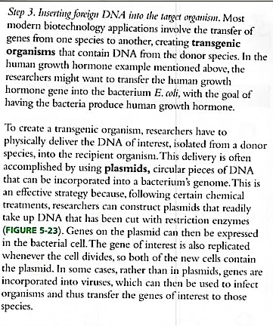
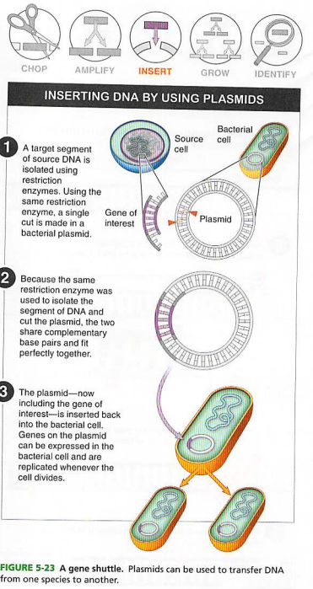

Slide 22
Our discussion today…
Disciplinary Literacy
Standards for Literacy in Science
Sources of Informational Text

Slide 23
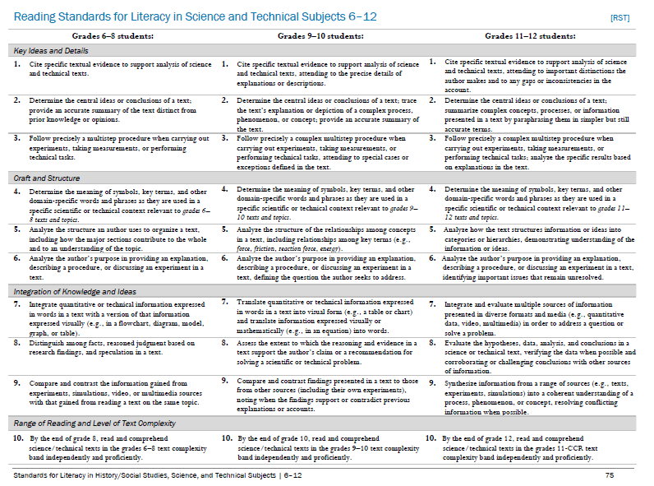
The Literacy Standards

Slide 24
RST 3: Understanding complex processes
Grades 6-8: Follow precisely a multistep procedure when carrying out experiments, taking measurements, or performing technical tasks.
Grades 9-10: Follow precisely a complex multistep procedure when carrying out experiments, taking measurements, or performing technical tasks, attending to special cases or exceptions defined in the text.
Grades 11-12: Follow precisely a complex multistep procedure when carrying out experiments, taking measurements, or performing technical tasks; analyze the specific results based on explanations in the text.
Notes:
RST 3

Slide 25
RST 7: Translation
Grades 6-8: Integrate quantitative or technical information expressed in words in a text with a version of that information expressed visually (e.g., in a flowchart, diagram, model, graph, or table).
Grades 9-12: Translate quantitative or technical information expressed in words in a text into visual form (e.g., a table or chart) and translate information expressed visually or mathematically (e.g., in an equation) into words.
Grades 11-12: Integrate and evaluate multiple sources of information presented in diverse formats and media (e.g., quantitative data, video, multimedia) in order to address a question or solve a problem.
Notes:
RST 7

Slide 26
RST 8: Critical Thinking
Grades 6-8: Distinguish among facts, reasoned judgment based on research findings, and speculation in a text.
Grades 9-10: Assess the extent to which the reasoning and evidence in a text support the author’s claim or a recommendation for solving a scientific or technical problem.
Grades 11-12: Evaluate the hypotheses, data, analysis, and conclusions in a science or technical text, verifying the data when possible and corroborating or challenging conclusions with other sources of information.
Notes:
RST 8

Slide 27
RST 9: Critical thinking
Grades 6-8: Compare and contrast the information gained from experiments, simulations, video, or multimedia sources with that gained from reading a text on the same topic.
Grades 9-10: Compare and contrast findings presented in a text to those from other sources (including their own experiments), noting when the findings support or contradict previous explanations or accounts.
Grades 11-12: Synthesize information from a range of sources (e.g., texts, experiments, simulations) into a coherent understanding of a process, phenomenon, or concept resolving conflicting information when possible.
Notes:
RST 9

Slide 28
Our discussion today…
Disciplinary Literacy
Standards for Literacy in Science
Sources of Informational Text

Slide 29
Why use multiple texts?
Science changes over time.
Scientific understandings exist at multiple levels.
Scientists read different types of text.
Scientists write different types of text.
Scientific explanations can be easy to difficult.
Deeper understandings result from reading multiple explanations.
Science knowledge is corroborated knowledge.

Slide 30
Sources of Informational Text
BBC News: Science and Environment
E! Science News
Earth Observatory
Learn Genetics
NASA News
National Science Teachers Association
The Natural Inquirer
New York Times Science Section
Science Daily
Science News For Kids
Science Times
Teach Genetics

Slide 31
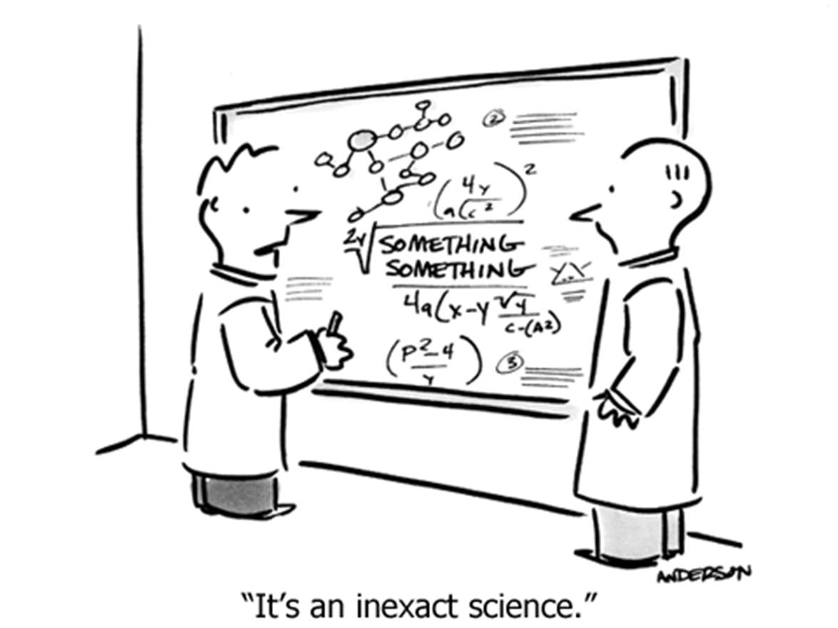
Thank you!
Thank
you!
Jenny Fanelli
jfanelli@ocmboces.org
Thank
you!

