Slide 1
Teacher Scores from the State

Slide 2
Teacher Scores from SED
Mostly 4th – 8th grade teachers of ELA and math
Some co-teachers or others can be connected to these

Slide 3
Teacher Scores from SED
“Like” students are compared from year to year, grouped by:
Previous score(s)
SWD?
ELL?
SES?

Slide 4
Teacher Scores from SED
“Like” students scores are compared to determine the Student Growth Percentile (SGP)

Slide 5
SGPs combined for MGP
Ms. Smith’s Class
 | SGP | Enrollment Duration | Attendance | Enrollment x Attendance
Student A | 45 | 80% | 90% | .72
Student B | 40 | 100% | 95% | .95
Student C | 55 | 50% | 80% | N/A
Student D | 60 | 100% | 90% | .90
Student E | 40 | 100% | 75% | .75
To measure teacher performance, we find the mean growth percentile (MGP) for her students, which is the weighted average of the SGPs. In this case:
Step 1: (.72*45)+(.95*40)+(.90*60)+(.75*40) = 154.4
Step 2: .72+.95+.90+.75 = 3.32
Step 3. 154.4 / 3.32 = 46.5
Ms. Smith’s mean growth percentile (MGP) is 46.5, meaning on average her students performed as well or better than almost 47 percent of similar students.
**Teachers need at least 16 SGPs attributed to them in order for an MGP to be reported

Slide 6
MGPs and Statistical Confidence
MGP
87
84
Lower Limit
90
Upper Limit
Confidence Range
New York State Education Department (NYSED) provides a 95 percent confidence range, meaning we can be 95 percent confident that an educator’s “true” MGP lies within that range. Upper and lower limits of MGPs will be used when classifying educators into HEDI categories.
An educator’s confidence range depends on a number of factors, including the number of student scores included in his or her MGP and the variability of student performance in the class or school.

Slide 7
MGPs for teachers
1 10 20 30 40 50 60 70 80 90 99
1 10 20 30 40 50 60 70 80 90 99
1 10 20 30 40 50 60 70 80 90 99
1 10 20 30 40 50 60 70 80 90 99
1 10 20 30 40 50 60 70 80 90 99
1 10 20 30 40 50 60 70 80 90 99
1 10 20 30 40 50 60 70 80 90 99
1 10 20 30 40 50 60 70 80 90 99
1 10 20 30 40 50 60 70 80 90 99

Slide 8
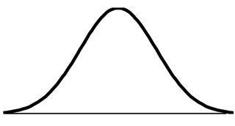
Distribution of HEDI Labels
State-Provided Teacher and Principal Scores
mean
Ineffective Range (6.7%)
Highly Effective Range (6.7%)
Developing Range (9.2%)
Effective Range (77.4%)
SD = -1.5
SD = -1
SD = 0
SD = +1.5
SD = +2
6%
16%
50%
94%
Notes:
Note: The actual proportion of educators receiving each rating can vary slightly from the distribution in this chart, after the confidence ranges are applied. The final label is based both on what HEDI category an educator’s MGP falls in and the upper and lower limits of their confidence ranges.

Slide 9
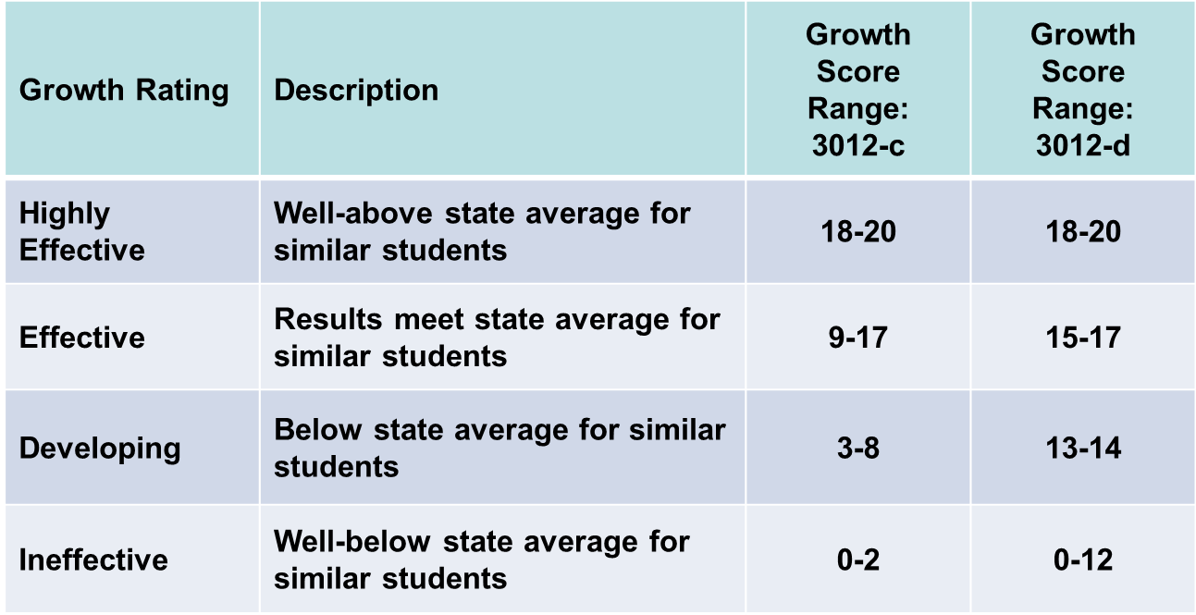
Assigning Points to HEDI Labels

Slide 10
§3012-c to § 3012-d Scoring Bands
 | 3012-c Bands |  | 3012-d Bands
HEDI Points | Min MGP | Max MGP | Min MGP | Max MGP
0 | 9 | 28 | 9 | 22
1 | 29 | 31 | 23 | 24
2 | 32 | 35 | 25 | 25
3 | 28 | 35 | 26 | 26
4 | 36 | 36 | 27 | 27
5 | 37 | 37 | 28 | 28
6 | 38 | 38 | 29 | 29
7 | 39 | 39 | 30 | 30
8 | 40 | 41 | 31 | 31
9 | 36 | 43 | 32 | 32
10 | 44 | 45 | 33 | 33
11 | 46 | 48 | 34 | 34
12 | 49 | 50 | 35 | 35
13 | 51 | 52 | 28 | 37
14 | 53 | 55 | 38 | 41
15 | 56 | 57 | 36 | 48
16 | 58 | 60 | 49 | 55
17 | 61 | 69 | 56 | 69
18 | 67 | 68 | 67 | 68
19 | 69 | 72 | 69 | 72
20 | 73 | 97 | 73 | 97
KEY | Description
Ineffective | Well-below state average for similar students
Developing | Below state average for similar students
Effective | Results meet state average for similar students
Highly Effective | Well-above state average for similar students
*For illustrative purposes only. 3012-d scoring bands were not in place for most teachers during 2014-15. The minimum and maximum MGPs associated with each point range may change in future years based on the MGPs of teachers statewide.

Slide 11
mean
Assigning Points to HEDI Labels
Previous Distribution
0 1 2
3 4 5 6 7 8
9 10 11 12 13 14 15 16 17
18 19 20
Ineffective Range (6.7%)
Highly Effective Range (6.7%)
Developing Range (9.2%)
Effective Range (77.4%)
SD = -1.5
SD = -1
SD = 0
SD = +1.5
SD = +2
6%
16%
50%
94%

Slide 12
mean
Assigning Points to HEDI Labels
Future Distribution
0 1 2 3 4 5 6 7 8 9 10 11 12
13 14
15 16 17
18 19 20
Ineffective Range (6.7%)
Highly Effective Range (6.7%)
Developing Range (9.2%)
Effective Range (77.4%)
SD = -1.5
SD = -1
SD = 0
SD = +1.5
SD = +2
6%
16%
50%
94%

Slide 13
Principal Scores from the State

Slide 14
SGPs to MGPs for Principals
To measure principal performance, we find the mean growth percentile (MGP) for all her students who were enrolled on BEDS day and assessment day. To find a principal’s mean growth percentile, take the average of SGPs in the school:
Step 1: 45+40+70+41 = 196
Step 2. 196/4 = 49.
Principal Jensen’s mean growth percentile (MGP) is 49, meaning on average her students performed as well or better than 49 percent of similar students.
Principal Jensen’s School
 | SGP | BEDS-Assessment Day Enrollment
Student Q | 45 | Yes
Student R | 40 | Yes
Student S | 70 | Yes
Student T | 60 | No
Student U | 41 | Yes
Same minimum sample size requirements (16 student scores) for principals as for teachers.

Slide 15
GREs for Principals
Simplified Illustrative Example
Principal’s score on this metric is 0.2. On average, students at this school are passing 0.2 Regents Exams more than similar students statewide. A zero represents average or effective results.
Student | Number of Regents Passed This Year For This Student | Number of Regents Passed This Year by Similar Students | Difference
Jessica | 1 | 1 | 0
Tyler | 2 | 2 | 0
Ashley | 1 | 2 | -1
Emily | 3 | 2 | 1
Jacob | 3 | 2 | 1
Total Difference (Sum of Differences) |  |  | 1
Average Difference (Total Difference/Number of Students) |  |  | 1/5 = .2
NOTE: 0 means student or school achieved the average (or “effective”) result compared to similar students statewide.

