Slide 1
Student Learning Objectives in §3012-c and §3012-d
Slides updated 9.17.15

Slide 2

It’s All About the Target

Slide 3
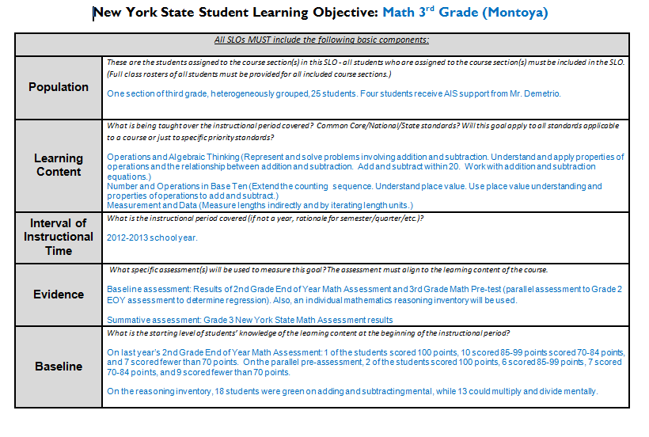
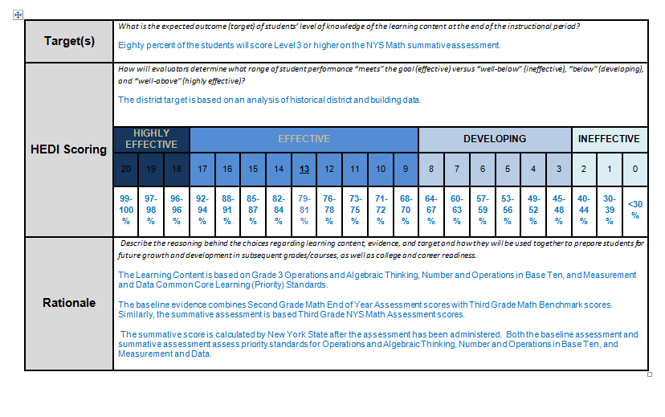
SLOs in §3012-c

Slide 4
Growth over time
Knowledge of Students & Student Learning
Compared to
Expected Growth
Knowledge of Content & Instructional Planning
Some Variables
Considered
20%
Student
Growth
SLOs Required
Instructional
Practice
60%
Multiple Measures
Moment in time
or growth
Learning
Environment
20%
Student
Achievement
Could be school-
wide measure
Assessment for
Student Learning
Local or
Purchased
Professional Responsibilities
and Collaboration
Some Variables
Considered
SLOs Optional
Professional
Growth

Slide 5
Growth over time
Compared to
Expected Growth
Some Variables
Considered
20%
Student
Growth
SLOs Required
60%
Multiple Measures

Slide 6
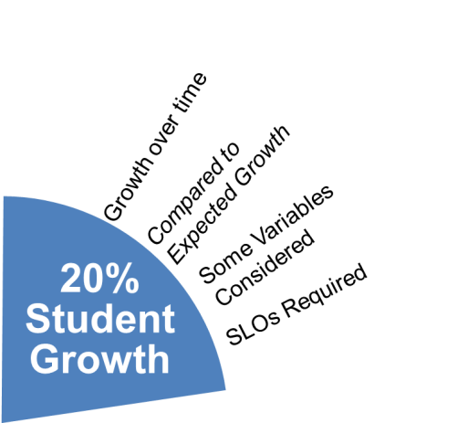
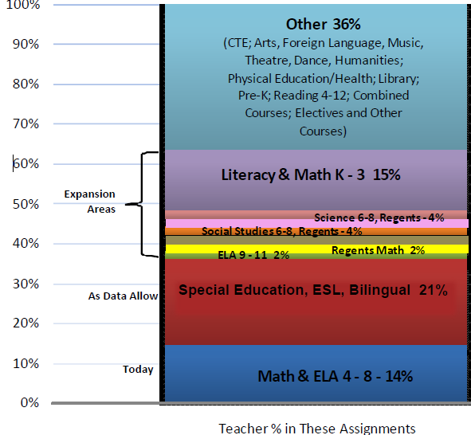
NO State-provided Growth Score; Use Student Learning Objectives
State-provided Growth Score

Slide 7
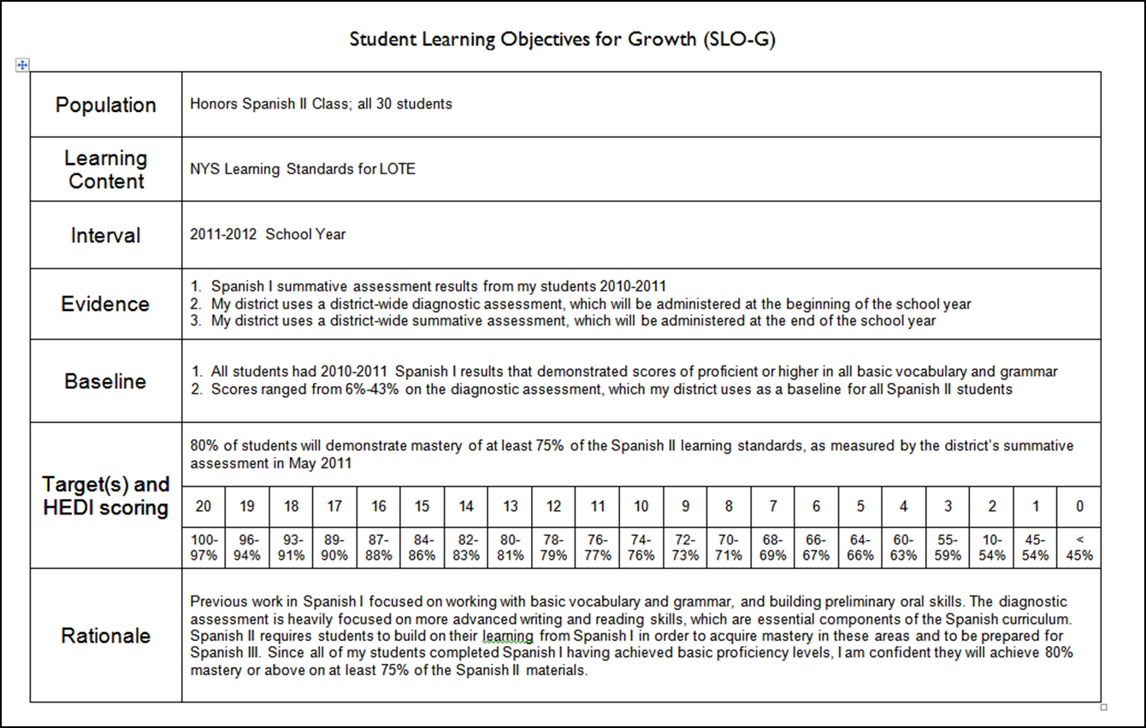
INGREDIENTS

Slide 8
Definition
A student learning objective is an academic goal for a teacher’s students that is set at the start of a course. It represents the most important learning for the year (or, semester, where applicable). It must be specific and measurable, based on available prior student learning data, and aligned to Common Core, State, or national standards, as well as any other school and district priorities. Teachers’ scores are based upon the degree to which their [targets] were attained.
Notes:
NOTES

Slide 9
Key Points
SLOs name what students need to know and be able to do at the end of the year.
SLOs place student learning at the center of the conversation.
SLOs are a critical part of all great educator’s practice.
SLOs are an opportunity to document the impact educators make with students.
SLOs provide principals with critical information that can be used to manage performance, differentiate and target professional development, and focus supports for teachers.
The SLO process encourages collaboration within school buildings.
School leaders are accountable for ensuring all teachers have SLOs that will support their District and school goals.

Slide 10
State
Determines SLO process
Identifies required elements
Requires use of State test
Provides training to NTs prior to 2012-13.
Provides guidance, webinars & videos
District
District goals & priorities
Match requirements to teachers
Define processes for before & after
Identify expectations
School
LE & teacher collaborate
LE approval
Ensure security
LE monitor & evaluation
Teacher
Works with colleagues & LE
SLOs

Slide 11
SLO Decisions for Districts
Assess and identify priorities and academic needs.
Identify who will have State-provided growth measures and who must have SLOs as “comparable growth measures.”
Determine District rules for how specific SLOs will get set.
Establish expectations for scoring SLOs and for determining teacher ratings for the growth component.
Determine District-wide processes for setting, reviewing, and assessing SLOs in schools.

Slide 12
SLOs in §3012-d

Slide 13
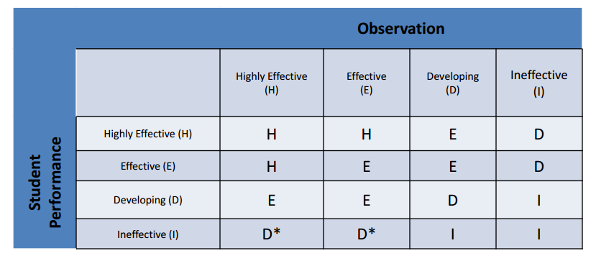
The Matrix
Scores from rubrics have to be converted to H-E-D-I levels for the matrix.
Notes:
* If the state-provided score is ineffective and an additional growth component is included and also ineffective the teacher can be rated no higher than ineffective.

Slide 14
NO State-provided Growth Score; Use Student Learning Objectives
State-provided Growth Score

Slide 15
Student Performance Half
SLO process:
Must use a state-approved student assessment.
Consistent across district.
Will have the same parts.
Develop a back-up SLO for all teachers whose courses end in a State created or administered test for which there is a State-provided growth model.

Slide 16
Student Performance Half
An additional/optional growth measure can be locally negotiated, consistent across district:
A teacher-specific score based on a particular level of the state test,
School-wide growth score linked to state-provided school score,
School-wide, group, or team growth score that is locally computed, or
A growth score based on a state designed approved assessment (SLO/LAT).

Slide 17
Student Performance Half
State-provided growth scores when at least 50% of teacher’s students are covered, or
SLOs that are consistent with the state’s goal setting process. These will be based on one year’s worth of growth on an approved assessment, or
School-wide, team, or linked results.

Slide 18
Assessment Approval
There will be two lists:
Approved List of Assessments to be used with SLOs
Approved List of Supplemental Assessments to be used with Growth Models
Notes:
* growthiness is a technical term ☺

Slide 19
It’s All About the Target

Slide 20
SLO Target Setting
Group
Banded
Individual

Slide 21
Notes:
Everyone who got a 1-3 had a target of 65, the 4s had a target of 85

Slide 23
 | 2nd Grade EOY | 3rd Grade Pre | +/- mentally | ×/÷- mentally | aply undst | Target (scale) | Actual 3rd Grade NYS | Met Target?
Pineyro, Issa | 50 | 47 | l | l | l | 190
Estevez, Ramon | 52 | 49 | l | l | l | 190
Ramos, Wander | 55 | 52 | l | l | l | 190
Jones, Rachel | 60 | 56 | l | l | l | 190
Baez, Gregory | 65 | 62 | l | l | l | 220
Thomas, Denise | 67 | 63 | l | l | l | 220
Martinez, Estralin | 67 | 63 | l | l | l | 220
Alvarez, Carlos | 69 | 67 | l | l | l | 270
Pena, Lisa | 71 | 68 | l | l | l | 270
Medina, Silvio | 76 | 73 | l | l | l | 270
Williams, Maleek | 84 | 80 | l | l | l | 270
Ronald, Patricia | 84 | 82 | l | l | l | 300
Norris, Frank | 89 | 86 | l | l | l | 300
Ostrum, Elizabeth | 95 | 92 | l | l | l | 300
Smith, Douglas | 95 | 93 | l | l | l | 325
Franklyn, Michelle | 96 | 93 | l | l | l | 325
Thompson, Stephen | 97 | 94 | l | l | l | 325
North, Laura | 90 | 100 | l | l | l | 345
Martinez, Pedro | 100 | 100 | l | l | l | 345
average | 76.95 | 74.74 | 18 | 13 | 12 |  | 262.89 | 68%

Slide 24
 | 2nd Grade EOY | 3rd Grade Pre | +/- mentally | ×/÷- mentally | aply undst | Target (scale) | Actual 3rd Grade NYS | Met Target?
Pineyro, Issa | 50 | 47 | l | l | l | 190 | 210 | Y
Estevez, Ramon | 52 | 49 | l | l | l | 190 | 180 | N
Ramos, Wander | 55 | 52 | l | l | l | 190 | 180 | N
Jones, Rachel | 60 | 56 | l | l | l | 190 | 210 | Y
Baez, Gregory | 65 | 62 | l | l | l | 220 | 210 | N
Thomas, Denise | 67 | 63 | l | l | l | 220 | 225 | Y
Martinez, Estralin | 67 | 63 | l | l | l | 220 | 210 | N
Alvarez, Carlos | 69 | 67 | l | l | l | 270 | 275 | Y
Pena, Lisa | 71 | 68 | l | l | l | 270 | 210 | N
Medina, Silvio | 76 | 73 | l | l | l | 270 | 275 | Y
Williams, Maleek | 84 | 80 | l | l | l | 270 | 275 | Y
Ronald, Patricia | 84 | 82 | l | l | l | 300 | 305 | Y
Norris, Frank | 89 | 86 | l | l | l | 300 | 305 | Y
Ostrum, Elizabeth | 95 | 92 | l | l | l | 300 | 305 | Y
Smith, Douglas | 95 | 93 | l | l | l | 325 | 340 | Y
Franklyn, Michelle | 96 | 93 | l | l | l | 325 | 340 | Y
Thompson, Stephen | 97 | 94 | l | l | l | 325 | 340 | Y
North, Laura | 90 | 100 | l | l | l | 345 | 340 | N
Martinez, Pedro | 100 | 100 | l | l | l | 345 | 260 | Y
average | 76.95 | 74.74 | 18 | 13 | 12 |  | 262.89 | 68%

Slide 27
A Year’s Worth of Growth
Vertical and horizontal discussions and agreements help with this
Eliminates teacher by teacher variation
Reflects collaboration
Should be connected to essential learning
Assists/educates the Lead Evaluator

Slide 28
Questions?

