Slide 1
Day 3: Steps for Your Library Program to Survive and Thrive
Allison Zmuda
zmuda@competentclassroom.com

Slide 2
MISSION

Slide 3
Mission, reviewed
Describes specific, long-term goals for learners
Goes beyond specified knowledge and skills to address larger aims of schooling
Provides enough specificity to be addressed through curriculum, assessment and instructional design
Key stakeholders are willing to commit to the scope of the mission statement

Slide 4
Source of authority and collaboration
Mission drives the work of the school when it creates strong internal accountability for student learning.
Staff believe they are responsible for student performance.
Staff collaborate with one another to analyze student work as well as each other’s instructional practice.
Staff learn new knowledge and skills based on what the students need and what the mission requires.

Slide 5
Proposed Newport News Secondary Library Mission
The mission of the media center is to develop the curiosity, creativity, and knowledge base of our students so they collaboratively build learning networks to analyze works of others and create and communicate works of their own. To that end, students will become effective, ethical, and discriminating users of information and technology.
Essential Question: What do I need to know? How do I find it? What do I do with it?
Essential Question: What do I wonder about? How do I pursue it? How do I share it?

Slide 6
Information Literacy Mission Statement from Carrollton-Farmers Branch, TX
As An Innovative Leader in Learning, the Carrollton-Farmers Branch ISD prepares all students to be competitive in a global market. This undertaking requires robust information literacy, problem solving, critical thinking and collaboration skills in order to tackle authentic and complex tasks. The results of engagement in such significant tasks is that students are able to pursue curiosities, investigate the possibilities and effectively communicate their ideas, aspirations and evidence for themselves and their communities.

Slide 7
Review your mission statement now
Is it succinct?
Is it memorable?
Is it measurable?
Does it give you the leverage you need to make substantive change? (Or to defend the changes you have made…)

Slide 8
MISSION
HERE

Slide 9
Vision and guiding principles
Look to the learning commons for your right answer
Go through each component….
Yes or no?
If yes, describe it.

Slide 10
Articulating the vision
Provides detail and inspiration
Represents what we would be if the reforms were successful
(Where we are headed soon…) Enables a vision-reality gap analysis to identify key goals and related actions
Notes:
Clearly contribute to improving student learning achievements.
Reflect established principles of learning
Respond to needs based on credible achievement data.
Be assessable.
Call for highest leverage actions.

Slide 11
Focus on student achievement
Create and model tasks that both motivate and measure student performance
Must be standards-based (AASL standards, NY State Learning Standards, Common Core)
Must be efficient with options for extension
Must be engaging
Must be in alignment with one or more of the learning components vision

Slide 12
Where do projects come from?
“So, where do projects come from? My answer is this: they are born in the places we love to visit, the things we love to see, the tasks we love to lose ourselves in. They are the things we find exciting. They are the things we deem worthy of writing essays and graphing charts about. They come from teachers who fall in love with something and decide to share that something with their students.”

Slide 13
Bounded freedom
While project-based learning and activities that go beyond school can be liberating for staff and students, it is important that activities incorporate a sense of bounded freedom—that students are given a clear set of guidelines, procedures or protocols within which they can make choices. As one Year 9 student put it: “I’d like to have a little bit more of a say, but...I think you need the teacher there to sort of guide you.”

Slide 14
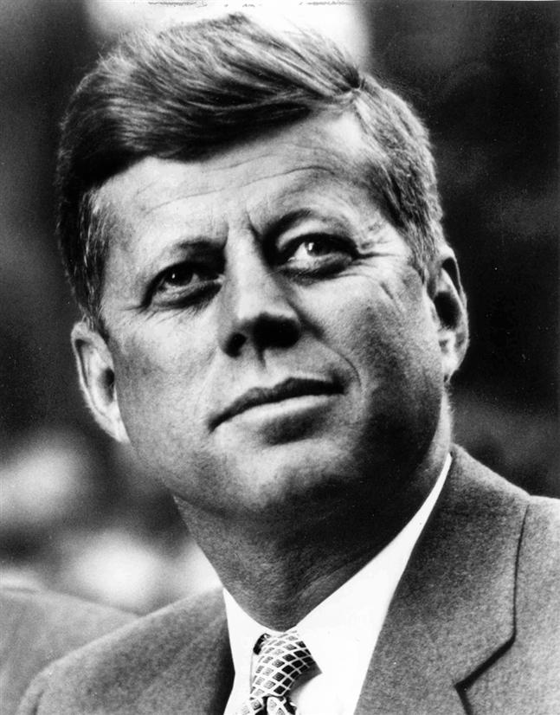
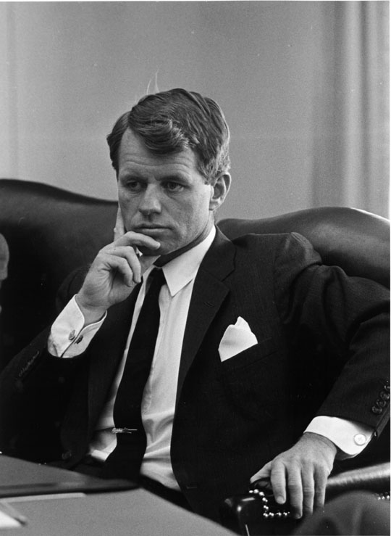
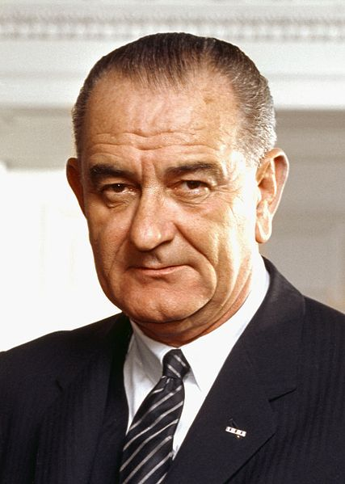
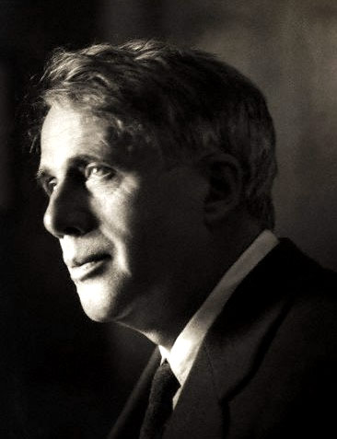
facebook
Wall
Photos
Flair
Boxes
John F. Kennedy
Logout
John F. Kennedy is preparing to sign the Nuclear Test Ban Treaty
Wall
Info
Photos
Boxes
Write something…
Share
View photos of JFK (5)
Send JFK a message
John F. Kennedy is preparing to sign the Nuclear Test Ban Treaty
October 7, 1963
Poke message
Bobby Kennedy to John F. Kennedy Have you finalized your plans for the Texas trip?
October 1, 1963
Information
Networks:
Washington D.C.
Birthday:
May 29, 1917
Political:
Democrat
Religion:
Catholic
Hometown:
Brookline, Mass.
John F. Kennedy I can’t believe I had to actually send the National Guard to Alabama just so some kids could go to college!
June 11, 1963
John F. Kennedy is so glad we avoided war with the Russians! That Crisis in Cuba had my blood boiling!
October 28, 1962
Friends
John F. Kennedy hopes everyone realizes how serious I am about putting a man on the moon!!!
September 9, 1962
LBJ
Frank
Marilyn
John F. Kennedy wishes the Bay of Pigs invasion had gone better! I think Castro is going to be a major thorn in the side of the U.S.
April 17, 1961
Bobby
Jackie
Robert

Slide 15
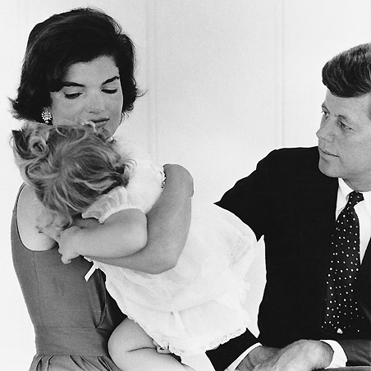
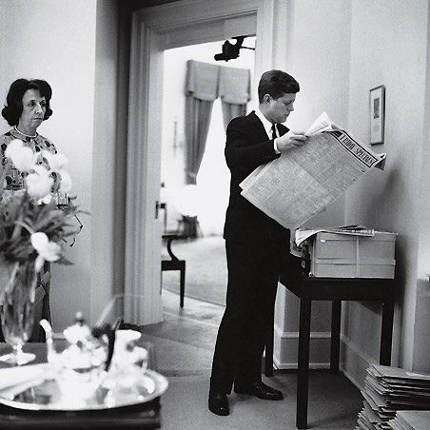
facebook
Wall
Photos
Flair
Boxes
John F. Kennedy
Logout
John F. Kennedy is preparing to sign the Nuclear Test Ban Treaty
Wall
Info
Photos
Boxes
Basic Information
Networks: Washington D.C.
Sex: Male
Birthday: May 29, 1917
Hometown: Brookline, Massachusetts
Relationship Status: Married to Jacqueline Kennedy
Political Views: Democrat
Religious Views: Catholic
View photos of JFK (5)
Send JFK a message
Poke message
Personal Information
Information
Activities: Commanding the Army, making peace with the Soviet Union, promoting civil rights,
Interests: Sailing, Football, Summers in Hyannis, Space Exploration
Favorite Music: Frank Sinatra, Dean Martin, Sammy Davis, Jr.
Favorite Movies: Some Like it Hot, Gentleman Prefer Blondes, Ocean’s Eleven, Guys and Dolls
Favorite TV Shows: The Ed Sullivan Show, The Frank Sinatra Show, To Tell the Truth
Favorite Books: The Road Not Taken, From Russia With Love, Marlborough, Decline and Fall of the Roman Empire
Networks:
Washington D.C.
Birthday:
May 29, 1917
Political:
Democrat
Religion:
Catholic
Hometown:
Brookline, Mass.
Photos
Contact Information
2 Albums
Address: 1600 Pennsylvania Avenue NW, Washington, DC 20500
Phone Number: (202) 456-1111
The Family
Updated last Tuesday
White House
Updated two months ago

Slide 16
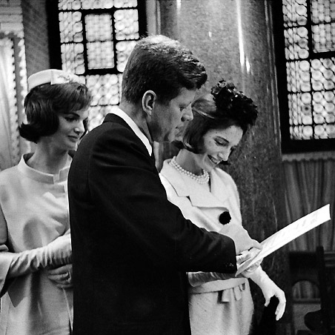
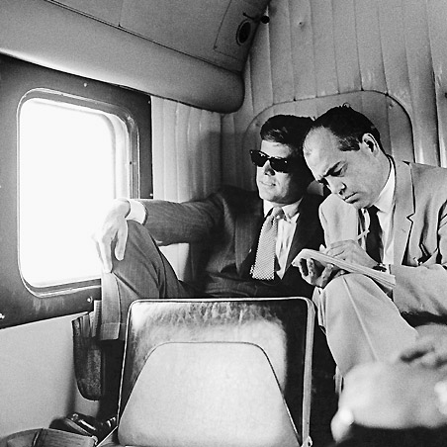
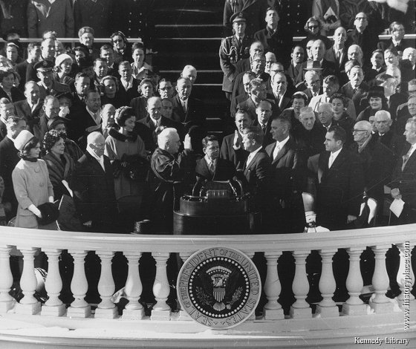
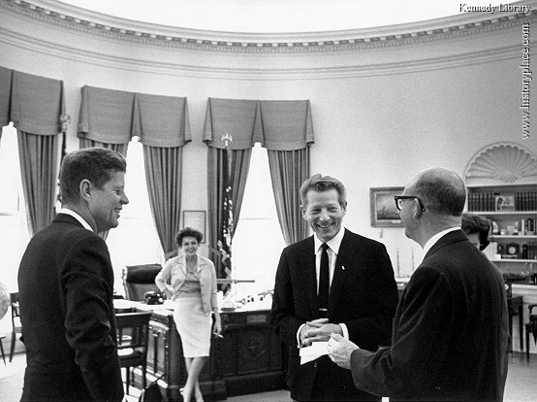
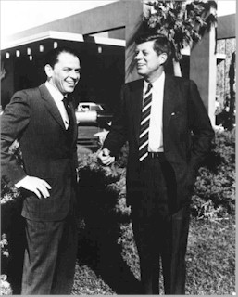
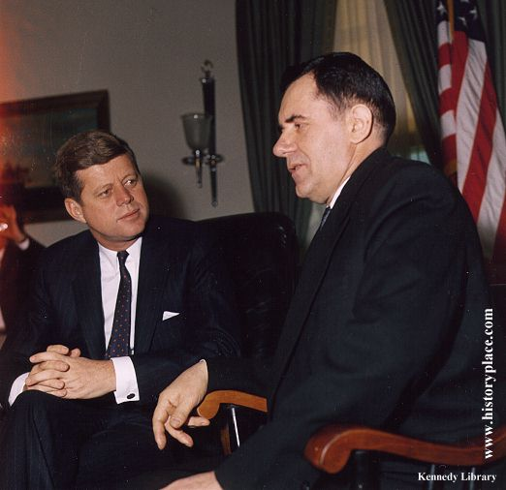
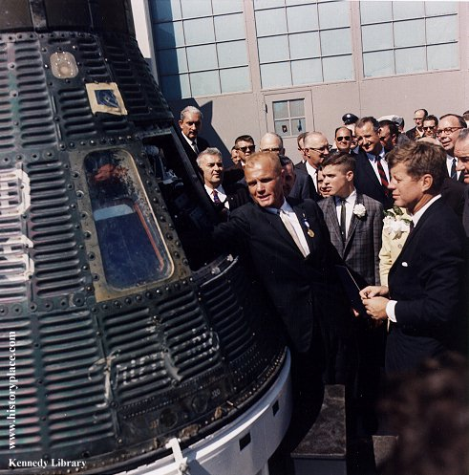
facebook
Wall
Photos
Flair
Boxes
John F. Kennedy
Logout
John F. Kennedy is preparing to sign the Nuclear Test Ban Treaty
Wall
Info
Photos
Boxes
Photos of JFK 7 Photos
JFK’s Albums 2 Photo Alums
The Family
5 photos
The White House
5 photos
Profile Pictures
1 photo

Slide 17
Physics Task
Choose a three- to five-minute clip from a movie or cartoon. Look for examples of correct physics or scenes where the laws of physics are violated. Make measurements and use physics equations to demonstrate why the scenes in the segment are not physically possible. You will be presenting to a panel of students, faculty members and scientists from the community.

Slide 18
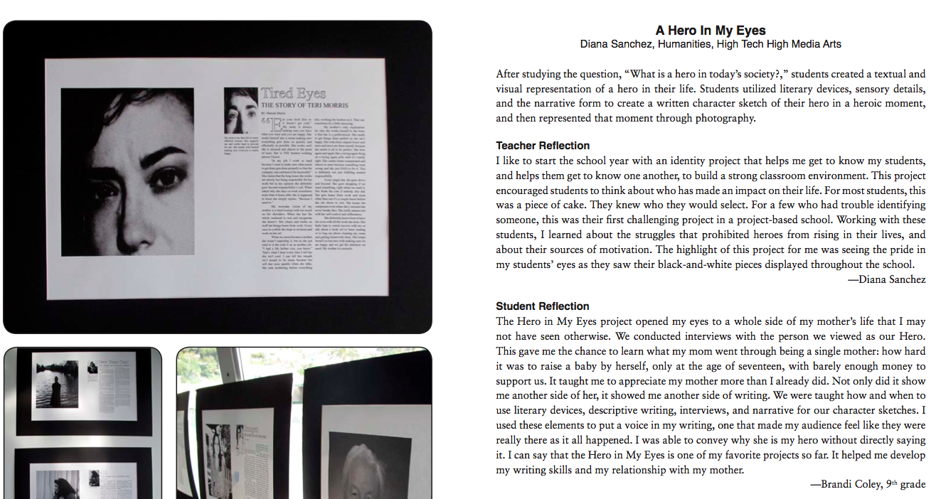

Slide 19
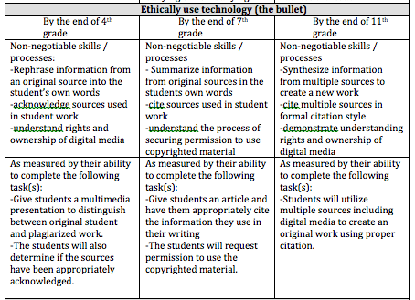

Slide 20
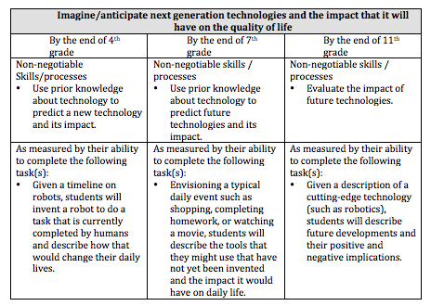

Slide 21
MISSION
HERE

Slide 22
Establish credible evidence/indicators of success.
What would we see if we achieved our mission? What will the educators, parents, community members, and students say and do if they are “living” the school’s mission and vision on a daily basis?
What are the indicators that our vision is becoming realized? What data will we need to collect and act on in a regular and timely way?
How will we judge our progress along the way?
How will we collect the needed data in the most effective and least intrusive ways?

Slide 23
MISSION
HERE

Slide 24
Assess the (inevitable) gap.
Where are we now (our current reality, both in terms of levels of student achievement – student data – and in the status of curriculum, assessment, and instruction – adult data) compared to where we want to be (our vision)?
What gaps should have priority, given the vision and the reality?

Slide 25
MISSION
HERE

Slide 26
Plan actions to narrow and close the gap, and act on the plan.
What concrete goals and plans (designed “backward” from desired results) will enable us to realize our vision most effectively?
What “best practices” in curriculum, assessment, and instruction are most likely to enable us to meet our goals, based on the root cause analysis we have conducted?
What specific actions will be required to implement the identified best practices?
What sequence of actions will maximize our progress?
Who will be responsible for what actions?
Within what timelines will actions occur?
What resources will be needed?
How will we build the capacity of the staff to implement the actions effectively?
What factors within the school and community will support our efforts? What resistors must be addressed?
What ongoing feedback will be needed to help us stay focused on our goals?

Slide 27
Analyze results and act on feedback.
How are we doing – ... against the Iowa core? ... compared to our vision?
What adjustments in our strategies are necessary? Where must we rethink our plan?
Who is now ready to take on a bigger role in the reform effort?

Slide 28
Plan to adjust
What approaches can we use to ensure implementation of strategic plan?
What practical tools can we use to track status of the implementation?
Who will monitor the status?

Slide 29
Articulate the vision and guiding principles.
What is our mission? In brief, what are we in business to accomplish?
What is our shared vision of success at this mission? What do we want our school to “look like” and “sound like” in the future?
What principles, values, and beliefs justify and serve as a basis of our vision and mission?

Slide 30
Develop action plans
What needs to be done?
What must be accomplished in light of the strategic issues or goals
How will that be done?
Who is responsible to achieve each objective
Time parameters
Necessary resources
How action plan will be monitored
Performance target

Slide 31
SLMPE Rubric
Instructional Design | O, EX, TH, EV
Information Literacy | O, EX,TH, EV, NU
Reading | NL,C, O,TH, NU
Assess for Learning | E, O
Teaching for Diverse Learning Needs | NL,C, CE
Inquiry Learning | NL, C, E, O, EX, TH, EV, NU
Social Learning | NL,C, EX,TH, NU
Social Responsibility | NL, C, O, EX,TH, EV,

Slide 32
AASL Standards
1. Inquiry | NL, O, C, EX,TH, EV
2. Draw conclusions | O, TH, CE, NU
3. Share knowledge | NL, O, CE, NU
4. Pursue growth | NL, C, O, EX,TH, EV, CE

