Slide 1
December Make-Up Session
Leading
the
Learning

Slide 2
Debriefing the Homework
Leading
the
Learning

Slide 3
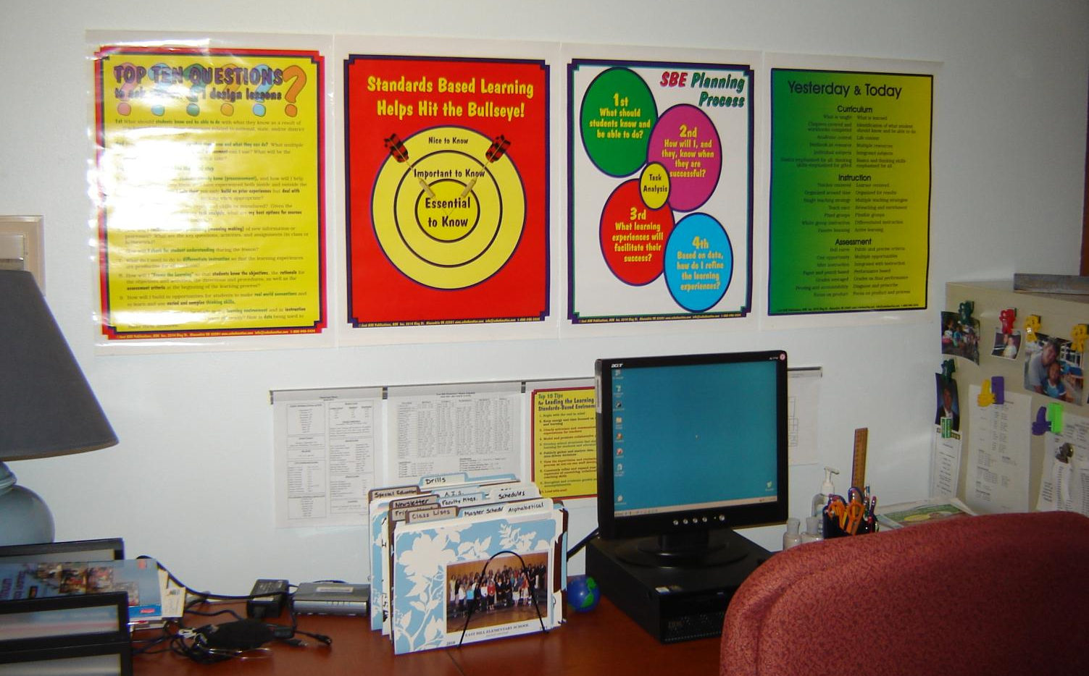
Homework Assignment Example

Slide 4
Reviewing Chapter 2
Leading
the
Learning

Slide 5
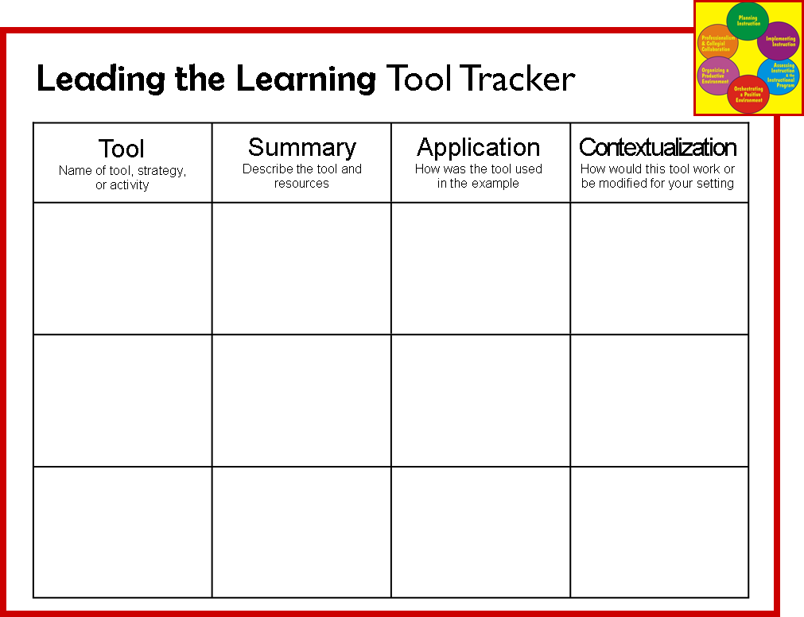
Tool Tracker

Slide 6
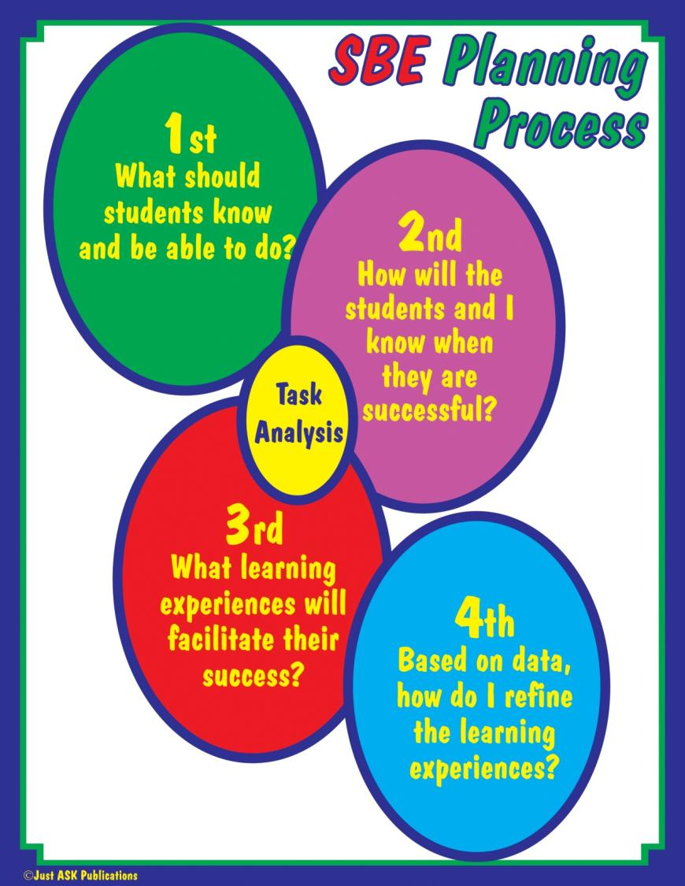

Slide 7
Tool Tracker

Slide 8
Leading the Learning
Reproducible Tool # 32

Slide 9
Leading the Learning
Reproducible Tool # 33

Slide 10
Leading the Learning
Reproducible Tool # 34

Slide 11
Leading the Learning
Reproducible Tool # 35

Slide 12
Leading the Learning
Reproducible Tool # 36

Slide 13
Leading the Learning
Reproducible Tool # 37

Slide 14
Leading the Learning
Reproducible Tool # 38

Slide 15
Leading the Learning
Reproducible Tool # 39

Slide 16
Tool Tracker

Slide 17
Old Faithfuls
Leading
the
Learning

Slide 18
Class Discussion

Slide 19
Old Faithfuls: Demonstrations Lectures Discussions Printed Text AV Sources Guest Speakers

Slide 20
DIRECTIONS: Create a poster that advertises your “old faithful.”

Slide 21
R: role A: audience F: format T: time or topic
RAFT (p. 63, I4All)

Slide 22
R: teacher(team) in your school A: rest of staff in your school F: color poster T: upgrading the old faithfuls

Slide 23
Old Faithfuls: Demonstrations (p. 63) Lectures (p.65-72) Discussions (p. 73-77) Printed Text (p. 70-80) AV Sources (p. 81-82) Guest Speakers

Slide 24
Tool Tracker

Slide 25
Homework Assignment
Leading
the
Learning

Slide 26
Gather data about use of “old faithfuls” in your school.
Try to tweak your use of “old faithfuls” in your practice.
Bring a one-page reflection for Brenda.

Slide 27
Homework Assignment Example

Slide 28
Homework Assignment Example

Slide 29
Homework Assignment
Leading
the
Learning

