Slide 1
Getting Aquainted
Instruction
for All
Students

Slide 5
Getting Aquainted
Instruction
for All
Students

Slide 6
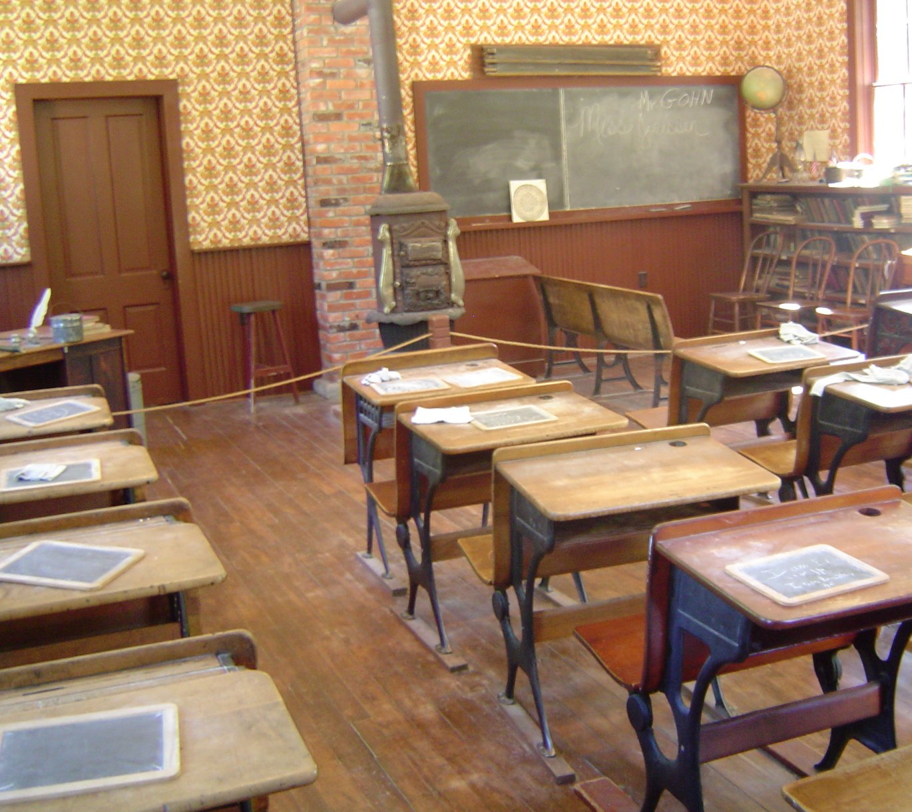

Slide 7
There is nothing new in this book.
DISCLAIMER

Slide 8
Take the tools we already use.

Slide 9
Have them organized and ready when we need them.

Slide 10
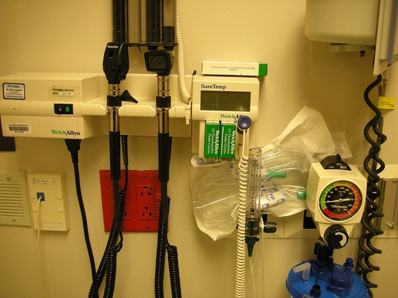
Modernize them a little bit.

Slide 11
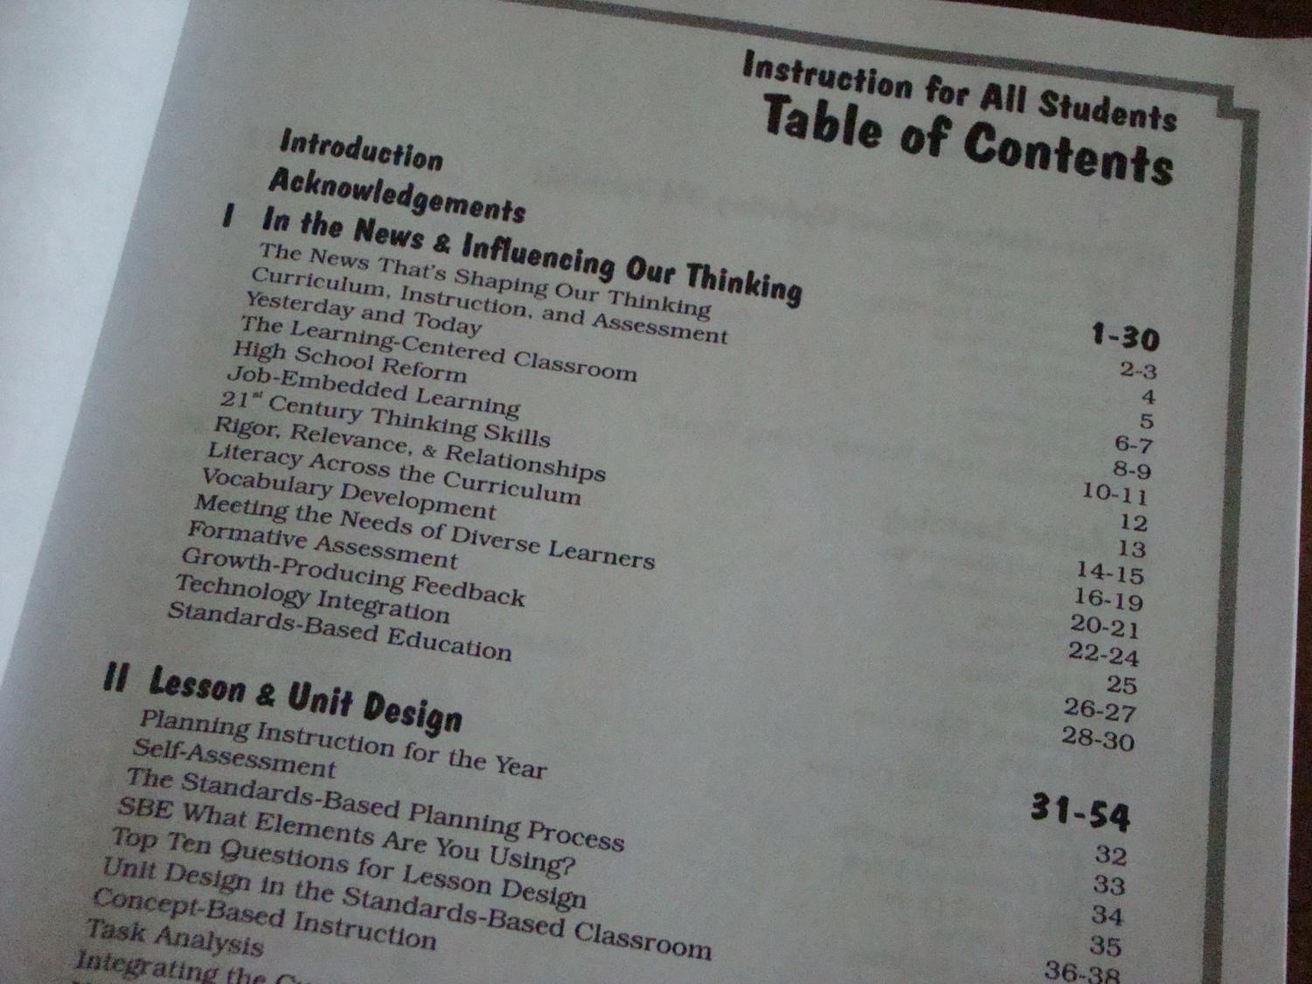

Slide 12
Lesson Planning

Slide 13
Unit Planning

Slide 14
Presentation Modes

Slide 15
Active Learning

Slide 16
Assignments

Slide 17
Assessment

Slide 18
Differentiation

Slide 19
Questioning

Slide 20
Learning Environment

Slide 21
Collaboration

Slide 22
Take the tools we already use.

Slide 23
Have them organized and ready when we need them.

Slide 24
Modernize them a little bit.

Slide 25
Where We’ve Been Where We’re Going
Instruction
for All
Students

Slide 26
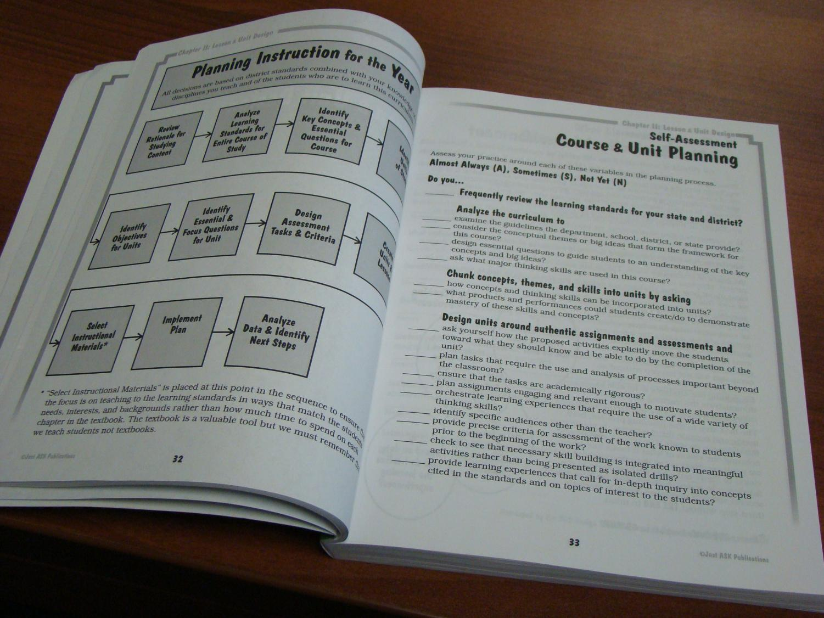

Slide 29
Unit
Planning
Look through the chapter
Write 10 word summary
Choose 2 pages to flag

Slide 31
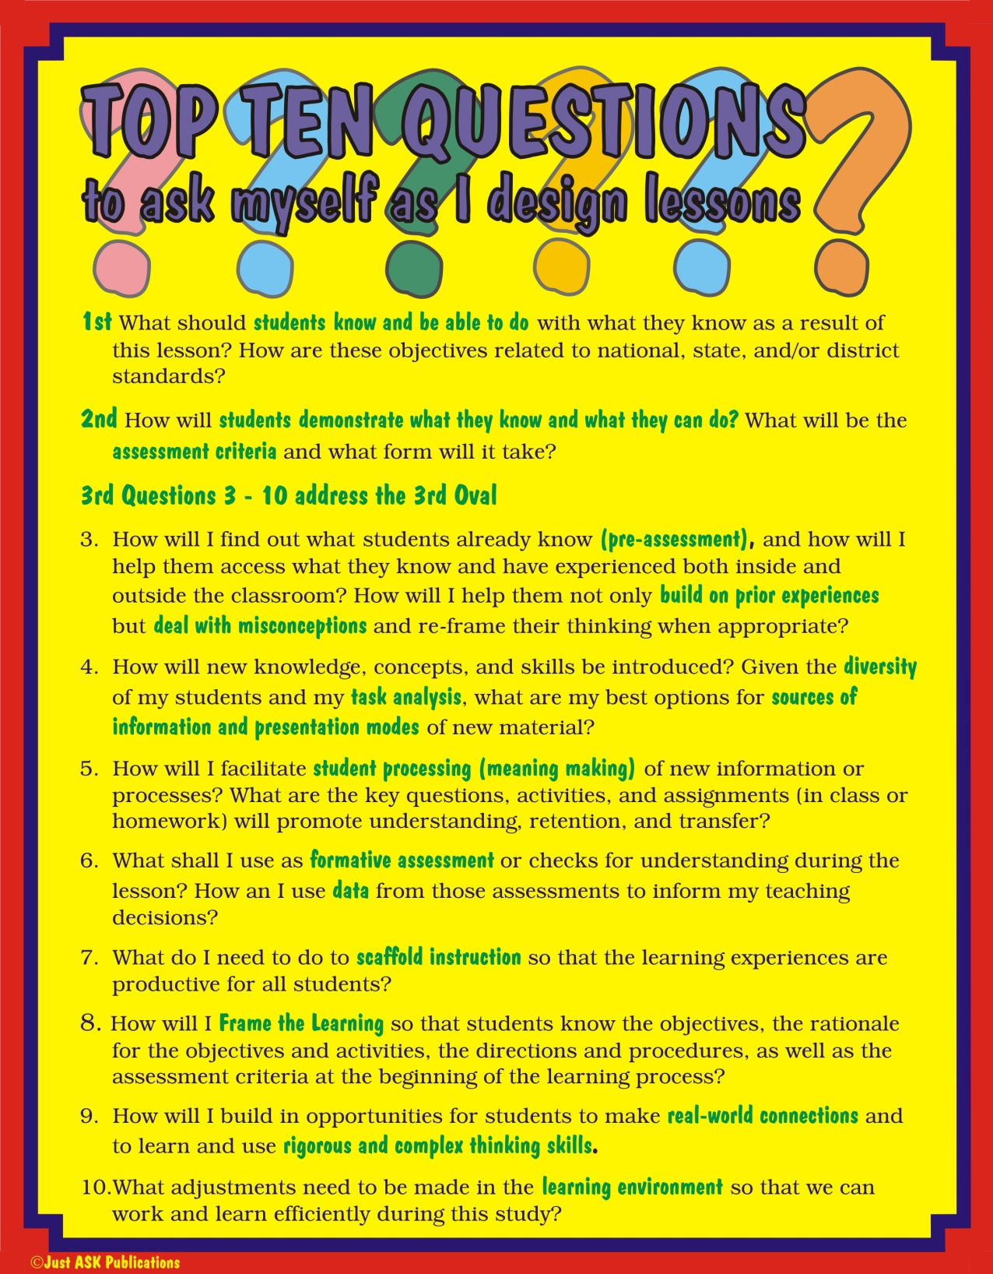

Slide 32
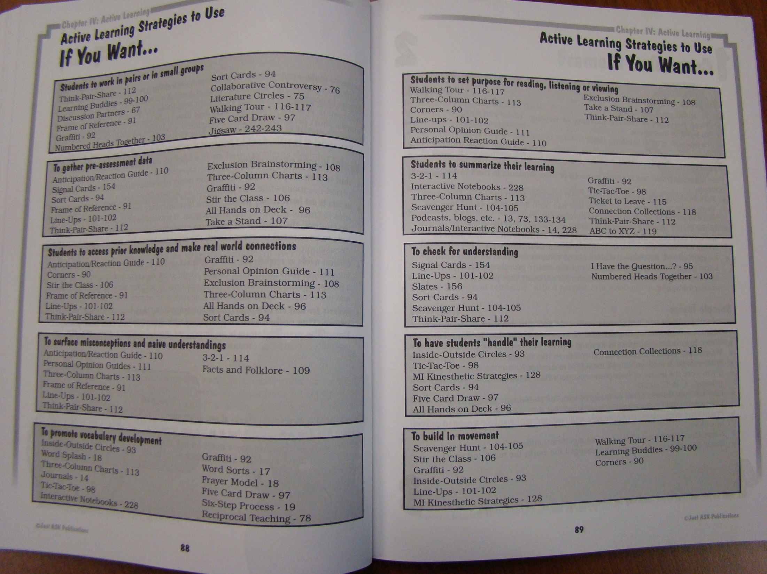
What can I use MONDAY?
Pages 88 & 89

Slide 33
Getting Aquainted
Instruction
for All
Students

