Slide 1
New York State Assessment Update
October/November 2013

Slide 2
“Required” Tests
Federal
State
3-8 ELA
3-8 Math
Science 4, 8, one in HS
HS ELA
HS math
ELL assessments
Special Ed (for 1% NYSAA)
Global Regents
US History Regents

Slide 3
“Optional” Tests
Pre-3012(c)
Post-3012(c)
Regents in math
Regents in science
SLOs
LATs

Slide 4
8th Grade Problem
Regents gave SED approval to apply for a waiver to USDOE
Allow Algebra proficient score to serve as 8th grade proficient score
Would require a different math score in HS

Slide 5
NYSAA is Changing
The NYSAA is changing to be Common Core-aligned, too.
This chart compares the old format to the new
SED has a page with all of the support materials
This detailed presentation goes through all aspects of the new format.

Slide 6
ELL Screening
LAB-R is being replaced by the NYSITELL
Piloting now
Start in February
Optional scan or hand score this year
Scores are reported to state

Slide 7
Common Core-aligned Regents
The Common Core ELA Regents Exam (Grade 11) is required for those students first entering grade 9 in 2013-14 or later
The Common Core Algebra I Regents Exam is required for those students first beginning commencement-level math in 2013-14 or later
For the first year, students enrolled in Common Core classes may take the old ELA or math exam in addition to the new exam and have the higher score count

Slide 8
example

Slide 9
Algebra 1
What to do?
Mixed messages if taking both
Aspirational levels?
Accountability levels?
Graduation levels?
Hold harmless provisions for students considered at November Regents meeting

Slide 10
Common Core Regents Exams
Resources have just been posted:
ELA 11 resources
A1 resources
The transition memo (the September update)

Slide 11
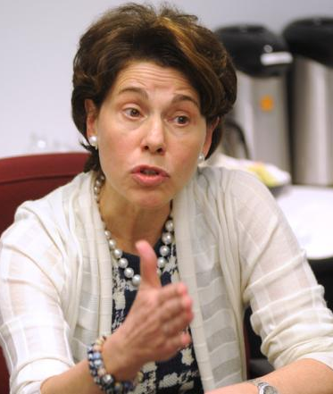
PARCC
No PARCC in 2014-2015
Continue to prepare for computer-based testing
Field testing continues
Final decision???
“Let them play in someone else’s kitchen”

