Slide 1

Curriculum and Instruction Council
April, 2012

Slide 2
Welcome and Introductions

Slide 3
State Ed Update

Slide 4
Dignity Act
Requirements still look like:
Revised VADIR reporting
Trained point person for each building
Annual education requirements for teachers and students
Revisions to Codes of Conduct

Slide 5
Dignity Act
Support for schools available from Youth Development (inside of School Improvement); $850/building ($1050 non-components)
“Advance” training on May 21st
No “takers” – what did we do wrong?

Slide 6
Standards
The Next Generation Science Standards are due out in draft form this spring and are scheduled to be finalized by next winter.
Common Core-aligned Social Studies Standards should be released this spring ??? Trying to get info…

Slide 7
Other Updates
x

Slide 8
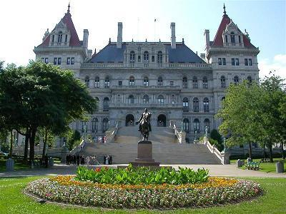


Legislative Updates

Slide 9
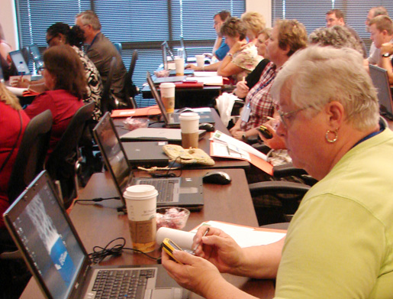
IT&D

Slide 10
CI&A
Planning Survey: Please share and complete by May 25
Summer schedule is posted on MLP-registration is open through June 15

Slide 11
 | BOCES Network Team Districts | Non-Network Team Districts
CI&A Workshops | Unlimited; no balance kept | Unlimited; no balance kept
CI&A Onsite Days | 1, 2, or 3 days depending on district size (unscheduled days released in February) | 1, 2, or 3 days depending on district size
Network Team Workshops & Large-Group Meetings | Unlimited | Unlimited
3-8 & Regents Regional Scoring | Included at hub locations | Included at hub locations
School Improvement Projects | No change, can be run either as a share or follow up (within 18 months of original event) | No change, can be run either as a share or follow up (within 18 months of original event)
NYS Reform Agenda District-Specific Planning and Technical Assistance | Unlimited | Billed per diem
Network Team Onsite Support | Up to 5 days (unscheduled days released in February) | Billed per diem
Lead Evaluator Training | Unlimited | Billed per participant
Principal Evaluator Training | Unlimited | Billed per Participant
Large-scale Regional Events (Solution Tree, Math Solutions, etc.) | Continued subsidization for free seats | Seats at cost (run through School Improvement)
Next Year

Slide 12

Teacher Centers

Slide 13
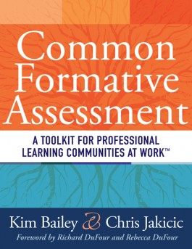
Solution Tree Common Assessment Institute
June 25th & 26th
Rodax 8
At 92/100!!!
Teachers and leaders
w/ CNY Teacher Center
BOTH AUTHORS!

Slide 14
SLO Example &
Bank Development
Examples are coming in
Will be posted at State 20% in APPR microsite as well as at CNYTC site
SLO training cadre being developed

Slide 15
PBL Cohort
Tentatively Scheduled for last week in June (27&28)
Joint project of CNYTC, Cortland & Cincy centers
No cost (including books) other than expenses involved with teacher attendance
Will connect with CI&A cohort in the fall

Slide 16
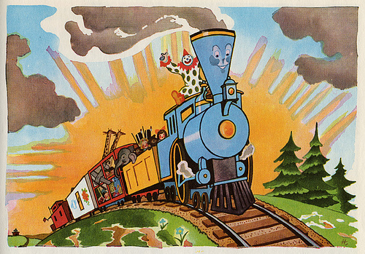
I think I can
I think I can…
Race To The Top

Slide 17
Math Solutions
K-8 teachers of math
K-2, 3-5, 6-8 bands (two groups each)
3 days; $625
Use NT funds for institute
August 8, 9, 10 (Rodax/Henry)
NT slots released June 1st if not spoken for

Slide 18
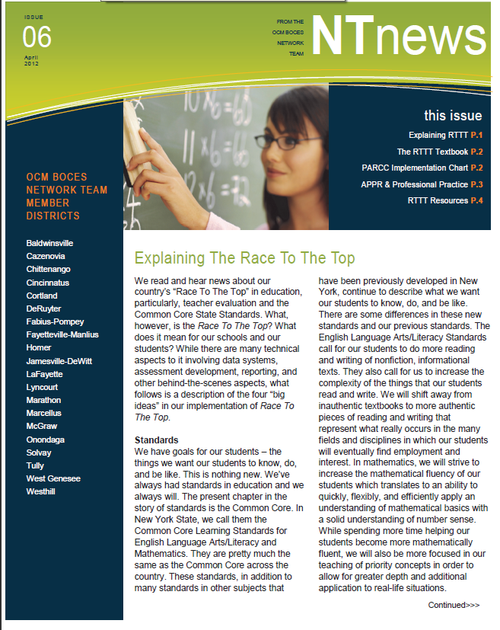
NT News
Special Overview Edition
Will provide you with copies – just tell us how many
Use sign-up sheet
(circulating)

Slide 19
Regional Assessment Development ???
Do it like we did LOTE from across BOCES with whoever wants to collaborate?
Support geographic clusters of districts that want to work together?
Provide assessment development training and if districts wanted to come for training and work on their own they could?
Do nothing together? Something else?

Slide 20
RTTT Planning
This is year 2 of 4.
Are you ”mapped” out?
Deliverables and expectations?
Surveys end of this year to collect implementation data (teacher, principal, superintendent, and NT/NTE leader level)
Site visits from SED starting next year
Common planning time for all teachers in schedules?
PD days and half-days?

Slide 21
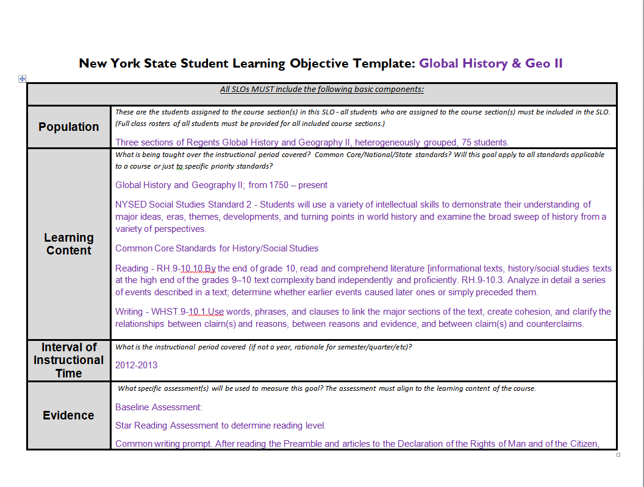
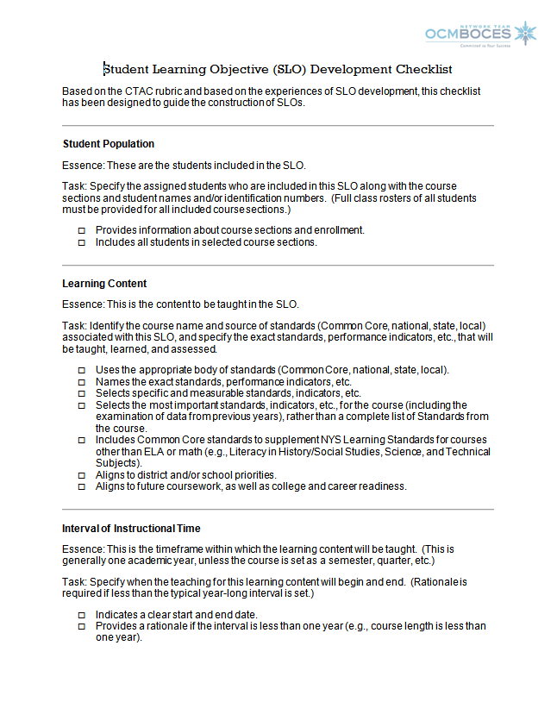
SLO Updates
SED has new template
Resources at State 20% on APPR microsite

Slide 22
SLO Updates
SED has new template
Resources at State 20% on APPR microsite

Slide 23
APPR Dates…
One Lead Evaluator Training Cohort (10 days) how many do you have?
Ongoing Lead Evaluator ≈ 4 ½ days?
No new Principal Evaluator Training Cohort
Ongoing Principal Evaluator ≈ 4 ½ days?
What else?

Slide 24
APPR Bands
Review your model carefully
Effective + Effective + Effective = Developing problem

Slide 25
3-8 Scoring
Ready to go?
Last minute issues?
Think about: What if we have to really have to randomize papers next year – how would we do that (and undo it) in the given window?
Think about: What if we had to regionally score Regents exams?

Slide 26
Curriculum and Instruction Council
Next Meeting: May 10, 2012

