Slide 1
Curriculum and Instruction Council
February, 2012

Slide 2
Welcome and Introductions

Slide 3
The 30 day clock is ticking… can you say 50/50?
State Ed Update

Slide 4
Dignity Act
Expect little to change as a result of the comment period
Now hearing that some of the directions and expectations won’t be communicated until regional meetings in May

Slide 5
Dignity Act
Requirements still look like:
Revised VADIR reporting
Trained point person for each building
Annual education requirements for teachers and students
Revisions to Codes of Conduct

Slide 6
SLOs
At this time:
Work through the Five Decision Points before making too many
Some examples emerging but tend to be traditional and paper/pencil
Resources posted at APPR site on State Growth 20% page

Slide 7
SLOs
Rose-colored advice:
Avoid knee-jerk reaction to just create paper and pencil, state test-like assessments
This is an opportunity to asses what is really important and do it differently than those State tests we complain about so much

Slide 8
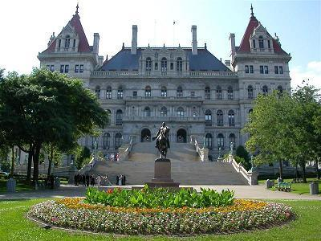
Legislative Updates

Slide 9
Getting Along
NYSUT – NYSED:
Earlier progress toward resolution seems stalled
SED depending on the ‘guv to force NYSUT to move to their opinion rather than risk 50/50???
One more week until 30-day amendments…

Slide 10
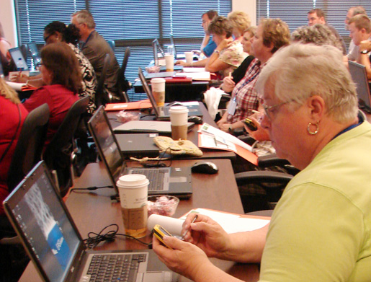
IT&D

Slide 11
CI&A
Upcoming Sessions

Slide 12
PBL
Should we schedule summer sessions?
2 days summer, one day in November
Elementary cohort?
Secondary cohort?

Slide 13
Checkpoint B
Target Language |  | Participating Districts
Chinese | 0
French | 7 | Fayetteville-Manlius, LaFayette, Liverpool, W. Genesee, Westhill, Tully, Baldwinsville
German | 2 | Fayetteville-Manlius, Baldwinsville
Italian | 2 | Solvay
Latin | 2 | Fayetteville-Manlius, Liverpool
Spanish | 15 | Fabius-Pompey, Fayetteville-Manlius, LaFayette, Marathon, N. Syracuse, OCM, Solvay, Sandy Creek, W. Genesee, Westhill, Tully, Baldwinsville, DeRuyter

Slide 14
 | BOCES Network Team Districts | Non-Network Team Districts
CI&A Workshops | Unlimited; no balance kept | Unlimited; no balance kept
CI&A Onsite Days | 1, 2, or 3 days depending on district size (unscheduled days released in February) | 1, 2, or 3 days depending on district size
Network Team Workshops & Large-Group Meetings | Unlimited | Unlimited
3-8 & Regents Regional Scoring | Included at hub locations | Included at hub locations
School Improvement Projects | No change, can be run either as a share or follow up (within 18 months of original event) | No change, can be run either as a share or follow up (within 18 months of original event)
NYS Reform Agenda District-Specific Planning and Technical Assistance | Unlimited | Billed per diem
Network Team Onsite Support | Up to 5 days (unscheduled days released in February) | Billed per diem
Lead Evaluator Training | Unlimited | Billed per participant
Principal Evaluator Training | Unlimited | Billed per Participant
Large-scale Regional Events (Solution Tree, Math Solutions, etc.) | Continued subsidization for free seats | Seats at cost (run through School Improvement)
Next Year

Slide 15
4th Grade NY SS
“Spotlight on NY” e-book collection
21 districts “in”
1 district “out”
Waiting to hear from 1 district
This is likely “enough” to get it!

Slide 16
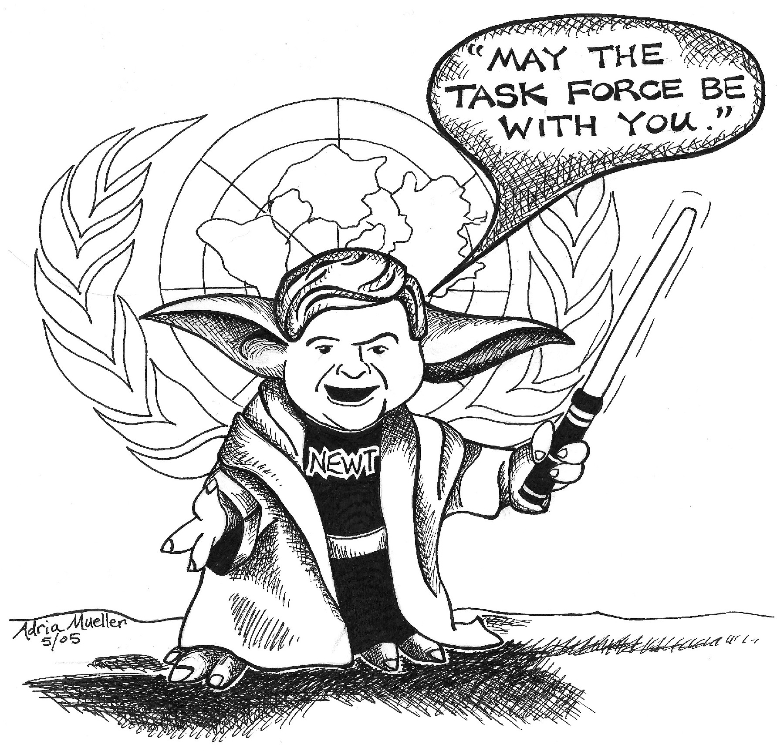
Task Force: SpEd
Meets February 14th
Any advice or comments for them?

Slide 17
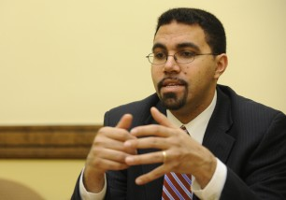
CCLS
DDI
APPR
PLC
Race To The Top

Slide 18
Math Solutions
K-8 teachers of math
K-2, 3-4, 5-6, 78 bands within
80 teachers in bands of 20
3 or 4 days
Use NT funds for institute
2nd week in August? Maybe?

Slide 19
Math Solutions
The question is: Would you be able to get at least four of your teachers to come?
4 x 20 districts = 80 teachers

Slide 20
RTTT Road Map

Slide 21
Regional Scoring
Hub meetings
What questions are popping up?
Next steps?

Slide 22
Curriculum and Instruction Council
Next Meeting: March 8, 2012

