Slide 1
BCIC Meeting
February, 2013

Slide 2
Welcome
Introductions
Overview of Agenda

Slide 3
SED Updates
Assessment
2013-2014 Schedules are out
Waiting for cohort guidance for A1, G and ELA
NYSESLAT info is up

Slide 4
SED Updates
Curriculum
More module posted (report later in agenda)
Draft (for comment) on 9-12 social studies framework is now up

Slide 5
SED Updates
Virtual AP Project
Art History and Statistics
Collecting letters from eligible district that want to participate
Hiring director as a JMT
Will then hire the OCM shepherd (guidance counselor)

Slide 6
ITD

Slide 7
CI&A February- March
Developing Collaborative Groups- Adaptive Schools: Feb 26, 27, April 9, 10
Responsive Classroom Level One: March 13-14, 22 and May 23-24
Instructional Strategies for Students from Poverty: March 18
Visual Arts Educators- Teaching Strategies in Studio Arts: March 22
CCLS ELA: Standards for Literacy in Science and Technical Subjects: March 26

Slide 8
Regional PD Opportunities Summer 2013 from CI&A
Short- Five question survey
Calendar out April (summer only)
Will survey for 2013-14 in April

Slide 9
Teacher Centers
Cortland Educators’ Conference is Saturday, March 16th
Celebration of Excellence is scheduled for March 18th
Another session of Model Building has been added on March 19th

Slide 10
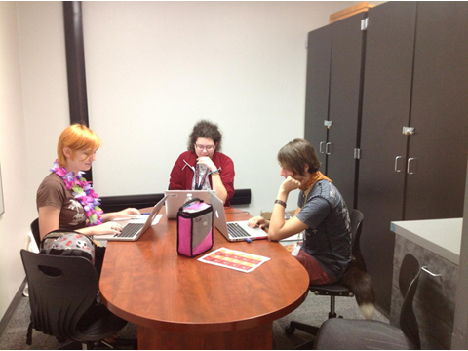
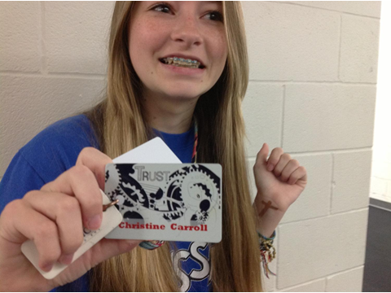
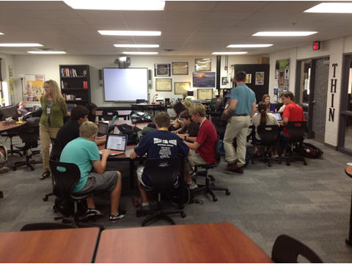
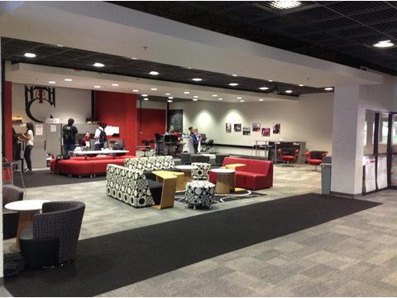
New Tech High
Visiting more schools (MI this time)
Three different possible applications

Slide 11
Overview of New Teacher Certification Exams
Andrea Lachance
Dean of the School of Education
SUNY Cortland

Slide 12
Old vs. New Exams

Slide 14
Four Components of edTPA

Slide 15
Task 1 - Instruction
Lesson plans for 3-5 days with “central focus” in discipline
Context of classroom
Instructional materials
Assessments
Planning Commentary

Slide 16
Task 2 - Instruction
Video clips of instruction
One or two clips maximum
Unedited
No more than 15 minutes total length
Shows interaction with students
Instruction commentary

Slide 17
Task 3 - Assessment
Choose one assessment
Present and analyze data collected on the assessment
Discuss patterns in the data
Provide 3 samples of student work on assessment
One must be a target student’s work
Provide samples of feedback on student work in video or writing
Assessment commentary on student work
Assessment commentary on teaching effectiveness and where to go next

Slide 18
edTPA Submission and Scoring
All artifacts are submitted on-line to Pearson
Fee of $300
Reviewers: 50% from higher ed; 50% from K-12
Reviewers must have expertise in the area being scored; recent experiences in K-12 schools; experience mentoring interns or new teachers.
15 rubrics used to score edTPA – 5 rubrics per task
Criteria for passing not yet determined

Slide 24
Race To The Top
(the Regents Reform Agenda)

Slide 25
PK-12 Math Modules Overview
PK-5
A Story of Units
Curriculum Map available on EngageNY
5-7 Modules planned per grade level – 4 released at this point
Each lesson is 60 minutes
8 Mathematical Practices woven throughout all lessons in modules
6-8
A Story of Ratios
Curriculum Map available on EngageNY
6 or 7 modules planned per grade level – 0 released at this point
8 Mathematical Practices woven throughout all lessons in modules
9-12
A Story of Functions
Curriculum Map available on EngageNY
4 or 5 modules planned per grade level – 0 released at this point
8 Mathematical Practices woven throughout all lessons in modules

Slide 26
PK-12 Math Modules Overview
PK-5
Modules released: K M5, Grade 2 M3, Grade 3 M5, Grade 5 M3
60 minute lesson includes: Fluency Practice, Concept Development, Application Problems, and Student Debrief
Scaffolding for diverse learners, foundational math practices, modeling, and assessments built into scripted lessons
6-8
Expectation: some modules will be released before the fall
Descriptive and Analytical Modeling emphasized
K-12 Progressions Documents: describe the progression of a topic across a number of grade levels; based on research on children’s cognitive development and the logical structure of math
9-12
Expectation: some modules will be released before the fall
Mathematical modeling based on real-world problems emphasized
Appendix A of CCSS has been replaced by the curriculum map and course outlines provided by CCLS on EngageNY
Aligned with new version of PARCC Model Content Framework v 3.0

Slide 27
Resources for Schools & Parents
Free website focused on developing conceptual understanding of math for PK-5 “Teachers of Math” through video and lessons
Site can be used by teachers and parents to help them understand CCSS in Math, by teachers to plan and assign lessons, and by students for remediation
Plans to expand include more math lessons at other grade levels and ELA lessons
Coming to Math Vendor Fair on May 10th

Slide 28
Math
Administrators Session March 1st, AM ½ day, Doubletree Hotel
Math vertical Trace March 6th PM ½ day
Modules Overview March 8th PM ½ day
Modules Overview March 18th PM ½ day (repeat)
A1 support group starts March 7th 1:30p
G support group starts March 14th 1:30p
Vendor Fair May 10th

Slide 29
May 10th Vendor Fair
CK-12
Connected Math
Connecting math concepts
Core-Plus Mathematics Project
Corrective math
Curriculum Associates
Digits
Envision
Everyday Math
Fast Math
Focus Math
Glencoe Algebra 1, Geometry, Algebra 2
Glencoe Math for grades 6-8 + new NY CCLS
Impact Math
Investigations
Marilyn Burns: Math Reads
Math 180
Math and Movement
Math labs
Math Navigator
Math Trailblazers [K-12]
Math Triumphs
Math Triumphs [intervention for below grade level]
My Math [PreK-5]
Number worlds
Singapore Math
Stepping Stones

Slide 30
Some Hard Questions
How do you know what messages and resources your teachers are getting?
Have your teachers worked with the mathematical practices?
Have your 3-8 teachers seen the sample items?
Have you used the math checklist?

Slide 31
PK-12 ELA Modules Overview
PK-2
Core Knowledge Language Arts
Skills Strand
3-8
Content-embedded instruction more evident at 3-5
Emphasis on complex text, evidence-based discussions and writings
9-12
O’Dell Education & Public Consulting Group
Evidence-Based Claims (1 in a series of 4)
Listening & Learning Strand
Expeditionary Learning & O’Dell Education
Progression of skills
Guided Reading Accountable Independent Reading (GRAIR)
6 Modules/3 Units per Module
Emphasis on complex text, evidence-based discussions and writings

Slide 32
PK-12 ELA Modules Key Points
PK-2
Each strand is 1 hour
3-8
Each lesson is one hour
9-12
Intense focus on evidence-based questioning, discussion, & writing
Text accompanies the modules
Guided Reading is on your own
Listening & Language has the most potential
Eliminate Science & SS instruction if adopting the L&L strand
Lessons are strategically built to scaffold learning
One module complete for each grade level
Texts must be located by teacher
Higher level of text reading & writing
Heavy emphasis on non-fiction
Academic vocabulary text-referenced

Slide 33
ELA
ELA vertical Trace March 6th AM ½ day
P-2 Modules Overview March 8th AM ½ day
P-2 Modules Overview March 18th AM ½ day (repeat)
3-5 Modules Overview March 12th AM ½ day
3-5 Modules Overview March 20th AM ½ day (repeat)
6-12 Modules Overview March 12th PM ½ day
6-12 Modules Overview March 20th PM ½ day (repeat)

Slide 34
Expeditionary Learning
Expeditionary Learning (Drivers Village)
June 24-26th, 8:30am - 4:00pm
Teachers, $375
Can run stipends through OCM BOCES
NT subsidy of $100 per NT seat
June 27th, 8:30am - 4:00pm
Grade 3-5 & District Administrators, $125
NT subsidy of $50 per NT seat

Slide 35
Expeditionary Learning
This workshop is designed to help teachers implementing or planning to implement Expeditionary Learning’s ELA modules understand the research behind the modules’ design so that the embedded best practices are used with fidelity. Participants will:
Learn why text complexity matters and how to use close reading practices to support students’ comprehension of complex text. Participants will examine the complexity of the texts in the modules and analyze the embedded scaffolding, including text-dependent questioning, that supports and engages all readers.
Understand the importance of teaching academic vocabulary and how the modules support the development of academic vocabulary.
Analyze the writing “shifts” addressed in the modules and learn how the modules support developing writers.
Participants will be provided with a full set of materials for the first module of the year for their specified grade level. Participants should come prepared with the central texts for Module 1 and a laptop or iPad.

Slide 36
Expeditionary Learning
This workshop is designed for building and district leaders to prepare them to support the implementation of the modules, gather data from module assessments, and provide focused feedback to teachers. Participants will:
Examine case studies of implementation and discuss the pros and cons of various implementation scenarios.
Participate in protocols designed to analyze student work and design intervention/action plans based on findings, as well as make plans to implement such protocols going forward.
Analyze module lessons using their own system’s rubrics, making connections between module lessons and expectations.
Participants will be provided with a full set of materials for the first modules of the year. Participants should come prepared with their districts’ APPR rubrics.

Slide 37
ELA Conversation
In groups, talk about what your thinking (and maybe plans) are for ELA
A quick report to the larger group
Next time we will chat about math plans

Slide 38
The Next Generation Science Standards
OCM BOCES Science Center
Dana Corcoran
dcorcoran@ocmboces.org

Slide 39
NGSS Public Release II/Timeline
Goal: To distribute and receive feedback from interested stakeholders and continue the development process to enable states to prepare for consideration of NGSS
The standards opened for review at 3:00 p.m. EST on January 8, 2013.
The review period ended on January 29, 2013.
The standards and the survey can be accessed at www.nextgenscience.org
Final Release – March of 2013
NYSED will have to decide whether to adopt the NGSS
**Adoption does not mean implementation**

Slide 40
What’s Different About the Next Generation Science Standards?

Slide 41
Conceptual Shifts in the NGSS
K-12 science education should reflect the interconnected nature of science as it is practiced and experienced in the real world.
The Next Generation Science Standards are student performance expectations – NOT curriculum.
The science concepts build coherently from K-12.

Slide 42
Conceptual Shifts in the NGSS
The NGSS focus on deeper understanding of content as well as application of content.
Technology, Math & Engineering are integrated in the NGSS from K–12.
The NGSS and Common Core (ELA/Literacy and Math) are aligned.

Slide 43
Are You Ready?
1 2 3 4 5 6 7 8 9 10

Slide 44
OCM BOCES Science Center
Facilitating regional look at drafts
Has tentative plan to revise curricula and materials of all kits/systems
Implementation schedule will depend on state assessment plan
Leading collaboration among centers across state
Transition to “STEM” Center

Slide 45
Next Steps

Slide 46
Professional Practice (APPR)
SLO Summative Resources
Long-term absence discussion
Crash Course added

Slide 47
Culture
PLCs at Work Summit
What about this date: PLC at Work™ Institute, July 24–26?
What about an Auburn location? Or OCM BOCES for smaller size?
Cost would be approx. $350 for three day version (inclusive)
This is the agenda (so far). How many days?
Nearing decision point. Discussion?

Slide 48
Resources for Schools & Parents
Parent Night Toolkit
Toolkit for Parent Engagement has been released in DRAFT form and is available on EngageNY
Roadmap for Planning a Parent Night
Goal is to help parents understand College & Career Readiness and Common Core Learning Standards
Resources include: planning tools, documents and agendas

Slide 49
Long-term Planning
How’s it going? Can we help?

Slide 50
Assessment

Slide 51
3-8 Scoring
Details to your site coordinator:
Materials
Food if OCM BOCES School Improvement
Number of scorers, facilitators, scoring leaders
Turn-Key Training for Scoring Leaders: March
RIC will print and provide all training materials– Thank you!

Slide 52
Training for Scoring Leaders
March 4: ELA- Henry DLC
March 5: Math- Henry DLC
March 11: ELA-McEvoy
March 13: Math-Cortland Kaufman Center, Cortland City School District
March 27: Reserved for Snow Day reschedule at Henry DLC

Slide 53
January Regents
Four districts participated
Number of exams ranged from 5-25
High resource burden (scorer/exam)-minimum scorers 4-6 needed
Hosting in a high school was helpful: codes, IP address for computers

Slide 54
Exploration of electronic scoring
Met with representative from Strategic Measurement and Evaluation
Level One: Similar to current practices at cost of $7-9/test
Upside is that would need about 30-40% fewer scorers
Downside is that scoring window likely to be shorter--- which could negate the upside!
Level Two: Includes outside scorers at cost of $11-13/test

Slide 55
Next BCIC Meeting
March 21, 2013
Distance Learning Center

