Slide 1

Curriculum and Instruction Council
Joint meeting with Special Education Council!
October, 2011

Slide 2
Welcome and Introductions

Slide 3

Framing
the issue

Slide 5
6 districts

Slide 6
2
districts

Slide 7
4 districts

Slide 8
15 districts
on a “list”

Slide 9
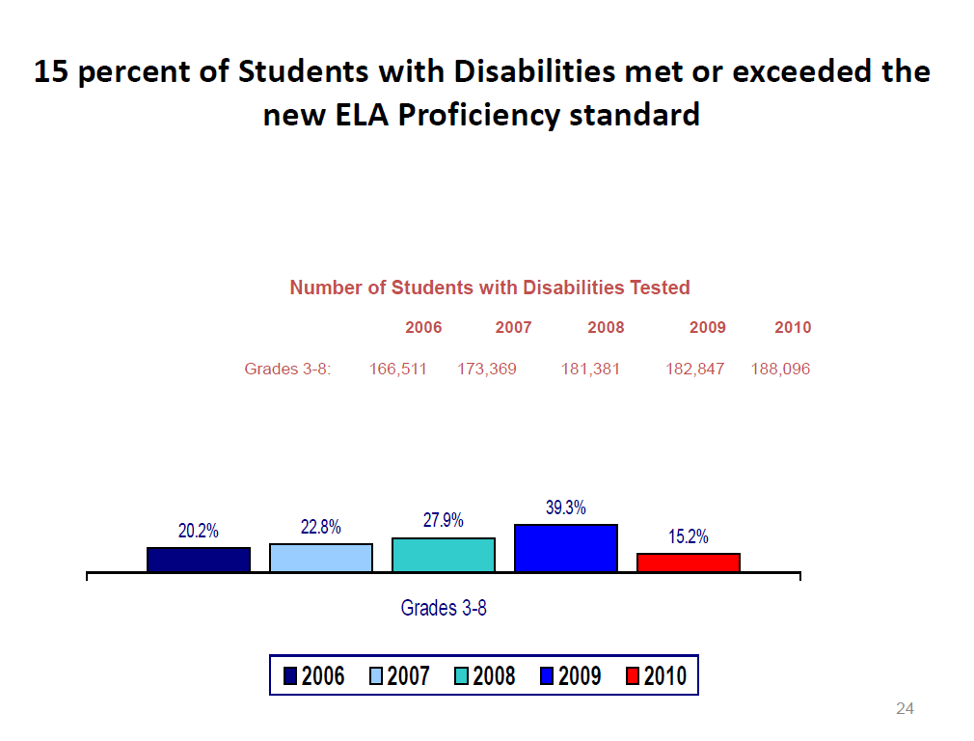
State data

Slide 10
Groups Failing AYP
2009-10
 | All | SWD | Native American | Asian | Black | Hispanic | White | LEP | ED | MR
Grades 3-8 ELA | 370 | 1045 | 0 | 11 | 324 | 270 | 19 | 344 | 415 | 0
Grades 3-8 Math | 24 | 168 | 0 | 2 | 16 | 9 | 2 | 20 | 21 | 0
Preliminary Data for 2010-11
 | All | SWD | Native American | Asian | Black | Hispanic | White | LEP | ED | MR
Grades 3-8 ELA | 457 | 1312 | 3 | 18 | 424 | 366 | 39 | 420 | 601 | 0
Grades 3-8 Math | 424 | 1001 | 2 | 9 | 414 | 306 | 55 | 281 | 575 | 0
AYP = Adequate Yearly Progress
ED = Economically disadvantaged
ELA = English language arts
LEP = Limited English proficient
MR = Multiracial
SWD = Students with disabilities
Coming Soon!

Slide 11
Framing
the issue

Slide 12
Disciplining Students with Disabilities

Slide 13
Glossary of Terms
Alternative Instruction
Behavior Intervention Plan (BIP)
Disciplinary Change In Placement
Expedited Due Process Hearing
Free Appropriate Public Education (FAPE)
Functional Behavioral Assessment (FBA)
In-School Suspension
Interim Alterative Educational Setting (IAES)
Long-term Suspension
Manifestation Determination
Removal
Short-term Suspension
Student Presumed to Have a Disability for Discipline Purposes
Superintendent’s Hearing
Suspension

Slide 14
Part 100.2(l)(2)(ii) Code of Conduct
Each BOE and BOCES must have a written Code of Conduct as defined in Education Law section 2801(1):
Procedures to assure safety of students & personnel,
Procedures for the removal of students who violate the Code,
Procedures regarding the period of time for which a disruptive student may be removed for each incident (Principal discretion),
Procedures to continue educational programs for students who receive detention, suspension, or removal (alternative educational programs appropriate to individual student needs),
Procedures for notifying persons in parental relationship to the student
of his/her code violation,
A Bill of Rights and Responsibilities of students focusing on positive student behavior, publicized and explained to all students annually,
Programs for in-service education programs for all district staff to ensure implementation of school policies regarding school discipline.

Slide 15
Part 100.2(l)(4)-Regs., 3214-State Law
Parental Notice of Suspension:
Five(5) days or less-Parents must be notified immediately in writing by the Principal, Superintendent, or BOE
Parents must receive the notification within 24 hours of the decision to suspend.
Parents should also be notified by telephone
Notice must provide a description of the incident and inform the parents of their right to request an immediate informal conference with the principal.
If the student denies the charges, the student and/or parents must be provided an informal hearing within 48 hours of the student’s removal.

Slide 16
More than 5 day suspension- Student and parent must have an opportunity for a fair hearing (Superintendent’s Hearing).
Student has the right to representation of counsel.
Student (or counsel) has the right to question witnesses, and present witnesses and other evidence on his/her behalf.
The Superintendent (or designee) as hearing officer must be authorized to administer oaths and issue subpoenas.
A record of the meeting must be maintained (tape recorder is sufficient).
The hearing officer must recommend disciplinary action to the Superintendent, who may accept all or part of the recommendation.
(The BOE has the same rights as the Superintendent.)
Notes:
If a student is suspended by the BOE, the BOE may hear the proceedings or appoint a hearing officer. The findings and recommendations of the hearing officer may be accepted in whole or part by the BOE.

Slide 17
In-School Suspension
In-School Suspension (ISS) indicates where the suspension takes place- it does not include the duration of the suspension
In-School Suspension- the student remains in the school building he/she regularly attends but receives instruction in another room for disciplinary reasons.
The student and parents must be provided a reasonable opportunity for an informal conference (notice by phone call, letter, voice or e-mail) with the person who imposed the suspension to discuss the misconduct and penalty.
Substantially, equivalent Alternative Instruction in the ISS setting must be to the same extent as provided to nondisabled students and equivalent in nature.

Slide 18
Out of School Suspension
Out of School Suspension-indicates where the suspension takes place- it does not include the duration of the suspension
Short-term Suspension- indicates the length of the suspension (five consecutive days or less)
Long-term Suspension- indicates the length of the suspension (in excess of five days)
Notes:
Suspension from the bus- If a student is suspended from the bus, he/she must continue to receive FAPE. The district must immediately figure out how to transport the student to school/program. Every day missed from school because of a bus suspension counts toward the 10 days. If the student exhibits similar behaviors (or different behaviors) on the bus than in school the district continues to have the responsibility to do an FBA and develop a BIP.

Slide 19
Educational Responsibilities During Suspension
If student is compulsory school age, he/she must receive alternative instruction within one or two days of suspension
*Regardless of age, a suspended student has the right to receive Academic Intervention Services (AIS) during the period of suspension unless/until the student’s performance indicates he/she is no longer eligible. AIS does not have to be identical, but must be comparable.
Alternative instruction must be substantially equivalent to the instruction received before the suspension- student must be able to complete requirements for all academic subjects
Alternative instruction is a minimum of one hour daily for an elementary student (K-6) and two hours daily for a secondary student (7-12)

Slide 20
Part 200.4(d)(3)(i)
“In the case of a student whose behavior impedes his or her learning or that of others, the CSE must consider strategies, including positive behavioral interventions, and supports and other strategies to address that behavior…”
Who do you need at the meeting?
What information do you need at the meeting?
What does the conversation sound like?
How are behavioral strategies developed at the meeting?
Who is responsible for implementing the strategies?
How will the strategies be evaluated?
Notes:
Refer to Chapter 2- Creating a Positive Classroom Environment for all Students (Tips 1-20)

Slide 21
Part 200.22- Behavioral Interventions for SWD
Functional Behavioral Assessment (FBA)- A process of determining why a student engages in behaviors that impede learning and how the student’s behavior relates to the environment. An FBA requires a signed parental consent.
An FBA includes:
Identification of the behavior,
Definition of the behavior in concrete terms,
Identification of the factors that contribute to the behavior, and
Formulation of a hypothesis of the conditions under which the behavior occurs and consequences that seem to maintain the behavior.

Slide 22
The FBA must be based on multiple sources of data (i.e., direct observation of the student, information from the student, the student’s teacher(s) and/or related service provider(s), a review of available data from the student’s record, and other relevant information provided by the student’s parent.
The FBA must not be based solely on the student’s history of problem behaviors.
The FBA must provide a baseline of problem behaviors with regard to frequency, duration, intensity and/or latency across activities, settings, people, and time of day.
The FBA must provide sufficient detail to form the basis for a Behavioral Intervention Plan.
Notes:
Resources- FBA information, discuss district/BOCES forms

Slide 23
Behavioral Intervention Plan- A plan based on the results of the FBA and, at a minimum, includes a description of the problem behavior, global and specific hypotheses as to why the problem behavior occurs, and includes intervention strategies to address the behavior.
The CSE/CPSE considers a BIP for a student:
exhibiting persistent behaviors (after interventions have been tried);
whose behavior places himself/herself or others at risk for harm;
when a more restrictive program or placement is considered; and/or
when it is decided at a manifestation determination meeting the behavior was attributed to the disability.

Slide 24
A BIP must include the following:
Baseline data of the problem behavior- frequency, duration, intensity, and/or latency,
Data taken across activities, settings, people and times of the day,
Baseline data used to evaluate progress,
Intervention strategies written to prevent the occurrence of the behavior, teach alternative behaviors, and provide consequences, and
A schedule to measure effectiveness of the interventions at scheduled intervals.
Notes:
Resources- BIP information, discuss district/BOCES forms

Slide 25
201.3-201.11
Superintendent’s Hearing- When disciplinary charges are lodged against a Student with a Disability, the hearing is bifurcated into guilt and penalty phases.
Guilt Phase- A determination of the student’s guilt or innocence regarding the alleged misconduct
If guilty, the hearing officer shall determine if a suspension or removal in excess of 10 school days should be considered. Before such a recommendation is made, a Manifestation Determination (MD) is made by the MD team.
If the team determines the behavior was a manifestation
of the student’s disability, the hearing is dismissed.

Slide 26
Penalty Phase- Conducted in the same way as the guilt phase, includes consideration of special education and disciplinary records
*Exception: If the behavior included serious bodily injury, illegal drugs, or controlled substances, the hearing officer may order a change in placement to an Interim Alternative Education Setting (IAES) for up to 45 school days.

Slide 27
Manifestation Determination- A review of the relationship between the student’s disability and the behavior subject to disciplinary action.
The meeting must take place no later than 10 days after:
A decision by a Superintendent to change the placement of a student to an Interim Alternative Educational Setting (IAES) for behavior involving serious bodily harm, weapons, illegal drugs, or controlled substances,
A decision by an Impartial Hearing Officer (IHO) to place a student in an IAES, or
Any decision by the BOE, DS of BOCES, Superintendent, or Principal to impose a suspension constituting a disciplinary change in placement.

Slide 28
The Manifestation Determination Team must include a representative of the district knowledgeable about the student and able to interpret information about child behavior,
the parents, and
relevant members of the CSE as determined by the parents and district.
The parents must receive written notice of the meeting stating the purpose of the meeting, the names of the participants and inform the parents of their right to have relevant members of the CSE at the meeting.

Slide 29
The Manifestation Determination team must review student’s IEP and other relevant information (to determine if:
1) the conduct is caused by or had a direct, substantial relationship to the student’s disability; or
2) the conduct is the direct result of the school district’s failure to implement the IEP.
If the team determines the conduct is a manifestation of the student’s disability, the CSE must:
1) conduct an FBA and implement a BIP; and
2) return the student to his/her placement, unless the parent and district agree to a change in placement as a change to the BIP.
If the team determines the conduct is a result of the district’s failure to implement the IEP, immediate steps must be taken to correct the deficiencies.
Notes:
Relevant information pertaining to the behavior- evaluation and diagnostic results, information supplied by the parents, observations
Appropriateness of IEP- special education services, supplementary aids and services, behavioral intervention strategies consistent with the IEP and placement

Slide 30
If the team determines the conduct is not a manifestation of the student’s disability, a disciplinary suspension or removal (not a suspension) may be imposed to the same extent as for a student without a disability, except the student must receive a Free and Appropriate Public Education (FAPE).
Notes:
Page 16 in brown book

Slide 31
Interim Alternative Educational Setting (IAES)
IAES is a temporary educational placement for a period of up to 45 calendar days.
An IAES must:
enable the student to continue in the general ed. curriculum;
enable the student to continue receiving special education services and modifications to meet the goals in his/her IEP; and
include services and modifications to address the behavior which precipitated the setting to prevent the behavior from recurring.

Slide 32
Disciplinary Change In Placement
A suspension or removal from a student’s current educational placement for either:
a period of more than 10 consecutive school days; or
a period of 10 consecutive school days or less if the student has received a series of suspensions or removals that constitute a pattern because they accumulate to more than 10 school days in a school year and the length of each suspension or removal (the total amount of time the student is removed and the proximity of the suspension or removals to each other).

Slide 33
Removal
It is considered a removal from a student’s current educational placement for disciplinary reasons when a superintendent places a student in an IAES for behavior involving weapons, illegal drugs or controlled substances, or
when an impartial hearing officer places a student in an IAES because of a dangerous situation.
A removal is not a suspension.
The IAES is determined by the CSE.

Slide 34
Students Presumed to Have a Disability
When a parent asserts the district had knowledge that a child was a student with a disability prior to behavior that caused disciplinary action, his/her status becomes a student presumed to have a disability.
In such a case, the superintendent/principal must determine if one or more of the following criteria apply:
1) The parent expressed concern in writing that the student required special education;
2) The student’s behavior warranted special education services;
3) The parent has requested an evaluation; and/or
4) A teacher or other school personnel has expressed concern to an administrator or other school personnel regarding the student’s behavior.

Slide 35
If there is no basis of knowledge that a student is presumed to have a disability, the student may be subjected to the same disciplinary actions as a nondisabled student.
If the parent disagrees with the determination that a student is not a student presumed to have a disability, the parent may submit a request for mediation or a due process hearing.

Slide 36
Expedited Evaluations
If a request for an evaluation is received while a nondisabled student is subjected to a disciplinary removal, an expedited evaluation must be conducted.
An expedited evaluation must be completed no later than 15 school days after receipt of parent consent.
The CSE meeting must be held no later than 5 school days after completion of the evaluation.

Slide 37
Graduation and
Students with Disabilities

Slide 38
Students with Disabilities (SWD) are GENERAL EDUCATION STUDENTS that receive special education services.
They receive the same curriculum as all students and graduate the same as all students.
The exceptions being a local option of 55-64 on the Regents to receive a local diploma or through the NYSAA.
There will be NO IEP DIPLOMA** after the 2012-2013 year .

Slide 40
What
to do?

Slide 41


Slide 42


Slide 43
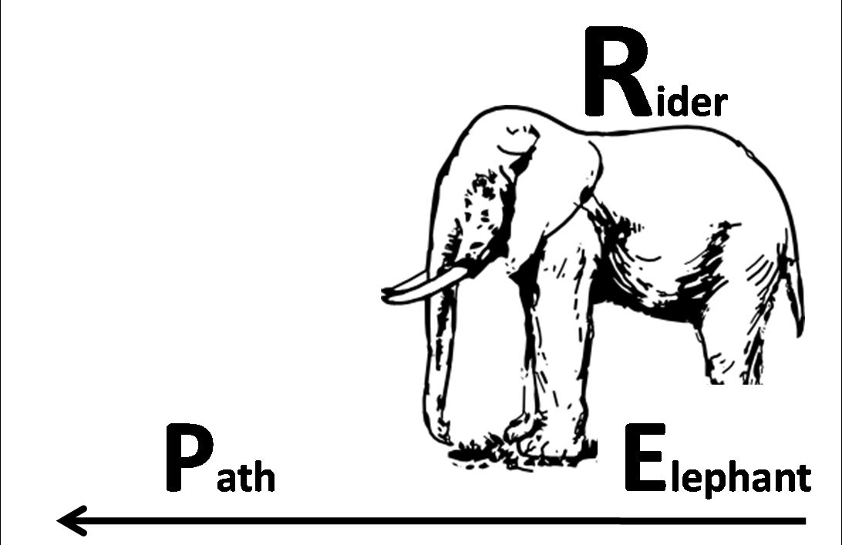

Slide 44

Direct the Rider
What looks like resistance is usually a lack of clarity. If the Rider doesn’t know where to go, they spin the Elephant in circles. To direct the rider, create a crystal clear vision of the outcome. This includes when or how much, along with a specific set of actions and tactics to get there.

Slide 45
Motivate the Elephant
What looks like laziness is often exhaustion. Make your audience feel the need for change. Analytical appeals don’t cut it. Knowing is not enough. Get beyond the knowing and make it possible for people to feel the impact. Win the heart and the mind follows.

Slide 46
Shape the Path
What looks like a people problem is often a situation problem. Make it easy to embrace the change. Make instructions simple with step-by-step guidance. Provide support groups. Create training. Pair people up with mentors. Create peer pressure and social proof. Behavior is contagious.

Slide 47
Paths
In mixed groups, generate some ideas for some possible paths for our elephant and rider.
Be prepared to report out
Weighted voting

Slide 48
First Steps
Choose one of the prioritized paths.
What might be the first steps down the path(s)?

Slide 49
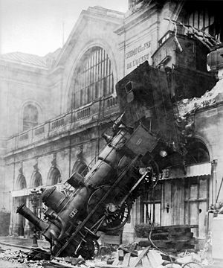
State Ed Update

Slide 50
Accountability
8 more OCM districts
Primarily 3-8 SWD
SQRs
QIPS
CEPS
%$*@!

Slide 51
Calendars
January 2012 just released
3-8 draft is in circulation
June Regents week not changing (this year)

Slide 52
Scoring
Can’t score your own
Can proctor your own
More auditing
More central scanning
Longer storage

Slide 53
Scoring
BCIC committee first meeting: Monday, October 24th, 2:00pm, Henry Large Conference Room

Slide 54
DASA
Task force still working
Regulations in winter/spring
Wait for it…

Slide 55
DASA
Task force still working
Regulations in winter/spring
Wait for it…

Slide 56
Credit Recovery
More “cheating”
More oversight

Slide 57
More Testing
Required kindergarten screening test on the horizon
6-8 SS and science still planned
$$$ for more ELA and math?
Tech for online assessment

Slide 58



Legislative Updates

Slide 59

Reeves & Co!
CCLS/Data Driven Instruction
November 15 & 16
Driver’s Village
Reeves, Ainsworth, Lassiter, Besser & others
Don’t Wait!

Slide 60

CI&A
Instruction for All Students
Cohort begins September 28

Slide 61

Race To The Top

Slide 62
RTTT
Shift first
“Units” second
Common Interim Assessments

Slide 63
Professional
Practice
Standards
Data
Culture

Slide 64
APPR
Districts in all stages
20% tough to figure out
Forms, processes, procedures?
Another big APPR meeting???

Slide 65
BCIC Schedule
WCNY’s Enterprise America
PBL Administrators’ Overview

Slide 66
Curriculum and Instruction Council
Next Meeting: November 10, 2011
Enterprise America
Regional Portal Update

