Slide 1
Curriculum and Instruction Council
January, 2012

Slide 2
Welcome and Introductions

Slide 3
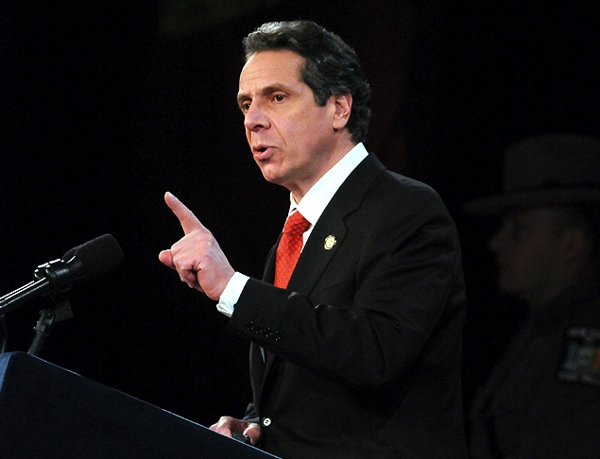
State Ed Update

Slide 4
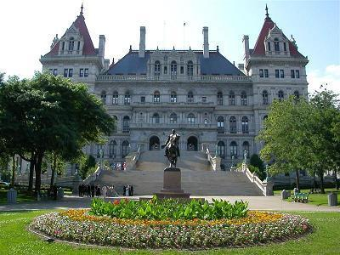
Legislative Updates

Slide 5
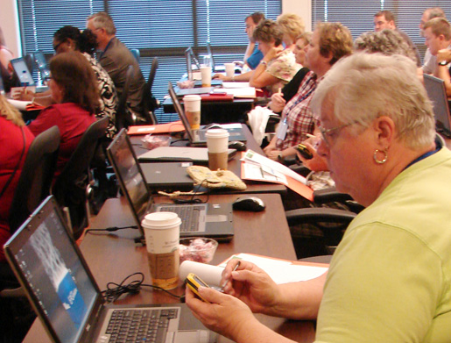
IT&D

Slide 6
CI&A
Upcoming Sessions

Slide 7
Checkpoint B
Target Language |  | Participating Districts
Chinese | 0
French | 7 | Fayetteville-Manlius, LaFayette, Liverpool, W. Genesee, Westhill, Tully, Baldwinsville
German | 2 | Fayetteville-Manlius, Baldwinsville
Italian | 2 | Solvay
Latin | 2 | Fayetteville-Manlius, Liverpool
Spanish | 15 | Fabius-Pompey, Fayetteville-Manlius, LaFayette, Marathon, N. Syracuse, OCM, Solvay, Sandy Creek, W. Genesee, Westhill, Tully, Baldwinsville, DeRuyter

Slide 8
ELA Leadership
Similar to other networks
Initial meeting January 30th

Slide 9
CNY ASCD
February 8th
3rd in this year’s RTTT theme
Focus: CCLS Literacy

Slide 10
4th Grade NY SS
“Spotlight on NY” e-book collection
Interest
$$$???

Slide 11
Special Ed
Task Force membership
Any one else?
February 14th?

Slide 12
RTTT Road Map

Slide 13
State
Determines SLO process
Identifies required elements
Requires use of State test
Provides training to NTs prior to 2012-13.
Provides guidance, webinars & videos
District
District goals & priorities
Match requirements to teachers
Define processes for before & after
Identify expectations
School
LE & teacher collaborate
LE approval
Ensure security
LE monitor and evaluation
Teacher
Works with colleagues & LE
SLOs

Slide 14
SLOs
Resources being collected at the State 20% page in APPR microsite
Collecting/archiving examples
SLO-G and SLO-SA

Slide 15
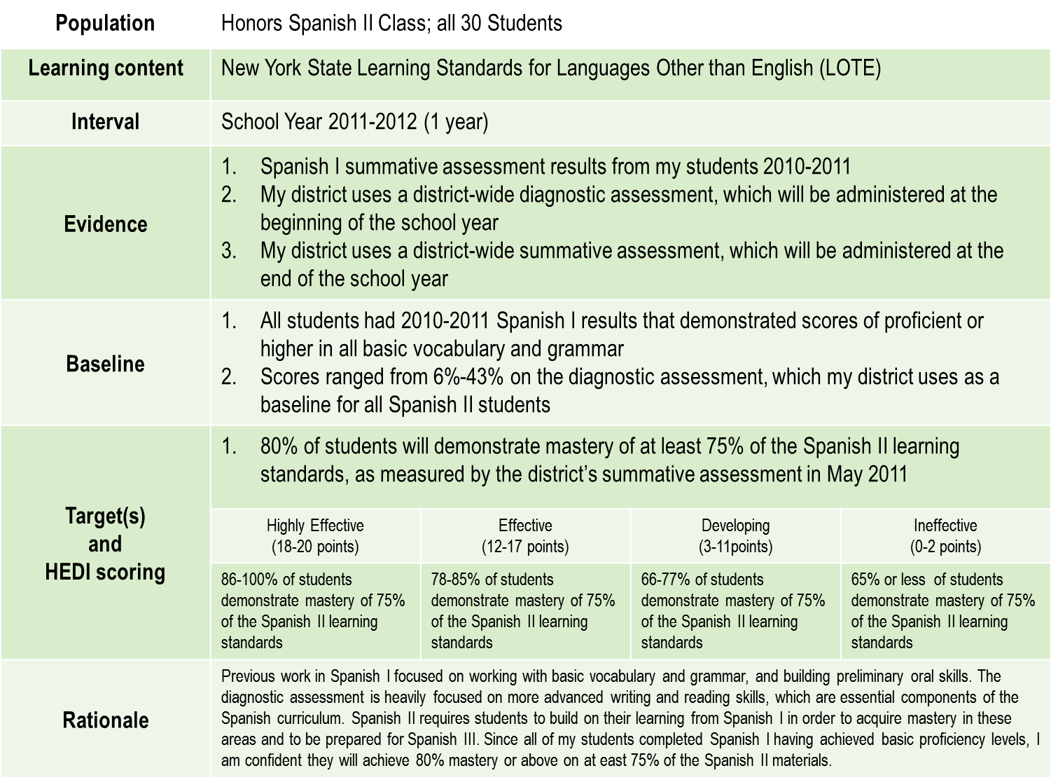

Slide 17
SLOs
“Have a go”

Slide 18
Regional Scoring
Hub meetings
What questions are popping up?
Next steps?

Slide 19
Curriculum and Instruction Council
Next Meeting: February 9, 2012
RTTT Road Map & Progress Assessment

