Slide 1


Slide 2
leadership standards
6
what are they?

Slide 3
2
1
6
Teaching
& Learning
Vision, Mission
& Goals
The Education
System
3
5
Managing
Organizational
Systems
& Safety
4
Ethics & Integrity
Collaborating
with Families
and
Stakeholders

Slide 4
but first,

Slide 5
where
did
they
come
from?

Slide 6
>
Council of Chief State School Officers (CCSSO)

Slide 7
“Leadership standards shall mean the Educational Leadership Policy Standards: ISLLC 2008”

Slide 8
Let’s take a closer look…

Slide 9
2
1
6
Teaching
& Learning
Vision, Mission
& Goals
The Education
System
3
5
Managing
Organizational
Systems
& Safety
4
Ethics & Integrity
Collaborating
with Families
and
Stakeholders

Slide 10
1
Vision, Mission
& Goals
An education leader promotes the success of every student by facilitating the development, articulation, implementation, and stewardship of a vision of learning that is shared and
supported by all stakeholders.
3rd
is the
world’s
largest economy

Slide 11
2
Teaching
& Learning
An education leader promotes the success of every student by advocating, nurturing, and
sustaining a school culture and instructional program conducive to student learning and staff professional growth.
is the
world’s

Slide 12
3
Managing
Organizational
Systems
& Safety
An education leader promotes the success of every student by ensuring management of the organization, operation, and resources for a safe, efficient, and effective learning environment.
is the
world’s

Slide 13
4
Collaborating
with Families
and
Stakeholders
An education leader promotes the success of every student by collaborating with faculty and community members, responding to diverse community interests and needs, and mobilizing
community resources.
is the
world’s

Slide 14
5
Ethics & Integrity
An education leader promotes the success of every student by acting with integrity, fairness, and in an ethical manner.
is the
world’s

Slide 15
6
The Education
System
An education leader promotes the success of every student by understanding, responding to, and influencing the political, social, economic, legal, and cultural context.
is the
world’s

Slide 16

What does this look like?
is the
world’s

Slide 17

In table groups, draw a picture that illustrates what the performance indicators might look like in action.

Slide 18
Let’s meet the leaders

Slide 19
How does this get assessed?

Slide 20


Slide 21
What rubric?

Slide 22
Will the state approve these rubrics?
CCSSO District leadership toolkit?
Kim Marshall?
Giselle Martin-Kneip?
Val-Ed?
???

Slide 23
What might a
rubric look like?

Slide 24
Performance Expectation 2: Teaching and Learning Education leaders ensure achievement and success of all students by monitoring and continuously improving teaching and learning.
 | Ineffective | Developing | Effective | Highly Effective

Slide 25
Performance Expectation 2: Teaching and Learning Education leaders ensure achievement and success of all students by monitoring and continuously improving teaching and learning.
B. Rigorous Curriculum and Instruction Improving achievement of all students requires all educators to know and use rigorous curriculum and effective instructional practices, individualized for success of every student.
 | Ineffective | Developing | Effective | Highly Effective

Slide 26
Performance Expectation 2: Teaching and Learning Education leaders ensure achievement and success of all students by monitoring and continuously improving teaching and learning.
B. Rigorous Curriculum and Instruction Improving achievement of all students requires all educators to know and use rigorous curriculum and effective instructional practices, individualized for success of every student.
 | Ineffective | Developing | Effective | Highly Effective
1. Develops shared understanding of rigorous curriculum and standards-based instructional programs, working with teams to analyze student work, monitor student progress, and redesign curricular and instructional programs

Slide 27
Performance Expectation 2: Teaching and Learning Education leaders ensure achievement and success of all students by monitoring and continuously improving teaching and learning.
B. Rigorous Curriculum and Instruction Improving achievement of all students requires all educators to know and use rigorous curriculum and effective instructional practices, individualized for success of every student.
 | Ineffective | Developing | Effective | Highly Effective
1. Develops shared understanding of rigorous curriculum and standards-based instructional programs, working with teams to analyze student work, monitor student progress, and redesign curricular and instructional programs | Does not understand how to use rigorous curriculum and instruction to improve student learning across diverse populations | Knows ways to use rigor and standards-based materials, student work, and data on student progress to adjust curriculum and instruction to meet diverse needs | Organizes people and information so that there is common focus in using rigor and standards-based materials, student work, and data on student progress to adjust curriculum and instruction to meet diverse needs | Models the use of rigor and standards-based principles to differentiate the ways in which others are led to redesign their work

Slide 28
Take a look at another rubric example – in your folder. What do you think?

Slide 29
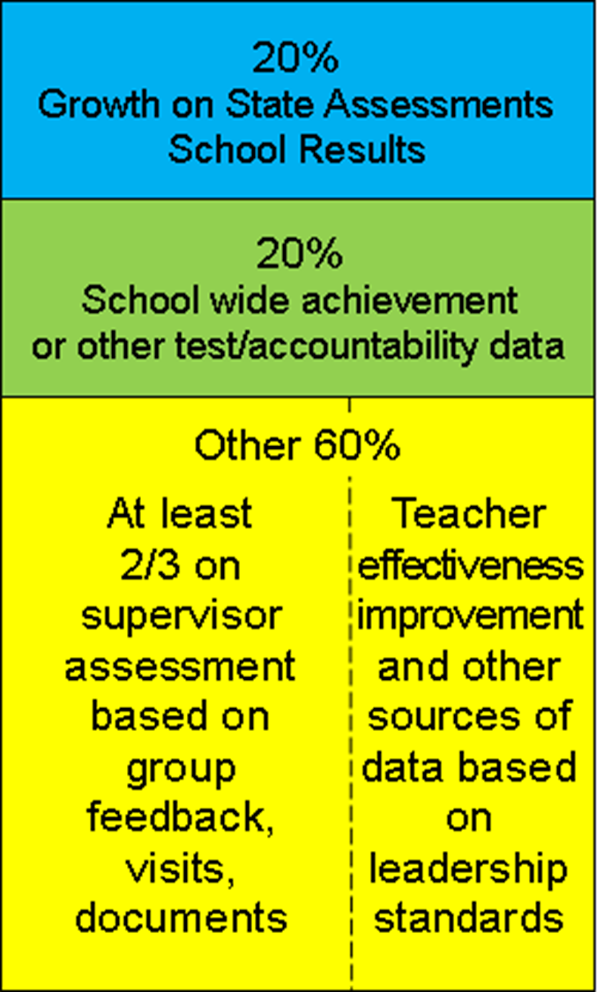
How does this “fit” into the new APPR?

Slide 30
Multiple measures

Slide 31
At least 40 of 60 points based on supervisor’s
broad assessment of principal leadership and
management actions

Slide 32
Based on supervisory visit(s) to school and:
Structured feedback from constituencies
Visits by other trained evaluators;
Review of school documents

Slide 33
Any remaining points will be based on results of one or more goals set
collaboratively with their lead evaluators.
Any remaining leadership standards not addressed through above requirements must be assessed at least once a year.

Slide 34
rubrics
due
in
late
July

Slide 35
choose
one
from
that
list

Slide 36
get in there and get dirty

Slide 37

resources available at
leadership.ocmboces.org

