Slide 1
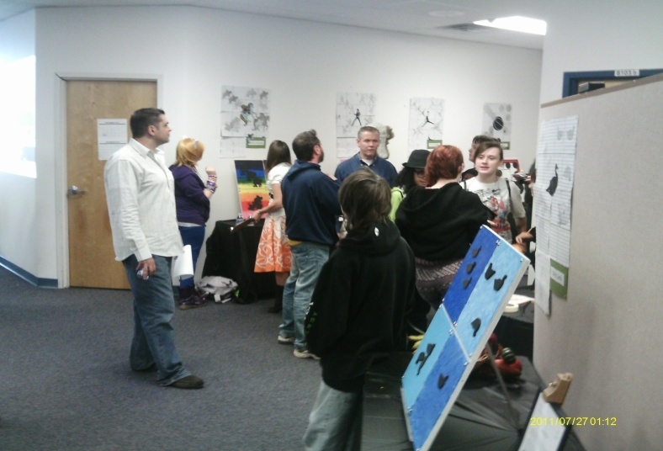
Project Based Learning In Action

Slide 2
Board of Education PBL Goal 2013-2014
Twelve Alternative Education and Special Education teachers will be trained in PBL and will implement interdisciplinary quarterly projects with business partners.

Slide 3
Evolution of PBL at OCM BOCES
2010-2011- 15 teachers and administrators from CTE, Special Ed. and Alternative Education were trained through the Buck Institute
2011-2012- CI&A received certification through Buck Institute to provide PBL training in Central New York
2011-2013- 20 additional Alternative and Special Education teachers trained through CI&A

Slide 4
Focused PBL
2013-2014- CI&A provided both training and coaching for Special Education and Alternative Education at the following sites:
Crossroads
Cortland Alternative School
Kasson Road
Reach
STARS Alternative High School

Slide 5
Examples of Current PBL Experiences
Kasson Road- Leaving a Legacy at Kasson
Reach- The Power of Symbols
CAS- Designing and implementing a 5K Race
STARS- Onondaga Lake - Past, Present and Future
Crossroads- The Onondaga Lake Bridge Parkway Project

Slide 6
Impact on Student Learning at OCM BOCES
Increased engagement
Improvement in collaboration skills
Increase motivation as a result of a freedom of choice to demonstrate their knowledge
Utilized higher level critical thinking skills
Ability to make better connections across the different content areas
Enhanced creativity, communication, collaboration and critical thinking

Slide 7
Reflections From Teachers
“Engagement is high when student choice is involved.”
“Students are learning because they are experiencing the content and immediately putting it in a real-world context.”
“I have had to pull back and allow my students to work through their conclusions instead of giving them the answer.”
“Required more team planning.”

Slide 8
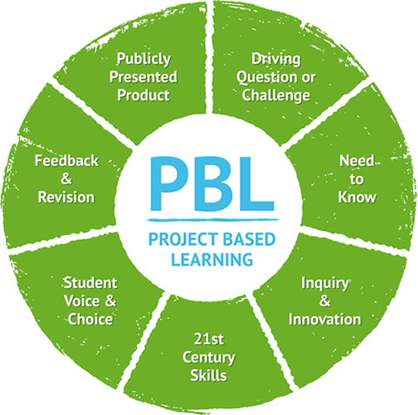
A Deeper Look at Project Based Learning at the Crossroads Program

Slide 9
Significant Content
ELA Common Core Standards: #1 Forming an argument; #2 Speaking; #11 Responding to Literature.
Math Common Core Standards: #G-MG- Modeling with Geometry; NQ #1,2,3- Quantities.
Social Studies: 2.4; 5.4
Science: 1, 4
Common Core Literacy Strategies:
Reading 1, 2, 6, 7, 8, 9; Writing 2, 4, 9, 10

Slide 10
21st Century Skills
Collaborating with one another in order to come up with a solution
Creating plans for an alternative to the current bridge
Critically Thinking about alternatives and the consequences of those alternatives
Communicating their ideas with their local community including the Department of Transportation (DOT)

Slide 11
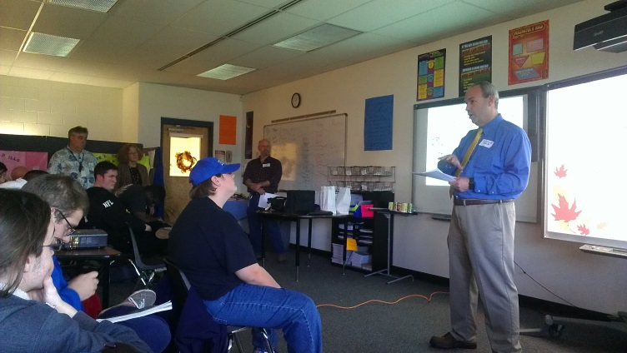
In-Depth Inquiry
Students were involved in a rigorous, extended process of:
Asking Questions
Using resources such as the Department of Transportation, the internet, articles, and multiple methods to present their findings (Prezi, Pow-Toons, Powerpoints, Flip Cameras, etc)
Developing answers to the driving questions

Slide 12
Driving Questions
Main Driving Question: Should a change be made to the Onondaga Lake Parkway Bridge?
Week 1: Social Studies-
What is the problem with the current bridge?
Week 2: Math –
What would be the cost and measurements of a new bridge?
What are the statistics in regards to the accident rate under that bridge?

Slide 13
Driving Questions
Week 3: Science –
What affect does acid rain have on the current bridge?
What would be the environmental impact of the new bridge?
Week 4 &5: English Language Arts-
How can we make the public aware of this issue and share our opinion of whether a change should be made to the current bridge?

Slide 14
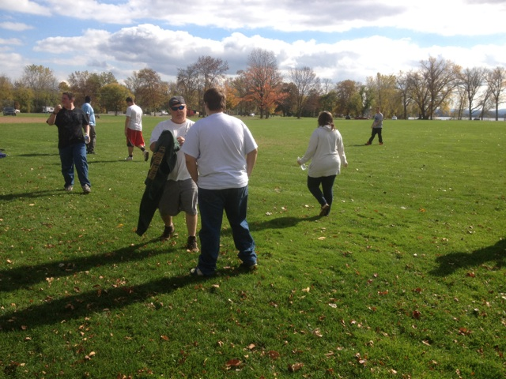
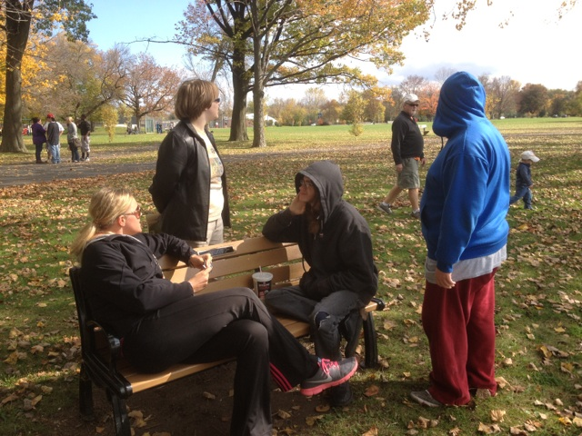
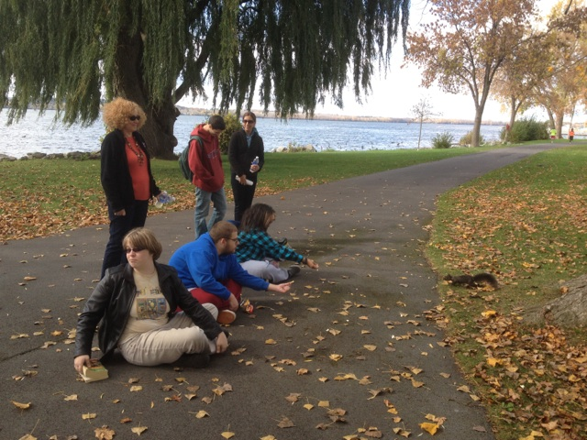
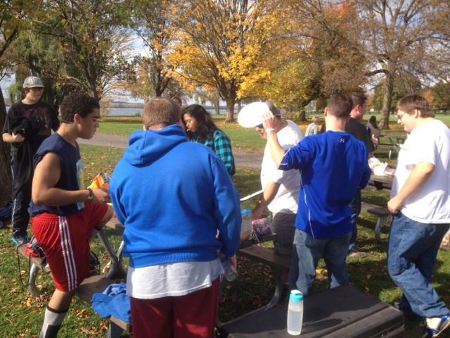
Need to Know
The entry event that generated interest and curiosity was the field trip to the Onondaga Lake Parkway Bridge with a teacher as a “tour guide.”
Once students saw the large dents in the bridge and were made aware of the accidents that happened, this generated several “need to knows” regarding why this was happening and how solutions could be reached that could stop it from continuing.

Slide 15
Voice and Choice
Voice: endless solutions to the problem with the bridge
Choice: endless ways in which students could present their voice

Slide 16
Revision and Reflection
Revision: several methods were used in order for students to revise their projects in ELA including critical friends
Reflection: students had 5 different lenses to look at the problem through and use those different perspectives to alter their solutions/opinions

Slide 17
Public Audience

