Slide 1





Slide 2
Welcome Back Mentors and Mentees
Please sit with your mentoring partner--
If your partner is not here, please join a “logical” pair.

Slide 3

Coming to the end of 2013
Select a penny– please take one that is dated within your lifetime
Think of an event from that year- personal or professional
Within your table group, take turns sharing your year and event…

Slide 4
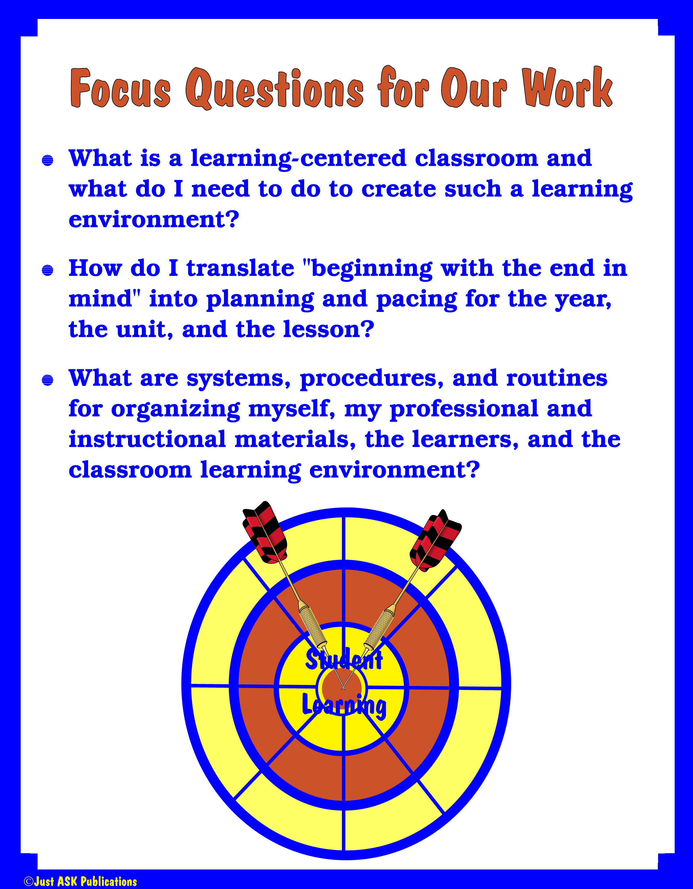

Slide 5
Day with Mentors in August Agenda
Who are We?
Roles and Expectations
Knowing our Resources
Coach, Consult, Collaborate
Planning visits, feedback and collaborations

Slide 6
October Agenda Mentors and Mentees
Who are We?
Creating a Positive Learning Environment
Knowing our Resources
A Good Place to Learn
    Making Learning Active
    Grouping Students

Slide 7
November Agenda- Mentees
Making Learning Active
  Share out/Make pick 2 more for next time
Framing the Learning
  Review and Reflect on Time Templates
  Designing Questions and Tasks: Bloom’s Taxonomy
  Let’s Go RAFTing!
Essentials of Standards-Based Environment
  Task Analysis

Slide 8
December: mentors and mentees
Welcome- Community Builder, Agenda, Connect to past learning (framing the learning)
Assessment
Literacy
Top 10 for 21st Century Teaching
Next Steps

Slide 9

Home Practice:
At-Home Professional Practice
Mentees:
  Plan lessons/units using the SBE Ovals…Come in with a basic lesson planned this way ( Use the OCM BOCES template)
  Apply 2 NEW Interactive Strategies found in Section IV. Making Learning Active and write a short one page reflection on each

Slide 10
Mentees
Draw the four ovals and explain to your mentor:
  What are the important questions for each oval?
  How do these relate to OCM BOCES planning?
What was a key idea for you?
Mentors- this is good opportunity for you to practice coaching stance.

Slide 11
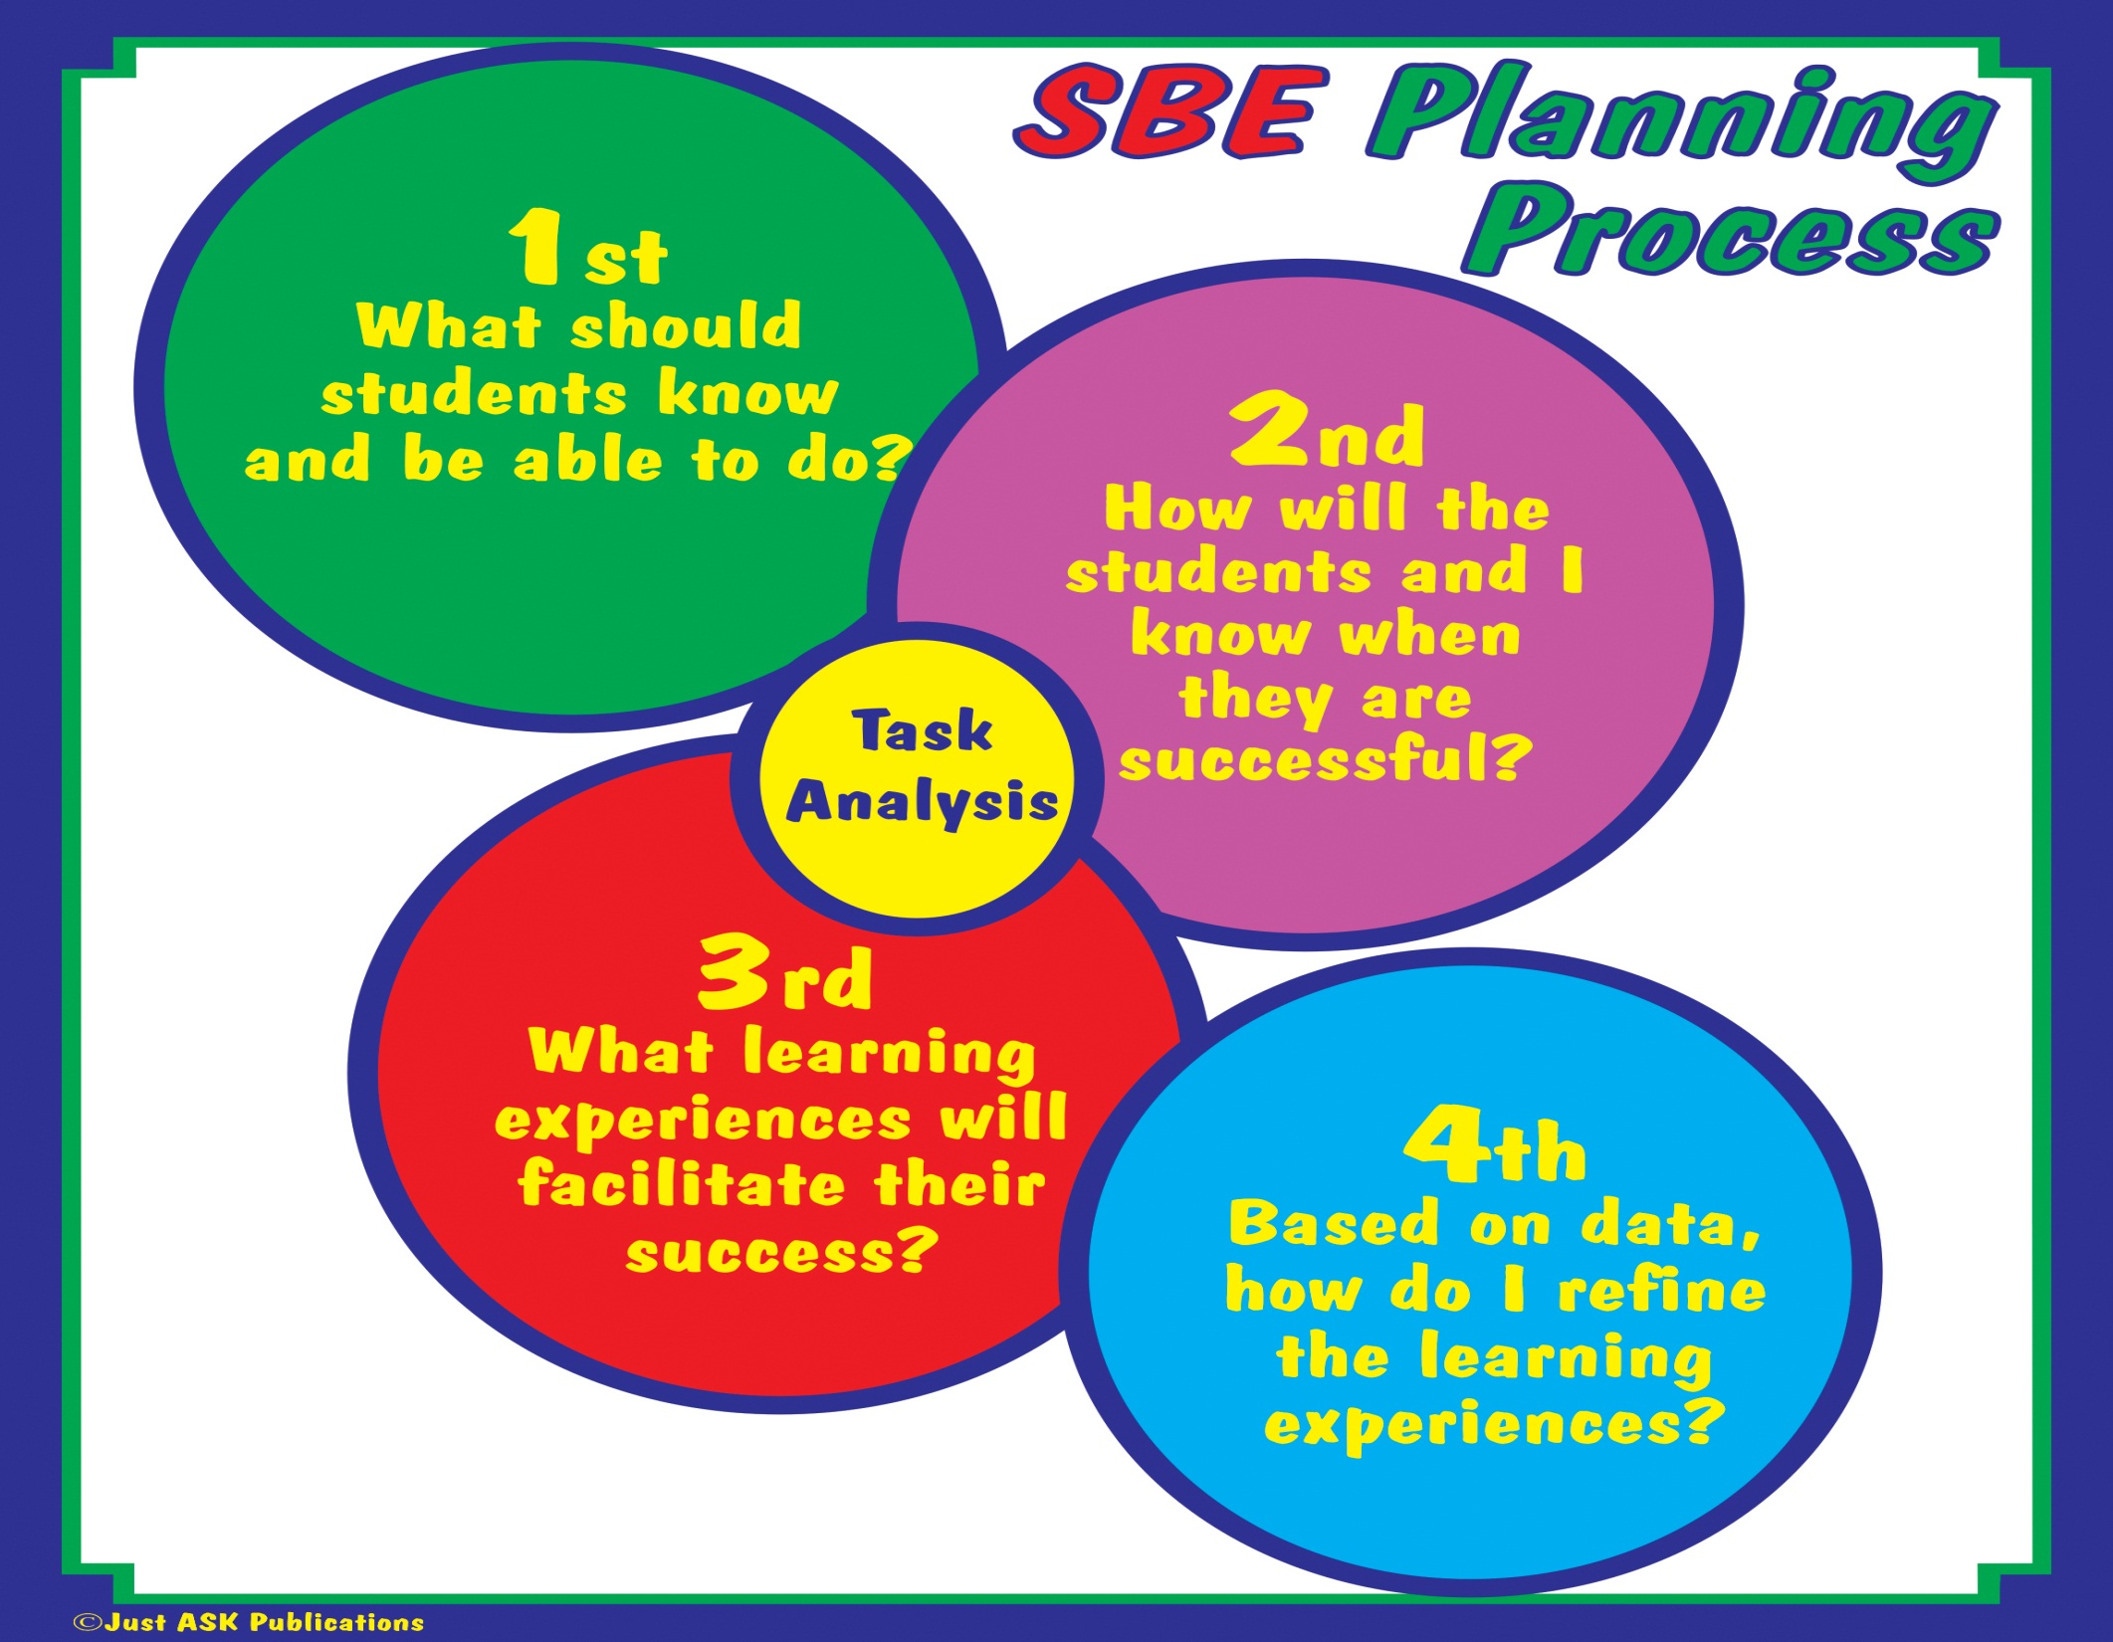

Slide 12
Professional Practice
Share your lesson with your mentor
Mentor: Practice your three stances
Where are the ovals
What is a strong about the lesson?
What is something you wonder about?

Slide 13
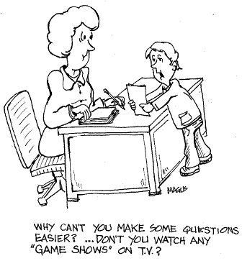

Slide 14

Binder p 18

Slide 15
Circle Map (Frame of Reference)
Assessment
What I Know
In Corners:
  How do you know what you know?
  What influenced your knowledge?
  How do your students view?
  What questions might you have?

Slide 16
Notices:
What are some elements in common?
What might be some misperceptions?
What might be some areas of focus?

Slide 17
Current Assessment Practices
What is working
Not so much….

Slide 18
Purpose of Assessment
Identify if students have mastered concepts or skills in standard
Evaluate the effectiveness of instructional strategies
Motivate students to be more engaged in learning
Help students learn content through application and other reasoning skills
Help students develop positive attitudes toward a subject
Communication expectations to students
Give students feedback about what they know and can do
Show students what they need to focus on to improve their understanding
Encourage student self-evaluation
Determine report card grades
Communicate to parents what students presently know and can do
  Larry Ainsworth, Common Formative Assessments

Slide 19
Past Practice
Pretest
Teach
Test

Slide 20
Assess
Analyze
Plan for Instruction
Teach

Slide 21

The more you teach without finding out who understands the information and who doesn’t, the greater the likelihood that only already-proficient students will succeed.
  Wiggins, 2006

Slide 22
Types
Classroom formative assessments
Classroom summative assessments
Common formative assessments
Common summative assessments

Slide 23
Summative Assessment
Summative assessment is the attempt to summarize student learning at some point in time.
Summative assessments are not designed to give feedback useful to teachers and students during the learning process.
OF LEARNING
Did they understand?

Slide 24
Formative Assessment
Provides information to teachers and their students to be used as feedback to modify the teaching and learning activities-can intervene or accelerate
FOR LEARNING
What should we do next?

Slide 25
Examples- and characteristics
Summative
Formative

Slide 26
Big Questions
How might a summative assessment become formative?
How might a formative assessment become summative?

Slide 27
What makes any particular assessment formative is not the specific measuring tool employed but how the information gathered from the tool is used.
  Laura Greenstein, What Teachers Really Need to Know about Formative Assessment

Slide 28
Preassessment
What and how use?
Partner conversation….

Slide 29

Let’s Explore the Text….
P. 141
Select one active learning strategy to explore
As mentor/mentee pair share

Slide 30

BREAK
Please be back in 10 minutes.

Slide 31
Check for Understanding
Text p 142-143
Share with your mentor/mentee partner one take away for you from the text

Slide 32
Good Ideas for quick in the moment formative assessments…Give one to Get one
3.2.1
Exit slips
Use blank sheet of paper and list how you might assess students for formative data or check for understanding

Slide 33
Beginning
Quality items
Reliability
Validity
Fairness
Readability-complexity
How many items
How often

Slide 34
What are learning targets?
An expectation we have for students on the path toward mastery of an objective.
It clearly states what we want the students to learn and what should be understood by teachers and students
Learning targets should be formatively assessed to monitor progress toward an objective.

Slide 35
Targets are the know and do:
Knowledge
Reasoning
Performance
Product

Slide 36
Which is which?
Verbs help…
Knowledge | Reasoning | Performance | Product
Know List Name Identify Tell Examine Recognize Explain Understand Describe Define | Compare Contrast Distinguish Analyze Organize Infer Deduce Predict Interpret Hypothesize Sort Evaluate Prove Judge Support Justify Classify | Play Do Use Observe Measure Explore Demonstrate Carry out Model Listen Perform Question Conduct Speak | Make Generate Design Construct Invent Produce Draw Write Create Develop

Slide 37
Knowledge Target
The student knows and understands concepts and facts. Includes being able to find information they need.
Key verbs: explain, understand, describe, identify, define

Slide 38
Reasoning Target
The student uses knowledge to solve an problem, make a decision, or plan.
Key Words: compare, contrast, analyze, synthesize classify, infer, deduce, evaluate

Slide 39
Performance Targets
The student demonstrates that he/she knows the process needed to complete a skill.
Key Words: observe, listen, perform, do use, question, conduct, speak

Slide 40
Product Targets
The student uses knowledge, reasoning, and skills to produce final quality product.
Key Words: design, produce, create, develop, make

Slide 41
Finding targets in standards; Unwrapping, unpacking, deconstructing-task analysis
Circle all verbs- skills we expect them to be able to do
Underline nouns –concepts they need to know
Double underline any context
Add any implied learning targets

Slide 42
The student will apply the rules of the road and correct safety procedures while driving a car in a variety of situations.
What will be the summative assessment?
What are the learning targets? (underline concepts-nouns and circle verbs)
What types of targets are identified (knowledge, reasoning, performance, skills)
What formative assessments best match?

Slide 43
Types of Assessments
Selected Response
Constructed Response
Performance

Slide 44
Choosing an Appropriate Assessment
Type of Assessment | Examples | Advantages | Disadvantages | Application or comments
Selected Response
Constructed Response
Performance
Handout

Slide 45
Select the type of assessment that best matches the RIGOR or expected thinking level of the target and that will be the most efficient for your intervention.

Slide 46
Quality Check
Are assessment items measuring identified learning targets and to what degree?
Is the type of assessment the most appropriate for measuring the intended purpose?
Are assessment items valid, reliable, fair and at appropriate level of rigor?
Are students asked to demonstrate their learning in a variety of ways?

Slide 47
How to best align intended outcomes with instruction– or the I taught but they didn’t learn syndrome
Clear learning targets ( from unpacking the standards)
Matching level of rigor (watch those verbs)
Creating assessments before instruction
Formative---shorter and more frequent

Slide 48

Text p 160- 163
Create top 3 tips with your partner
Be prepared to share with another pair (2x4x8)

Slide 49

Professional Practice:
Stir the Class p 45 Binder
Active Learning Strategies…..
List your top 3, plus 1 you have use that is NOT in the book
Get UP – Stir the Class – Pair with another
Give one idea and get one – Move on and make a new pair
Continue to do this until time is called
Goal = LOTS of IDEAS!

Slide 50
Lunch
See you in ONE hour!

Slide 51
Most Important Point
With your partner….

Slide 52

Discuss…..
In the past month: how have I demonstrated I’m a teacher of literacy

Slide 53

What does literacy look like for my content/population/class?
Create a texting summary /tweet
Share with your table…..

Slide 54
Being Deliberate About Reading Levels
Interquartile Ranges Shown (25% - 75%)
1600
1400
1200
Text Lexile Measure (L)
1000
800
600
High
School
Literature
College
Literature
High
School
Textbooks
College
Textbooks
Military
Personal
Use
Entry-Level
Occupations
SAT 1,
ACT,
AP*
From: Datametrics
Notes:
54

Slide 55
Why….
Approximately 50 percent of readers in grades 11-12 read BELOW Lexile 1100
GED (1060L)
CD-DVD Player Instructions (1080L)
Microsoft Window User Manual (1150L)
GM Protection Plan (1150)
Installing Your Child Safety Seat (1170L)
Federal Tax Form W-4 (1260L)
Application for a student loan (1270L)
Medical Insurance Benefits Pkg. (1280L

Slide 56
Why Does this Matter?
Students in the
bottom quartile
of reading
achievement are
20 times more
likely to drop out
than students in
the top quartile.

Slide 57
Why Does this Matter?
43% of adults performing below basic levels of literacy on a national assessment were living in poverty, compared to 4% of those at the highest levels of literacy.
Non-literate adults average $240 per week in wages and highly literate individuals $681 per week.
7 in 10 prisoners in the US performed at very basic or below basic levels of literacy.

Slide 58
Why Does this Matter?
4.1 percent: Unemployment rate for college graduates
8.3 percent: Unemployment rate for those with high school diplomas and some college.
12.6 percent: Unemployment rate for those with no high school diploma
“Meltdown 101, Unemployment by the Numbers,” March 6, 2009 Associated Press

Slide 59
College and Career Readiness from Literacy Standards
Independence
Strong content knowledge
Respond to varying demands of audience, task, purpose, and discipline
Comprehend and critique
Value evidence
Use technology and digital media strategically and capably
Come to understand other perspectives and cultures

Slide 60
Integrating Literacy Instruction
Select one PLUS vocabulary from the following slide.
We will use a Mix and Mingle to share key ideas
Closing will be discussing with mentor/mentee pairs – implications for your class
Hand-out

Slide 61
Integrating Literacy Instruction
Why Didn’t I Learn This in College?
An Overview of Integrating Literacy Instruction –p 110-114
Profiles of Proficient and Unsuccessful readers and how to help those unsuccessful readers-p. 126-130
Using Prior Knowledge and Inferencing –p. 115-117
English Language Learners-p. 131-132
Reciprocal Teaching and Think Alouds-p 133-134
Text Organizational Patterns –p. 118-120
Using Journal and Interactive Notebooks-p. 81-84
Setting a purpose for Reading- p. 67- with page references for nine strategies
Vocabulary-p.122-125 EVERYONE

Slide 62

Sharing
LE TOOL 49
Read for 10 minutes– record key idea
Mix and Mingle to share key ideas

Slide 63

BREAK

Slide 64
More from Chapter Five
Scavenger Hunt Handout
Select and complete 1-2 responses
At signal, find someone who can complete answer for other items…. Continue until signal
Upon returning to mentor/mentee, compare…. What might be some goals

Slide 65
Common Core Shifts
ELA & Content Literacy
Balancing Informational & Literary Texts (Grades PK-5)
Knowledge in the Disciplines (Grades 6-12)
Staircase of Complexity
Text-based Answers
Writing from Sources
Academic Vocabulary

Slide 66

Balancing Informational & Literary Texts
SHIFT 1
Grades
PK-5
Range of Text Types
Literature = Stories, Dramas, Poetry
Informational = Literary Nonfiction, Historical, Scientific, & Technical Texts
12th grade
8th grade
Increase in teaching and learning with non-fiction text
50% fiction 50% nonfiction
40% fiction 60% nonfiction
20% fiction 80% nonfiction
4th grade

Slide 67
Knowledge in the disciplines
SHIFT 2
Grades
6-12
Reading & Writing Literacy Standards
Depending on text rather than referring to it
Think sophisticated non-fiction
Complement, not replace content standards
Read a president’s speech & write a response
Read scientific papers & write an analysis
Analyze and evaluate texts within disciplines
Gain knowledge from texts that convey complex information through diagrams, charts, evidence, & illustrations
Expectation of rigorous domain specific literacy instruction outside of ELA
Notes:
Depend on text not refer so learn from it not just quote….
Use of journals, speeches, articles in library data base…
Rigorous literacy instruction outside the ela classroom
Areas for collaboration like common writing rubric…
Only have reading and writing--- presenting not there but still important

Slide 68
Staircase of complexity
SHIFT 3
Increase in text complexity at each grade level
Qualitative
Quantitative
Reader & Task
Levels of meaning
Word length
Motivation
Structure
Clarity of language
Knowledge demands
Sentence length
Text cohesion
Knowledge
Experience
Expectation of proficiency and independence in reading grade level text
Appendix B:
Text Exemplars and Sample Performance Tasks

Slide 69
Text-based answers
SHIFT 4
Questions tied directly to the text, but extend beyond the literal
Students must cite text to support answers
Personal opinions, experiences, and connections to the text are minimized in favor of what the text actually says or doesn’t say
Questions are purposefully planned & direct students to closely examine the text
Notes:
See cheryl explanation for the relationship between text based and text referred

Slide 70
Writing from sources
SHIFT 5
Three Text Types
Argument
Supporting a claim with sound reasoning and relevant evidence
Informational/Explanatory Writing
Increase subject knowledge
Explain a process
Enhance comprehension
Narrative Writing
Conveys experience i.e. fictional stories, memoirs, anecdotes, autobiographies
Argumentative writing is especially prominent in the CCLS
Appendix C:
Samples of Student Writing
Notes:
Short pieces rather than 6 week research paper---
Invite librarian

Slide 71
Academic vocabulary
SHIFT 6
Tier One Words
Words of everyday speech
Tier Two Words
Not specific to any one academic area
Generally not well-defined by context or explicitly defined within a text
Wide applicability to many types of reading
Tier Three Words
Domain specific
Low-frequency
Often explicitly defined
Heavily scaffolded
Ramp up instruction of Tier Two words
Notes:
Bringing words to life…. Elizabeth Beck
Marzano academic voc is tier three
Lists of tier two words are easily available- need to decide who teaches what when

Slide 72
Shifts and Literacy Standards
Select one shift…..What will you need to do? What will students need to do?
Together with your mentor- discuss one way to incorporate a shift into instruction….

Slide 73
Active learning… specifically with literacy…..
Before
During
After

Slide 74
Strategy Mining
Select resource
Research one strategy
Prepare to “teach”- briefly to share with others in group

Slide 75
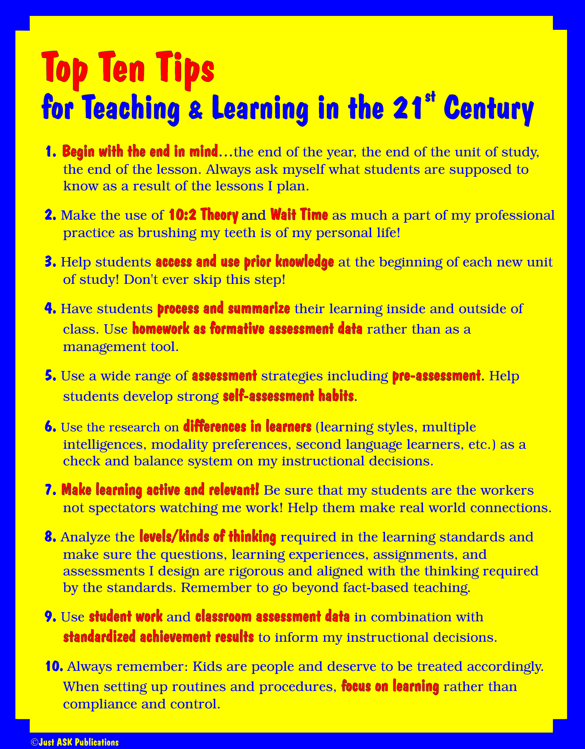
page 5

Slide 76
Top Ten Tips
Read through the Top 10 List
Pick ONE that you feel supports the learning of your students

Slide 77

Save the Last Word for Me!
Rachel Billmyer Strategies to Engage the Minds of the Learner
Form groups of 4 ( or in other words… connect with one other pair)
Person 1 goes first. Read word-for-word the one you picked from the TOP 10 , but say no more!
Person 2 replies making a brief comment, summary, question, or connection (Text to Self, Text to Text or Text to World – E. Keene Mosaic of Thought). The Person 3, 4 and so on around the table
NO CROSS-TALK!!!!
When it gets back to person 1, they get to have the “Last Word”
Person #2 now gets to now share their favorite (Different one). Procedure for responding continues until all member have a chance to share their favorite and Last Word

Slide 78
Planning
What is the focus for your next visit?
What is your next goal?
What skills will you be intentional about including (stances, active learning, lesson design, classroom environment…..)

Slide 80

Summary
ABC…..XYZ

Slide 81
Professional Practice:
Stir the Class p 45 Binder
Active Learning Strategies…..
List your top 3, plus 1 you have use that is NOT in the book
Get UP – Stir the Class – Pair with another
Give one idea and get one – Move on and make a new pair
Continue to do this until time is called
Goal = LOTS of IDEAS!

Slide 82
page 5

Slide 83
Top Ten Tips
Read through the Top 10 List
Pick ONE that you feel supports the learning of your students

Slide 84
Save the Last Word for Me!
Rachel Billmyer Strategies to Engage the Minds of the Learner
Form groups of 4 ( or in other words… connect with one other pair)
Person 1 goes first. Read word-for-word the one you picked from the TOP 10 , but say no more!
Person 2 replies making a brief comment, summary, question, or connection (Text to Self, Text to Text or Text to World – E. Keene Mosaic of Thought). The Person 3, 4 and so on around the table
NO CROSS-TALK!!!!
When it gets back to person 1, they get to have the “Last Word”
Person #2 now gets to now share their favorite (Different one). Procedure for responding continues until all member have a chance to share their favorite and Last Word

