Slide 1
Pbl Principal primer: Bcic
Joanne keim
PBL coordinator, Trainer and Coach
October 2014

Slide 2
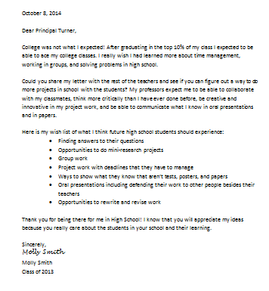
Entry Doc
What does this tell us about how we prepare our students for their future?
Notes:
Handout

Slide 3
Driving question
How can we, as administrators, support our teachers as they plan and implement authentic and rigorous Project Based Learning experiences that are meaningful for our students?
Notes:
Today’s session will involve us exploring how PBL can lead to meaningful learning.

Slide 4
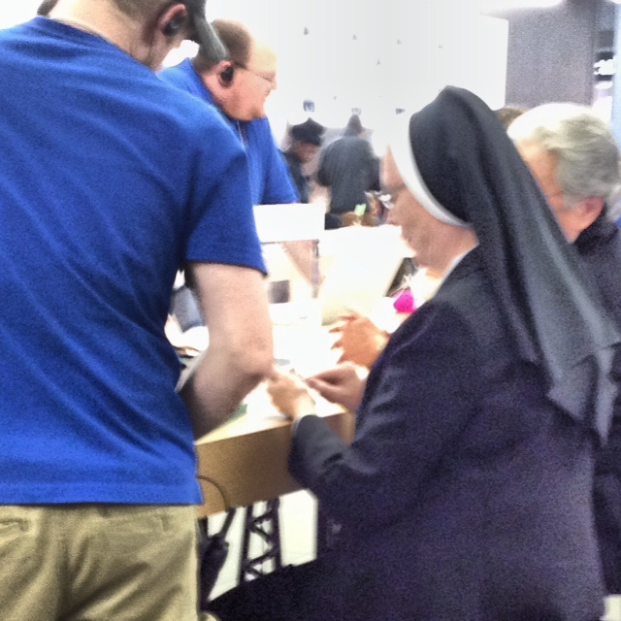
The world has changed!
Picture courtesy of P. Shaw
Notes:
A nun in the Apple Store at Destiny USA learning how to use her smartphone!

Slide 5
Jobs that Did NOT Exist 15 Years Ago
Social Media/Online-Community Manager
3D Animator and Technician
Educational Consultant
Blogger
Sustainability Manager
Search Engine Optimization Specialist
Online Advertising Manager
Elder Care Services Coordinator
Medical Biller/Coder
Forbes.com

Slide 6
The Ideal Graduate a 21st Century Learner
Notes:
6
What skills, knowledge, and personal qualities to you want your ideal graduate to have upon graduation from your program?
Chart out

Slide 7
How can we best prepare students to be ready for their future not our past?

Slide 8
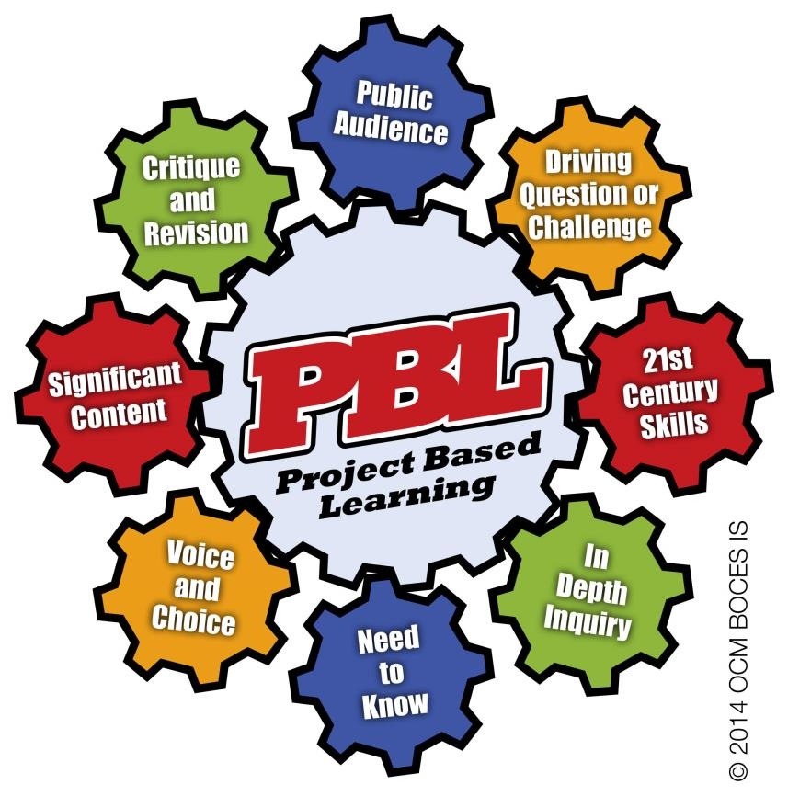

Slide 9
Why use Project-Based Learning?

Slide 10
What if all students. . .
Were motivated?
Were engaged?
Were ready for college and career?
Earned some college credit?
Could communicate?
Could collaborate?
Thought critically?
Creatively solved problems?

Slide 11
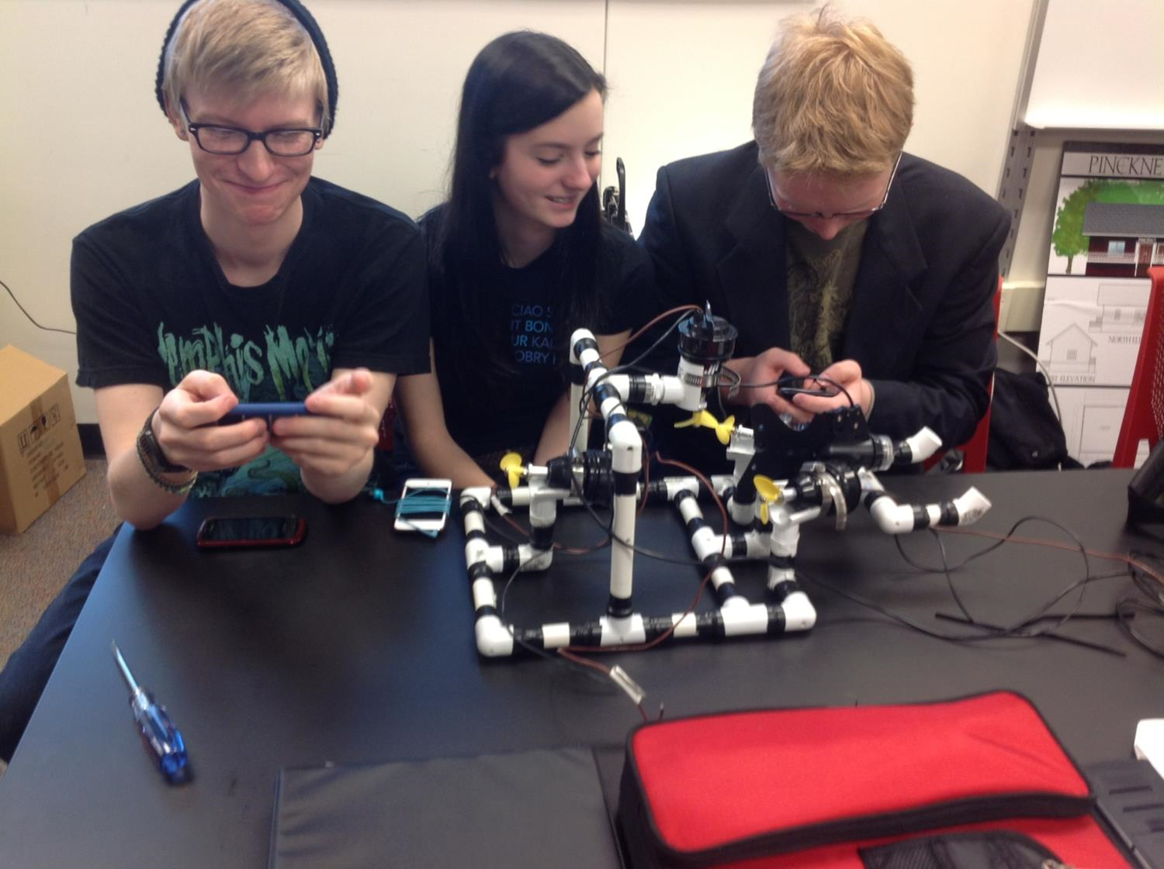
Teaching that Engages

Slide 12
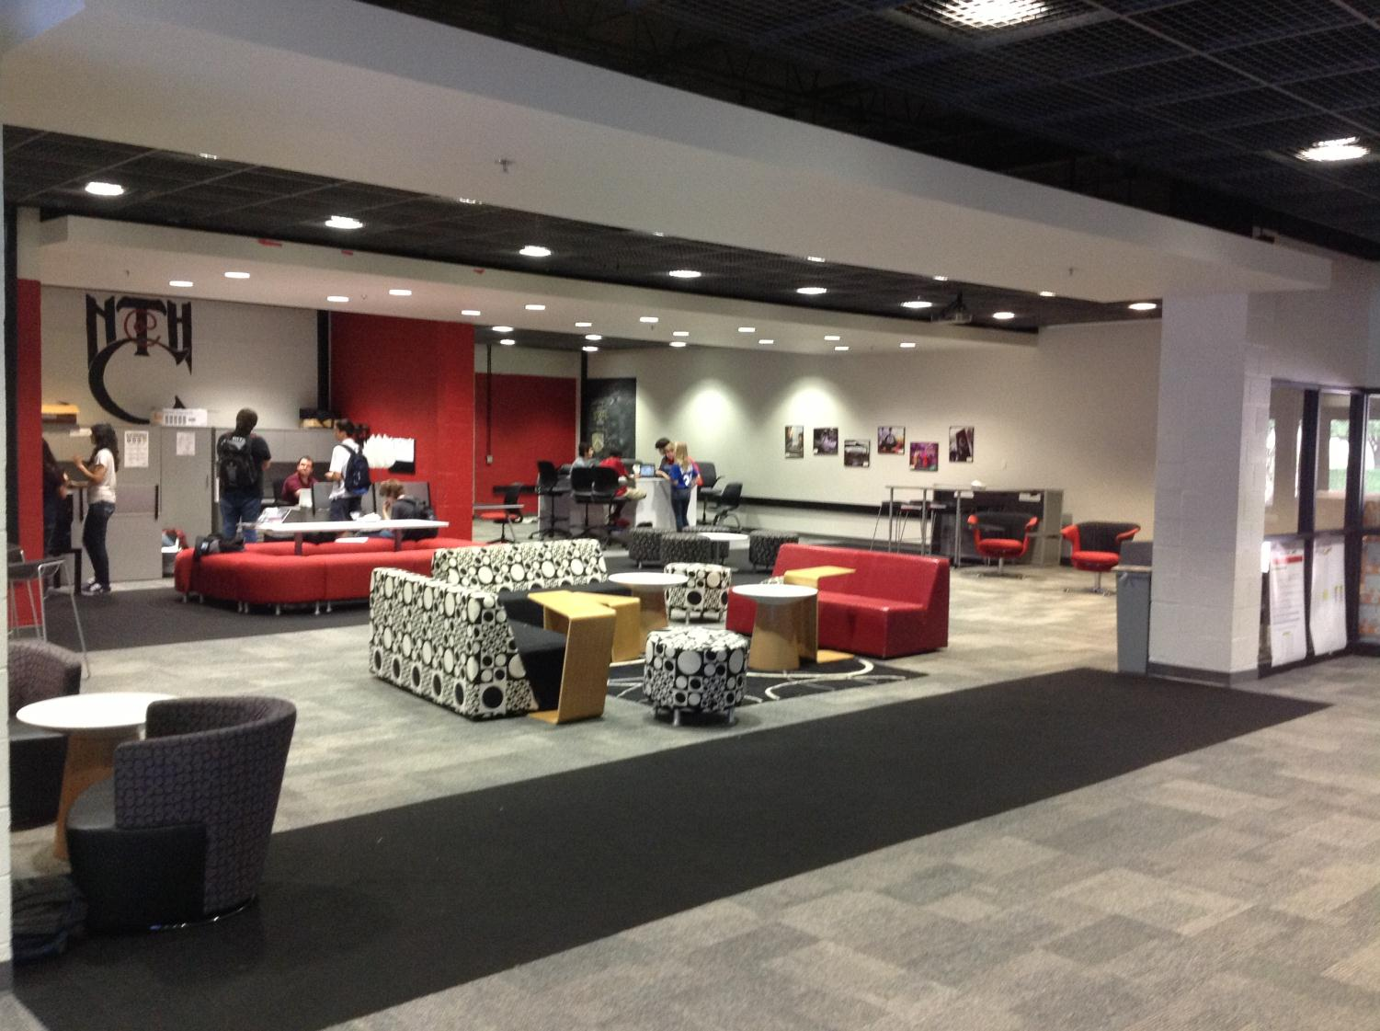
Culture that Empowers
Notes:
Facilities can enhance the learning environment, especially if it “looks” like college and career environments. We saw newer facilities and older facilities – both work as long as space is flexible and allows for larger, integrated classes and student collaboration spaces.

Slide 13
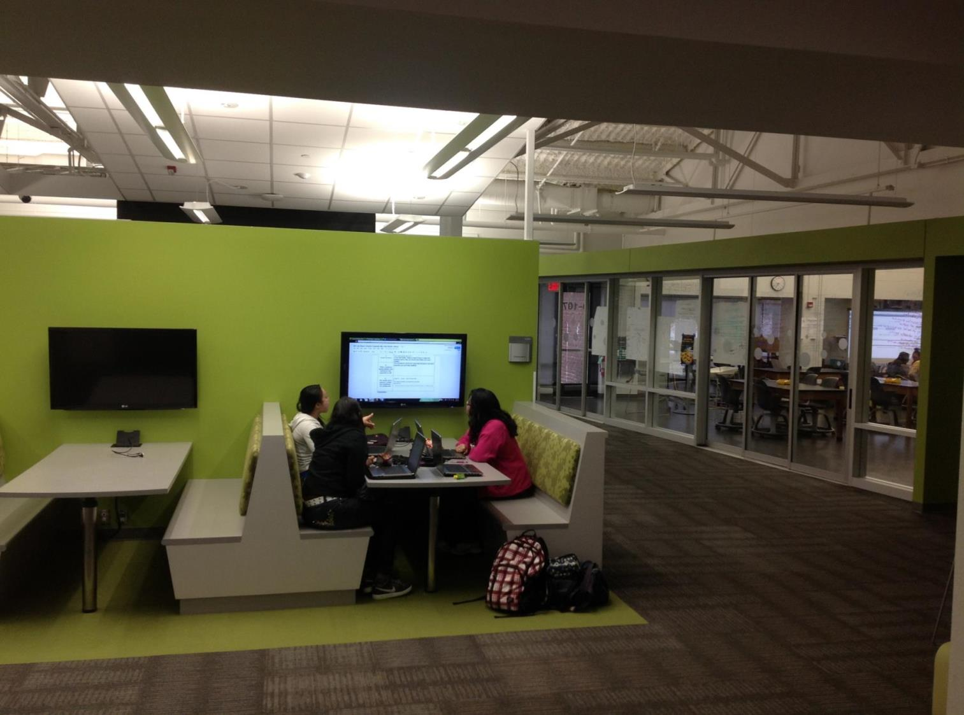
Technology that Enables
Notes:
Collaborative spaces that emulate how people collaborate and use technology in college and career settings

Slide 14
Professional Practice
Standards
PBL as a Regional Vision for 60,000 Students
Data
Culture
Notes:
Regents Reform Agenda has led us to looking at PBL as a vehicle to change schools – our regional vision.

Slide 15
Notes:
The Regents Reform Agenda: close the achievement gap through the implementation of common curricula, data driven instruction, a positive school culture that reflects high expectations for student learning, and a teacher/principal evaluation system aimed at supporting educator effectiveness (APPR).
PBL meets the criteria found in the Regents Reform Agenda.
A PBL project is standards-based with aligned formative and summative assessments that occur throughout the project. The data collected from the assessments will generate enrichment and remediation lessons as needed. Teachers use the data to improve instructional practices within the project and develop necessary lessons to develop students’ knowledge and skills.
PBL is inquiry-based leading to student engagement, development of 21st Century skills, and constructivist learning; the three learning priorities found in the New York State Teaching Standards. Additionally, PBL can be an initiative to change the school culture due to teacher collaboration on interdisciplinary projects and student collaboration in completing projects.
When students and teachers are empowered to make choices about their learning, the culture will naturally be more collaborative and inquiry-based leading to improvement, satisfaction, and achievement.

Slide 16
What is Project-Based Learning?

Slide 17
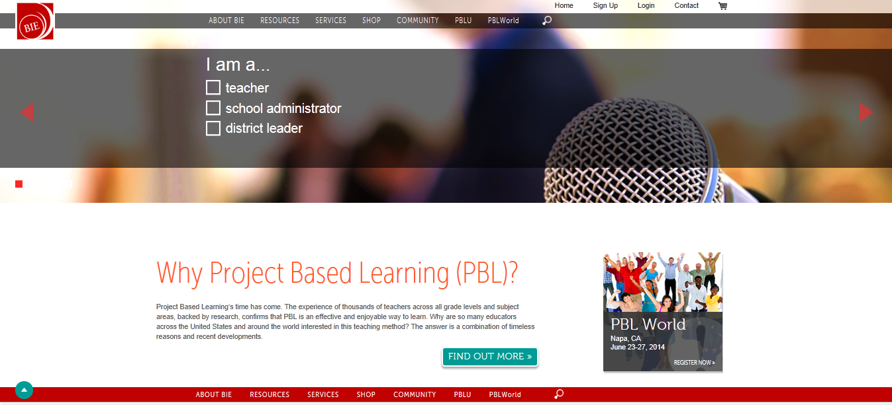
BIE.ORG
Notes:
Buck Institute for Education story

Slide 18
The Buck institute of education
defines pbl . . .
“as a systematic teaching method that engages students in learning knowledge and skills through an extended inquiry process structured around complex, authentic questions and carefully designed products and tasks.”
Notes:
Choose one or two words from this definition that deepens your personal definition of PBL—Share with your shoulder partner—Share whole group.
PBL is curriculum-fueled and standards-based.
PBL asks a question or poses a problem that ALL students can answer. Concrete, hands-on experiences come together during project-based learning.
PBL allows students to investigate issues and topics in real-world problems.
PBL fosters abstract, intellectual tasks to explore complex issues.

Slide 19
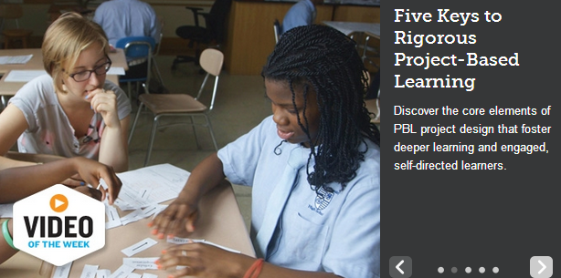
Notes:
https://www.youtube.com/watch?v=hnzCGNnU_WM
6.30 minutes
We know from our own experience that learning is not a spectator sport. Learning requires the student to be actively engaged in the learning process, rather than “passively” absorbing information.

Slide 20
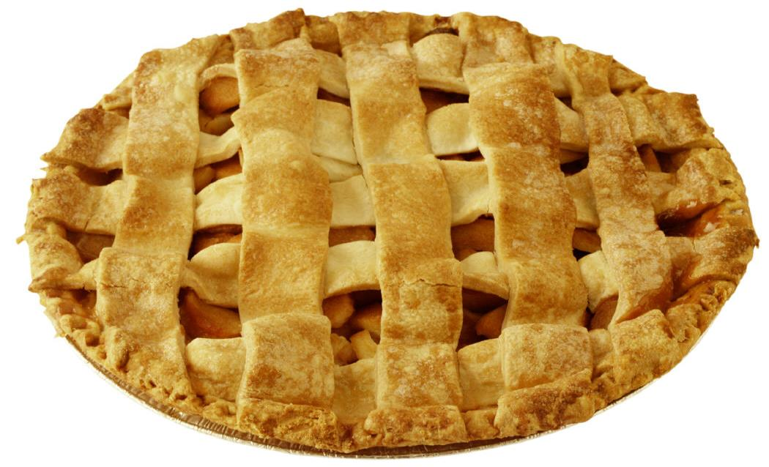
PBL is not a Dessert

Slide 21
pbl is not the project at the end of a unit
New Tech Network

Slide 22
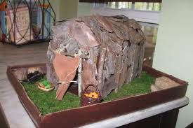
New York State Long House

Slide 23
The Common Core is the WHAT
PBL is the HOW
PBL is the MAIN COURSE – PBL is the UNIT
Notes:
23

Slide 24
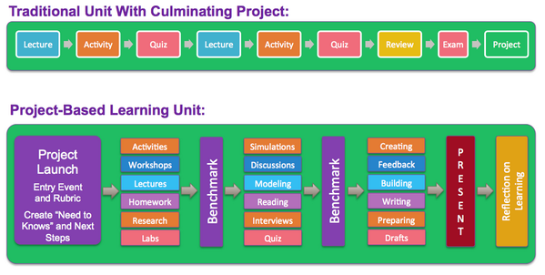
New Tech Network
Notes:
PBL is different from the traditional project.
A traditional unit is linear and teacher-driven with little opportunity to for student voice and choice, revision, collaboration and relevancy.
A PBL unit, incorporates the eight essential elements so that student learning is personalized, meaningful, and deep.
Differentiate the tasks within the project that will help students to answer the DQ and lead the inquiry then create assessment to match the tasks.
Project based learning is an excellent way to differentiate instruction in a full inclusion classroom, especially when that class includes students of widely different abilities, from the cognitively or developmental disabled to the gifted children. Project based learning is also excellent in resource rooms or self contained classrooms with either typically developing partners or with sufficient support or accommodations.

Slide 25
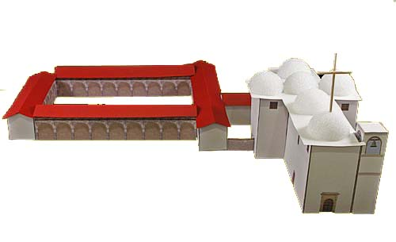
California mission project
BIE.org
Notes:
25
Presenter’s choice of story about a “project” that is dessert, not PBL:
Sometimes people tell us, “we already do projects” – but what they might be doing is what we call a “dessert” project, not truly Project Based Learning.
A “dessert” project comes after traditional instruction; may be fun but is not intellectually engaging; does not require deep understanding, its is often done individually, at home without inquiry, no presentation, etc.
(E.g., California Mission-building in 4th grade)

Slide 26
Dear Keepers of the Missions of Alta California,
The church is eager to establish another mission, the 22nd, after we build the one now being planned for Sonoma.
Please tell us exactly where you think the mission should be located and what it should look like. When you present your ideas, explain how the mission will help meet our urgent goals for this part of the world.
With gratitude,
Archbishop Fonte
Mexico City, 10 June 1818
BIE.org
Notes:
(presenter’s choice of “main course” project example/video)
What if this were the task instead?
(Optional: Do need to know activity. Participants could discuss in pairs: “Pretend you’re a 4th grader given this document on the first day of the unit. What would you say you needed to know in order to do this task?”)
Example of a Main Course project; Curricular focus, not just an add-on.
Students do this task in teams and present their work to a panel of adults playing the roles of church leaders, with a model or other visual aides.
Project takes 3 weeks, during which teacher provides lessons & resources for learning the same content as in the traditionally-taught unit, although some of it is learned through independent student research, not direct instruction.
26

Slide 27
How Does Project-Based Learning Work?

Slide 28
“8 Essentials for Project-Based Learning”
Educational Leadership Article:
John Larmer, John R. Mergendoller, Ph.D. Buck Institute for Education
Notes:
Handout: 8 Essentials Checklist (not this article)

Slide 29
Entry Doc
What does this tell us about how we prepare our students for their future?
Notes:
Handout

Slide 30
Driving question
How can we, as administrators, support our teachers as they plan and implement authentic and rigorous Project Based Learning experiences that are meaningful for our students?
Notes:
Today’s session will involve us exploring how PBL can lead to meaningful learning.

Slide 31
What do you Need to know about PBL?
Need to Know
Notes:
Anticipated Needs to Know
What makes a good project?
How is PBL different from what is already being done?
How does PBL support exceptional students and students placed in an alternative setting?

Slide 32
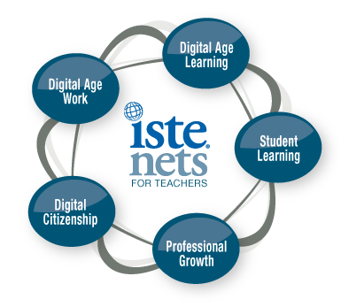
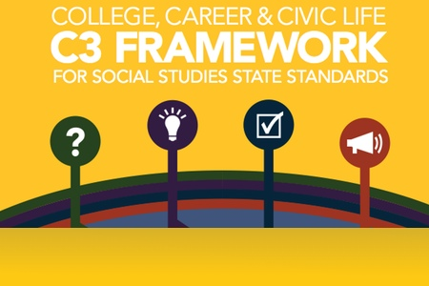
Notes:
All learning experiences found in the project are aligned with Common Core Learning Standards and content area standards
The significant content drives the project—not the end product.
PBL focuses on the process of learning.
Knowledge and skills are scaffolded providing academic support.
This done through by modeling the expected outcome, guided practice, until the student can independently demonstrate learning or the skill.

Slide 33
Seamlessly embedded in the project
One or two are taught and assessed
Collaboration
Creativity
Critical Thinking
Communication
Notes:
4 C’s of 21st Century Career and College Readiness—collaboration, communication, creativity, critical thinking—are seamlessly embedded in a project.
Competencies that should be taught and assessed
Life skills required for future success – in general and in the workplace
Students will get better at these skills if they see them modeled, have the opportunity to talk about them and practice them
‘Moreover, we believe:
Schools (and PBL) can teach these
Students can get better at these skills if they see them modeled, talk about what they are, and practice them.
These skills should be assessed. And they will become even more important if they are explicitly factored into grades and reported to students, parents, and even employers and post-secondary institutions.

Slide 34
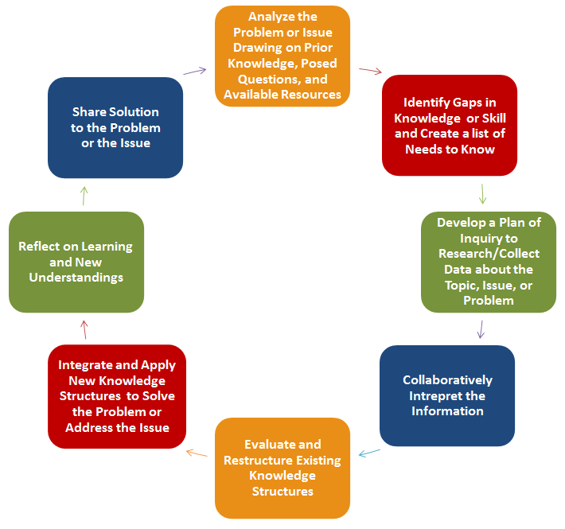
The PBL
Inquiry Process
Notes:
Inquiry is a process and way of thinking that involves:
Asking questions
Digging for answers
Asking new questions
Finding supporting evidence for your conclusions
A project requires students to engage in inquiry.
By “inquiry” we don’t just mean researching something.
We often think of inquiry in terms of science experiments or investigations, or research papers in a history class. But any project can be thought of as inquiry.
For example, designing a website informing citizens of the revitalization project for downtown: Who do we want to visit the site? Why do we want people to visit our site? What information do we want to reveal about the project? What images do we use? What is the best way to present this information on the website so the website is functional and achieves our goals?

Slide 35
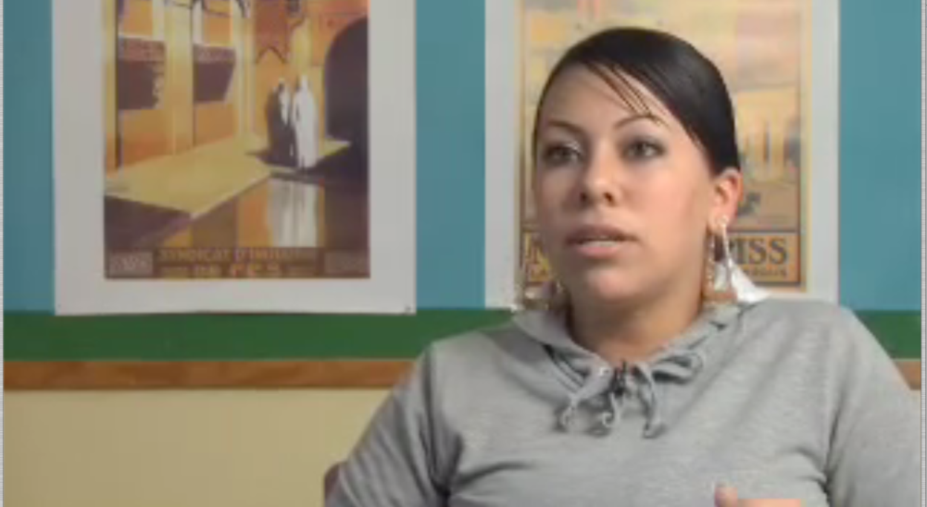
Students make choices, independently and collectively, to express their learning based on their interests, values, or beliefs.
BIE.org
Notes:
Students should have some degree of voice and choice in a project, to increase engagement and encourage independent thinking.
To learn something deeply, students need to internalize it and make it their own.
To be able to use that learning and influence issues that matter to them.
Therefore, student voice activities revolve around the development and application of individual students’ skills, ideas, and connections to others, which make the learning student centered.
Students can help create a Driving Question, or sub-questions for inquiry; decide what products they will create to answer the Question; decide who will do what on a team, what resources to gather, how to organize time and tasks.
Driving Question, Inquiry Questions, End Products, Team Roles and Tasks, Project Timelines, Resources

Slide 36
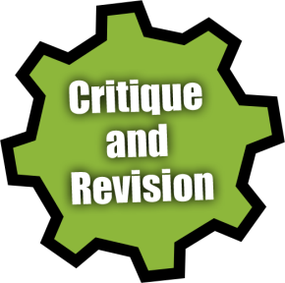
CRITICAL FRIENDS TUNING PROTOCOL
PRESENTERS | Presentation: Project Title & Idea, Driving Question, Culminating Products or Performances, Entry Event*, and any concerns you’d like feedback about | 5 min
EVERYONE | Clarification: Audience asks short clarifying questions | 2 min
AUDIENCE | Good Stuff: Audience shares what they liked about the project Wondering Stuff: Audience shares their concerns and probing questions Next Stuff: Audience shares their thoughts on resources and improvements | 2 min 2 min 2 min
PRESENTERS | Reflection: Group reflects on useful feedback, next steps | 2 min
 | TOTAL TIME | 15 min
BIE.org
Notes:
During a project, there should be frequent opportunities for students to get feedback from peers and the teacher (or other adults) on the quality of their work, so they can improve it.
For example, students, teachers, and partners would review research notes; analyze time and tasks logs; critique rough drafts and prototypes; and provide feedback on practice presentations.
This process of critique and revision, leading to high-quality products, becomes part of the culture of the classroom.
Students also get feedback on how they’re working.
For example, how well their team is collaborating and communicating; how well they are using critical thinking and problem solving skills.

Slide 37
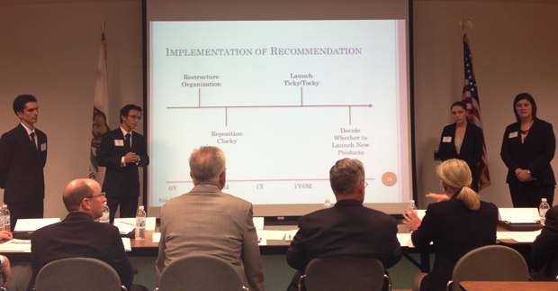
Notes:
There are several reasons why a project should include a presentation to some sort of audience.
It requires students to think of their audience: who are we creating products for, who are we speaking to, and what does this audience need?
It gives students the chance to demonstrate that they have built skills and gained knowledge, and are offering up their work as proof.
It culminates the project with a bang. A big project should have a big finish after all the work.
It motivates students to do high-quality work if they know they have to stand in front of an audience.
It allows for assessment of 21st century skills such as communication and use of media.
It shows the world -- other students, parents, administrators, business and community members -- what your students can do (and how they can dress up!). It impresses people and includes them in a celebration of work well done.
A presentation might be a formal oral presentation, or it could be a showing of student work, or a performance like a debate, a speech, a play, or a piece of music.

Slide 38
Assessing projects
Notes:
38
Use 8 Essentials Handout
Look for the 8 essential elements 5:31
http://www.youtube.com/watch?v=cJ5Z53JAivE

Slide 39
Sustaining and Supporting PBL

Slide 40
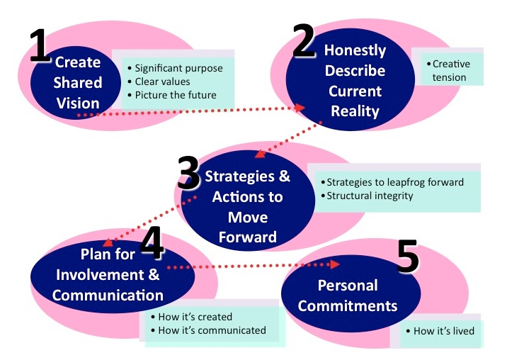
Articulate a Shared Vision
Seapointcenter.com
Notes:
Step 1: Create a Compelling Team Vision
Destination: Where are we going?
Purpose: Why do we exist? What greater good do we serve?
Values: What principles guide our decisions and actions on our journey?
Step 2: Honestly Describe the Current Reality
Examine your current realities in relation to your vision. Identify what’s working and what’s not, your strengths and weaknesses.
Step 3: Identify Key Strategies and “Structural Integrity” that Support Moving Forward
Identify the greatest opportunities to close the gap between your vision and your current reality.
Include some quick wins – to help you see progress and stay motivated.
Create “structural integrity” by ensuring your systems and structures will not derail you as you move forward.
Step 4: Plan for Involvement and Communication
If this work is being done by a leadership team that wants to bring the vision forward to the rest of the organization, your work during this step is to create a plan for involving others in shaping the vision, identifying the roadblocks and the strategies and goals to close the gap.
You will need to present the vision statement as a draft and ask for feedback. Be open to requests for changes in language that do not change the essence of your vision. However, if there is a pattern of requests for substantive changes, it’s possible you may have missed something important and should revisit the first step. You will also need to have ongoing dialogue throughout the organization about the roadblocks and strategies to move forward.
Step 5: Make Personal Commitments
Never leave the room without putting yourself in the vision. As soon as you identify your vision, if you believe in it, you must start to live it, behave consistently with it, and model the values.

Slide 41
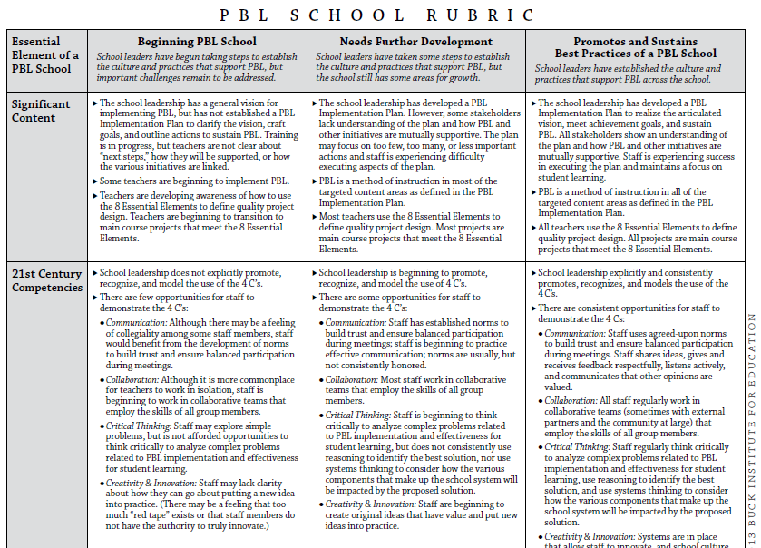
Develop a PBL Culture
BIE.org
Notes:
Handout

Slide 42
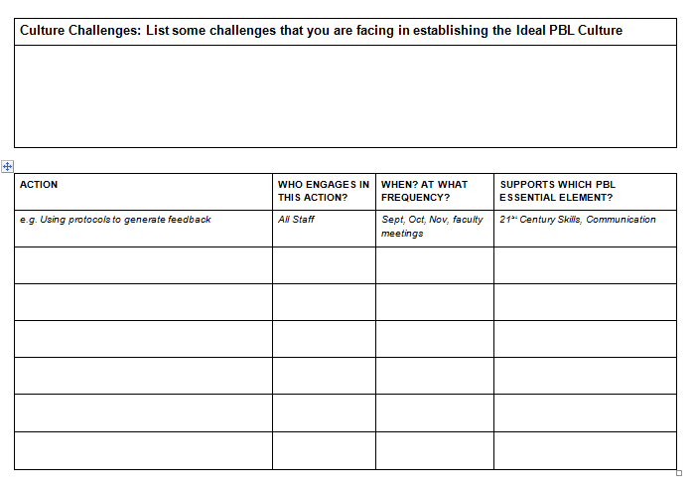
Create an Action plan
BIE.org
Notes:
Culture

Slide 43
Communicate the Benefits of Pbl
Reinforce content retention
Deepen understanding
Multi-sensory instruction
Teaches skills in cooperation and collaboration
Alternate means of assessing students' progress
Student engagement at its best
Jerry Webster, specialed.about.com
Notes:
Reinforce content retention: Project learning has proven, in research, to improve concept retention in a range of students.
Deepen understanding: When students are asked to use content knowledge, they are driven to use higher level thinking skills (Blooms Taxonomy) such as Evaluate or Create.
Multi-sensory instruction: Students, not just students with disabilities, all come with different learning styles. Some are strongly visual learners, some are auditory. Some are kinetic, and learn best when they can move. Many children benefit from sensory input, and students who are ADHD or Dyslexic benefit from being able to move as they process information.
Teaches skills in cooperation and collaboration: Future jobs will require not only higher levels of training and technical skills, but also the ability to work collaboratively in groups. Groups work well when they are chosen by both the teacher and the students: some groups could be affinity based, others could be cross ability, and some could be "friendship" based.
Alternate means of assessing students' progress: Using a rubric to lay out standards can put students of varying abilities on a level playing field.
Student engagement at its best: When students are excited about what they are doing in school, they will behave better, participate more fully and benefit the most.

Slide 44
Launch PBL to the Faculty and staff
Generate Interest and Excitement and “The Why”
Entry Event
Driving Question
Need to Know
Shared Vision
Implementation Plan – “The What and How”
Training and Coaching
Administrative Support
Notes:
“It is much easier to change an organization’s attitude (climate) than it is to change its personality (culture).”
Climate
Developed by the minute, hour, day
Based on feelings, perceptions
Outsiders can feel it when they walk on campus
Short Term
Easy to Change
A component of academic, social and emotional growth
Culture
Develops over several days/months/years
Based on beliefs and values
Staff members cannot feel it just by walking through
Long Term
Harder to change
Integral to academic, social and emotional growth

Slide 45
PBL Administrator Training
401-Bringing PBL to Scale
402-Creating a Supportive PBL School Culture
403-Evaluating Teacher Performance in a PBL Classroom
understand the eight essential elements of a project
develop a shared PBL vision (district and/or building)
assess the current district/school culture
generate an action plan for district-wide or school-wide PBL implementation, which includes scheduling training and coaching –or– create an action plan to support teachers who have been trained in PBL 101
assess the current district/school culture
generate an action plan to:
establish collaborative inquiry and critique
examine student work and critiquing projects (DDI/RTI)
determine strategies for involving parents and the community
Prerequisite PBL 401
collect evidence found in a project using the district rubric
develop coaching strategies to use during pre- and post-conferences to strengthen PBL and standards-based education practices
use rubrics and protocols in designing high-quality projects and creating a classroom culture of inquiry and critique
practice using teacher reflection strategies to improve student learning
make connections between the NYS Teaching Standards and PBL
Prerequisite PBL 401
Notes:
Handout

Slide 46
Joanne Keim
jkeim@ocmboces.org
@ jkeim11 #pblny

