Slide 1
BCIC Meeting
December, 2013

Slide 2
Welcome
Introductions
Overview of Agenda

Slide 3

SED Updates

Slide 4
New York State
Assessment Update
December 2013

Slide 5
3-8 ELA Test
Split into 3 books
Administered across 3 days
Day 2 will consist of one book with both multiple-choice and constructed response questions
Grades 5-8, Day 2 will have fewer passages and questions than Day 2 of the 2013 tests

Slide 6
3-8 Mathematics Test
Fewer questions on the 2014 Grades 3-8 Mathematics Tests than the 2013 tests
Shorter administration times for the 2014 Grade 3-8 Mathematics Tests than in 2013;
Clarifications to the Mathematics rubrics and scoring policies; and
Change in Grade 8 content emphasis

Slide 7
8th Grade Math Testing
SED has applied for the waiver to USDOE
Allow A1 proficient score to serve as 8th grade proficient score
Would require an additional math test in High School
This is for THIS year

Slide 8
Common Core ELA Regents
The Common Core ELA Regents Exam (Grade 11) is required for those students first entering grade 9 in 2013-14 or later

Slide 9
Common Core ELA Regents
For January, June & August, 2014 administrations only, students enrolled in CC English courses may, at local discretion, take both
The Board of Regents altered regulations at the November meeting to allow for the widespread administration of the Regents Comprehensive Examination in January.

Slide 10
Common Core ELA Regents
The higher of the two scores may be used for local transcript purposes, and will be used for institutional accountability for the 2013-14 school year
Students may meet the exam requirement for graduation by passing either exam (old exam or new CC exam)

Slide 11
Common Core ELA Regents
January survey to ask if districts are planning to have students take CC test in June to find out if enough for standard setting (If yes, how many students?)
Regents exams/items will be fully released by summer 2014 so we will see it once administered, not secure for now.

Slide 12
Common Core ELA Regents
Part 1 – reading comprehension with 24 questions requiring close reading and an understanding of the whole text, one literary nonfiction, one literature piece and likely one poem. Incorrect answers are text based and plausible and based on likely misconceptions if they didn’t understand full text.
Part 2 – writing from sources different from a DBQ so no comparison, it will not allow for drawing upon outside knowledge, must draw on text only, writing a source based argument. Part 2 is significant emphasis and likely will be weighted as such.
Part 3 – text analysis, not an extended response as in Part 2. Two to three paragraph response that identifies a central idea, authors writing strategy or literary technique

Slide 13
Common Core ELA Regents
Test Part | Suggested Time | Standards Addressed (coverage will vary) | Text Description | Student Task
PART 1 READING COMPREHENSION | 60 minutes | RL.1-6, 10 RI.1-6, 8-10 L.3-5 | 2 – 3 texts Up to approximately 2,600 words total Each test will contain at least one literature and one informational text. | Students will perform a close reading of the texts and answer 24 multiple-choice questions.
PART 2 WRITING FROM SOURCES | 90 minutes | RL.1-6,10-11 RI.1-10 W.1, 4,9 L.1-6 | 2 – 5 texts Up to approximately 2,600 words total Each test will contain at least two informational texts and, in addition, may contain graphics or one literature text. | Students will perform a close reading of the texts and write a source-based argument, as directed by the task.
PART 3 TEXT ANALYSIS | 30 minutes | RL.1-6, 10 RI.1-6, 8-10 W.2,4,9 L.1-6 | 1 text Up to approximately 1,000 words Each test will contain one literature or one informational text. | Students will perform a close reading of the text and write a two to three paragraph response that identifies a central idea in the text and analyzes how the author’s use of one writing strategy (literary element or literary technique or rhetorical device) develops this central idea.
Overall, the test requires that students read closely 5-9 texts of up to approximately 6,200 words and that they answer 24 multiple-choice questions, write one source-based argument, and one text-based response that identifies a central idea in the text and analyzes how the author’s use of one writing strategy develops this central idea. The test assesses Common Core Learning Standards in Reading, Writing and Language for the Grade 11-12 span, but, due to the integrative and cumulative nature of the standards, items may also assess standards in earlier grade bands. Exact standard coverage will vary from test to test based on the texts and writing tasks used.

Slide 14
Common Core A1 Regents
The Common Core Algebra I Regents Exam is required for those students first beginning commencement-level math in 2013-14 or later (so, too, is CCLS-aligned instruction)
Other first administrations
Geometry (Common Core) – June 2015
Algebra II (Common Core) – June 2016

Slide 15
Common Core A1 Regents
For the June 2014 , August 2014, and January 2015 administrations only, students enrolled in Common Core classes may take the old ELA or math exam in addition to the new exam and have the higher score count.
The June 3, 2014 results for the Regents Exam in AI (CCLS) will NOT be available before the Regents Exam in IA on June 20th

Slide 16
Common Core A1 Regents
Assessment changes:
Focus on the priority Standards
Fluency according to PARCC
Multiple problems on the same standards
Four good resources: Progressions documents; PARCC Model Content Frameworks; A Story of Functions; Illustrative Mathematics

Slide 17
Common Core A1 Regents
Test Blueprint
Conceptual Category | Percent of Exam by Points
Number and Quantity | 2% - 8%
Algebra | 50% - 56%
Functions | 32% - 38%
Statistics and Probability | 5% - 10%

Slide 18
Common Core A1 Regents
2014 Regents Exam Test Design
Algebra I Exam | Number of Questions | Point Value per Question | Total Point Value per Section
Part I | 24 MC | 2 | 48
Part II | 8 CR | 2 | 16
Part III | 4 CR | 4 | 16
Part IV | 1 CR | 6 | 6
Total | 37 | - | 86

Slide 19
Common Core Regents Exams
Likely to have five levels of distinction rather than the four we have had
Resources continue to be posted:
ELA 11 resources
A1 resources
Test guides soon
Transition memo (the September update)

Slide 20
PARCC
No PARCC in 2014-2015
Continue to prepare for computer-based testing
Wider net for field testing volunteers
Release of sample items continues
Maryland now LEA state
Final decision???

Slide 21
PISA
Test is a little different than the others
US results unchanged
Other countries “moving ahead”
Job growth in the industrialized world has almost exclusively been at the top end of the PISA skill distribution,” explained Schleicher, “while routine cognitive skills, the kinds of things that are easy to teach but also easy to digitize and outsource, have seen the steepest decline in demand.”
Notes:
As quoted in http://www.nytimes.com/2013/12/08/opinion/sunday/friedman-cant-we-do-better.html?_r=0

Slide 22
PISA
Poverty matters
Early childhood matters
The highest performing countries are pursing goals and strategies that are different than the US
AFT video

Slide 23
PISA – So What?
The most successful students are those who feel real “ownership” of their education
Students feel they personally can make a difference in their own outcomes
Students feel education will make a difference for their future

Slide 24
PISA – So What?
Culture in the highest performing PISA schools:
Teachers participate in shaping standards and curriculum
Teachers have ample time for continuous professional development
Ample planning and collaboration time
Teachers have ownership of their practice and standards, and hold each other accountable

Slide 25
Curriculum News
SS Frameworks
NGSS
Arts

Slide 26

Legislative Updates

Slide 27
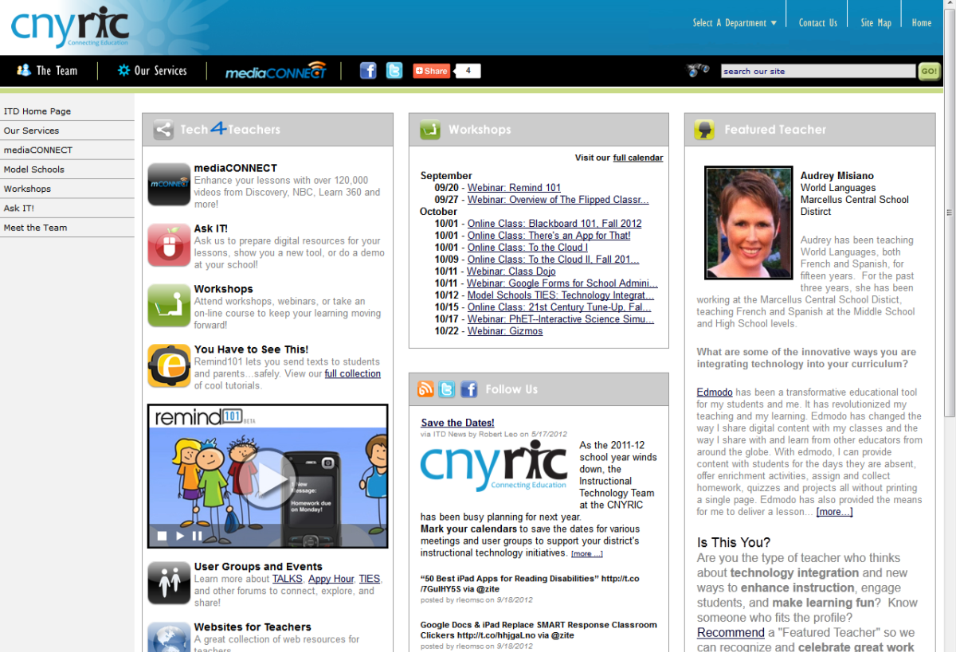
ITD

Slide 28
CI&A: Jan through Feb Break
Jan 14 and 15- Classroom Instruction that Works.
CCLS for SS Teachers 6-12: Jan 17
PBL 101- Feb 3
Developing Collaborative Groups: Adaptive Schools- Feb 4
Feb 4- Differentiated Instruction
Students from Poverty- Feb 11
Instructional Strategies for Students from Poverty-Feb 12

Slide 29
Teacher Centers

Slide 30
Higher Education

Slide 31
CNY NYS ASCD
Data-Driven Instruction theme
October 9: What’s a PLC, Really?
December 10, 2013 – How To Talk (About Common Formative Assessments)
February 27, 2014 – Now What? (Tier 1 Strategies)
March 19, 2014 – How Do I Teach Every Kid? (Meeting the Needs of Diverse Learners)
May 15, 2014 – Annual Meeting at Dinosaur

Slide 32

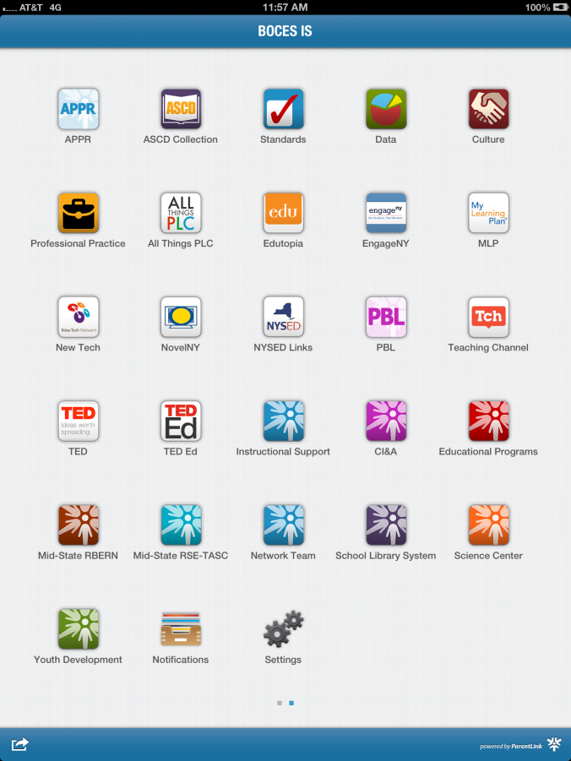
BOCES IS app

Slide 33
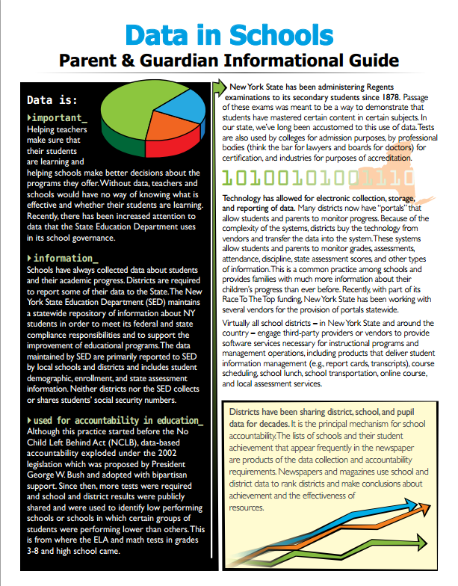

Slide 34
OCM BOCES Facilities
Responsible Planning
for the Future

Slide 35
Facilities Planning
Current Condition
Challenges
Desired State
Proposed Solutions

Slide 36
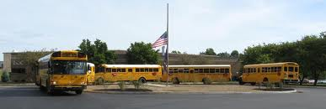
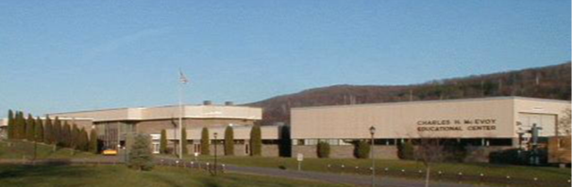
Current Condition
Owned Facilities
Leased Facilities
McEvoy (acquired 1969)
Henry (acquired 1975)
Career Training Center
Rodax 1-3 (CNYRIC)
Rodax 7/8
Science Center
Kasson Road School
St. Cecilia’s School*
Liverpool Community Church*
Cortland Alternative School
* = currently for sale
Henry Campus, Syracuse, NY
McEvoy Campus, Cortland, NY
Notes:
OCM BOCES owns two campuses; our other sites are leased from school districts or other community entities

Slide 37
Challenges
Increasing enrollment in special education
Limited ability to grow in adult education
Adult education students and K-12 students in same building
Meeting district needs
Responsiveness to business community
Quality of leased buildings
Lack of adequate space for instructional programs
Containing the rental budget
Segregated setting at Kasson Road School
Notes:
Because of the nature of the varied services a BOCES provides, facilities can be a challenge. Some of our services are provided centrally, others are provided in our component school districts. While leasing provides flexibility, it is not necessarily the most cost-effective approach.

Slide 38
Desired State
Adult Education in its own facility
Adequate space for programs
Modest amount of room for expansion
Minimize (but not eliminate) leasing
Control growth of capital/rental costs
Notes:
Presently, we have adult education students sharing facilities with K-12 students. The educational needs of these two groups are different. Separate facilities provide better opportunities for each group. If we could relocate our adult education programs to a separate location, space for other cramped programs could be realized. OCM BOCES is growing and that is another reason why additional space is important. If we can accomplish these goals through the consolidation of multiple leased spaces into a BOCES-owned location, programs can be better served and our lease costs can be contained.

Slide 39
Possible Solutions
Status quo
Lease additional space
Do a capital project
Reallocate leasing expenses

Slide 40
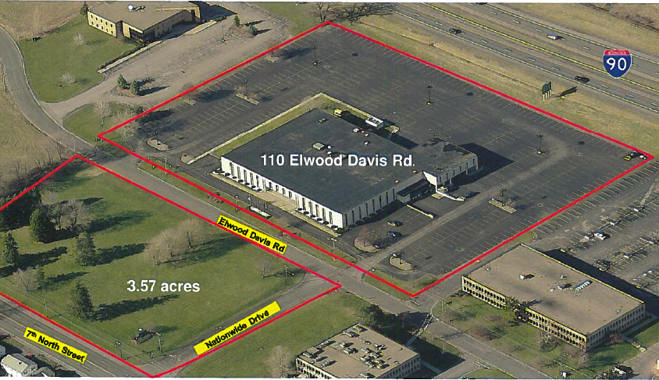
Proposed Solution
Purchase an existing facility and convert it to our use: “Nationwide Building”
Notes:
A facility exists in our community that can meet some of the challenges. There is a now vacant building, located between 7th North Street and the Thruway in the Town of Salina, that is the right size to meet BOCES’ needs. This facility would be home to the adult education programs in Onondaga County. Additionally, it is large enough to allow us to relocate administration, the Science Center, and other departments, allowing us to eliminate several of our leases.

Slide 41
Proposed Solution
Discontinue some leases, moving those programs to the newly purchased facility
Adult Education (from CTC)
Instructional Support (from Rodax 7 & 8)
Administration (from Henry)
Conference Spaces (from Henry & Rodax)
Science Center (from Corporate Drive)
Notes:
This slide lists the programs and departments that would relocate to the new location.

Slide 42
Proposed Solution
Discontinue other leases, moving those programs to the newly vacated facilities
Kasson Road special education program to CTC
STARS alternative high school from St. Cecilia’s in Solvay to Henry
Notes:
This slide lists programs that would move as a result of the changes listed on the previous slide.

Slide 43
Proposed Solution
Present Scenario
CTC $927,000
CAS $245,000
Alt Hmb $ 66,000
Rodax 1-3 $490,000
Rodax 7/8 $138,000
Sci Ctr $ 86,000
St. Cecilia’s $ 51,000
Kasson Rd $135,000
Summer $ 63,000
Site-based $165,000
$2,366,000
Adult Ed-Rental Budget ($410,000)
CNYRIC ($203,000)
$1,753,000
New Debt Srv $ 0
Adult Ed-Debt Paymt $ 0
Net Total $1,753,000
Proposed
CTC $927,000
CAS $245,000
Alt Hmb $ 66,000
Rodax 1-3 $490,000
Rodax 7/8 $ 0
Sci Ctr $ 0
St. Cecilia’s $ 0
Kasson Rd $ 0
Summer $ 63,000
Site-based $165,000
$1,956,000
Adult Ed-Rental Budget ($ 0)
CNYRIC ($203,000)
$1,753,000
New Debt Srv $410,000
Adult Ed-Debt Paymt ($410,000)
Net Total $1,753,000
Notes:
This slide summarizes our leases and debt services. In the scenario we are proposing, the amount of expense saved from the elimination of several leases will directly offset the debt service on the purchase of the building.

Slide 44
To Acquire a Facility
Requires referendum of the “qualified voters of the BOCES district” (popular vote)
Citizen of the US
Age 18
Resident within BOCES for
30 days prior to the referendum
Notes:
A referendum is required to approve the purchase of the building.

Slide 45
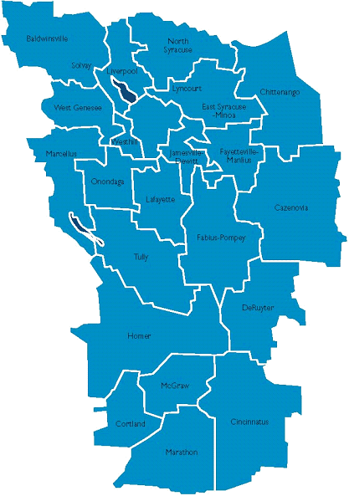
Referendum Details
Thursday, January 23, 2014
10am – 8pm
Three BOCES locations:
  CTC, Liverpool (Main Entrance)
  Henry Campus, Thompson Rd
  (Administration Building)
  McEvoy Center, Cortland
  (Adult Education Entrance)
Notes:
These are the details of the referendum

Slide 46
Summary
Improved facilities for our students
Purchase an existing facility and convert it to our use
Discontinue some leases, moving those programs to the purchased facility
Reallocate funds, net cost ≈ $0
Notes:
Highlighted points

Slide 47
District Sharing
Onondaga Central School District

Slide 48

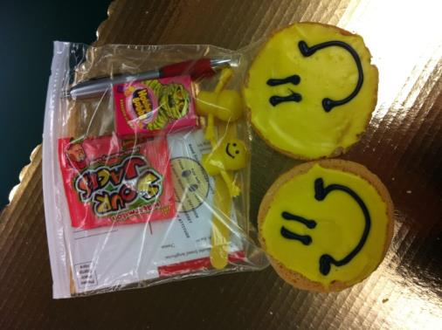
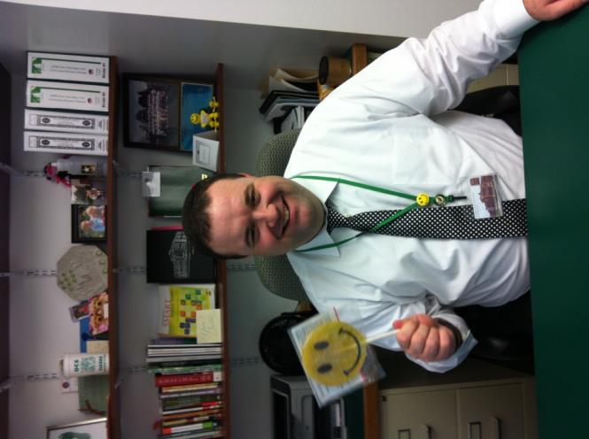

Smile Therapy
Daily Stories, Wisdom, Tips, & Life Lessons
Smile-Therapy.com

Slide 49
Race To The Top
(the Regents Reform Agenda)

Slide 50
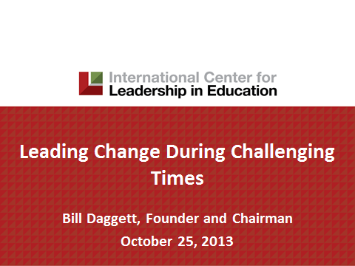
The Need for Change
Bill Daggett
January 9, 3-6p
Rodax 8
Open Enrollment
until full
Superintendents
& other leaders

Slide 51
Network Team- Regional January
Literacy Leadership Network- Jan 15
CCLS- Math Digging Deeper into Algebra 1- Jan 16
ELA Module Support Network Grades 3-8: Jan 22 or 23
CCLS- Math Digging Deeper into Geometry-Jan 23
Math Networking for K-2 – Jan 27

Slide 52
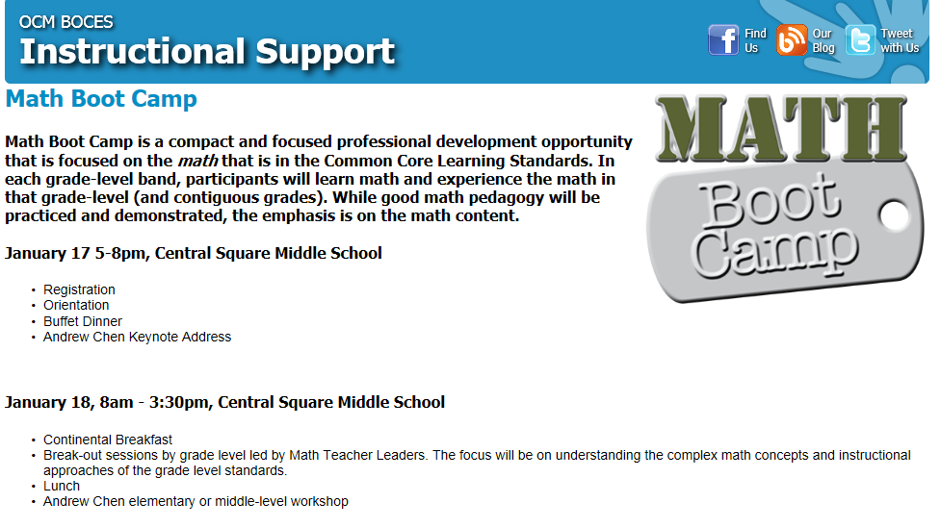

Slide 53
Core Research
Research and the
Common Core Learning Standards (CCLS)

Slide 54
Research:
January 31st for Elementary
February 3rd for Middle and Secondary Levels
At McEvoy

Slide 55
Data-Driven Instruction

Slide 56
PLCs at Work
Follow-up sessions
Coaching available
CNY NYS ASCD Focus
Still working out August 12-14, 2015, to host the real thing in Syracuse. What kind of interest do we have (we have to make a big commitment)?

Slide 57
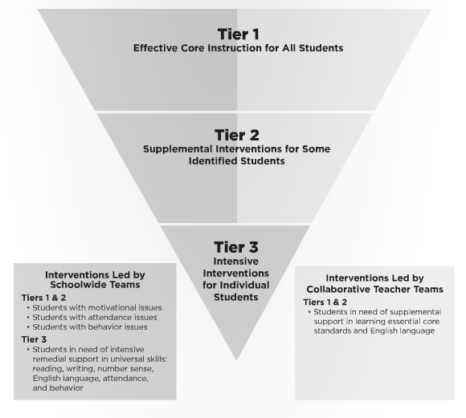
Turn Your RtI Upside Down
Mike Mattos
October 24, 2014
On BOCES
calendar
SRC Arena
is reserved
What do you
think?

Slide 58
Professional Practice

Slide 59
Lead Evaluator Training
From the Review Room: “Describe the process by which evaluators will be trained and the process for how the district will certify and re-certify lead evaluators. Describe the process for ensuring inter-rater reliability. Describe the duration and nature of such training.”
Make sure all of your Lead Evaluators
are getting their required training to be
re-certified

Slide 60
Culture

Slide 61
Assessment & Systems Thinking
 | Classroom Assessments |  | Common Formative Assessments | Common Interim Assessments | Student Learning Objectives | External Assessments
Examples | Worksheets, classroom response, whiteboards, exit tickets, conferences, student self-assessment | Chapter/unit tests, final projects | Common tasks and prompts assessed with rubric, quizzes | Performances, tests, or writing prompts given every 6-8 weeks | Growth measures designed for use with the APPR growth and local achievement | 3-8 tests, Regents exams, SAT, AP
Format | Very formative; can be diagnostic if used prior to instruction | Mostly summative | Formative | Formative and summative | Summative | Very summative
Responsibility | Classroom teachers | Classroom teachers | Grade level/discipline teams of teachers working together. District teams of representative teachers may also look at the data |  | Teachers and lead evaluators/principals | An external group of “experts”
Purpose | Provides immediate feedback and guides instructional decisions | Provision of grades | To assess student learning in order to make instructional decisions. Also serves to assess curriculum, instruction, and pacing. |  | Conversion to scores for use in teacher and principal evaluation | Accountability and placement

Slide 62
Long Term Planning

Slide 63
RTTT Reporting

Slide 64
Other Business

Slide 65
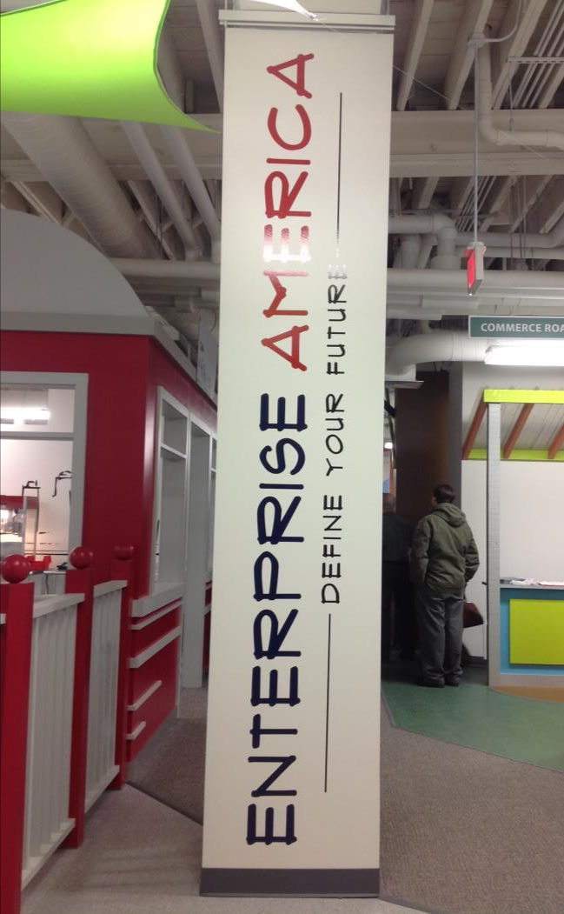
Ready to book
$1175 per class
Like a science kit/system
Aidable

Slide 66
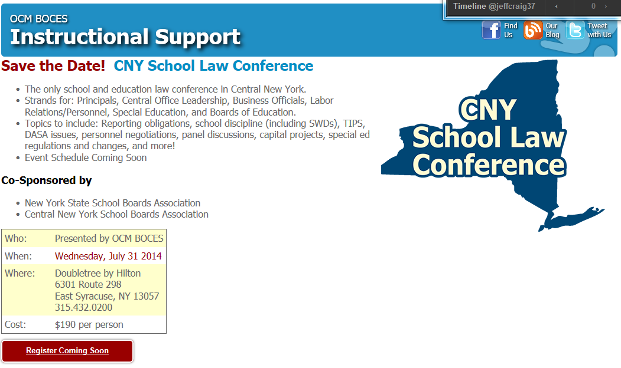

Slide 67

August 5-7, 2014

Slide 68
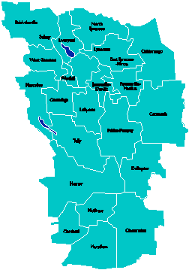
A Vision for Education in
Central New York
College, Career
& Citizenship Readiness
Notes:
Talk about where this vision came from. While it is Colleen and Jeff presenting, the Student Services committee and others have been visiting schools, talking about the future, and developing this vision. In the midst of all the compliance stuff like SLOs, and vested interest, and APPR, it’s been re-invigorating to think about the future and to think about our kids and their future.

Slide 69


Home Sweet Home
Notes:
We struggled to identify our goal for the year, as an organization, when it suddenly occurred to us that it doesn’t matter what we think the goal might be, the world has given us the goal – preparing kids for their future rather than the adults’ past. Now, it might be different on some other planet, but things have changed on this planet – and so, too, must school change.

Slide 70
What if…
… all students were intrinsically motivated?
… all students were intrinsically engaged?
… all students were ready for college and career?
… all students earned some college credit?
… all student could communicate? Collaborate? Think critically? Creatively solve problems?
Notes:
And so we went looking for schools that represented a vision…

Slide 71
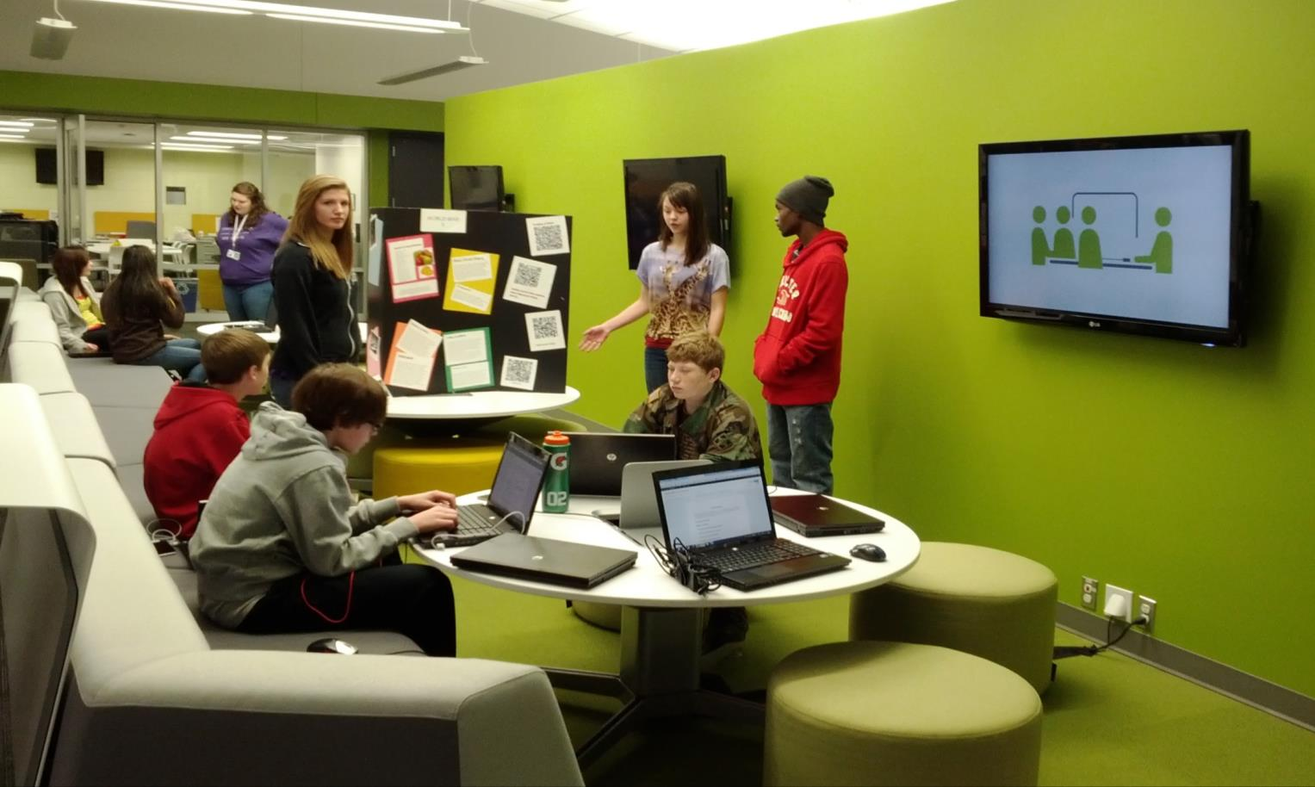
What Might that Look Like?

Slide 72
We Found “It” at New Tech
Started in 1996 in Napa, California
Businesses had concerns that high school graduates did not have essential skills
Funding from Bill and Melinda Gates Foundation
120 New Tech Schools
  Across 18 States in the U.S. and in Australia

Slide 73
New Tech Students:
Grow 75% more in higher order thinking skills between freshmen and senior years than comparison group.
Graduate at a rate 6% greater than the national average.
Enroll in college at a rate 9% greater than the national average, regardless of locale.
Persist in 4-year colleges at a rate 14% higher than the national average and in 2-year colleges at a rate 43% higher than the national average.

Slide 74
A Vision for Education in CNY
Teaching that Engages
Culture that Empowers
Technology that Enables

Slide 75
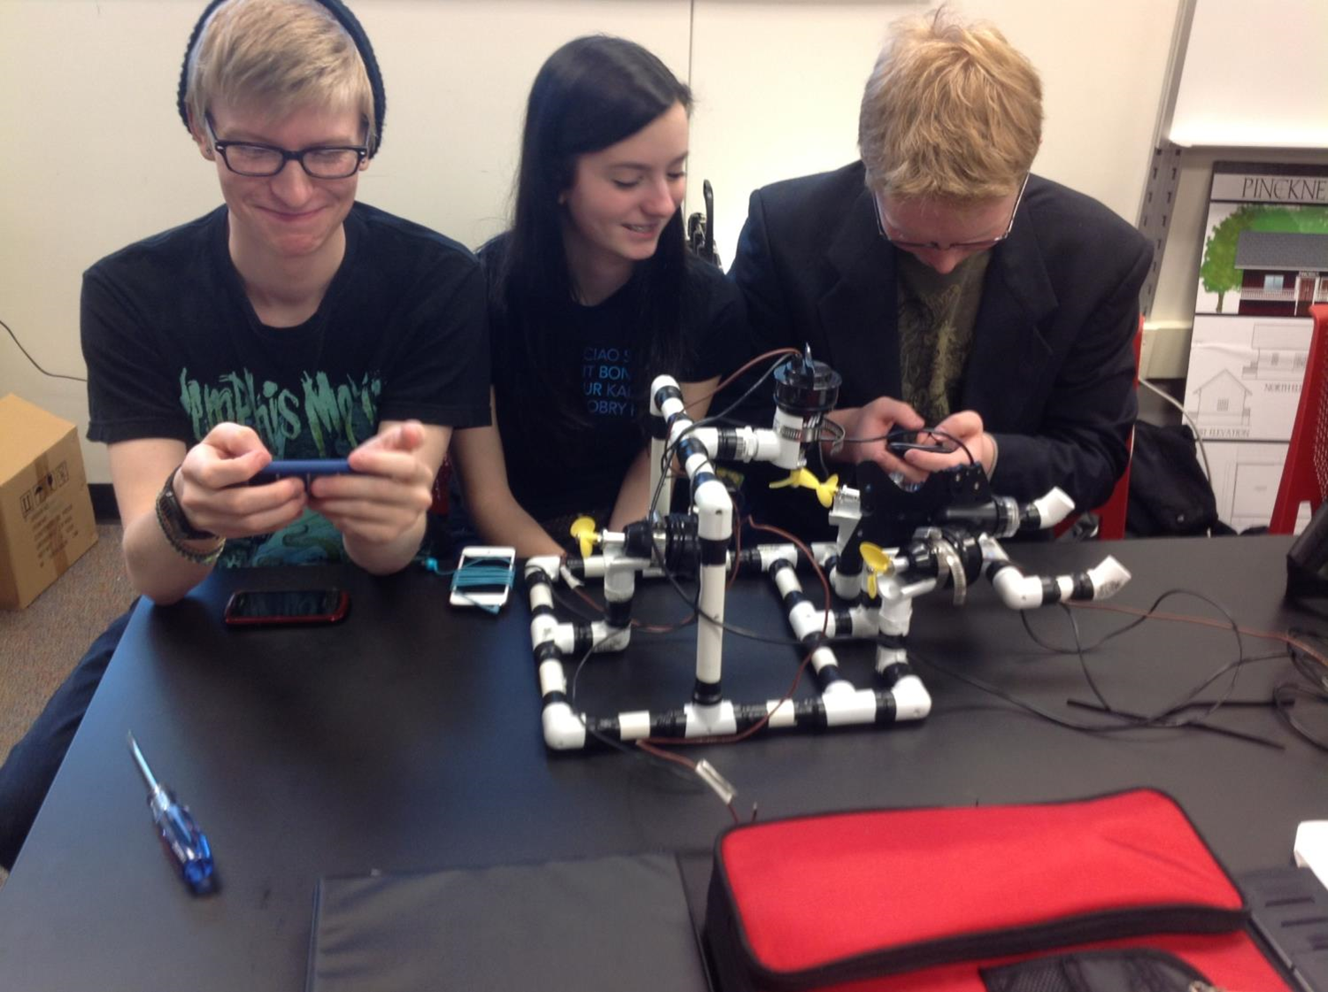
Teaching that Engages
Notes:
This is one way of thinking about the vision – all that this one picture expresses.

Slide 76
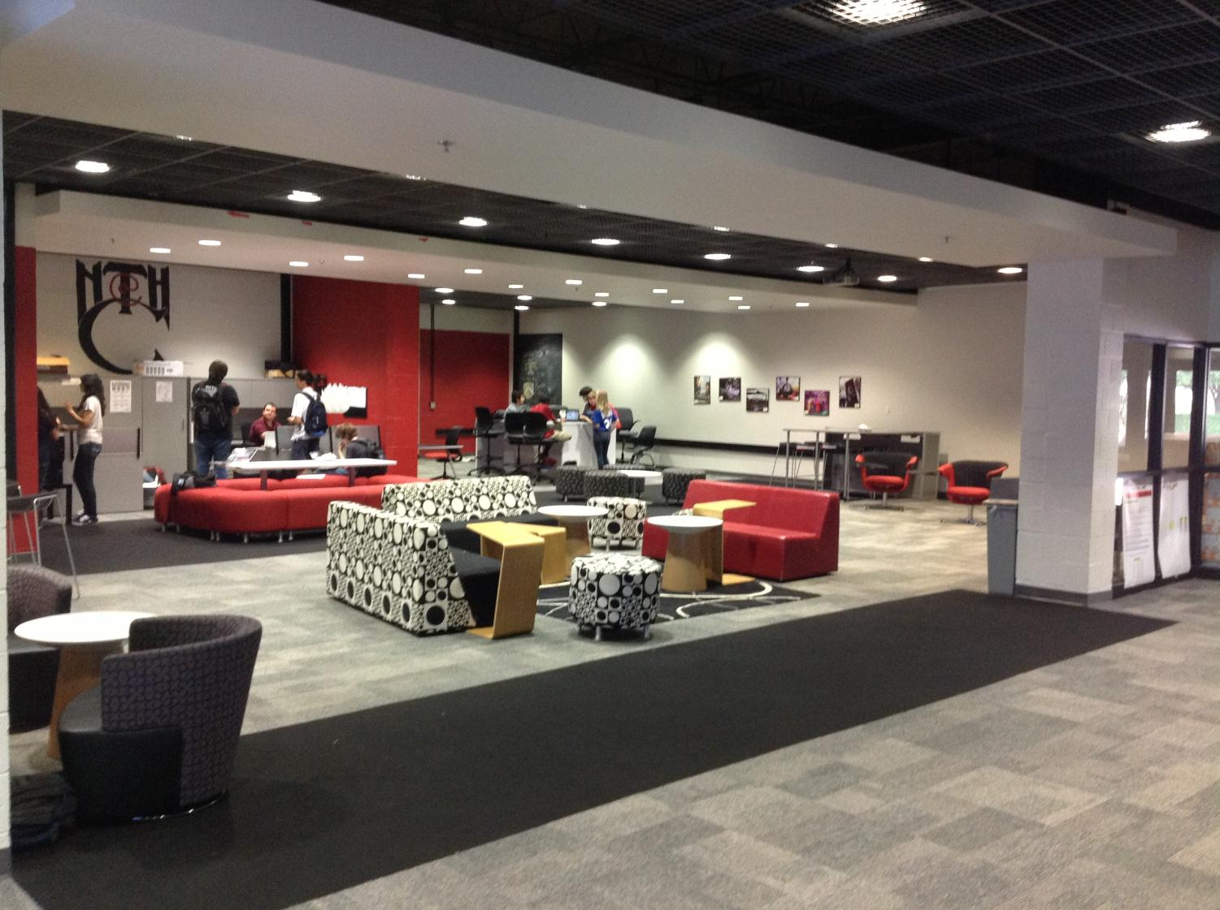
Culture that Empowers
Notes:
Facilities can enhance the learning environment, especially if it “looks” like college and career environments. We saw newer facilities and older facilities – both work as long as space is flexible and allows for larger, integrated classes and student collaboration spaces.

Slide 77

Technology that Enables
Notes:
Collaborative spaces that emulate how people collaborate and use technology in college and career settings

Slide 78
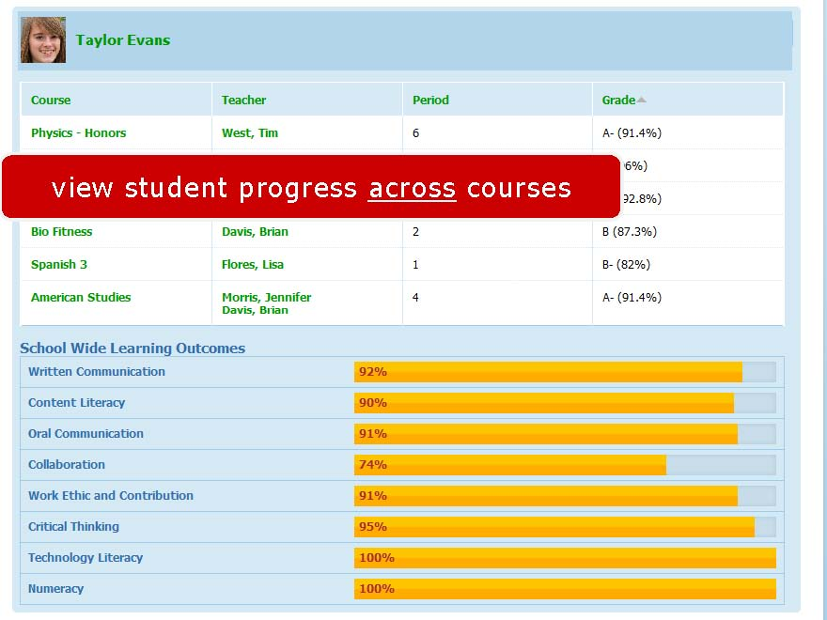
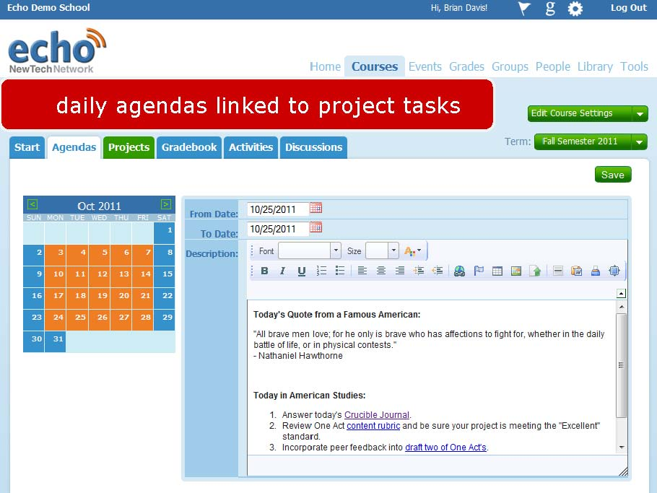

Slide 80
What does it REALLY mean to be College, Career & Citizenship ready?
Notes:
It starts with this as the goal. We’ve all done the three question activity or thought about this. New Tech, by the way, has the “school success rubric” that does the best job of capturing this that I’ve seen…

Slide 81
College Readiness in NY:
75%
ELA test
80%
Math test
Notes:
Explain how this isn’t NYSED’s definition of readiness, but an actual idea about what it means to be ready for college, career, and citizenship. Elaborate.

Slide 82
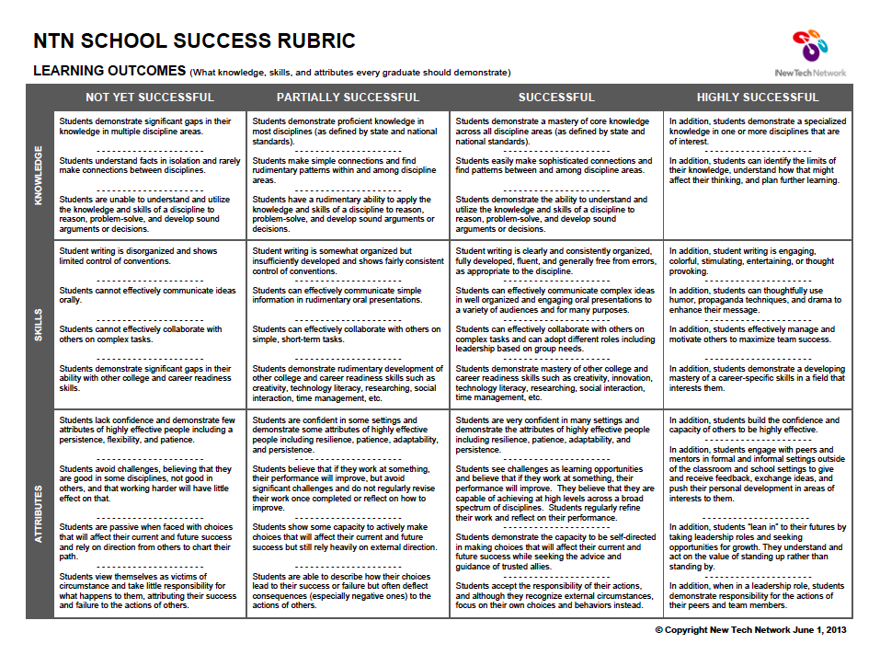

Slide 83
Pre-Service Teacher Training
Early College and Dual Enrollment
Standards (CCLS, NGSS, SS Framework, NYS Teaching Standards, 4Cs, ISTE, etc.)
Business Partnerships
Notes:
So, we’ve constructed regional vision that rests on these four blocks (explain, briefly).

Slide 84
Pre-Service Teacher Training
Early College and Dual Enrollment
Professional
Development
School:
Visitations
Observation
Training
(Buck Institute
and NTN)
Coaching
Co-teaching
Standards (CCLS, NGSS, SS Framework, NYS Teaching Standards, 4Cs, ISTE, etc.)
Business Partnerships
Notes:
Layer on the idea of a professional development school.

Slide 85

Notes:
While we move ahead with our work with New Tech Network for the schools, we are incrementally building our professional development school with training, coaching, professional development, and, next summer, our next big “conversation promoting” event: PBL-NY. This will be an event next summer that will be similar to a PBL WORLD but with our own interjection of 21st Century Readiness, Common Core, and the planet on which we live.

Slide 86
Pre-Service Teacher Training
Early College and Dual Enrollment
Professional
Development
School:
Visitations
Observation
Training
(Buck Institute
and NTN)
Coaching
Co-teaching
New Tech Network Model
New Tech High School
New Tech
OCM BOCES Programs
Alternative Education
Special Education
District/School-Based
Integrated PBL Courses
School-
within-a-School
Standards (CCLS, NGSS, SS Framework, NYS Teaching Standards, 4Cs, ISTE, etc.)
Business Partnerships
Notes:
And, how New Tech High Schools serve as the model and vision that influences everything else. So, we move ahead trying to figure out just how the heck to pull this off!

Slide 87
Pre-Service Teacher Training
Early College and Dual Enrollment
Professional
Development
School:
Visitations
Observation
Training
(Buck Institute
and NTN)
Coaching
Co-teaching
PBL^{NY}
New Tech Network Model
New Tech High School
CNY New Tech High School in Cortland County
OCM BOCES Programs
Innovation Tech at the Career Academy
District/School-Based
Integrated PBL Courses
Baldwinsville School-
within-a-School
Standards (CCLS, NGSS, SS Framework, NYS Teaching Standards, 4Cs, ISTE, etc.)
Business Partnerships
Notes:
Update on all three of these

Slide 88
What has happened since we updated you in March?
Visit to Tech Valley in Albany with School District & BOCES Administrators
Summer Work Session with School District & BOCES Administrators
Presentation at TC3 to College Administrators
Visit to Tech Valley with Legislators
Visit from New Tech Network to CNY

Slide 89
“Innovation Tech”
Transformation of the Career Academy
September 2014
Begin with grades 9 & 10
Students in grades 11 & 12 complete the Career Academy program, including CTE
Summer 2014-Redesign space to support Innovation Tech model

Slide 90
Baldwinsville New Tech
School-within-a-School (shared campus)
September 2015
Begin with grade 10

Slide 91
Central New York New Tech High School
Multiple districts
Location TBD
September 2015
Begin with grades 9 & 10
NTH@CNY

Slide 92
Next Steps
Negotiating agreement with New Tech Network
December visit to Tech Valley with School District Administrators (December 17, February 11, March 11)
Visit to Tech Valley with Career Academy teachers (February 11)
Training for Principal & Director – Spring 2014
Teacher Training – Spring 2014

Slide 93
A Vision for Education in CNY
Teaching that Engages
Culture that Empowers
Technology that Enables

Slide 94
Assessment

Slide 95
LOTE Checkpoint B
Update

Slide 96
3-8 Cluster Scoring
Scoring plans
Reconfigure sites and finalize schedule as needed

Slide 97
BCIC Meeting
NEXT
December 16, 2013
Henry Large Conference Room

