Slide 1
OCM BOCES
Day 8
Principal
Evaluator
Training
Notes:
NOTES

Slide 2

Day Seven Agenda
Introductions
Objectives and Agenda Review
Where do districts stand?
In Literature: The Ripple Effect
20% Ideas and Process – any progress?
Back to the Franklyn Case Study
Supporting Your Principal
Planning for Next Year
Closure: What Did You Learn? Still Need?
Notes:
NOTES

Slide 3
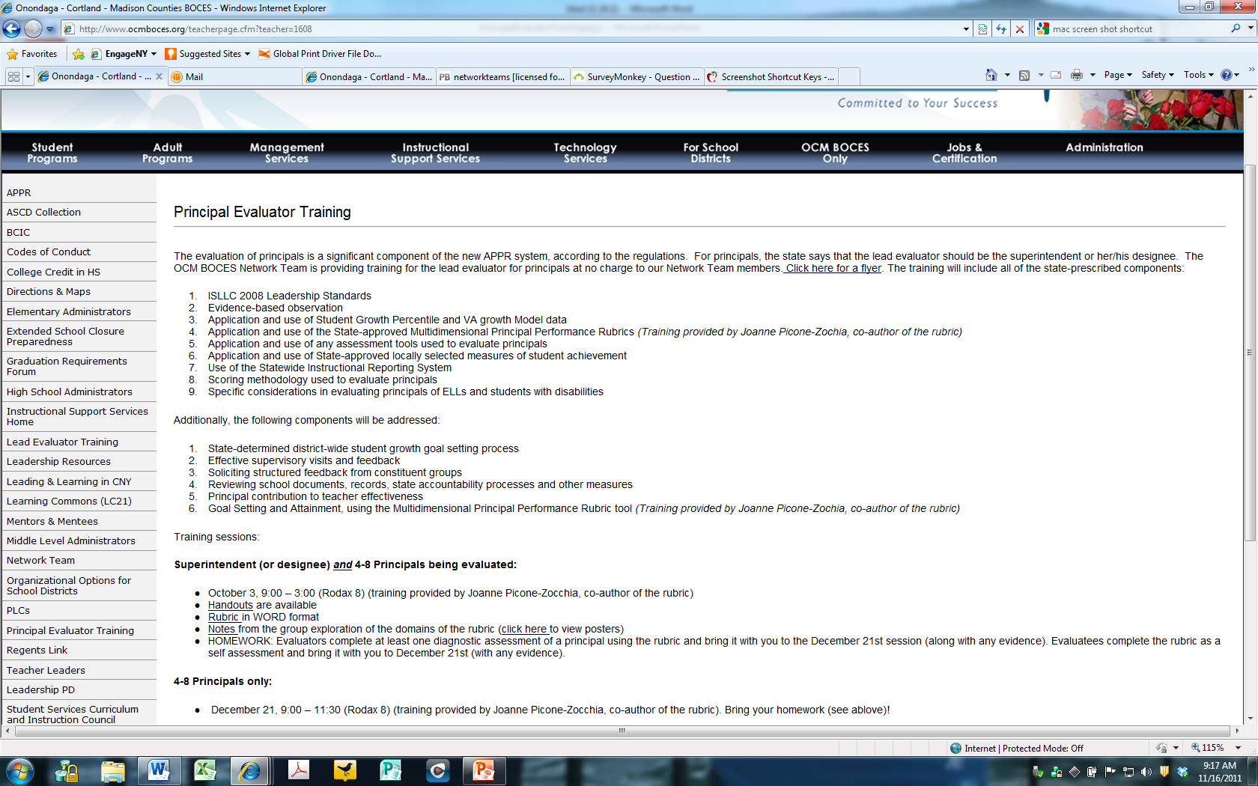
Resources
Resources are archived at the Principal Evaluator Training page off of leadership.ocmboces.org.
Notes:
NOTES

Slide 4
Nine Components
Objectives of Principal Evaluator Training:
  ISLLC 2008 Leadership Standards
  Evidence-based observation
  Application and use of Student Growth Percentile and VA growth Model data
  Application and use of the State-approved Multidimensional Principal Performance Rubric (Training provided by Joanne Picone-Zochia, co-author of the rubric)
  Application and use of any assessment tools used to evaluate principals
  Application and use of State-approved locally selected measures of student achievement
  Use of the Statewide Instructional Reporting System
  Scoring methodology used to evaluate principals
  Specific considerations in evaluating principals of ELLs and students with disabilities
✓
✓
✓
✓
Notes:
NOTES

Slide 5
Nine Components
Objectives of Principal Evaluator Training (con’t):
  SLOs: State-determined district-wide student growth goal setting process
  Effective supervisory visits and feedback
  Soliciting structured feedback from constituent groups
  Reviewing school documents, records, state accountability processes and other measures
  Principal contribution to teacher effectiveness
  Goal Setting and Attainment, using the Multidimensional Principal Performance Rubric tool (Training provided by Joanne Picone-Zochia, co-author of the rubric)
✓
✓
✓
✓
Notes:
NOTES

Slide 6
APPR Planning
Where Do Districts Stand?
  At you tables, share information about where you stand on the APPR for your principals.
Notes:
NOTES

Slide 7
Research
Literature Update (AIR)
  Two perspectives on principal evaluation:
  Focus on Principal Knowledge, Skills, and Practices
Notes:
NOTES

Slide 8
Research
Literature Update (AIR)
  Two perspectives on principal evaluation:
  Focus on Principal Knowledge, Skills, and Practices
  Focus on Results for Students
Notes:
NOTES

Slide 9
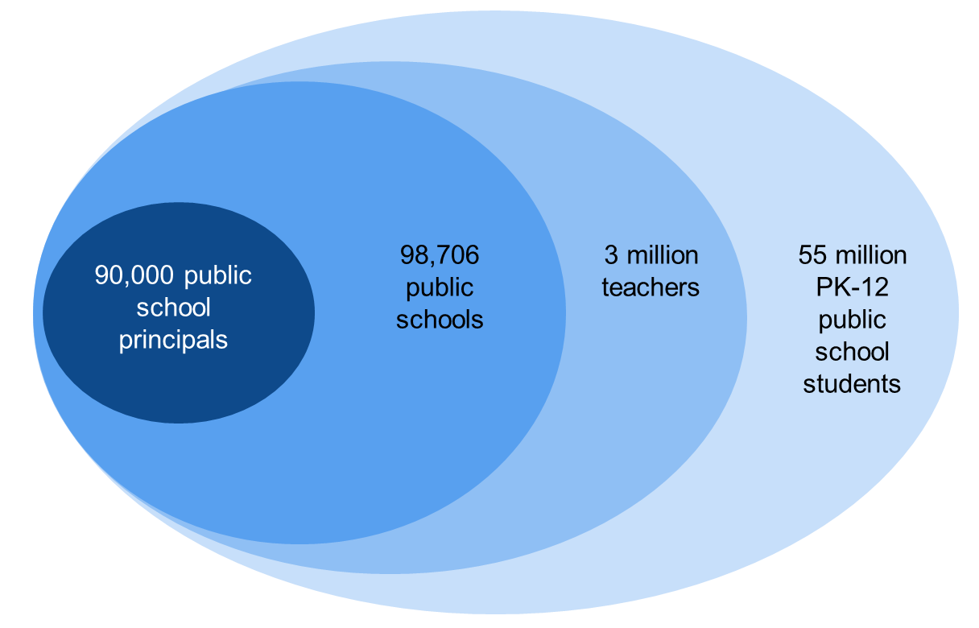
Research
Literature Update (AIR)
  The “ripple effect” model:
Notes:
U.S. Census, 2011; Battle & Gruber, 2010; Gates et al., 2002

Slide 10
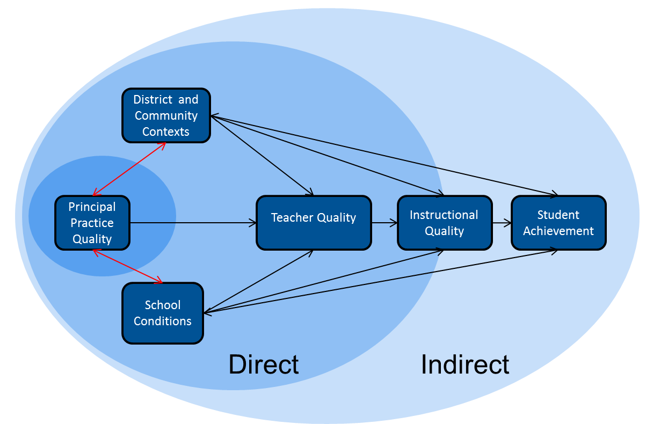
Research
Literature Update (AIR)
  The “ripple effect” model:
Notes:
U.S. Census, 2011; Battle & Gruber, 2010; Gates et al., 2002

Slide 11
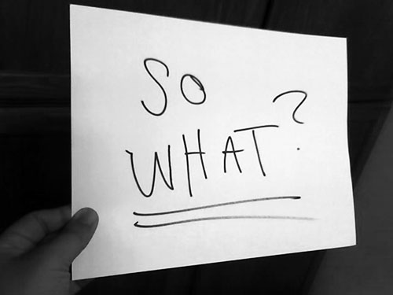
Implications for Practice

Slide 12
Lead Evaluators Next Year
Beginning of the Year
  Beginning of the year meeting
  Standards I and II
  SLO and local (LAT) target setting
  New Conversations: Growth Producing Feedback

Slide 13
Lead Evaluators Next Year
Most of the Year
  Evidence Submission by Teacher
  Evidence Collection
  Sharing the evidence
  Feedback Conversations
  New Conversations: Growth Producing Feedback

Slide 14
Lead Evaluators Next Year
Summative Evaluation
  SLO point determination
  LAT point determination
  Evidence from the year collected
  Compare collected evidence to the rubric
  New Conversations: Growth Producing Feedback

Slide 15
Implications for Practice

Slide 16
APPR Planning
What Your Principals Want
  As a table, review the data collected from the latest Lead Evaluator training
  What does it tell you about your principals?
  What does it mean for you?
Notes:
NOTES

Slide 17
APPR Planning
From last time: What’s Going to Be Different About Your Supervision of Principals
  Last time you completed this chart.
  Any changes?
+
↑
↓
Notes:
NOTES

Slide 18
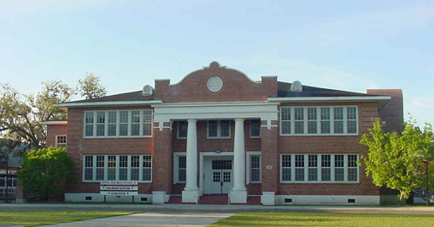
APPR Planning
Benjamin Franklyn Case Study
Notes:
NOTES

Slide 19
APPR Planning
Benjamin Franklyn Case Study
Random Collection of Evidence (contextualized
goal setting process NOT employed)
  Table is assigned “type” of evidence
  Review your evidence
  For which Standard(s) does it provide evidence?
  What does this tell you about the principal?
  What does it not tell you?
  Report out
Notes:
NOTES

Slide 20

APPR Planning
Benjamin Franklyn Case Study
Planning a School Visit
  If you were planning an unannounced
  Based on evidence already collected
  What would you do?
  What would you look for?
  Why?
Notes:
NOTES

Slide 21
Implications for Practice

Slide 22
Planning
Getting Ready
  What’s been added… and what else to add?
  START NOW
Notes:
NOTES

Slide 23
Principal Evaluation
Year One Reflection
  How has your thinking about principal evaluation changed this year…
  From the regulations?
  From research?
  From training?
  From each other?
Notes:
NOTES

Slide 24
Taking Care of Business
Ongoing Principal Evaluator Training
Next year (tentatively)
Four half-days of training distributed across year
and, optionally,
“Growth Producing Feedback” course for Lead Evaluators:
  2 summer days to prepare for beginning of year
  1 fall day to prepare for generic
  1 spring day to prepare for summative meetings

