Slide 1
OCM BOCES
Day 7
Principal
Evaluator
Training
Notes:
NOTES

Slide 2

Day Seven Agenda
Introductions
Objectives and Agenda Review
Where do districts stand?
20% Ideas and Process – any progress?
Another Case Study
Planning for Next Year
Closure
Notes:
NOTES

Slide 3
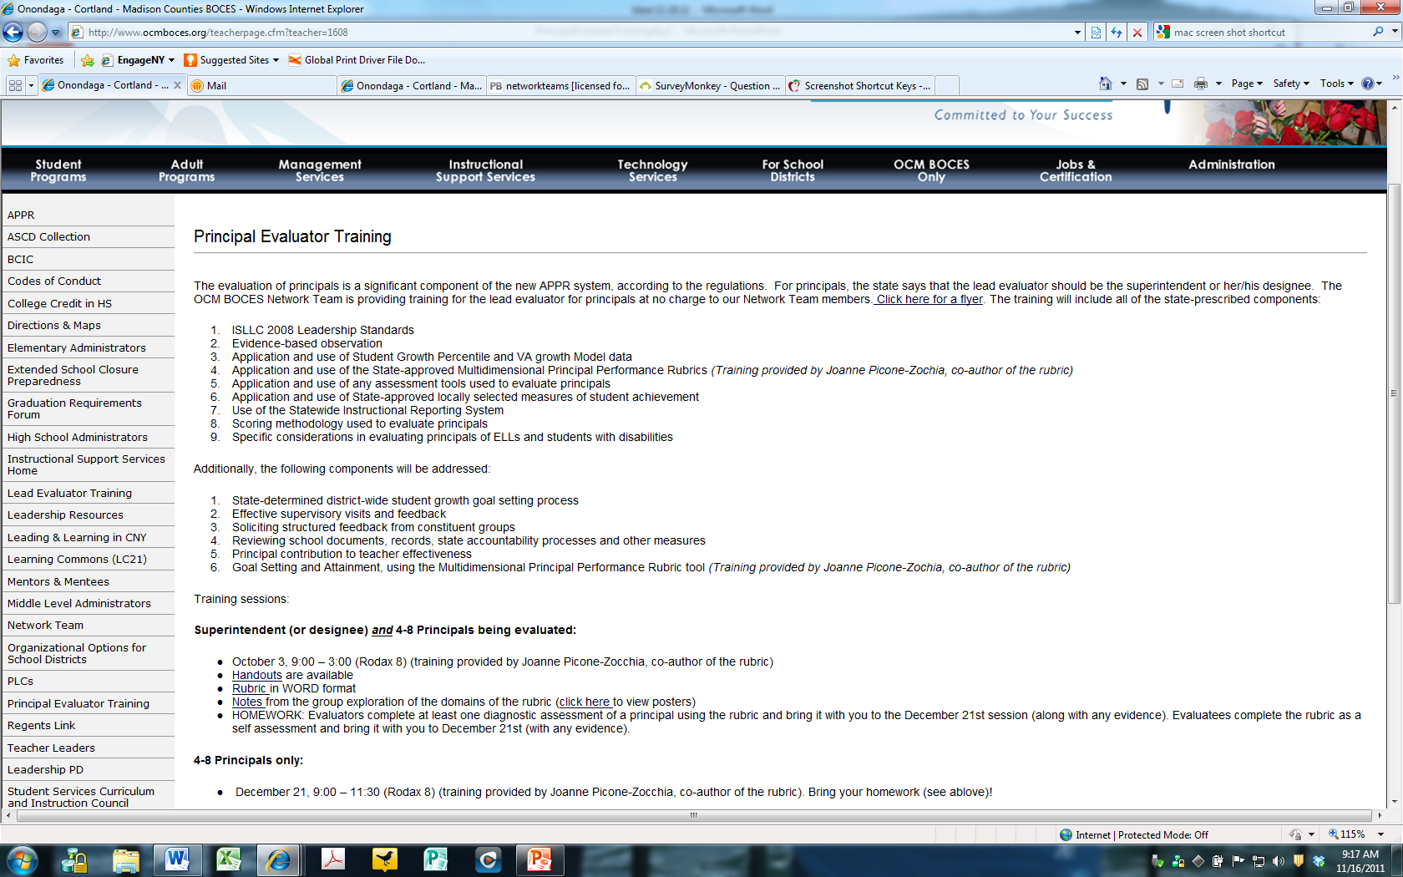
Resources
Resources are archived at the Principal Evaluator Training page off of leadership.ocmboces.org.
Notes:
NOTES

Slide 4
Nine Components
Objectives of Principal Evaluator Training:
  ISLLC 2008 Leadership Standards
  Evidence-based observation
  Application and use of Student Growth Percentile and VA growth Model data
  Application and use of the State-approved Multidimensional Principal Performance Rubric (Training provided by Joanne Picone-Zochia, co-author of the rubric)
  Application and use of any assessment tools used to evaluate principals
  Application and use of State-approved locally selected measures of student achievement
  Use of the Statewide Instructional Reporting System
  Scoring methodology used to evaluate principals
  Specific considerations in evaluating principals of ELLs and students with disabilities
✓
✓
✓
✓
Notes:
NOTES

Slide 5
Nine Components
Objectives of Principal Evaluator Training (con’t):
  SLOs: State-determined district-wide student growth goal setting process
  Effective supervisory visits and feedback
  Soliciting structured feedback from constituent groups
  Reviewing school documents, records, state accountability processes and other measures
  Principal contribution to teacher effectiveness
  Goal Setting and Attainment, using the Multidimensional Principal Performance Rubric tool (Training provided by Joanne Picone-Zochia, co-author of the rubric)
✓
✓
✓
✓
Notes:
NOTES

Slide 6
APPR Planning
Research Update (Fullan/AERA)
  Learning is the Work:
  Establish goals and expectations
  Use resources strategically
  Ensure quality teaching
  Ensure safe and orderly environment
  Lead teacher learning and development
Notes:
NOTES

Slide 7
APPR Planning
Research Update (Fullan/AERA)
  Instructional Leadership:
  Transformational leadership
  Mentoring
  Walk-throughs
  Building social capital with teachers focused on learning, mentoring, feedback, and corrective action
Notes:
A recent study by Scholastic and the Gates Foundation found that teachers spend only about 3 percent of their teaching day collaborating with colleagues. The majority of American teachers plan, teach, and examine their practice alone.

Slide 8
APPR Planning
Research Update (Fullan)
  Personnel Practices:
  Role Descriptions
  Selection and hiring criteria
  Performance appraisal
Notes:
NOTES

Slide 9
APPR Planning
Where Do Districts Stand?
  State Growth 20%
  4-8 Principals -- All Set
  High School Principals – Likely from State
  Others – SLOs
  Combinations – Combine mathematically or cover other with local 20%
Notes:
NOTES

Slide 10
APPR Planning
Where Do Districts Stand?
  Local 20%
  Needs Measures
  Need a Process (SLO-like)
Teaching Assignment | Is there a State-Provided Growth Score (or is there a state assessment that must be used)? | What (if any) SLOs would have to be employed?
Kindergarten Common Branch
First Grade Common Branch
Third Grade Common Branch
Fourth Grade Common Branch
Fifth Grade Math
Sixth Grade Social Studies
Seventh Grade Science
8th Grade ELA and Social Studies teacher with 100 students Class One: ELA with 35 students Class Two: ELA with 20 students Class Three: SS with 30 students Class Four: SS with 15 students
Science teacher with 110 total students across five sections Two Living Environment (Regents) sections with 20 students each Two Living Environment (non-Regents) with 25 students each One Forensic Science elective with 20 students
7th grade Math and Science teacher with 130 students across 5 sections Two 7th grade Math sections with 30 students each Two 7th grade Science sections with 25 students each One Advances 7th grade Science section with 20 students
Middle school PE teacher with 5 sections and 140 students total 2 sections of 6th grade PE (60 students total) 2 sections of 7th grade PE (50 students total) Section of 8th grade PE (sop students)
High school resource teacher with a total of 25 students 2 groups of 9th grade students 2 groups of 10th grade students 1 group of 11th/12th grade students
K-6 art teacher with a total of 480 students 4 sections of K (80 students) 4 sections of 1st grade (100 students) 4 sections of 2nd grade (100 student) 3 sections of 3rd grade (90 students) 4 sections of 4th grade (110 students)
5th and 6th grade AIS/reading teacher with a total of 80 students 6 groups of 5th grade students who meet every other day (35 students total) 6 groups of 6th grade students (45 students total)
11th grade special education teacher 2 sections of co-taught ELA (class size 20 each with 6 SWD in each) 3 sections of 11th grade resource room (total of 15 students)
K-6 instrumental music teacher 4th grade lessons (30 students who meet once per week in lessons of 3 students each) 5th grade band (35 students who meet every other day) 5th grade lessons (35 students who meet once per week in lessons of 5 students each) 6th grade band (35 students who meet every other day) 6th grade lessons (35 students who meet once per week in lessons of 5 students each)
Middle-level library/media specialist (600 students in school) 5th grade classes (150 students attend library class once per week in 6 groups of 25) 6th – 8th grade students use library as needed or as scheduled in conjunction with teachers.
Notes:
NOTES

Slide 11
APPR Planning
Where Do Districts Stand?
  Multiple Measures 60%
  Rubric Choices
  ISLLC Coverage
  Point Allocation
  Contextualized ISLLC Goal Setting
  Evaluators and/or Observers
Notes:
NOTES

Slide 12
APPR Planning
Where Do Districts Stand?
  Rest of the Plan
  Appeals
  Improvement Plan
  Timely Provision of Feedback
Notes:
NOTES

Slide 13
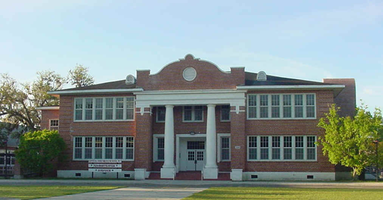
APPR Planning
Benjamin Franklyn Case Study
Notes:
NOTES

Slide 14
APPR Planning
Benjamin Franklyn Case Study
Random Collection of Evidence (contextualized
goal setting process NOT employed)
  Peruse evidence with a PARTNER
  READ Case Study Introduction
  Look at evidence and complete organizer
  MUST READ Appendix K
  Others as you have time
Notes:
NOTES

Slide 15

APPR Planning
Benjamin Franklyn Case Study
Growth Producing Feedback
  Principal – teacher conversation
  Provide principal feedback
Notes:
NOTES

Slide 16

APPR Planning
Benjamin Franklyn Case Study
Planning a School Visit
  If you were planning an unannounced
  Based on evidence already collected
  What would you do?
  What would you look for?
  Why?
Notes:
NOTES

Slide 17

Research

Slide 18
APPR Planning
Getting Ready
  Map It Out
  Start in JULY
Notes:
NOTES

Slide 19
APPR Planning
Getting Ready: What’s Going to Be Different About Your Supervision of Principals
  As a table, work on the chart
  Be ready to report out ONE thing from each category (with out repeating anything)
+
↑
↓
Notes:
NOTES

Slide 20
APPR Planning
Support for Principals
  What kind of support do you want from BOCES for your principals?
  What kind of support do YOU want?
  [Tentatively] plan on four days (1/2 days) for Principal Evaluator Training next year
  (dates coming soon)
Notes:
NOTES

Slide 21
Day Eight
June Dates
(choose session that best fits your schedule)
  June 6, 12:30pm – 3:00pm (DLC) or
  June 14, 11:00am – 1:30pm (DLC)
  Closure
    +/Δ
Notes:
NOTES

