Slide 1
OCM BOCES
Day 6
Principal
Evaluator
Training
Notes:
NOTES

Slide 2

Nine Components
Objectives of Principal Evaluator Training:
  ISLLC 2008 Leadership Standards
  Evidence-based observation
  Application and use of Student Growth Percentile and VA growth Model data
  Application and use of the State-approved Multidimensional Principal Performance Rubric (Training provided by Joanne Picone-Zochia, co-author of the rubric)
  Application and use of any assessment tools used to evaluate principals
  Application and use of State-approved locally selected measures of student achievement
  Use of the Statewide Instructional Reporting System
  Scoring methodology used to evaluate principals
  Specific considerations in evaluating principals of ELLs and students with disabilities
✓
✓
✓
✓
✓
Notes:
NOTES

Slide 3
Nine Components
Objectives of Principal Evaluator Training (con’t):
  SLOs: State-determined district-wide student growth goal setting process
  Effective supervisory visits and feedback
  Soliciting structured feedback from constituent groups
  Reviewing school documents, records, state accountability processes and other measures
  Principal contribution to teacher effectiveness
  Goal Setting and Attainment, using the Multidimensional Principal Performance Rubric tool (Training provided by Joanne Picone-Zochia, co-author of the rubric)
✓
✓
✓
✓
Notes:
NOTES

Slide 4
Day Five Agenda
Introductions
Objectives and Agenda Review
Review the Regulations
A look at the revised Principals Map
SLO Questions and Answers
Case Study
20% Ideas
School Visits: Mini-observations & conversations
Closure
Notes:
NOTES

Slide 5
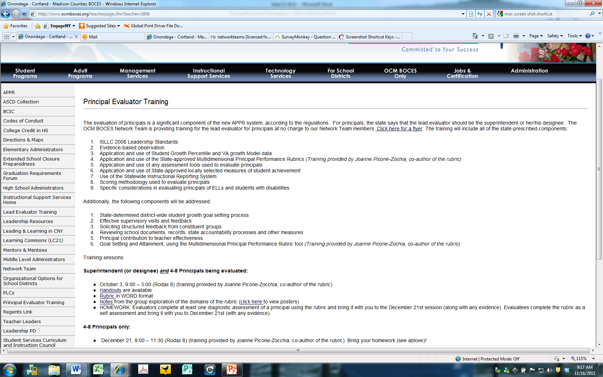
Resources
Resources are archived at the Principal Evaluator Training page off of leadership.ocmboces.org.
Notes:
NOTES

Slide 6
The Regulations
20%
Student
Growth
60%
Multiple Measures
20%
Student
Achievement

Slide 7
The Regulations
ISLLC 2008 Standards
Growth for Now
Value-Added
Sooner or Later
Multiple schools visits
SLOs Required
Unannounced visit
20%
Student
Growth
Other sources “two?”
60%
Multiple Measures
Moment in time
or growth
20%
Student
Achievement
Remaining points (if any): goals
School-
wide measure
Teacher
Effectiveness
Can use state tests
In different ways
Can use teacher
local measures
Feedback gathering w/ approved tools only
SLOs Optional

Slide 8
The Regulations
Growth for Now
State growth scores for now (4-8)
Value Added (sooner than we thought)?
SLOs for a few?
Value-Added
Sooner or Later
SLOs Required
20%
Student
Growth

Slide 9
The Regulations
Re-purpose state data
Emphasis on graduation for HS principals (or graduation-related measures)
Other exams could be used
SLOs process can be employed
20%
Student
Growth
60%
Multiple Measures
Moment in time
or growth
20%
Student
Achievement
School-
wide measure
Can use state tests
In different ways
Can use teacher
local measures
SLOs Optional

Slide 10
The Regulations
ISLLC 2008 Standards
At least 31/60 – still recommend 60/60
School visits
Structured feedback
Independent observer?
Review of documents
Contribution to teacher effectiveness
Other academic results or learning environment
All standards every year (some rubrics might need more)
Multiple schools visits
Unannounced visit
20%
Student
Growth
Other sources “two?”
60%
Multiple Measures
Remaining points (if any): goals
Teacher
Effectiveness
Feedback gathering w/ approved tools only

Slide 11
Who matters more?
Research & Evidence
TEACHER
PRINCIPAL
Notes:
The school principal as leader: guiding schools to better teaching and learning - The Wallace Foundation, January 2012.

Slide 12

Who matters more?
Research & Evidence
Notes:
The school principal as leader: guiding schools to better teaching and learning - The Wallace Foundation, January 2012.

Slide 13
Who matters more?
Research & Evidence
D
A
C
E
B
Notes:
The school principal as leader: guiding schools to better teaching and learning - The Wallace Foundation, January 2012.

Slide 14
Principal Supervision
A Year in the Life
Updated map with regulation changes
Notes:
NOTES

Slide 15

Research

Slide 16
Job Description
Principal Evaluators have to:
Know what the principal has to do, including
  Standards (CCLS)
  Data (Common Formative and Interim Assessment)
  Professional Practice (APPR)
  Culture (PLC)
  Everything else they have always had to do
Help the principal do all of the above
Help find the time in which to do all of the above

Slide 17
Job Description
Principal Evaluators have to:
Help principal to choose and define the right
initiative/goal for item listed above
Understand how to use ISLLC (and maybe a rubric)
to guide the initiative/goal
Collect evidence along the way
Provide growth-producing feedback
Use APPR system for evaluation and identification of appropriate professional development
Implement improvement plan (if necessary)

Slide 18
Research

Slide 19
Case Study
At your table, read through the Douglass Middle School case study.
Review ISLLC Standard 1
Tables answer questions the follow
Compare to MPPR Rubric. How would you rate the evidence from this case study? What other evidence might you collect?
Notes:
NOTES

Slide 20
Research

Slide 21
The 20%s
20% + 20%
How might the 20% play out in your districts?
Teaching Assignment | Is there a State-Provided Growth Score (or is there a state assessment that must be used)? | What (if any) SLOs would have to be employed?
Kindergarten Common Branch
First Grade Common Branch
Third Grade Common Branch
Fourth Grade Common Branch
Fifth Grade Math
Sixth Grade Social Studies
Seventh Grade Science
8th Grade ELA and Social Studies teacher with 100 students Class One: ELA with 35 students Class Two: ELA with 20 students Class Three: SS with 30 students Class Four: SS with 15 students
Science teacher with 110 total students across five sections Two Living Environment (Regents) sections with 20 students each Two Living Environment (non-Regents) with 25 students each One Forensic Science elective with 20 students
7th grade Math and Science teacher with 130 students across 5 sections Two 7th grade Math sections with 30 students each Two 7th grade Science sections with 25 students each One Advances 7th grade Science section with 20 students
Middle school PE teacher with 5 sections and 140 students total 2 sections of 6th grade PE (60 students total) 2 sections of 7th grade PE (50 students total) Section of 8th grade PE (sop students)
High school resource teacher with a total of 25 students 2 groups of 9th grade students 2 groups of 10th grade students 1 group of 11th/12th grade students
K-6 art teacher with a total of 480 students 4 sections of K (80 students) 4 sections of 1st grade (100 students) 4 sections of 2nd grade (100 student) 3 sections of 3rd grade (90 students) 4 sections of 4th grade (110 students)
5th and 6th grade AIS/reading teacher with a total of 80 students 6 groups of 5th grade students who meet every other day (35 students total) 6 groups of 6th grade students (45 students total)
11th grade special education teacher 2 sections of co-taught ELA (class size 20 each with 6 SWD in each) 3 sections of 11th grade resource room (total of 15 students)
K-6 instrumental music teacher 4th grade lessons (30 students who meet once per week in lessons of 3 students each) 5th grade band (35 students who meet every other day) 5th grade lessons (35 students who meet once per week in lessons of 5 students each) 6th grade band (35 students who meet every other day) 6th grade lessons (35 students who meet once per week in lessons of 5 students each)
Middle-level library/media specialist (600 students in school) 5th grade classes (150 students attend library class once per week in 6 groups of 25) 6th – 8th grade students use library as needed or as scheduled in conjunction with teachers.

Slide 22
Research

Slide 23

Evidence Collection
Aligning School Visits to ISLLC and RTTT
What have you tried to do differently this year?
How’s it going?
What’s next?
Notes:
NOTES

Slide 24
Evidence Collection
School Visit: Mini-observations
Go on a “mini” together
Three part role play:
  Teacher
  Principal
  Evaluator/Supervisor
Notes:
NOTES

Slide 25
Day Five Agenda
March Dates
  April 25, 12:30 – 3:00 (DLC) or
  April 26, 9:00 – 11:30 (DLC)
  (choose session that best fits your schedule)
  Closure
    +/Δ
Notes:
NOTES

