Slide 1
OCM BOCES Day 5
Principal
Evaluator
Training
Notes:
NOTES

Slide 2
Nine Components
Objectives of Principal Evaluator Training:
ISLLC 2008 Leadership Standards
Evidence-based observation
Application and use of Student Growth Percentile and VA growth Model data
Application and use of the State-approved Multidimensional Principal Performance Rubric (Training provided by Joanne Picone-Zochia, co-author of the rubric)
Application and use of any assessment tools used to evaluate principals
Application and use of State-approved locally selected measures of student achievement
Use of the Statewide Instructional Reporting System
Scoring methodology used to evaluate principals
Specific considerations in evaluating principals of ELLs and students with disabilities
✓
✓
✓
✓
Notes:
NOTES

Slide 3
Nine Components
Objectives of Principal Evaluator Training (con’t):
SLOs: State-determined district-wide student growth goal setting process
Effective supervisory visits and feedback
Soliciting structured feedback from constituent groups
Reviewing school documents, records, state accountability processes and other measures
Principal contribution to teacher effectiveness
Goal Setting and Attainment, using the Multidimensional Principal Performance Rubric tool (Training provided by Joanne Picone-Zochia, co-author of the rubric)
✓
✓
✓
✓
Notes:
NOTES

Slide 4
Day Five Agenda
Introductions
Objectives and Agenda Review
A Little More research
SLO Questions and Answers
School Visits
Closure
Notes:
NOTES

Slide 5
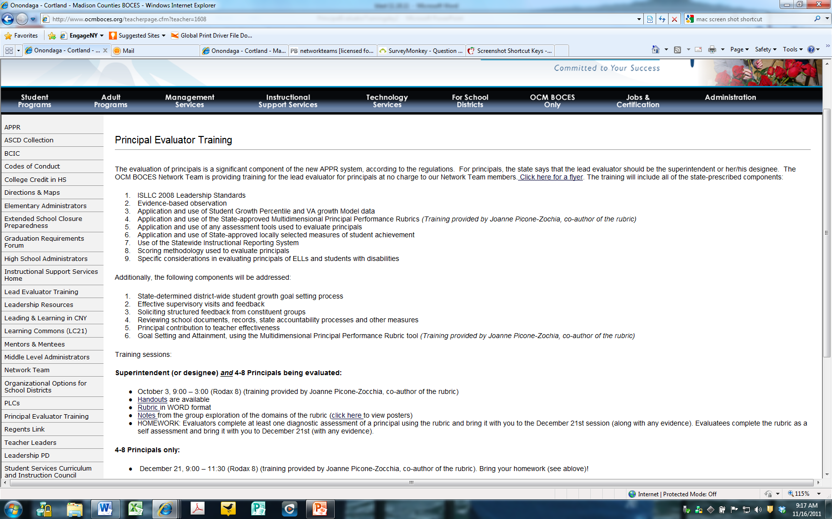
Resources
Resources are archived at the Principal Evaluator Training page off of leadership.ocmboces.org.
Notes:
NOTES

Slide 6
Wallace Foundations Says:
Research
Most school variables, considered separately, have little impact
The real payoff comes when individual variables combine to reach a critical mass
Creating the conditions under which that can occur is what an effective leader does

Slide 7
Five Key Responsibilities:
Research & Evidence
Shaping a vision of academic success for all students, based on high standards
Creating a climate hospitable to education in order that safety, a cooperative spirit and other foundations of fruitful interaction prevail
Cultivating leadership in others, so that teachers and other adults assume their part in realizing the school vision
Improving instruction to enable teachers to teach at their best and students to learn at their utmost
Managing people, data and processes to foster school improvement
Notes:
The school principal as leader: guiding schools to better teaching and learning - The Wallace Foundation, January 2012.

Slide 8
School Culture:
Research
Leadership styles impact on staff performance by creating the environment in which staff work, which in turn influences their discretionary effort:
Leadership
Styles
The Context for
School Improvement
50% to 70%
30% to 40%
Discretionary Effort
Notes:
Hay Group

Slide 9
Research
School Culture:
Notes:
Ranked by agreement in the highest growth schools, elementary and secondary combined

Slide 10
Research
School Culture:
 | Highest Achieving | Lowest Achieving | ∆
1. The school culture here makes everyone feel obligated to teach well. | 89 | 43 | 46
2. School leaders push teachers to deliver excellent teaching. | 77 | 38 | 39
3. Teachers here hold one another accountable for working hard. | 80 | 42 | 38
4. This school sets high standards for academic performance | 89 | 54 | 35
5. Teachers in this school share and discuss student work with other teachers. | 91 | 55 | 35
6. I collaborate with other teachers here on designing assessment of student learning. | 86 | 51 | 35

Slide 11
Research & Evidence
School Culture:
What is one specific way in which an effective principal could create a positive school culture -- focusing not on a positive culture all about the adults but for a culture of high expectations for student learning?
As a principal’s evaluator, what objective evidence would you seek to help you evaluate the principal’s role in leading this change?

Slide 12
Research

Slide 13
SLOs
Notes:
NOTES

Slide 14
SLOs
State
Determines SLO process
Identifies required elements
Requires use of State test
Provides training to NTs prior to 2012-13.
Provides guidance, webinars & videos
District
District goals & priorities
Match requirements to teachers
Define processes for before & after
Identify expectations
School
LE & teacher collaborate
LE approval
Ensure security
LE monitor & evaluation
Teacher
Works with colleagues & LE
SLOs

Slide 15
SLO Decisions for Districts
SLOs
Assess and identify priorities and academic needs.
Identify who will have State-provided growth measures and who must have SLOs as “comparable growth measures.”
Determine District rules for how specific SLOs will get set.
Establish expectations for scoring SLOs and for determining teacher ratings for the growth component.
Determine District-wide processes for setting, reviewing, and assessing SLOs in schools.
March 1
April 16
May 30

Slide 16
SLO Decision # 1
SLOs
What are your district priorities?
What are your building priorities?
ELLs achievement
AP participation
SWD achievement
Graduation rate
Achievement gap
ELA? Math? Sci?
Non-fiction writing

Slide 17
SLO Decision # 2
SLOs
Go through the scenarios for different teachers
Teaching Assignment | Is there a State-Provided Growth Score (or is there a state assessment that must be used)? | What (if any) SLOs would have to be employed?
Kindergarten Common Branch
First Grade Common Branch
Third Grade Common Branch
Fourth Grade Common Branch
Fifth Grade Math
Sixth Grade Social Studies
Seventh Grade Science
8th Grade ELA and Social Studies teacher with 100 students Class One: ELA with 35 students Class Two: ELA with 20 students Class Three: SS with 30 students Class Four: SS with 15 students
Science teacher with 110 total students across five sections Two Living Environment (Regents) sections with 20 students each Two Living Environment (non-Regents) with 25 students each One Forensic Science elective with 20 students
7th grade Math and Science teacher with 130 students across 5 sections Two 7th grade Math sections with 30 students each Two 7th grade Science sections with 25 students each One Advances 7th grade Science section with 20 students
Middle school PE teacher with 5 sections and 140 students total 2 sections of 6th grade PE (60 students total) 2 sections of 7th grade PE (50 students total) Section of 8th grade PE (sop students)
High school resource teacher with a total of 25 students 2 groups of 9th grade students 2 groups of 10th grade students 1 group of 11th/12th grade students
K-6 art teacher with a total of 480 students 4 sections of K (80 students) 4 sections of 1st grade (100 students) 4 sections of 2nd grade (100 student) 3 sections of 3rd grade (90 students) 4 sections of 4th grade (110 students)
5th and 6th grade AIS/reading teacher with a total of 80 students 6 groups of 5th grade students who meet every other day (35 students total) 6 groups of 6th grade students (45 students total)
11th grade special education teacher 2 sections of co-taught ELA (class size 20 each with 6 SWD in each) 3 sections of 11th grade resource room (total of 15 students)
K-6 instrumental music teacher 4th grade lessons (30 students who meet once per week in lessons of 3 students each) 5th grade band (35 students who meet every other day) 5th grade lessons (35 students who meet once per week in lessons of 5 students each) 6th grade band (35 students who meet every other day) 6th grade lessons (35 students who meet once per week in lessons of 5 students each)
Middle-level library/media specialist (600 students in school) 5th grade classes (150 students attend library class once per week in 6 groups of 25) 6th – 8th grade students use library as needed or as scheduled in conjunction with teachers.

Slide 18
SLO Update
SLOs
Some updates

Slide 19
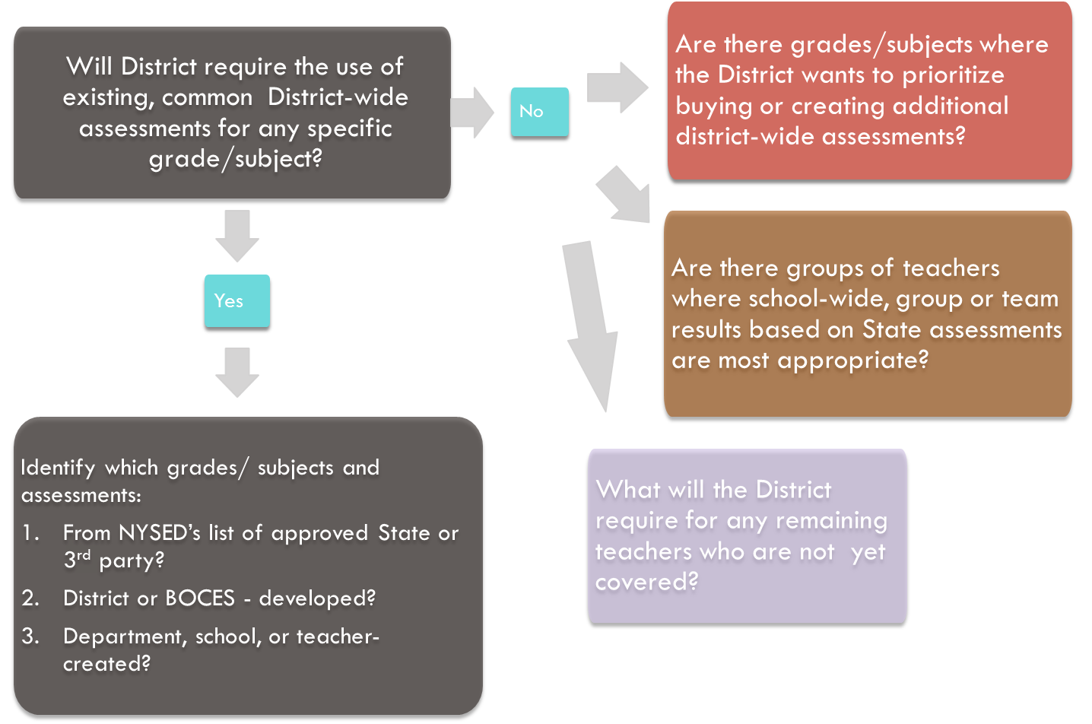
SLO Decision # 3
SLOs

Slide 20
SLO Decision # 4
SLOs
Establish expectations for scoring SLOs and for determining teacher ratings for the growth component.

Slide 21
SLO Decision # 5
SLOs
Determine District-wide processes for setting, reviewing, and assessing SLOs in schools.

Slide 22
Job Description
Principal Evaluators have to:
Know what the principal has to do
Standards (CCLS)
Data (Common Formative & Interim Assessment)
Professional Practice (APPR)
Culture (PLC)
How to help the principal do it
How to find the time for it

Slide 23
Evidence Collection
The schools visits we want (and need):
Notes:
NOTES

Slide 24
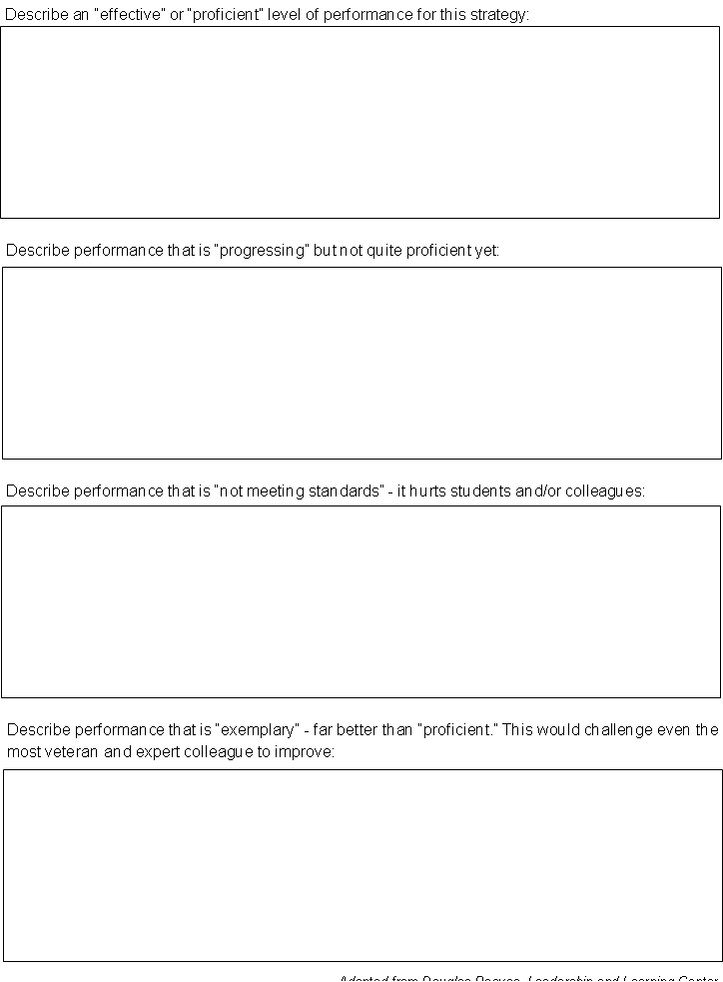
Regrouping
A rubric for school visits (for principal feedback):
Last time!
Notes:
NOTES

Slide 25
Evidence Collection
A rubric for school visits (for principal feedback):
How have your school visits changed?
Notes:
NOTES

Slide 26
Evidence Collection
Aligning School Visits to ISLLC and RTTT
Visit Characteristic/Quality | What would tell you about the principal? Why is it important? | What would be a source(s) of evidence that could be collected of this?
Walkthroughs together (random)
Reflective conversation that focuses on learning (ISLLC)
Evidence that principal knows students (and what is being done)
Knows staff (including instruction) (not specified)
Look at data together
See connection between district and building
Insightful about teacher improvement
See connection between district and building
Insightful about teacher improvement
Awareness of community, culture (outside of specific classrooms)
Evidence of feedback loop with every teacher
Some documentation/evidence collection
Provide leader affirmation and growth-producing feedback
Understands and effectively using resource
See variety of teaching techniques in classroom visits with principals
Assess instructional culture
Resources adequate and aligned
Evidence of a teacher collaboration
See the community in the building
Varied times of visits
Front office impressions
Principal presence
Teacher Leadership
Professionalism
Notes:
NOTES

Slide 27
Evidence Collection
Aligning School Visits to ISLLC and RTTT
What have you tried to do differently this year?
How’s it going?
What’s next?
Notes:
NOTES

Slide 28
Quick Break
Break

Slide 29
ISLLC Evidence Collection
Evidence Collection
In groups generate some examples of evidence that you might collect for one of the ISLLC Standards.
Standard # ___
Evidence:
Artifact
Artifact
Artifact
Artifact

Slide 30
2
1
6
Teaching & Learning
Vision, Mission & Goals
The Education System
3
5
Managing Organizational Systems & Safety
4
Ethics & Integrity
Collaborating
with Families and
Stakeholders

Slide 31
1
Vision, Mission & Goals
An education leader promotes the success of every student by facilitating the development, articulation, implementation, and stewardship of a vision of learning that is shared and
supported by all stakeholders.

Slide 32
2
Teaching & Learning
An education leader promotes the success of every student by advocating, nurturing, and
sustaining a school culture and instructional program conducive to student learning and staff professional growth.

Slide 33
3
Managing Organizational Systems & Safety
An education leader promotes the success of every student by ensuring management of the organization, operation, and resources for a safe, efficient, and effective learning environment.

Slide 34
4
Collaborating
with Families and
Stakeholders
An education leader promotes the success of every student by collaborating with faculty and community members, responding to diverse community interests and needs, and mobilizing
community resources.

Slide 35
5
Ethics & Integrity
An education leader promotes the success of every student by acting with integrity, fairness, and in an ethical manner.

Slide 36
6
The Education System
An education leader promotes the success of every student by understanding, responding to, and influencing the political, social, economic, legal, and cultural context.

Slide 37
ISLLC Evidence Collection
Evidence Collection
In groups generate some examples of evidence that you might collect for one of the ISLLC Standards.

Slide 38
ISLLC Evidence Collection
Evidence Collection
ISLLC Standards + Evidence Collection = a binder full of unconnected, random pieces of evidence
2018-2019
2017-2018
2016-2017
2015-2016
2014-2015
2013-2014
2012-2013
2011-2012

Slide 39
Contextualized Evidence Collection
Evidence Collection
ISLLC Standards + Evidence Collection = a binder full of unconnected, random pieces of evidence
or
ISLLC + Context + Evidence Collection = meaningful feedback/evaluation and a more successful implementation of an initiative

Slide 40
Contextualized Evidence Collection
Evidence Collection
At your table, choose an initiative going on in a school, which could be
School or district based
CCLS, PLC/DDI
Now analyze that initiative in terms of each of the six ISLLC Standards

Slide 41
Job Description
Principal Evaluators have to:
Know what the principal has to do, including
Standards (CCLS)
Data (Common Formative and Interim Assessment)
Professional Practice (APPR)
Culture (PLC)
Everything else they have always had to do
Help the principal do all of the above
Help find the time in which to do all of the above

Slide 42
Job Description
Principal Evaluators have to:
Help principal to choose and define the right initiative/goal for item listed above
Understand how to use ISLLC (and maybe a rubric) to guide the initiative/goal
Collect evidence along the way
Provide growth-producing feedback
Use APPR system for evaluation and identification of appropriate professional development
Implement improvement plan (if necessary)

Slide 43
Principal Supervision
A Year in the Life
How has a “year in the life” of a principal changed?
Notes:
NOTES

Slide 44
Principal Supervision
What can a superintendent do to make it [more] possible [and likely]?
Notes:
NOTES

Slide 45
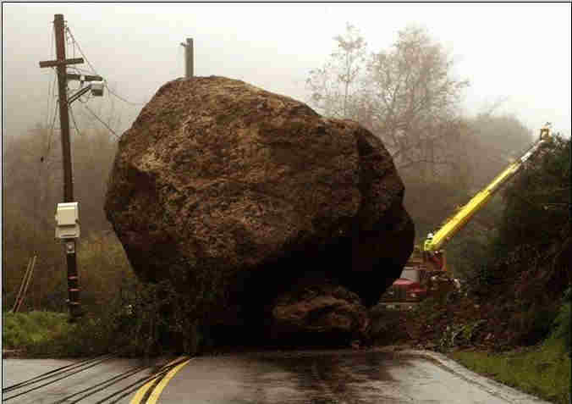
Principal Supervision
What are the roadblocks to doing all of this?
Notes:
NOTES

Slide 46
Advice
At your table, read through the excerpts from the “Carol Edison at Citrus High School” case study.
Prepare for your monthly meeting with this principal. When the issue of evaluations comes up, what will you tell her?
Notes:
NOTES

Slide 47
Day Five Agenda
March Dates
March 8th after BCIC
March 21st after CSA
Closure
+/Δ
Notes:
NOTES

