Slide 1
OCM BOCES
Day 4
Principal
Evaluator
Training
Notes:
NOTES

Slide 2

Nine Components
Objectives of Principal Evaluator Training:
  ISLLC 2008 Leadership Standards
  Evidence-based observation
  Application and use of Student Growth Percentile and VA growth Model data
  Application and use of the State-approved Multidimensional Principal Performance Rubric (Training provided by Joanne Picone-Zochia, co-author of the rubric)
  Application and use of any assessment tools used to evaluate principals
  Application and use of State-approved locally selected measures of student achievement
  Use of the Statewide Instructional Reporting System
  Scoring methodology used to evaluate principals
  Specific considerations in evaluating principals of ELLs and students with disabilities
✓
✓
✓
✓
✓
Notes:
NOTES

Slide 3
Nine Components
Objectives of Principal Evaluator Training (con’t):
  SLOs: State-determined district-wide student growth goal setting process
  Effective supervisory visits and feedback
  Soliciting structured feedback from constituent groups
  Reviewing school documents, records, state accountability processes and other measures
  Principal contribution to teacher effectiveness
  Goal Setting and Attainment, using the Multidimensional Principal Performance Rubric tool (Training provided by Joanne Picone-Zochia, co-author of the rubric)
✓
✓
✓
✓
Notes:
NOTES

Slide 4
Day Three Agenda
Joanne Picone-Zocchia
  Rubric based on the ISLLC Standards
  Goal-Setting Rubric
  Rubric based on the ISLLC Standards
  Goal
  Setting
  Rubric
Notes:
NOTES

Slide 5






Day Three Agenda
Joanne Picone-Zocchia
  Rubric based on the ISLLC Standards
  Goal-Setting Rubric
  Rubric based on the ISLLC Standards
  Goal
  Setting
  Rubric
Notes:
NOTES

Slide 6
Day Three Agenda
Joanne Picone-Zocchia
  Rubric based on the ISLLC Standards
  Goal-Setting Rubric
  Rubric based on the ISLLC Standards
  Goal
  Setting
  Rubric
Notes:
NOTES

Slide 7
Day Three Agenda
Joanne Picone-Zocchia
  Rubric based on the ISLLC Standards
  Goal-Setting Rubric
  Rubric based on the ISLLC Standards
  Goal
  Setting
  Rubric
60%
Notes:
NOTES

Slide 8
Day Four Agenda
That’s today!
Introductions
Objectives and Agenda Review
Balancing two needs:
  Establishing Multiple Measures
    APPR plan
    Local 20% (SLO decisions points)
    Your 60% structure
  Longer term need to focus on good leadership
    Latest research (two studies)
    Working with your principals (goals and visits)
Closure
Notes:
NOTES

Slide 9
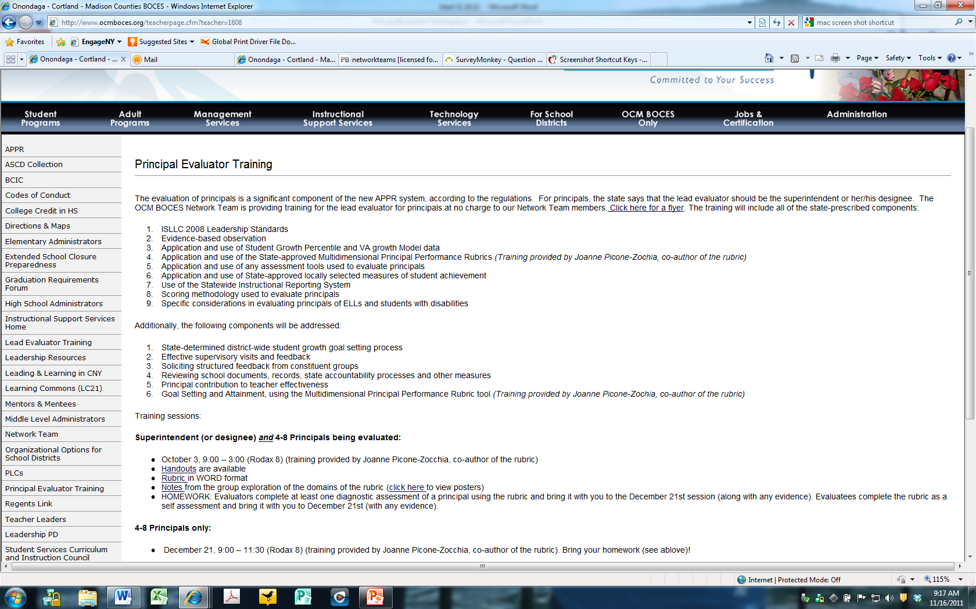
Resources
Resources are archived at the Principal Evaluator Training page off of leadership.ocmboces.org.
Notes:
NOTES

Slide 10
The Latest
Teacher Effectiveness Research
Research
Teacher effectiveness matters!
This is the right work!
Two new research studies confirm this

Slide 11

Research
The Long-Term Impacts of Teachers: Teacher Value-added and Student Outcomes in Adulthood (Chetty, Friedman & Rockoff). http://obs.rc.fas.harvard.edu/chetty/value_added.html

Slide 12
Study details:
Research
2.5M children from childhood to early adulthood in 1 large district
Teacher/course linkages and test scores in grades 3-8 from 1991-2009
US government tax data from W-2s: on parents AND students
    About parents: household income, retirement savings, home ownership, marriage, age when student born
    About students up to age 28: teen birth, college attendance, earnings, neighborhood “quality”

Slide 13
Teacher effectiveness matters
Research
Having a higher value-added teacher for even one year in grades 4-8 has substantial positive long-term impacts on a student’s life outcomes including:
      Likelihood of attending college (↑ 1.25%)
      Likelihood of teen pregnancy (↓ 1.25%)
      Salary earned in lifetime (↑ $25K )
      Neighborhood (↑ college grads)
      Retirement savings (↑)

Slide 14
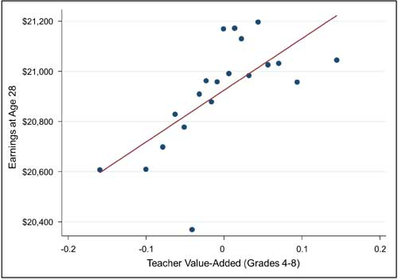
Student Future Earnings
Research
Notes:
Value-added

Slide 15
What is “teacher value added”
Research
A statistical measure of the growth of a teacher’s students that takes into account the differences in students across classrooms that school systems can measure but teachers can’t control.
Value-added is:
Growth compared to the average growth of similar students

Slide 16
Test Scores Alone
Research
680
670
Achievement scores say more about students than teachers.
2015
2015
Teacher A
Teacher B

Slide 17
Growth
Research
Adding average prior achievement for the same students shows Teacher B’s students had higher growth.
Growth
+25
Growth
+20
680
670
660
645
2014
2015
2015
2014
2015
Teacher A
Teacher B

Slide 18
Value-Added
Research
Comparing growth to the average growth of “similar” students gives teacher A the higher “value-added” result.
Value-
Added
+15 Above
Average
Growth
+20
680
Growth
+25
Value-
Added
AVERAGE
665
670
670
660
645
2015
2014
2015 Avg for similar students
2015 Avg for similar students
2014
2014
2015
Teacher A
Teacher B

Slide 19
Myth-busting
Research
MYTH: A lot of big research people say value-added isn’t reliable. You can’t really prove the teacher caused the change in scores
REALITY:
Some researchers say this. Others say it is the best way we have to identify the stronger and weaker teachers.
This study adds new evidence to support that value-added measures DO measure real differences in the effect different teachers have on student learning.

Slide 20
What do you think would happen:
Research
A high value-added teacher (top 5%) arrives in a new school to teach fourth grade:
What happens to the new teacher’s kids’ fourth grade test scores?

Slide 21
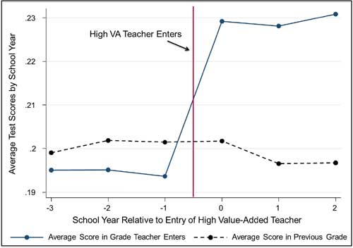
The scores go up.
Research

Slide 22
But what about?
Research
Maybe the “high value-added teacher’s” kids were all from high income families?
  The researchers thought of that, got the data and it doesn’t change the fact that having a high value-added teacher matters.
Maybe “high value-added teachers” are always assigned to the higher achieving kids.
  They thought of that, got the data, and it doesn’t change the fact that (guess what)…...
Maybe it’s just true for the top 5% of teachers. We can’t all be superstars.
  They thought of that (and guess what?)

Slide 23
But what about?
Research
Recent questions about the study point out that these data come from a period prior to high stakes testing?
  Chetty said it was possible that in high-stakes conditions the usefulness of value-added ratings could be impacted, but implausible that the effect would totally disappear.
Could it be that teachers under pressure to raise their students’ scores through extensive test preparation will get inflated results that do not carry over positively to adulthood?
  This might be true except for the fact that test prep has been proven to have a negative impact on student achievement – thus inflated results due to test prep does not occur.

Slide 24
What this study doesn’t answer
Research
Once teachers’ evaluation results depend on value-added, will their behavior change?
    Will they teach to the test?
    Will they cheat?
    Will they focus on data driven instruction, Common Core Standards and teacher practices that research says support student learning?
What are the specific policy actions to take in a school district?
    How can you keep high value-added teachers in their schools?
    What professional development helps people get better?
    What about teachers who aren’t getting any better
    after 3 or 4 years?

Slide 25
What will you tell your principals?
Research
Once teachers’ evaluation results depend on value-added, will their behavior change?
    Will they teach to the test?
    Will they cheat?
    Will they focus on data driven instruction, Common Core Standards and teacher practices that research says support student learning?
What are the specific policy actions to take in a school district?
    How can you keep high value-added teachers in their schools?
    What professional development helps people get better?
    What about teachers who aren’t getting any better
    after 3 or 4 years?

Slide 26

Measures of Effective Teaching
Research

Slide 27
Measures of Effective Teaching
Research
Indicators tested:
    5 instruments for classroom observations
    Student surveys (Tripod Survey)
    Value-added on state tests
Size:
    3,000 teachers
    22,500 observation scores (7,500 lesson videos x 3 scores)
    900 + trained observers
    44,500 students completing surveys and supplemental assessments
Outcomes studied:
    Gains on state math and ELA tests
    Gains on supplemental tests (BAM & SAT9 OE)
    Student-reported outcomes (effort and enjoyment in class)

Slide 28
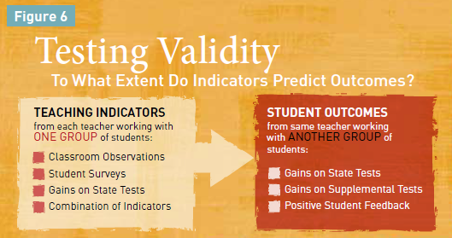
Research
Predictive power: Which measure could most accurately identify teachers likely to have large gains when working with another group of students?
Reliability: Which measures were most stable from section to section or year to year for a given teacher?
Potential for Diagnostic Insight: Which have the potential to help a teacher see areas of practice needing improvement

Slide 29
Research
Measures of Effective Teaching
H
M
L
M
H
M
L
M/H
H

Slide 30
Use multiple measures
Research
All the observation rubrics are positively associated with student achievement gains
Using multiple observations per teacher is VERY important (and ideally multiple observers)
The student feedback survey tested is ALSO positively associated with student achievement gains

Slide 31
Change what is valued
Research
Combining observation measures, student feedback and value-added growth results on state tests was more reliable and a better predictor of a teacher’s value-added on State tests with a different cohort of students than:
        Any measure alone
        Graduate degrees
        Years of teaching experience
  Combining “measures” is also a strong predictor of student performance on other kinds of student tests.

Slide 32
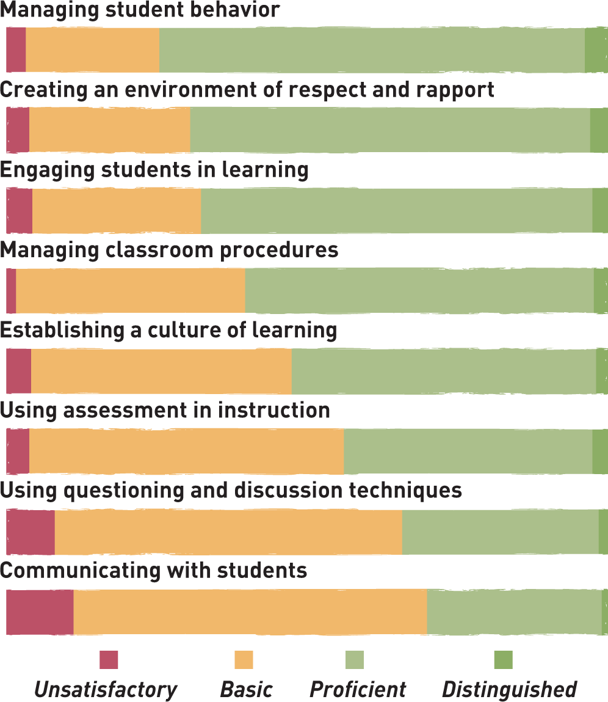

Research
Framework for Teaching

Slide 33
Research
Framework for Teaching
Highest scores for orderly environment
Lowest scores for more complex aspects of instruction

Slide 34
Research
Student Feedback
Rank
Survey Statement
Student survey items with strongest relationship to middle school math gains:
1
Students in this class treat the teacher with respect
2
My classmates behave the way my teacher wants them to
3
Our class stays busy and doesn’t waste time
4
In this class, we learn a lot every day
5
In this class, we learn to correct our mistakes

Slide 35
Research
Student Feedback
Rank
Survey Statement
Student survey items with the weakest relationship to middle school math gains:
38
I have learned a lot this year about [the state test]
39
Getting ready for [state test] takes a lot of time in our class

Slide 36
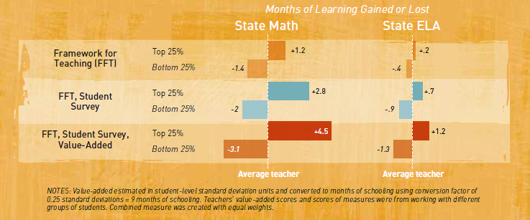
Multiple Measures
Research

Slide 37
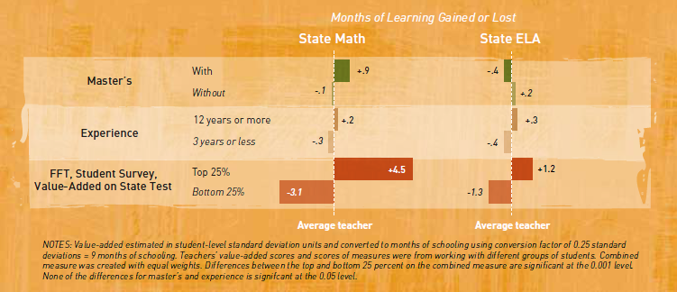
Traditional Measures
Research

Slide 38
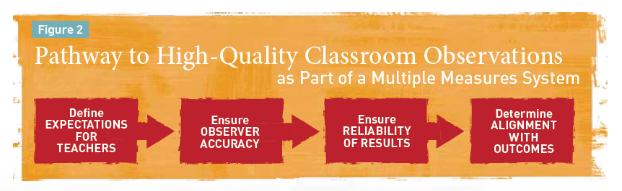
Four Steps
Research

Slide 39
Policy Advice
Research
Choose an [observation] instrument that sets clear expectations
Train evaluators and require observers to generate accurate observations (with periodic recertification)
Multiple observations are necessary for high stakes situations
Combine observations with [constituent] feedback
Verify that higher evaluation scores correspond to higher achievement (monitor the system)

Slide 40
How would you answer?
Research
New York’s evaluation system is based mostly on State test scores and that’s not good.
A principal knows a good teacher when s/he sees one; we don’t need to include value-added results too.
I’ve been doing teacher observations for years. I don’t need to go to your training.
Teacher Value-added information is unreliable and shouldn’t be a part of teacher evaluation.
By putting test scores into teacher evaluation, everyone will do even more to “teach to the test” and if that doesn’t work, they’ll cheat.

Slide 41
Research
How would you answer?
New York’s evaluation system is based mostly on State test scores and that’s not good.
  NY uses multiple measures as research advises. 60% involves measures of educator practice. 20-25% involves GROWTH on state assessments or comparable measures. And the remaining points will be a locally-selected measure of student growth or achievement.
A principal knows a good teacher when s/he sees one; we don’t need to include value-added results too.
  Recent METS study shows that combining observation results and teacher value-added is more predictive and reliable than either measure alone.

Slide 42
Research
How would you answer?
I’ve been doing teacher observations for years.
I don’t need to go to your training.
  The MET study shows that regularly recalibrating observers against benchmarks of accurate observation ratings is critical to ensuring a valid and reliable evaluation system. Even the best observers can “drift” over time. And the best can help others stay in sync. In addition, NYS training will help everyone identify evidence that the new Common core standards are being implemented well in classrooms.

Slide 43
Research
How would you answer?
Teacher Value-added information is unreliable and shouldn’t be a part of teacher evaluation.
  Many researchers have shown that teacher value-added is the best predictor we have of the future learning growth of a teacher’s students. Two new research studies, Chetty/Friedman/Rockoff and the Measures of Effective Teaching Study add new evidence in support of this argument.
By putting test scores into teacher evaluation, everyone will do even more to “teach to the test” and if that doesn’t work, they’ll cheat.
  No one has been able to research yet the predictiveness and reliability of teacher value-added measures when they are used in high stakes environments since such evaluation systems are just beginning across the country. Some teachers may try to game the system. Others may strive to develop the skills research says align with higher value-added results. However, the power of these measures argues for including them as part of a multiple measures system.

Slide 44

Research

Slide 45

Goal Setting
Aligning Goals to ISLLC and RTTT
Notes:
NOTES

Slide 46
Goal Setting
Aligning Goals to ISLLC and RTTT
Goal for Principal(s) | What evidence is being collected to evaluate this goal? | How might this goal be revised in order to better align to the ISLLC standards and the work of RTTT?
Notes:
NOTES

Slide 47

SLOs
Notes:
NOTES

Slide 48
SLOs
Definition (underline key words):
A student learning objective is an academic goal for a teacher’s students that is set at the start of a course. It represents the most important learning for the year (or, semester, where applicable). It must be specific and measurable, based on available prior student learning data, and aligned to Common Core, State, or national standards, as well as any other school and district priorities. Teachers’ scores are based upon the degree to which their goals were attained.
Notes:
NOTES

Slide 49
Key SLO “messages”
SLOs
SLOs name what students need to know and be able to do at the end of the year.
SLOs place student learning at the center of the conversation.
SLOs are a critical part of all great educator’s practice.
SLOs are an opportunity to document the impact educators make with students.
SLOs provide principals with critical information that can be used to manage performance, differentiate and target professional development, and focus supports for teachers.
The SLO process encourages collaboration within school buildings.
School leaders are accountable for ensuring all teachers have SLOs that will support their District and school goals.

Slide 50
SLOs
State
Determines SLO process
Identifies required elements
Requires use of State test
Provides training to NTs prior to 2012-13.
Provides guidance, webinars & videos
District
District goals & priorities
Match requirements to teachers
Define processes for before & after
Identify expectations
School
LE & teacher collaborate
LE approval
Ensure security
LE monitor & evaluation
Teacher
Works with colleagues & LE
SLOs

Slide 51
SLO Decisions for Districts
SLOs
Assess and identify priorities and academic needs.
Identify who will have State-provided growth measures and who must have SLOs as “comparable growth measures.”
Determine District rules for how specific SLOs will get set.
Establish expectations for scoring SLOs and for determining teacher ratings for the growth component.
Determine District-wide processes for setting, reviewing, and assessing SLOs in schools.
March 1
April 16
May 30

Slide 52
SLO Decision # 1
SLOs
What are your district priorities?
What are your building priorities?
ELLs achievement
AP participation
SWD achievement
Graduation rate
Achievement gap
ELA? Math? Sci?
Non-fiction writing

Slide 53
SLO Decision # 2
SLOs
Go through the scenarios for different teachers
Teaching Assignment | Is there a State-Provided Growth Score (or is there a state assessment that must be used)? | What (if any) SLOs would have to be employed?
Kindergarten Common Branch
First Grade Common Branch
Third Grade Common Branch
Fourth Grade Common Branch
Fifth Grade Math
Sixth Grade Social Studies
Seventh Grade Science
8th Grade ELA and Social Studies teacher with 100 students Class One: ELA with 35 students Class Two: ELA with 20 students Class Three: SS with 30 students Class Four: SS with 15 students
Science teacher with 110 total students across five sections Two Living Environment (Regents) sections with 20 students each Two Living Environment (non-Regents) with 25 students each One Forensic Science elective with 20 students
7th grade Math and Science teacher with 130 students across 5 sections Two 7th grade Math sections with 30 students each Two 7th grade Science sections with 25 students each One Advances 7th grade Science section with 20 students
Middle school PE teacher with 5 sections and 140 students total 2 sections of 6th grade PE (60 students total) 2 sections of 7th grade PE (50 students total) Section of 8th grade PE (sop students)
High school resource teacher with a total of 25 students 2 groups of 9th grade students 2 groups of 10th grade students 1 group of 11th/12th grade students
K-6 art teacher with a total of 480 students 4 sections of K (80 students) 4 sections of 1st grade (100 students) 4 sections of 2nd grade (100 student) 3 sections of 3rd grade (90 students) 4 sections of 4th grade (110 students)
5th and 6th grade AIS/reading teacher with a total of 80 students 6 groups of 5th grade students who meet every other day (35 students total) 6 groups of 6th grade students (45 students total)
11th grade special education teacher 2 sections of co-taught ELA (class size 20 each with 6 SWD in each) 3 sections of 11th grade resource room (total of 15 students)
K-6 instrumental music teacher 4th grade lessons (30 students who meet once per week in lessons of 3 students each) 5th grade band (35 students who meet every other day) 5th grade lessons (35 students who meet once per week in lessons of 5 students each) 6th grade band (35 students who meet every other day) 6th grade lessons (35 students who meet once per week in lessons of 5 students each)
Middle-level library/media specialist (600 students in school) 5th grade classes (150 students attend library class once per week in 6 groups of 25) 6th – 8th grade students use library as needed or as scheduled in conjunction with teachers.

Slide 54
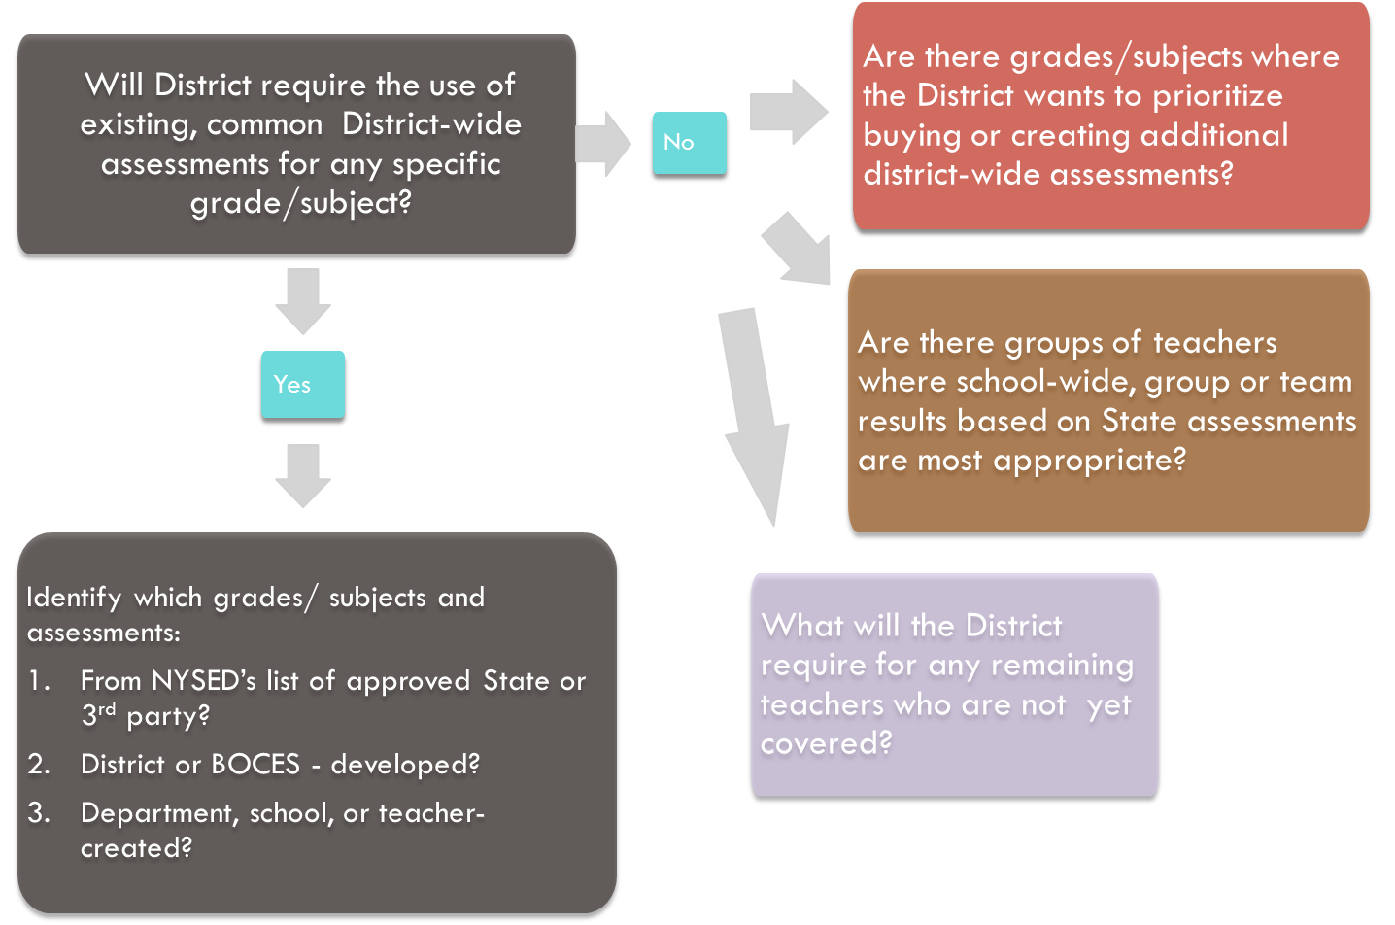
SLO Decision # 3
SLOs

Slide 55
SLO Decision # 4
SLOs
Establish expectations for scoring SLOs and for determining teacher ratings for the growth component.

Slide 56
SLO Decision # 5
SLOs
Determine District-wide processes for setting, reviewing, and assessing SLOs in schools.

Slide 57

Regrouping
The schools visits we want (and need):
Notes:
NOTES

Slide 58
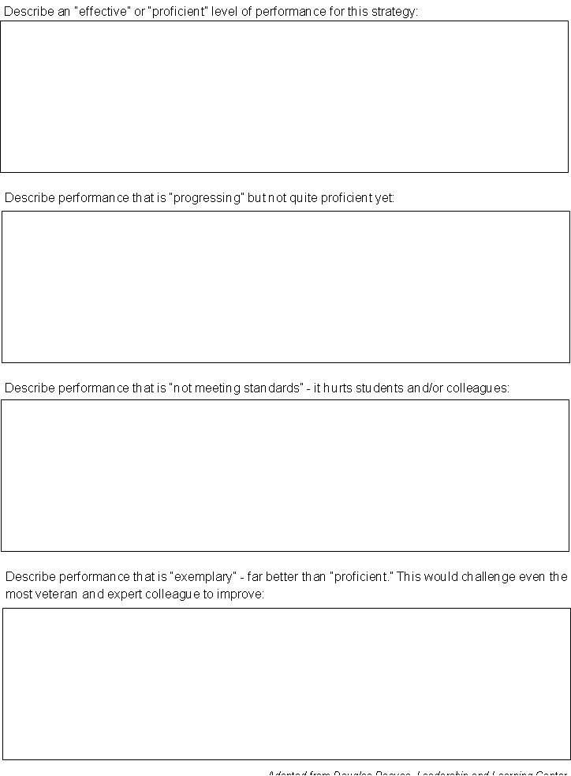
Regrouping
A rubric for school visits (for principal feedback):
Last time!
Notes:
NOTES

Slide 59
Regrouping
A rubric for school visits (for principal feedback):
How have your school visits changed?
Notes:
NOTES

Slide 60
Nine Components
Aligning School Visits to ISLLC and RTTT
Visit Characteristic/Quality | What would tell you about the principal? Why is it important? | What would be a source(s) of evidence that could be collected of this?
Walkthroughs together (random)
Reflective conversation that focuses on learning (ISLLC)
Evidence that principal knows students (and what is being done)
Knows staff (including instruction) (not specified)
Look at data together
See connection between district and building
Insightful about teacher improvement
See connection between district and building
Insightful about teacher improvement
Awareness of community, culture (outside of specific classrooms)
Evidence of feedback loop with every teacher
Some documentation/evidence collection
Provide leader affirmation and growth-producing feedback
Understands and effectively using resource
See variety of teaching techniques in classroom visits with principals
Assess instructional culture
Resources adequate and aligned
Evidence of a teacher collaboration
See the community in the building
Varied times of visits
Front office impressions
Principal presence
Teacher Leadership
Professionalism
Notes:
NOTES

Slide 61

Advice
At your table, read through the Top 10 List of Mistakes to avoid. Discuss. Any good advice?
Notes:
NOTES

Slide 62
Advice
At your table, read through the excerpts from the “Carol Edison at Citrus High School” case study.
Prepare for your monthly meeting with this principal. When the issue of evaluations comes up, what will you tell her?
Notes:
NOTES

Slide 63
Day Five Agenda
February Dates
  February 9th following BCIC has to be cancelled
  (I will be in Albany for more Principal Evaluator training to turn around to you)
  February session following CSA is 12:30pm on February 15th
  Proposing an additional session February 17th, 12:30pm-3:00pm in Distance Learning Room. Is this good for anyone?
Closure
  +/Δ
Notes:
NOTES

