Slide 1
OCM BOCES
Day 2
Principal
Evaluator
Training
Notes:
NOTES

Slide 2


Nine Components
Back to the beginning:
Notes:
NOTES

Slide 3
Nine Components
Objectives of Principal Evaluator Training:
  ISLLC 2008 Leadership Standards
  Evidence-based observation
  Application and use of Student Growth Percentile and VA growth Model data
  Application and use of the State-approved Multidimensional Principal Performance Rubrics (Training provided by Joanne Picone-Zochia, co-author of the rubric)
  Application and use of any assessment tools used to evaluate principals
  Application and use of State-approved locally selected measures of student achievement
  Use of the Statewide Instructional Reporting System
  Scoring methodology used to evaluate principals
  Specific considerations in evaluating principals of ELLs and students with disabilities
Notes:
NOTES

Slide 4
Nine Components
Objectives of Principal Evaluator Training (con’t):
  SLOs: State-determined district-wide student growth goal setting process
  Effective supervisory visits and feedback
  Soliciting structured feedback from constituent groups
  Reviewing school documents, records, state accountability processes and other measures
  Principal contribution to teacher effectiveness
  Goal Setting and Attainment, using the Multidimensional Principal Performance Rubric tool (Training provided by Joanne Picone-Zochia, co-author of the rubric)
Notes:
NOTES

Slide 5
Day One Agenda
Joanne Picone-Zocchia
  Rubric based on the ISLLC Standards
  Goal-Setting Rubric
Notes:
NOTES

Slide 6
Day Three Agenda
Joanne Picone-Zocchia returns
  Half-day with principals
  Half-day with evaluators
Bring your application of the tool to one of your principals
Remind your principals to bring the rubric completed as a self-reflection
Notes:
NOTES

Slide 7
Day Two Agenda
That’s today!
Introductions
Objectives and Agenda Review
Balancing two needs:
  Immediate need to get going
    APPR plan
    Local 20%
    Your 60% structure
  Longer term need to focus on good leadership
    What matters for student achievement
    ISLLC review
    Working with your principals
Closure
Notes:
NOTES

Slide 8
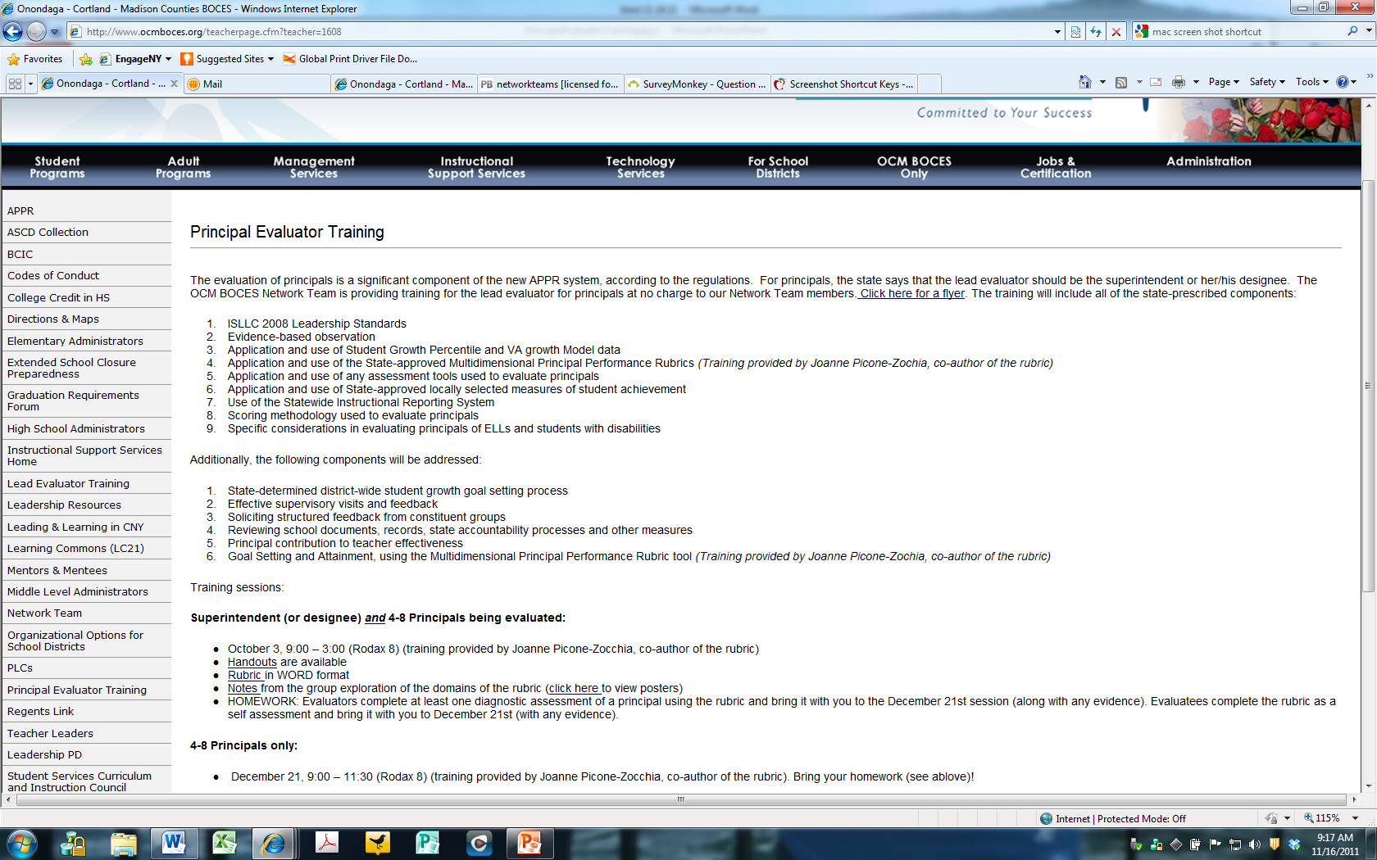
Resources
Resources are archived at the Principal Evaluator Training page off of leadership.ocmboces.org.
Notes:
NOTES

Slide 9
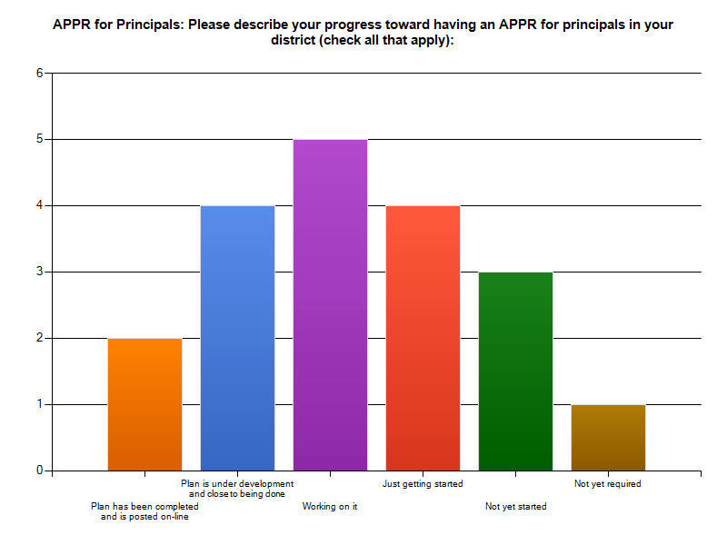
Checking In

Slide 10
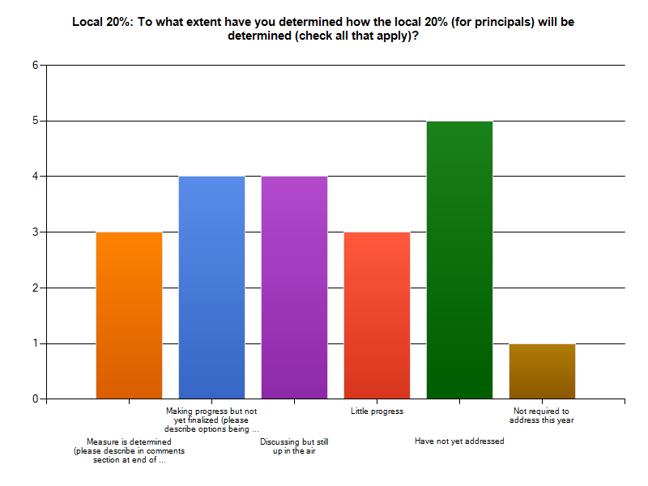
Checking In

Slide 11
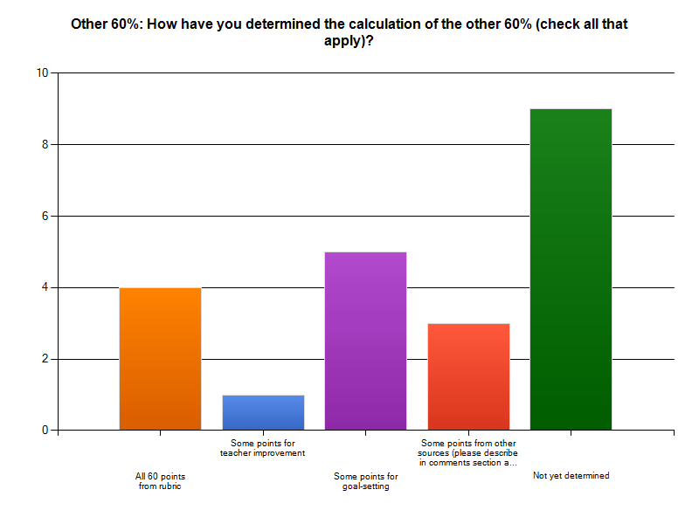
Checking In

Slide 12
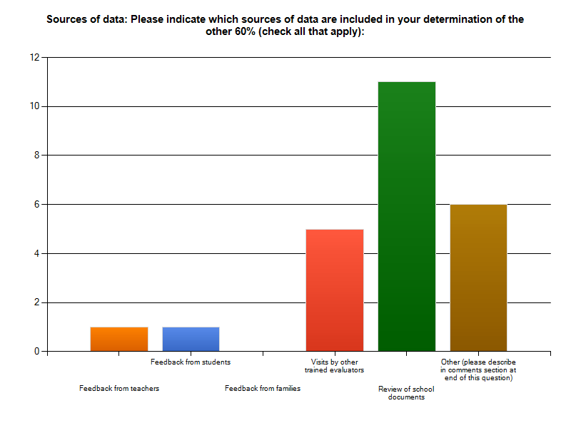
Checking In

Slide 13
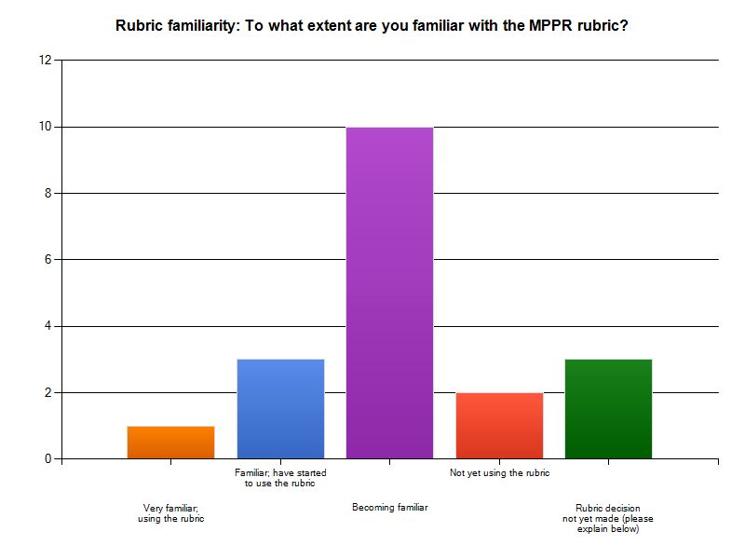
Checking In

Slide 14
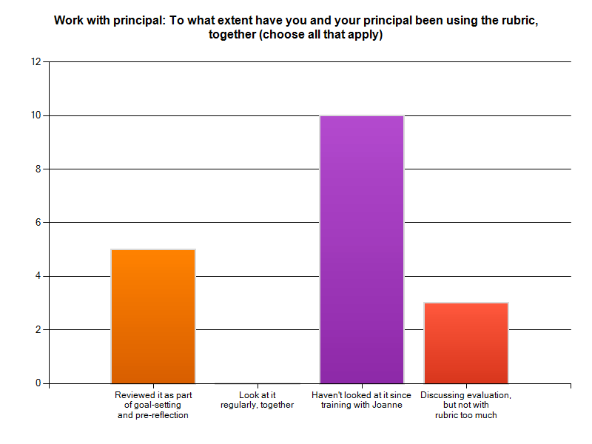
Checking In

Slide 15
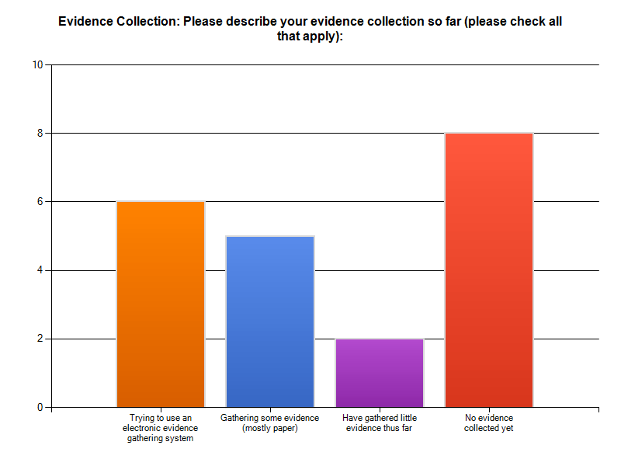
Checking In

Slide 16
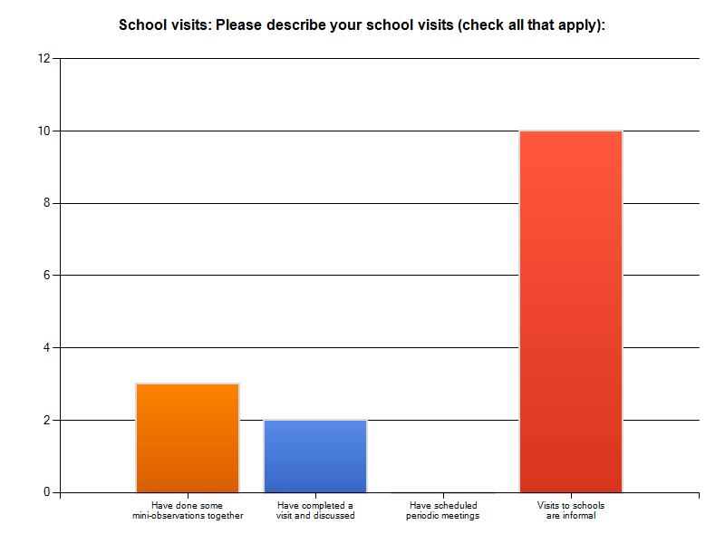
Checking In

Slide 17
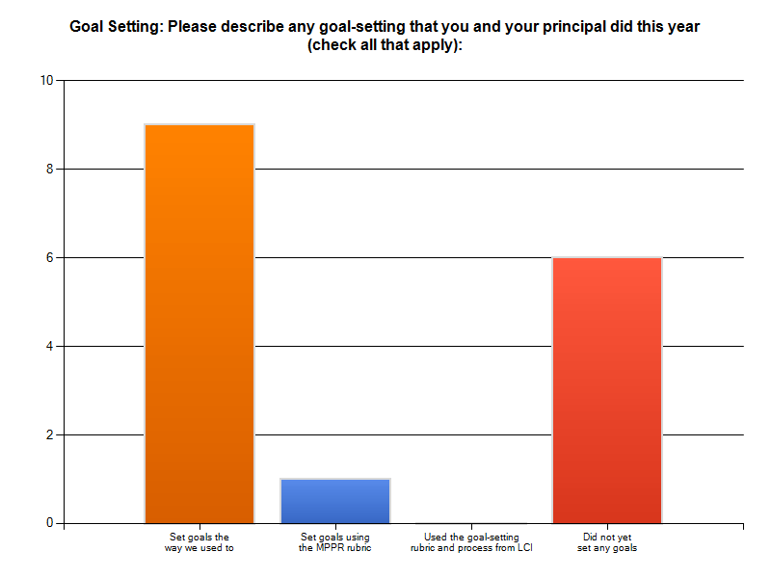
Checking In

Slide 18
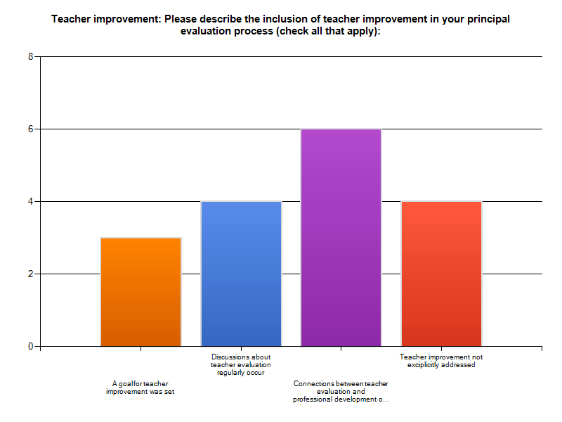
Checking In

Slide 19

Regrouping
Review the Regulations
  State 20%
  Local 20%
  Other 60%
Notes:
NOTES

Slide 20
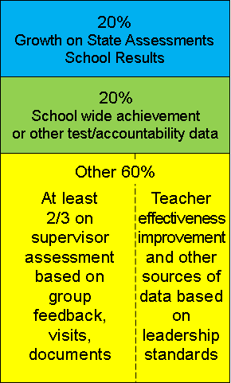
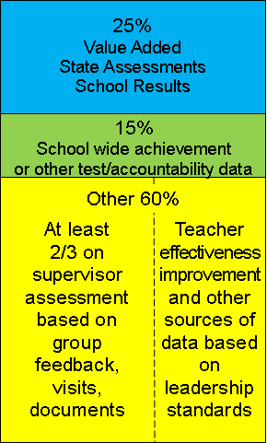
Reviewing the Regs
When
Value-Added is implemented

Slide 21
Reviewing the Regs
Growth: Elem/Middle
  Result of student growth
  Added to as measures become available
  Other measures being used for teachers in the school

Slide 22
Reviewing the Regs
Growth: High School
  Result of student growth
  Added to as available
  Progress to graduation
  Other measures being used for teachers in the school

Slide 23
Reviewing the Regs
Achievement: Elem/Middle
  District-wide achievement measures
  Achievement on state tests
  Growth or achievement for subgroups

Slide 24
Reviewing the Regs
Achievement: High School
  Regents participation rates
  College ready rates
  Graduation rates
  Credit accumulation
  Dropout rates
  PSAT, SAT, AP, IB, etc.

Slide 25
Reviewing the Regs
Other 60%: Required
  Multiple measures
  ≥ 2/3 based on broad assessment of actions via supervisor visits
  Include at least two:
    Feedback from constituencies
    School visits from others
    Review of documents

Slide 26
Reviewing the Regs
Other 60%: Required
  Locally-selected measure of teacher effectiveness contribution, such as:
    High performer retention
    Granted v. denied tenure
    Teacher satisfaction w/ feedback
    Evaluation quality

Slide 27
Reviewing the Regs
Other 60%: Required
  All standards at least once per year

Slide 28
Reviewing the Regs
Other 60%: Optional
  Teacher and/or student attendance
  School goals
  Goals and reflection

Slide 29
Reviewing the Regs
 | Student Growth 20% | Achievement 20% | Other 60% | Composite
Ineffective | 0-2 | 0-2 | Ranges determined locally | 0-64
Developing | 3-11 | 3-11 |  | 65-74
Effective | 12-17 | 12-17 |  | 75-90
Highly Effective | 18-20 | 18-20 |  | 91-100
SED interpreting that this also has to be revised.

Slide 30

Regrouping
So where are you? Talk at tables.
Notes:
NOTES

Slide 31

Principals
Reviewing the Regs

Slide 32


Directions
Some resources (placemat, rubrics, etc.):
Notes:
NOTES

Slide 33
2
1
6
Teaching
& Learning
Vision, Mission
& Goals
The Education
System
3
5
Managing
Organizational
Systems
& Safety
4
Ethics & Integrity
Collaborating
with Families
and
Stakeholders

Slide 34
1
Vision, Mission
& Goals
An education leader promotes the success of every student by facilitating the development, articulation, implementation, and stewardship of a vision of learning that is shared and
supported by all stakeholders.
3rd
is the
world’s
largest economy

Slide 35
2
Teaching
& Learning
An education leader promotes the success of every student by advocating, nurturing, and
sustaining a school culture and instructional program conducive to student learning and staff professional growth.
is the
world’s

Slide 36
3
Managing
Organizational
Systems
& Safety
An education leader promotes the success of every student by ensuring management of the organization, operation, and resources for a safe, efficient, and effective learning environment.
is the
world’s

Slide 37
4
Collaborating
with Families
and
Stakeholders
An education leader promotes the success of every student by collaborating with faculty and community members, responding to diverse community interests and needs, and mobilizing
community resources.
is the
world’s

Slide 38
5
Ethics & Integrity
An education leader promotes the success of every student by acting with integrity, fairness, and in an ethical manner.
is the
world’s

Slide 39
6
The Education
System
An education leader promotes the success of every student by understanding, responding to, and influencing the political, social, economic, legal, and cultural context.
is the
world’s

Slide 40
Regrouping
Look at some research
  Marzano & Waters
  Hattie
Notes:
NOTES

Slide 41

Balanced Leadership:
School Leadership that Works™
Notes:
Version: February 28, 2006

Slide 42
McREL’s meta-analyses
Meta-analyses | Publication titles
Classroom-level practices | Classroom Instruction that Works (Marzano, Pickering, & Pollock, 2001)
School-level practices & student characteristics | What Works in Schools (Marzano, 2003)
Leadership responsibilities & practices | School Leadership that Works (Marzano, Waters, & McNulty, 2005)

Slide 43
Findings from
McREL’s meta-analysis
There is a relationship between leadership and student achievement — leadership matters.
There are 21 leadership responsibilities, each with statistically significant and positive relationships to student achievement.
Leaders perceived as strong do not always have a positive impact on achievement.

Slide 44
Responsibilities & practices
21 leadership responsibilities
66 leadership practices
All correlated to student achievement
Each correlation is statistically significant

Slide 45
21 leadership responsibilities
Affirmation (r=.19) | Involvement with CIA (r=.20)
Change agent (r=.25) | Knowledge of CIA (r=.25)
Communication (r=.24) | Monitor/evaluate (r=.27)
Contingent rewards (r=.24) | Optimize (r=.20)
Culture (r=.25) | Order (r=.25)
Discipline (r=.27) | Outreach (r=.27)
Flexibility (r=.28) | Relationships (r=.18)
Focus (r=.24) | Resources (r=.25)
Ideals/beliefs (r=.22) | Situational awareness (r=.33)
Input (r=.25) | Visibility (r=.20)
Intellectual stimulation (r=.24)

Slide 46
The differential impact of leadership
Leaders perceived as strong do not always have a positive effect on student achievement.

Slide 47
Examples of ineffective focus
Focus on improving school and classroom practices that are already well developed and implemented.
Focus on school and classroom practices that are implemented marginally.
Focus on practices that lack evidence for improving student achievement.

Slide 48
Findings from McREL’s factor analysis
Two major factors: first-order change and second-order change
21 responsibilities with positive correlations to changes perceived as first order
11 responsibilities with correlations to changes perceived as second order

Slide 49
Regrouping
Look at some research
  Marzano & Waters
  Hattie
Notes:
NOTES

Slide 50
Research
-0.2 -0.1 0.0 0.1 0.2 0.3 0.4 0.5 0.6 0.7 0.8 0.9 1.0 1.1
Effective homework practices (0.29)

Slide 51
Research
-0.2 -0.1 0.0 0.1 0.2 0.3 0.4 0.5 0.6 0.7 0.8 0.9 1.0 1.1
Distributed practice (0.71)

Slide 52
Research
-0.2 -0.1 0.0 0.1 0.2 0.3 0.4 0.5 0.6 0.7 0.8 0.9 1.0 1.1
Ensure teachers intellectually stimulated with current theories and practices (0.64)

Slide 53
Research
-0.2 -0.1 0.0 0.1 0.2 0.3 0.4 0.5 0.6 0.7 0.8 0.9 1.0 1.1
Promoting and participating in teacher learning (0.91)

Slide 54
Research
-0.2 -0.1 0.0 0.1 0.2 0.3 0.4 0.5 0.6 0.7 0.8 0.9 1.0 1.1
Planning, coordinating & evaluating teaching and the curriculum (0.74)

Slide 55
Research
-0.2 -0.1 0.0 0.1 0.2 0.3 0.4 0.5 0.6 0.7 0.8 0.9 1.0 1.1
Direct involvement in support & evaluation of teaching via frequent visits w/ feedback (0.74)

Slide 56
Research
-0.2 -0.1 0.0 0.1 0.2 0.3 0.4 0.5 0.6 0.7 0.8 0.9 1.0 1.1
Overall instructional leadership influences on student achievement (0.66)

Slide 57
Research
-0.2 -0.1 0.0 0.1 0.2 0.3 0.4 0.5 0.6 0.7 0.8 0.9 1.0 1.1
Overall leadership influences on affective outcomes (0.54)

Slide 58
Research
One last thing. What is the best way to motivate [principals]?
Public Recognition
Private recognition
Bonus for performance
Threats for poor performance
Data on personal and team progress
Annual Professional Performance Review
Notes:
NOTES

Slide 59
Research
One last thing. What is the best way to motivate [principals]?
Public Recognition
Private recognition
Bonus for performance
Threats for poor performance
Data on personal and team progress
Annual Professional Performance Review
Notes:
NOTES

Slide 60
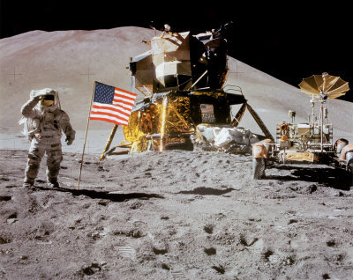
Regrouping
The schools visits we want (and need):
Notes:
NOTES

Slide 61
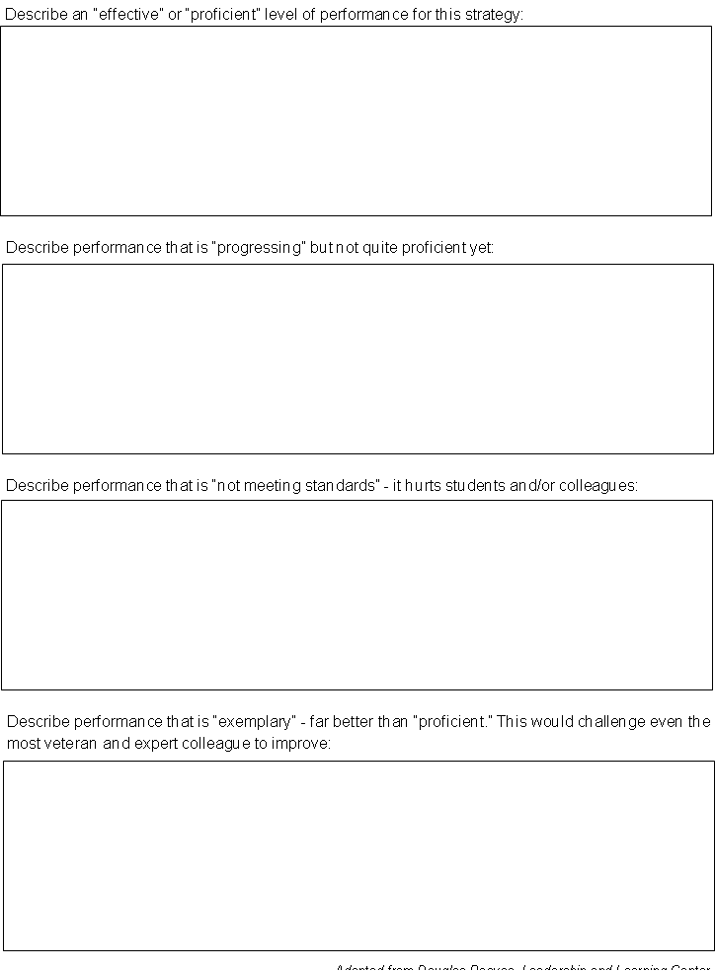
Regrouping
A rubric for school visits (for principal feedback):
Notes:
NOTES

Slide 62

Regrouping
What are the barriers to growth-producing feedback school visits? Talk at tables.
Notes:
NOTES

Slide 63
Homework
Joanne Picone-Zocchia returns
  Half-day with principals AM
  Half-day with evaluators PM
Bring your application of the tool to one of your principals
Remind your principals to bring the rubric completed as a self-reflection
Notes:
NOTES

Slide 64
Homework
Joanne Picone-Zocchia returns
  Half-day with principals AM
  Half-day with evaluators PM
Bring your application of the tool to one of your principals
Remind your principals to bring the rubric completed as a self-reflection
And, a school visit…
Notes:
NOTES

