Slide 1

Principal Evaluator Training
Day 3
2012-2013

Slide 2
Agenda
Introductions & Warm-Up
Taking Stock (with the checklist)
Supervisor Tools
  [more] ISLLC Goal-Setting Organizers
  Talking about a goal (in small groups)
Looking at [your] Evidence w/ your rubric
Summative scoring w/ your rubric
“On Your Radar” between now and June

Slide 3
Warm Up
Look over the scored rubrics (MPPR or Marshall).
What does it tell you? What does in NORT tell you?
What’s your overall impression of this principal based on the rubric language?
Notes:
Five minutes

Slide 4
Back Again: 9 Components
New York State Teaching Standards and Leadership Standards
Evidence-based observation
Application and use of Student Growth Percentile and VA Growth Model data
Application and use of the State-approved teacher or principal rubrics
Application and use of any assessment tools used to evaluate teachers and principals

Slide 5
Back Again : 9 Components
Application and use of State-approved locally selected measures of student achievement
Use of the Statewide Instructional Reporting System
Scoring methodology used to evaluate teachers and principals
Specific considerations in evaluating teachers and principals of ELLs and students with disabilities

Slide 6
Back Again : 9+ Components
State-determined district-wide student growth goal setting process (Student Learning Objectives)
Effective supervisory visits and feedback
Soliciting structured feedback from constituent groups
Reviewing school documents, records, state accountability processes and other measures
Principal contribution to teacher effectiveness
Increasing the likelihood that it makes a difference

Slide 7
“What You Said”
Same fast pace
Conversation is good
Examples and templates are good
Have people bring something from their school visit(s)
Have people bring examples of evidence they are collecting
Continue to compare evidence to standards

Slide 8
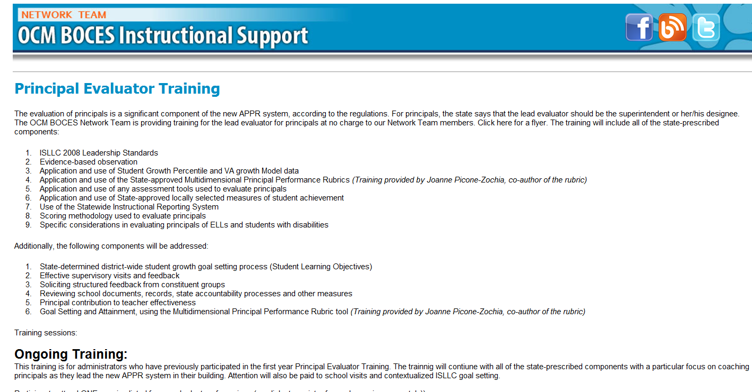
Resources Are Archived

Slide 9
Agenda
Introductions & Warm-Up
Taking Stock (with the checklist)
Supervisor Tools
  [more] ISLLC Goal-Setting Organizers
  Talking about a goal (in small groups)
Looking at [your] Evidence w/ your rubric
Summative scoring w/ your rubric
“On Your Radar” between now and June

Slide 10
Taking Stock
Using the Supervisor’s Guide

Slide 11
The Check-list
Go through the checklist and review the things you have done.
When done, talk about which things were easier to do and which were more difficult or problematic.
Discuss the evidence you collected along the way.

Slide 12
The Check-list
It REALLY is important that you have conversations with your principals (individually as well as collectively) about
ELA implementation (including unit plans)
Math implementation (including unit plans)
Data-Driven Instruction (and common formative assessments)
Culture
This is what the APPR is about – not scores!

Slide 13
More Tools
Contextualized Goal-Setting

Slide 14
Contextualized Goal Setting
Take a look at the [new] three different organizers.
How do they work?
What can you add that wasn’t listed?
Is this tool helpful?

Slide 15
Contextualized Goal Setting
Choose the “corner” of the room that most interests you.
When you get there, discuss how you talk about the initiative with a principal.
Questions to ask? Evidence to seek?

Slide 16
Evidence
And Your Rubric

Slide 17
Evidence Review
Look at your evidence
Compare your evidence with the rubric
Mark the rubric as you can based on the evidence you have right now

Slide 18
Summative Scoring
Calculating the 100pt Score

Slide 19

Summative Evaluation
At your table, generate a list of everything you are going to need to be able to do your summative evaluations and End-of-the-Year Meetings.

Slide 20
Summative Evaluation
SLO scoring conversion
LAT scoring conversion
Rubric scaling to 60 points
Total Score > HEDI scale
Growth-Producing Feedback
PD recommendations
Improvement Plan Requirements

Slide 21
SLO/LAT Scoring Conversion
Figure out the score this principal would get on her SLO and LAT.

Slide 22
Multiple Measures Scoring
Figure out the score this principal would get on her 60%. Use the final scores provided and your district’s APPR plan.

Slide 23
Total Summative Score
What would the score be for the principal?
HEDI?

Slide 24
Total Summative Score
What professional development would you recommend for this principal for next year?
What goals might be important to this principal (and school) next year?

Slide 25


Slide 26
On Your Radar
Looking At the Balance of the Year

Slide 27
On Your Radar
Review the materials from today:
  What’s done/not done on the checklist
  What evidence do you have?
  What will you need in order to do your summative evaluation
Start making some plans for the remainder of the year for your supervision of this principal

Slide 28
Agenda
Introductions & Warm-Up
Taking Stock (with the checklist)
Supervisor Tools
  [more] ISLLC Goal-Setting Organizers
  Talking about a goal (in small groups)
Looking at [your] Evidence w/ your rubric
Summative scoring w/ your rubric
“On Your Radar” between now and June

Slide 29
Next Session
April 10, 2013 - 12:00p – 2:30p – DLC
or
April 18, 2013 - 11:00a to 1:30p - DLC
Agenda will include:
Evidence collection and review
Managing artifacts from visits
Summative Evaluation
Looking Ahead

Slide 30
Questions
+/∆
+
∆
Notes:
NOTES

Slide 31
Principal Evaluator Training
Day 3
2012-2013

