Slide 1

Principal Evaluator Training
Day 2
2012-2013

Slide 2
Agenda
Introductions & Warm-Up
Bridging the Gap
Supervisor Tools
  Checklists
  ISLLC Goal-Setting Organizers
Looking at Evidence
Planning Unannounced School Visits
Closure

Slide 3
Warm Up
What is one thing you’ve done this year, for principal evaluation, that you never had to do before? How has it gone?
If you brought any evidence with you, how are you using it?
Discuss in your table group!
Notes:
Five minutes

Slide 4
Back Again: 9 Components
New York State Teaching Standards and Leadership Standards
Evidence-based observation
Application and use of Student Growth Percentile and VA Growth Model data
Application and use of the State-approved teacher or principal rubrics
Application and use of any assessment tools used to evaluate teachers and principals

Slide 5
Back Again : 9 Components
Application and use of State-approved locally selected measures of student achievement
Use of the Statewide Instructional Reporting System
Scoring methodology used to evaluate teachers and principals
Specific considerations in evaluating teachers and principals of ELLs and students with disabilities

Slide 6
Back Again : 9+ Components
State-determined district-wide student growth goal setting process (Student Learning Objectives)
Effective supervisory visits and feedback
Soliciting structured feedback from constituent groups
Reviewing school documents, records, state accountability processes and other measures
Principal contribution to teacher effectiveness
Increasing the likelihood that it makes a difference

Slide 7
“What You Said”
Same fast pace
Conversation is good
Examples and templates are good
Have people bring something from their school visit(s)
Have people bring examples of evidence they are collecting
Continue to compare evidence to standards

Slide 8
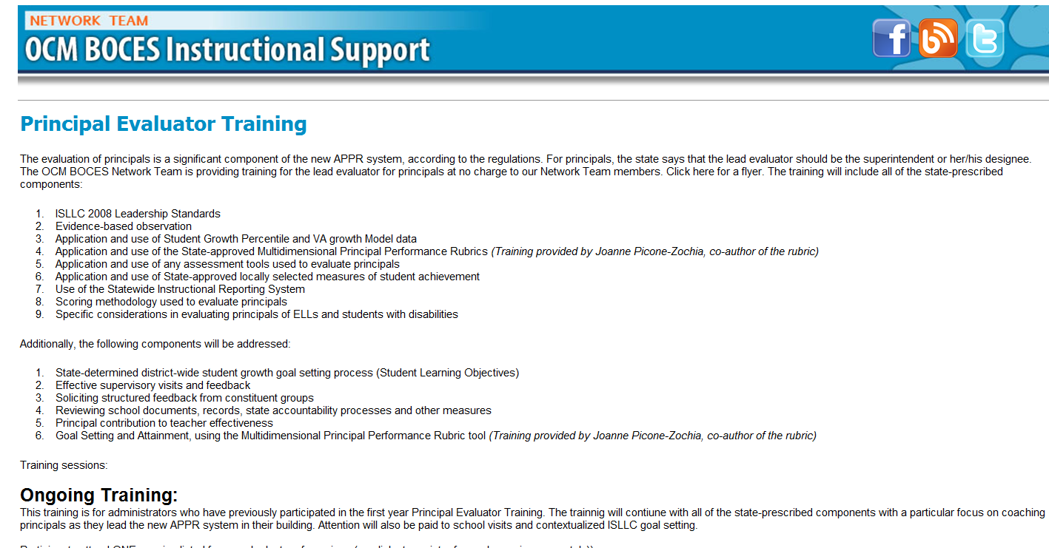
Resources Are Archived

Slide 9
Agenda
Introductions & Warm-Up
Bridging the Gap
Supervisor Tools
  Checklists
  ISLLC Goal-Setting Organizers
Looking at Evidence
Planning Unannounced School Visits
Closure

Slide 10
Bridging the Gap
Working with Principals working with Teachers

Slide 11
Principals and Teachers
What are the typical/traditional ways principals have interacted with teachers?
Jot down some things on the left hand side of the organizer.

Slide 12
Principals and Teachers
How do we want principals to interact with teachers?
Jot down some things on the right hand side of the organizer.

Slide 13
Principals and Teachers
What are some ways to bridge the gap?
Jot down some things on the center of the organizer.

Slide 14

Leading Leaders (article)
Read the article from the November Kappan by Paul Bambrick-Santoyo.

Slide 15
Principals and Supervisors
Turn over the organizer.
As a table, repeat the process, this time for how we want supervisors to interact with principals.

Slide 16
Some New Tools

Slide 17
The Check-list
Take a look at the checklist.
What can you check-off?
What can you add that wasn’t listed?
Is this tool helpful?

Slide 18
Contextualized Goal Setting
Take a look at the three different organizers.
How do they work?
What can you add that wasn’t listed?
Is this tool helpful?

Slide 19
Looking at Some Evidence

Slide 20
Evidence Review
Look at the evidence (all about a unit planning initiative). Discuss:
To which ISLLC standard does it fit?
What is it evidence of?
What questions would you ask the principal?
What further evidence might you seek?

Slide 21
Planning a
School Visit

Slide 22
Planning an Unannounced School Visit
Who would you speak with?
What artifacts would you seek from the principal?
What other evidence would you hope to collect?
What are you doing with the artifacts and evidence?
What (and when) will you tell your principal about it?
Notes:
Give table groups ten minutes to plan a hypothetical school visit. Use the organizer (optional)?

Slide 23
Agenda
Introductions & Warm-Up
Bridging the Gap
Supervisor Tools
  Checklists
  ISLLC Goal-Setting Organizers
Looking at Evidence
Planning Unannounced School Visits
Closure

Slide 24
Next Session
February 13, 2013 - 12:30p - 3:00p – DLC
or
February 14, 2012 - 11:00a to 1:30p - DLC
Agenda will include:
Evidence collection and review
Managing artifacts from visits

Slide 25
Questions
+/∆
+
∆
Notes:
NOTES

Slide 26
Principal Evaluator Training
Day 1
2012-2013

