Slide 1

Principal Evaluator Training
Day 1
2012-2013

Slide 2
Agenda
Introductions
Objectives and Agenda Review
SLOs: Lessons Learned
A Look at Some Evidence
Planning School Visits
Supporting Principals
Closure

Slide 3

Warm Up, Part 1
Now that we’re 1.5 months into the school year, what’s different for principals than it used to be?
Notes:
Five minutes

Slide 4
Warm Up, Part 2
Now that we’re 1.5 months into the school year, what are you doing differently for your principals?
Notes:
Interrupt, change slide and change the discussion question to this one. Give another five minutes.

Slide 5
Back Again: 9 Components
New York State Teaching Standards and Leadership Standards
Evidence-based observation
Application and use of Student Growth Percentile and VA Growth Model data
Application and use of the State-approved teacher or principal rubrics
Application and use of any assessment tools used to evaluate teachers and principals

Slide 6
Back Again : 9 Components
Application and use of State-approved locally selected measures of student achievement
Use of the Statewide Instructional Reporting System
Scoring methodology used to evaluate teachers and principals
Specific considerations in evaluating teachers and principals of ELLs and students with disabilities

Slide 7
Back Again : 9+ Components
State-determined district-wide student growth goal setting process (Student Learning Objectives)
Effective supervisory visits and feedback
Soliciting structured feedback from constituent groups
Reviewing school documents, records, state accountability processes and other measures
Principal contribution to teacher effectiveness
Increasing the likelihood that it makes a difference

Slide 8
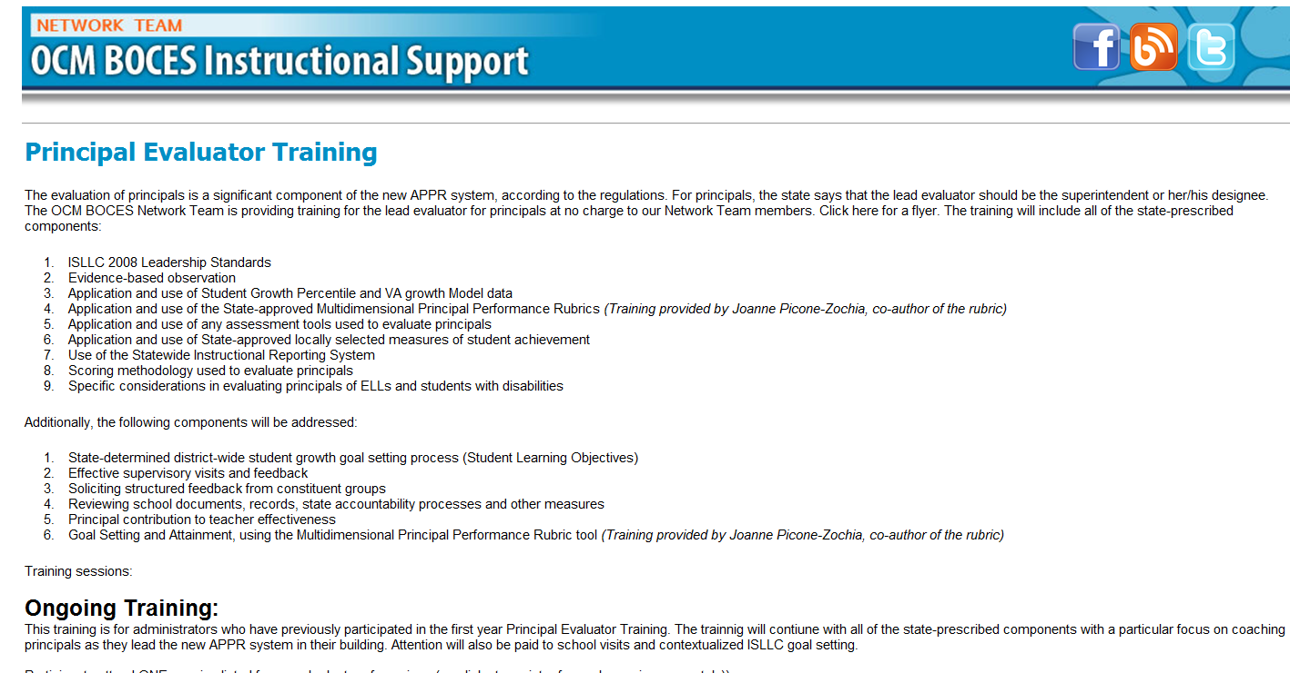
Resources Are Archived

Slide 9
Agenda
Introductions
Objectives and Agenda Review
SLOs: Lessons Learned
A Look at Some Evidence
Planning School Visits
Supporting Principals
Closure

Slide 10
What Did We Learn from our First SLO-Setting?

Slide 11
SLO Lessons Learned
What did we learn,
Organizationally?
Culturally?
In terms of supporting our principals?
Write one “lesson” learned, each, on a 5x8 card with a marker. Use multiple cards.

Slide 12
Looking at Some Evidence

Slide 13
Evidence Review
Choose a piece of evidence as a table group. Discuss:
To which ISLLC standard does it fit?
What is it evidence of?
What questions would you ask the principal?
What further evidence might you seek?

Slide 14
Planning a
School Visit

Slide 15
Planning an Announced School Visit
Who would you speak with?
What artifacts would you seek from the principal?
What other evidence would you hope to collect?
What are you doing with the artifacts and evidence?
Where would you go with the principal?
What would you do w/o the principal?
Notes:
Give table groups ten minutes to plan a hypothetical school visit. Use the organizer (optional)?

Slide 16
Principal Learning

Slide 17

Principal Learning
Principals report that while they are attempting to create conditions to support learning for others, their own learning is not well supported.
Notes:
From “Rethinking Principal Evaluation: A New Paradigm Informed by Research and Practice,” p. 9.

Slide 18
Principal Learning
Do you think the statement from principals is a fair generalization?
Do you expect your principals to get better?
Would your principal(s) agree?
If so, how would she/he know?
Notes:
Table discussions, start allow 5-7 minutes. The point is not to necessarily resolve these questions but to get people thinking about this.

Slide 19
Principal Learning
What are you planning to…
Help your principal(s) with time management
Increase the inter-rater reliability and agreement among your lead evaluators
Help principals plan their faculty meetings
Help principals remain positive and be positive leaders
Help principals with their own learning

Slide 20
Principal Learning
Choose the topic that most interests you:
Help your principal(s) with time management
Increase the inter-rater reliability and agreement among your lead evaluators
Help principals plan their faculty meetings
Help principals remain positive and be positive leaders
Help principals with their own learning
Notes:
Go to a different table in the room. Talk, in the interest group, about what you are doing, plan to do, or are thinking about doing for the topic. Record on chart paper. Report out. Chart paper gets transcribed and distributed at next session.

Slide 21
Agenda
Introductions
Objectives and Agenda Review
SLOs: Lessons Learned
A Look at Some Evidence
Planning School Visits
Supporting Principals
Closure

Slide 22
Next Session
December 19, 2012 - 12:30p - 3:00p – DLC
or
December 20, 2012 - 11:00a to 1:30p - DLC
Agenda will include:
Evidence collection and review
Planning unannounced school visits
Managing artifacts from visits

Slide 23
Questions
+/∆
+
∆
Notes:
NOTES

Slide 24
Principal Evaluator Training
Day 1
2012-2013

