Slide 1
Lead Evaluator Training
2014-2015
Day 8

Slide 2
Agenda
Aligning RTTT
Growth and Value-Added
Evidence Collection
Inter-rater agreement and reliability
Growth-Producing Feedback
Notes:
Review the agenda.

Slide 3
Lead Evaluator Training
Year 1
New York State Teaching Standards and Leadership Standards
Evidence-based observation
Application and use of Student Growth Percentile and VA Growth Model data
Application and use of the State-approved teacher or principal rubrics
Application and use of any assessment tools used to evaluate teachers and principals
Application and use of State-approved locally selected measures of student achievement
Use of the Statewide Instructional Reporting System
Scoring methodology used to evaluate teachers and principals
Specific considerations in evaluating teachers and principals of ELLs and students with disabilities
Notes:
These are the “nine” official goals of Lead Evaluator Training.

Slide 4
Lead Evaluator Training
Ongoing
From the Review Room: “Describe the process by which evaluators will be trained and the process for how the district will certify and re-certify lead evaluators. Describe the process for ensuring
inter-rater reliability. Describe the duration and nature of such training.”
Notes:
This is where ongoing training is mentioned in the Review Room.

Slide 5
Lead Evaluator Training
Ongoing
Continue to collect evidence
Use collected evidence to rate teachers on a rubric (with feedback)
Manage the new system
Employ growth-producing feedback to increase the quality of teaching
Implement the Reform Agenda (RTTT)
Notes:
Our local goals for Lead Evaluator Training, in addition to the required components.

Slide 6
Lead Evaluator Training
What You Said
Growth & Value Added
RTTT/Reform Agenda
Classrooms with ELLs
SIRS (evolved to different systems)
Summative Evaluation – next session
Notes:
This is based on feedback from the last meeting.

Slide 7
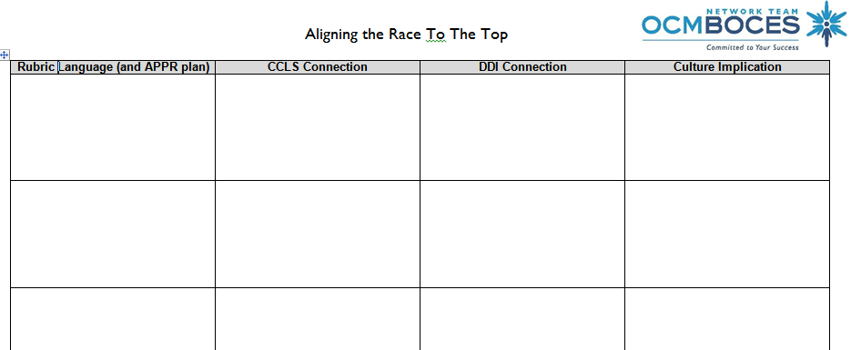

Aligning the “race” to the top
  Work as like-rubric partners to complete
  Don’t get too specific – focus on big ideas and talking points with teachers
Notes:
NOTES

Slide 8
Aligning the “race” to the top
  Work as like-rubric partners to complete
  Don’t get too specific – focus on big ideas and talking points with teachers
Are lessons becoming more aligned to CCLS
Did instructional changes I made based on common formative assessment work?
Do schedules have built-in time for teachers to co-labor?
7. Professional Growth
Notes:
NOTES

Slide 9


Slide 10
SED’s Research
Behind Teacher Evaluation

Slide 11
Teacher Effectiveness Research
Teacher effectiveness matters!
This is the right work!
Two big research studies confirm this

Slide 12
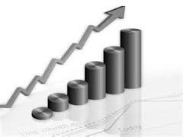
Chetty, Friedman & Rockoff
The Long-Term Impacts of Teachers: Teacher Value-added and Student Outcomes in Adulthood
Notes:
http://obs.rc.fas.harvard.edu/chetty/value_added.html

Slide 13
Chetty, Friedman & Rockoff
2.5M children from childhood to early adulthood in 1 large district
Teacher/course linkages and test scores in grades 3-8 from 1991-2009
US government tax data from W-2s: on parents AND students
About parents: household income, retirement savings, home ownership, marriage, age when student born
About students up to age 28: teen birth, college attendance, earnings, neighborhood “quality”

Slide 14
Chetty, Friedman & Rockoff
Having a higher value-added teacher for even one year in grades 4-8 has substantial positive long-term impacts on a student’s life outcomes including:
Likelihood of attending college (↑ 1.25%)
Likelihood of teen pregnancy (↓ 1.25%)
Salary earned in lifetime (↑ $25K )
Neighborhood (↑ college grads)
Retirement savings (↑)

Slide 15
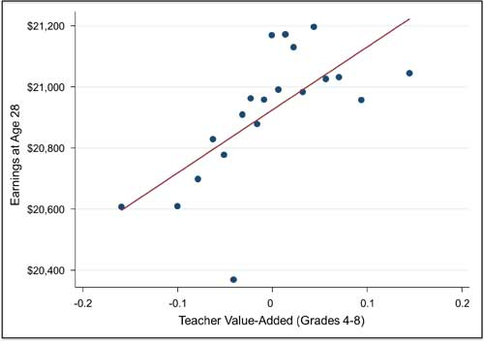
Chetty, Friedman & Rockoff
Student
Future
Earnings

Slide 16
What is “teacher value added”
A statistical measure of the growth of a teacher’s students that takes into account the differences in students across classrooms that school systems can measure but teachers can’t control.
Growth compared to the average growth of similar students

Slide 17
Test Scores Alone
680
670
Achievement scores say more about students than teachers.
2015
2015
Teacher A
Teacher B

Slide 18
Growth
Adding average prior achievement for the same students shows Teacher B’s students had higher growth.
Growth
+25
Growth
+20
680
670
660
645
2014
2015
2015
2014
2015
Teacher A
Teacher B

Slide 19
Value-Added
Comparing growth to the average growth of “similar” students gives teacher A the higher “value-added” result.
Value-
Added
+15 Above
Average
Growth
+20
680
Growth
+25
Value-
Added
AVERAGE
665
670
670
660
645
2015
2015 Avg for similar students
2015 Avg for similar students
2014
2014
2014
2015
Teacher A
Teacher B

Slide 20
How would you answer?
New York’s evaluation system is based mostly on State test scores and that’s not good.
A principal knows a good teacher when s/he sees one; we don’t need to include value-added results too.
I’ve been doing teacher observations for years. I don’t need to go to your training.
Teacher Value-added information is unreliable and shouldn’t be a part of teacher evaluation.
By putting test scores into teacher evaluation, everyone will do even more to “teach to the test” and if that doesn’t work, they’ll cheat.
Notes:
New York’s evaluation system is based mostly on State test scores and that’s not good.
NY uses multiple measures as research advises. 60% involves measures of educator practice. 20-25% involves GROWTH on state assessments or comparable measures. And the remaining points will be a locally-selected measure of student growth or achievement.
A principal knows a good teacher when s/he sees one; we don’t need to include value-added results too.
Recent METS study shows that combining observation results and teacher value-added is more predictive and reliable than either measure alone.
I’ve been doing teacher observations for years.
I don’t need to go to your training.
The MET study shows that regularly recalibrating observers against benchmarks of accurate observation ratings is critical to ensuring a valid and reliable evaluation system. Even the best observers can “drift” over time. And the best can help others stay in sync. In addition, NYS training will help everyone identify evidence that the new Common core standards are being implemented well in classrooms.
Teacher Value-added information is unreliable and shouldn’t be a part of teacher evaluation.
Many researchers have shown that teacher value-added is the best predictor we have of the future learning growth of a teacher’s students. Two new research studies, Chetty/Friedman/Rockoff and the Measures of Effective Teaching Study add new evidence in support of this argument.
By putting test scores into teacher evaluation, everyone will do even more to “teach to the test” and if that doesn’t work, they’ll cheat.
No one has been able to research yet the predictiveness and reliability of teacher value-added measures when they are used in high stakes environments since such evaluation systems are just beginning across the country. Some teachers may try to game the system. Others may strive to develop the skills research says align with higher value-added results. However, the power of these measures argues for including them as part of a multiple measures system.

Slide 21

Quick break

Slide 22
Specific considerations in evaluating teachers and principals of ELLs

Slide 23
Quick break

Slide 24
Mini-lesson:
21st Century Skills

Slide 25


Slide 26
21C Scavenger Hunt
In the document provided to your table, look through it and highlight any references to
21st Century Skills
Communication
Collaboration
Critical Thinking
Creativity and Problem Solving

Slide 27
NYS Teaching Standards III.5
Teachers engage students in the development of multidisciplinary skills, such as communication, collaboration, critical thinking, and use of technology.
Students synthesize and express ideas both in written and oral formats.
Students work effectively with others, including those from diverse groups and with opposing points of view.
Students make decisions, solve problems, and take actions as appropriate.
Students solve problems and/or acquire new knowledge through creative and innovative approaches to learning.
Students utilize technologies and resources to solve real world problems.

Slide 28
NYS Teaching Standards III.5
Teachers engage students in the development of multidisciplinary skills, such as communication, collaboration, critical thinking, and use of technology.
Students synthesize and express ideas both in written and oral formats.
Students work effectively with others, including those from diverse groups and with opposing points of view.
Students make decisions, solve problems, and take actions as appropriate.
Students solve problems and/or acquire new knowledge through creative and innovative approaches to learning.
Students utilize technologies and resources to solve real world problems.
THESE ARE THE 4 Cs!

Slide 29
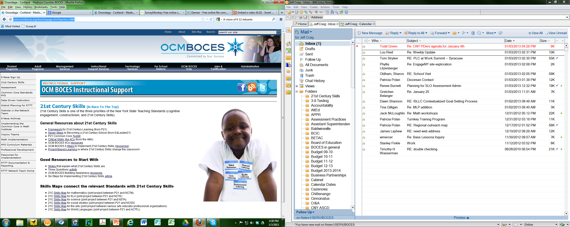
21C Resources

Slide 30
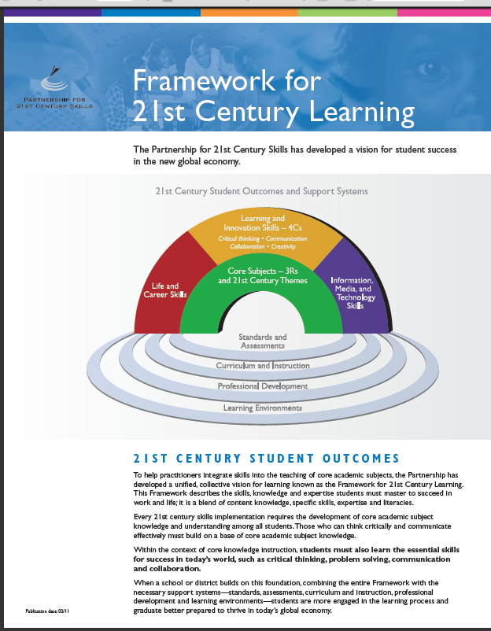
21C Resources

Slide 31
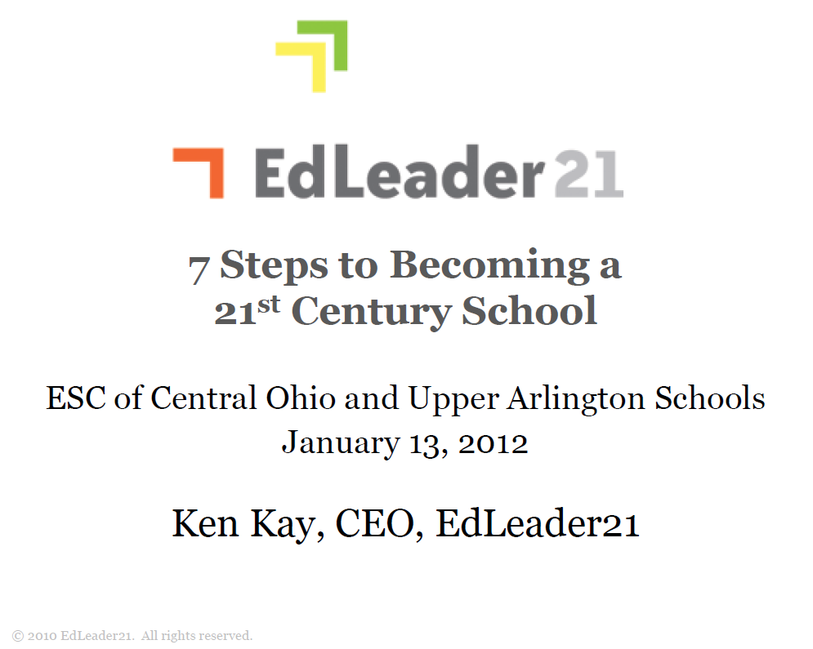
21C Resources

Slide 32

21C Resources

Slide 33
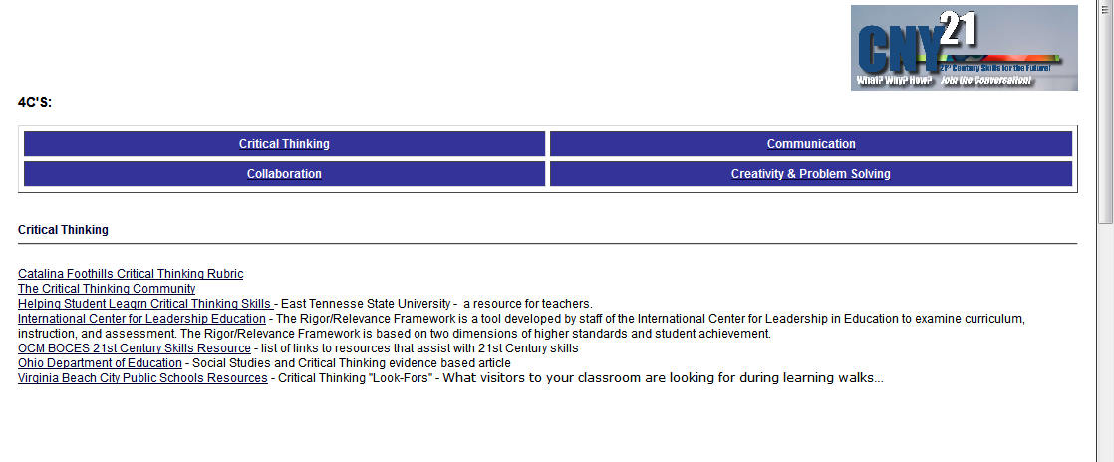
21C Resources

Slide 34
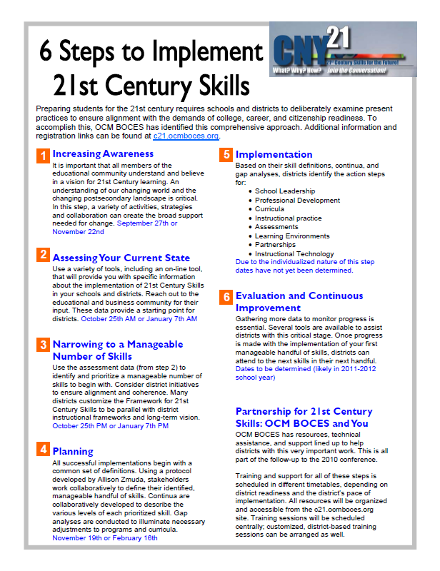
21C Resources

Slide 35

21C Resources

Slide 36
21C Resources

Slide 37
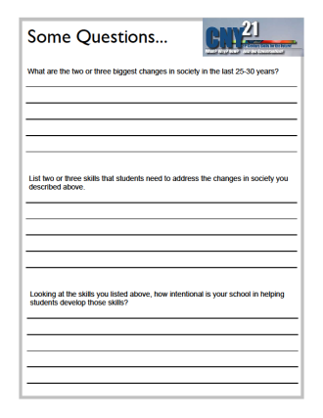
21C Resources

Slide 38
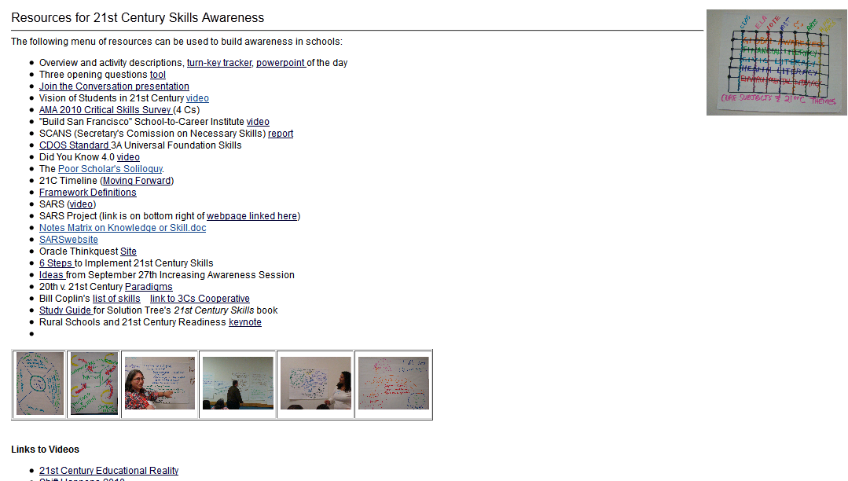
21C Resources

Slide 39
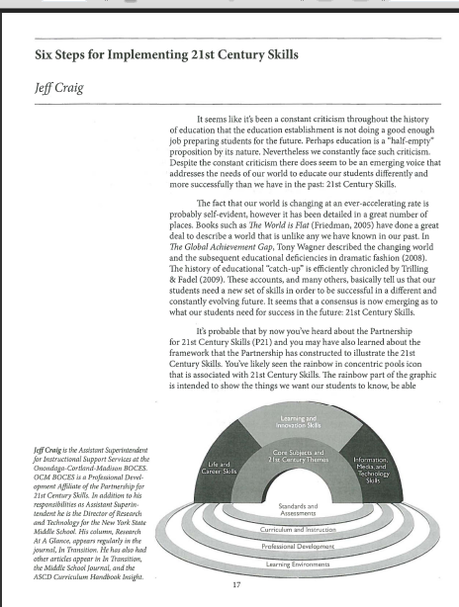
21C Resources

Slide 40
Quick break

Slide 41
Evidence Collection and
Growth-Producing Feedback

Slide 42
Evidence Collection
Watch the video
Collect evidence
Focus on instruction
  Standard III (Teaching Standards and NYSUT)
  Domain 3 (Danielson)

Slide 43
Evidence Collection
Label the evidence provided to you
Use Standards (or refer to Danielson)

Slide 44
Evidence Collection
Rate the teacher on Standard 3 (NYSUT).
As prompted in polleverywhere, text your rating
Where were you, compared to
  Others in the room
  (inter-rater agreement)
  The facilitator
  (inter-rater reliability)

Slide 45

Growth-Producing Feedback
With your neighbor, plan your conversation with the teacher

Slide 46
Growth-Producing Feedback
Choose one of the cards from the center of the table. READ IT.
Think about how you would talk about the situation described on the card.

Slide 47
Growth-Producing Feedback
Go talk to someone from another table WHO DOESN’T HAVE THE SAME CARD AS YOU.
First share the situation, and then how you would tackle it in a conversation with the teacher.
Switch!

Slide 49
Next Session
December 16th in Syracuse
Agenda will include
  Summative Calculations
  Summative Conversations
  Looking to the future

