Slide 1
OCM BOCES
SLOs
Workshop

Slide 2
APPR
Race To The Top:
Standards
Data
Professional Practice
Culture
APPR

Slide 3
APPR
20%
Student Growth
60%
Multiple Measures
20%
Student Achievement

Slide 4
APPR
Growth over time
Compared to Expected Growth
Some Variables Considered
20%
Student Growth
SLOs Required
60%
Multiple Measures
20%
Student Achievement

Slide 5
APPR
20%
Student Growth
60%
Multiple Measures
Moment in time or growth
20%
Student Achievement
Could be school-
wide measure
Local or Purchased
Some Variables Considered
SLOs Optional

Slide 6
APPR
Knowledge of Students & Student Learning
Knowledge of Content & Instructional Planning
Instructional Practice
60%
Multiple Measures
Learning Environment
Assessment for Student Learning
Professional Responsibilities and Collaboration
Professional Growth

Slide 7
APPR
Growth over time
Knowledge of Students & Student Learning
Compared to Expected Growth
Knowledge of Content & Instructional Planning
Some Variables Considered
20%
Student Growth
SLOs Required
Instructional Practice
60%
Multiple Measures
Moment in time or growth
Learning Environment
20%
Student Achievement
Could be school-
wide measure
Assessment for Student Learning
Local or Purchased
Professional Responsibilities and Collaboration
Some Variables Considered
SLOs Optional
Professional Growth

Slide 8
APPR
Growth over time
Compared to Expected Growth
Some Variables Considered
20%
Student Growth
SLOs Required
60%
Multiple Measures

Slide 9
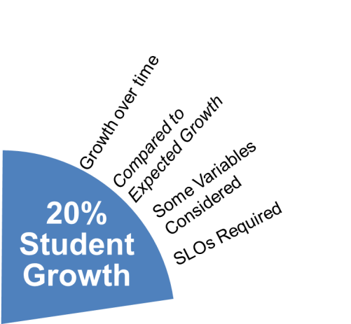
APPR
NO State-provided Growth Score; Use Student Learning Objectives
State-provided Growth Score

Slide 10
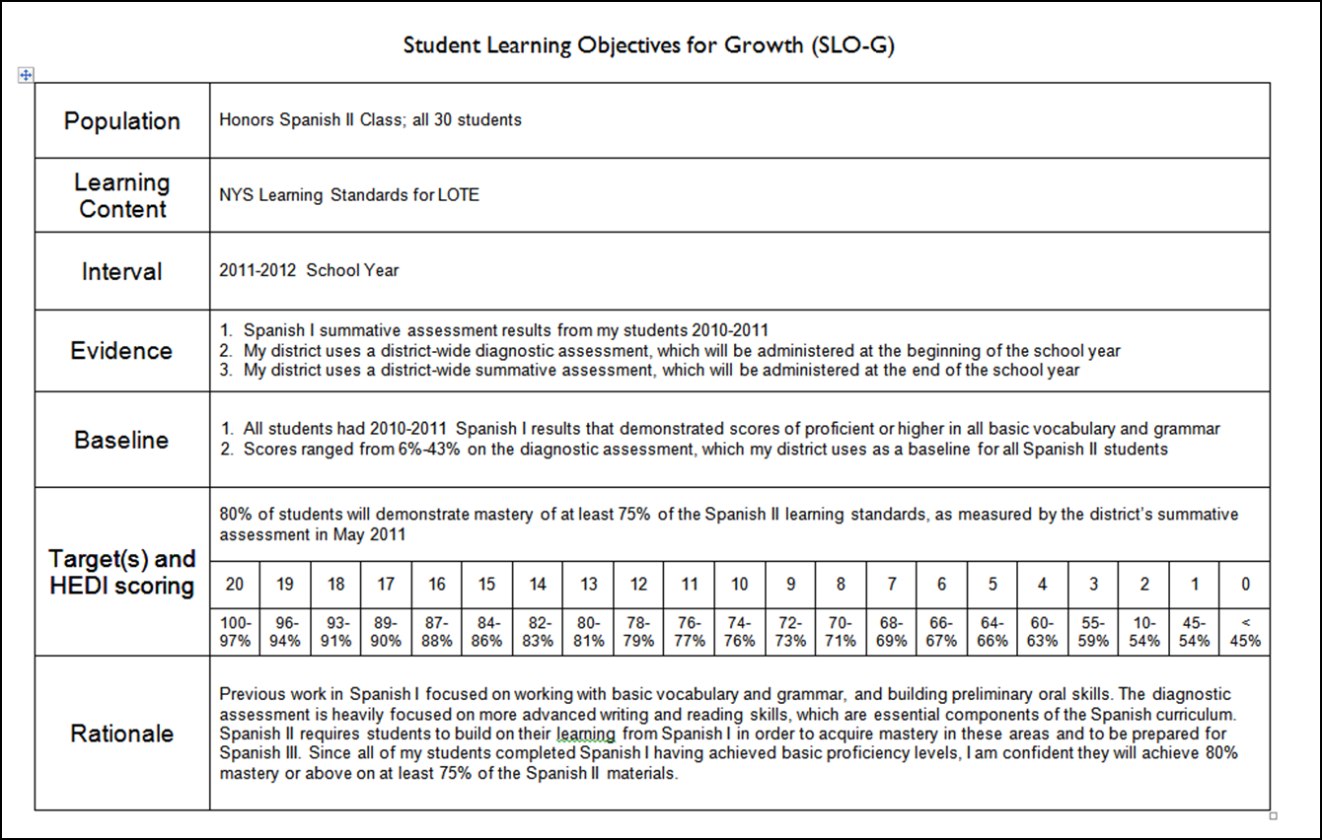
APPR
INGREDIENTS

Slide 11
SLOs
Definition (underline key words):
A student learning objective is an academic goal for a teacher’s students that is set at the start of a course. It represents the most important learning for the year (or, semester, where applicable). It must be specific and measurable, based on available prior student learning data, and aligned to Common Core, State, or national standards, as well as any other school and district priorities. Teachers’ scores are based upon the degree to which their goals were attained.
Notes:
NOTES

Slide 12
Key Points
SLOs
SLOs name what students need to know and be able to do at the end of the year.
SLOs place student learning at the center of the conversation.
SLOs are a critical part of all great educator’s practice.
SLOs are an opportunity to document the impact educators make with students.
SLOs provide principals with critical information that can be used to manage performance, differentiate and target professional development, and focus supports for teachers.
The SLO process encourages collaboration within school buildings.
School leaders are accountable for ensuring all teachers have SLOs that will support their District and school goals.

Slide 13
SLOs
State
Determines SLO process
Identifies required elements
Requires use of State test
Provides training to NTs prior to 2012-13.
Provides guidance, webinars & videos
District
District goals & priorities
Match requirements to teachers
Define processes for before & after
Identify expectations
School
LE & teacher collaborate
LE approval
Ensure security
LE monitor & evaluation
Teacher
Works with colleagues & LE
SLOs

Slide 14
SLO Decisions for Districts
SLOs
Assess and identify priorities and academic needs.
Identify who will have State-provided growth measures and who must have SLOs as “comparable growth measures.”
Determine District rules for how specific SLOs will get set.
Establish expectations for scoring SLOs and for determining teacher ratings for the growth component.
Determine District-wide processes for setting, reviewing, and assessing SLOs in schools.
March 1
April 16
May 30

Slide 15
SLO Decision # 1
SLOs
What are your district priorities?
What are your building priorities?
ELLs achievement
AP participation
SWD achievement
Graduation rate
Achievement gap
ELA? Math? Sci?
Non-fiction writing

Slide 16
SLO Decision # 2
SLOs
Go through the scenarios for different teachers
Teaching Assignment | Is there a State-Provided Growth Score (or is there a state assessment that must be used)? | What (if any) SLOs would have to be employed?
Kindergarten Common Branch
First Grade Common Branch
Third Grade Common Branch
Fourth Grade Common Branch
Fifth Grade Math
Sixth Grade Social Studies
Seventh Grade Science
8th Grade ELA and Social Studies teacher with 100 students Class One: ELA with 35 students Class Two: ELA with 20 students Class Three: SS with 30 students Class Four: SS with 15 students
Science teacher with 110 total students across five sections Two Living Environment (Regents) sections with 20 students each Two Living Environment (non-Regents) with 25 students each One Forensic Science elective with 20 students
7th grade Math and Science teacher with 130 students across 5 sections Two 7th grade Math sections with 30 students each Two 7th grade Science sections with 25 students each One Advances 7th grade Science section with 20 students
Middle school PE teacher with 5 sections and 140 students total 2 sections of 6th grade PE (60 students total) 2 sections of 7th grade PE (50 students total) Section of 8th grade PE (sop students)
High school resource teacher with a total of 25 students 2 groups of 9th grade students 2 groups of 10th grade students 1 group of 11th/12th grade students
K-6 art teacher with a total of 480 students 4 sections of K (80 students) 4 sections of 1st grade (100 students) 4 sections of 2nd grade (100 student) 3 sections of 3rd grade (90 students) 4 sections of 4th grade (110 students)
5th and 6th grade AIS/reading teacher with a total of 80 students 6 groups of 5th grade students who meet every other day (35 students total) 6 groups of 6th grade students (45 students total)
11th grade special education teacher 2 sections of co-taught ELA (class size 20 each with 6 SWD in each) 3 sections of 11th grade resource room (total of 15 students)
K-6 instrumental music teacher 4th grade lessons (30 students who meet once per week in lessons of 3 students each) 5th grade band (35 students who meet every other day) 5th grade lessons (35 students who meet once per week in lessons of 5 students each) 6th grade band (35 students who meet every other day) 6th grade lessons (35 students who meet once per week in lessons of 5 students each)
Middle-level library/media specialist (600 students in school) 5th grade classes (150 students attend library class once per week in 6 groups of 25) 6th – 8th grade students use library as needed or as scheduled in conjunction with teachers.

Slide 17
Rules for Decision #2?
SLOs
Math and ELA trump
Use state test if there is one
Must cover 50%
Bigger enrollment to lesser enrollment

Slide 18
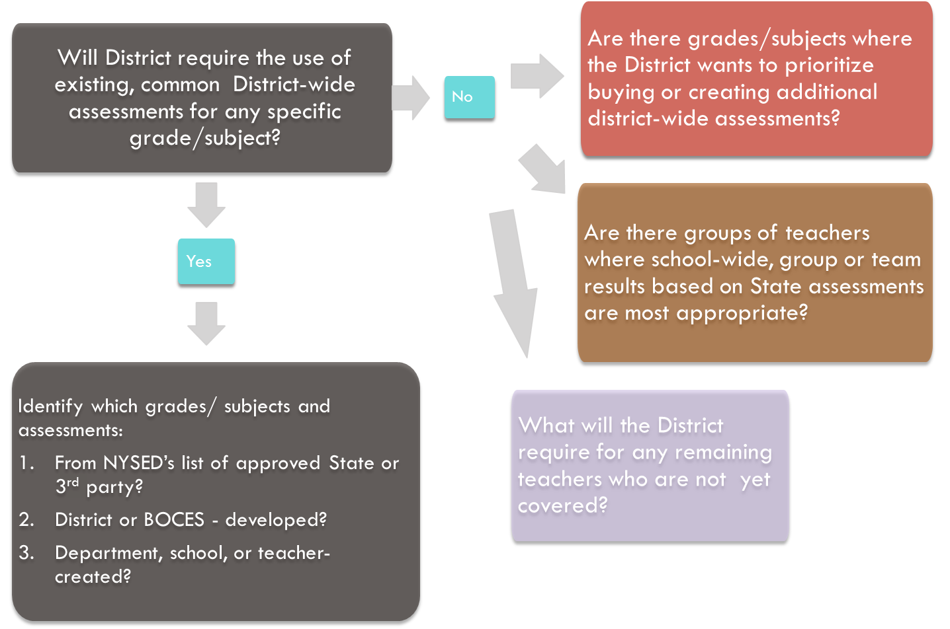
SLO Decision # 3
SLOs
DISALLOWED

Slide 19
SLO Decision # 4
SLOs
Establish expectations for scoring SLOs and for determining teacher ratings for the growth component.

Slide 20
SLO Decision # 5
SLOs
Determine District-wide processes for setting, reviewing, and assessing SLOs in schools.
Be ready to demonstrate rigor and comparability to SED as assessments are identified/constructed

Slide 21
SLOs

Slide 22
SLOs
Population | Four sections of Regents US History (90 students)
Learning Content | NYS Learning Standards for Social Studies (History of the United States and New York, Standard 1)
Interval | 2012-2013 School Year
Evidence | District-wide diagnostic assessment (June 2009 Regents US History Exam), which will be administered at the beginning of the school year Regents US History examination will be used at the end of the year
Baseline | All of the students passed the Global Regents exam the previous year; 35% at mastery level (85% or higher) The average score on the diagnostic assessment (June 2009 Regents) was 74%; 67% of the students scored at least a 65%; 21% of the students scored at least 85%.
Target(s) and HEDI scoring | 50% of the students will score at least an 85% on the Regents exam given at the conclusion of the course.
 | 20 | 19 | 18 | 17 | 16 | 15 | 14 | 13 | 12 | 11 | 10 | 9 | 8 | 7 | 6 | 5 | 4 | 3 | 2 | 1 | 0
 | 100-85% | 80-84% | 75-79% | 70-74% | 65-69% | 60-64% | 55-59% | 50-54% | 55-59% | 51-54% | 50-53% | 49-52% | 45-48% | 41-44% | 35-40% | 30-34% | 25-29% | 20-24% | 15-19% | 10-14% | < 10%
Rationale | Almost all students have historically passed the US History Regents examination. Increasing the number of students who achieve at the mastery in social studies is a school-wide goal. The average number of students scoring at the mastery level on US History for the district has been 50%. Because students have been learning US history for much of their education (4th grade, 5th grade, 7th grade, 8th grade), the use of a past Regents exam was appropriate as a diagnostic assessment.

Slide 23
SLOs
Population | Co-taught inclusion 9th grade English Language Arts (16 heterogeneous general education students and 7 students with IEPs)
Learning Content | NYS Learning Standards for ELA/Literacy, District scope and sequence for research and nonfiction writing
Interval | 2012-2013 School Year
Evidence | 8th grade research papers (scored according to district nonfiction writing rubric) 9th grade on-demand writing prompt (scored according to district nonfiction writing rubric) 9th grade research report (scored according to district nonfiction writing rubric)
Baseline | At the conclusion of 8th grade, all students were expected to write an eight-page research report about a topic in American History of their choosing (an ELA/social studies interdisciplinary project). The research papers were scored with the district-wide rubric. Of the students in this class, four reports were rated “distinguished,” eight “proficient,” eight “developing,” and three “not yet.” In the first week of school, all 9th graders were given the same nonfiction writing prompt. In this class, three papers were rated “distinguished,” seven “proficient,” ten “developing,” and three “not yet.”
Target(s) and HEDI scoring | Using the formula [(#distinguished + #proficient)*2 + #developing]
 | 20 | 19 | 18 | 17 | 16 | 15 | 14 | 13 | 12 | 11 | 10 | 9 | 8 | 7 | 6 | 5 | 4 | 3 | 2 | 1 | 0
 | 45-46 | 43-44 | 41-42 | 39-40 | 37-38 | 35-36 | 33-34 | 31-32 | 29-30 | 27-28 | 25-26 | 23-24 | 21-22 | 19-20 | 17-18 | 15-16 | 13-14 | 11-12 | 9-10 | 5-8 | <5
Rationale | An identified district goal has been nonfiction informational writing. Based on the research supporting the skill as well as the CCLS ELA/Literacy Standards and the district’s scope and sequence for research, the district has developed a uniform rubric that is used to assess nonfiction writing at all levels. In 9th grade, students are expected to write a nine-page research report that uses at least nine sources.

