Slide 1

Creating a
Student Learning Objective (SLO)

Slide 2
Training Objectives
Understand how Student Learning Objectives (SLOs) fit into the APPR System
Understand the components of an SLO
Know for which courses you have to have an SLO
Be able to BEGIN to construct an SLO

Slide 3
Race To The Top
Learning Standards
Data
Professional Practice
Culture
APPR

Slide 4
20%
Student
Growth
60%
Multiple Measures
20%
Student
Achievement

Slide 5
Growth over time
Compared to
Expected Growth
Some Variables
Considered
20%
Student
Growth
SLOs Required
60%
Multiple Measures
20%
Student
Achievement

Slide 6
20%
Student
Growth
60%
Multiple Measures
Moment in time
or growth
20%
Student
Achievement
Could be school-
wide measure
Local or
Purchased
Some Variables
Considered
SLOs Optional

Slide 7
Knowledge of Students & Student Learning
Knowledge of Content & Instructional Planning
Instructional
Practice
60%
Multiple Measures
Learning
Environment
Assessment for
Student Learning
Professional Responsibilities
and Collaboration
Professional
Growth

Slide 8
Growth over time
Knowledge of Students & Student Learning
Compared to
Expected Growth
Knowledge of Content & Instructional Planning
Some Variables
Considered
20%
Student
Growth
SLOs Required
Instructional
Practice
60%
Multiple Measures
Moment in time
or growth
Learning
Environment
20%
Student
Achievement
Could be school-
wide measure
Assessment for
Student Learning
Local or
Purchased
Professional Responsibilities
and Collaboration
Some Variables
Considered
SLOs Optional
Professional
Growth

Slide 9
Growth over time
Compared to
Expected Growth
Some Variables
Considered
20%
Student
Growth
SLOs Required
60%
Multiple Measures

Slide 10
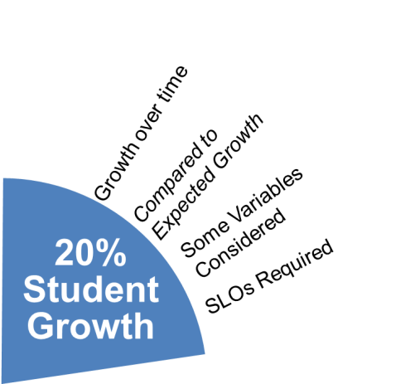
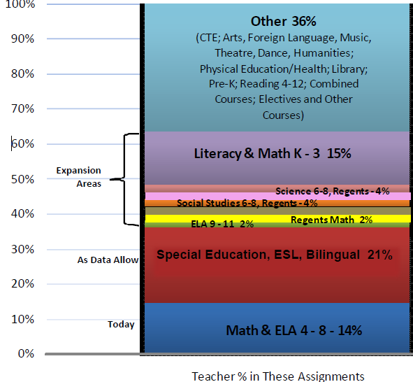
NO State-provided Growth Score; Use Student Learning Objectives
State-provided Growth Score

Slide 11
INGREDIENTS

Slide 12
INGREDIENTS

Slide 13
Definition:
A student learning objective is an academic goal for a teacher’s students that is set at the start of a course. It represents the most important learning for the year (or, semester, where applicable). It must be specific and measurable, based on available prior student learning data, and aligned to Common Core, State, or national standards, as well as any other school and district priorities. Teachers’ scores are based upon the degree to which their goals were attained.
Notes:
NOTES

Slide 14
Key Points
SLOs name what students need to know and be able to do at the end of the year.
SLOs place student learning at the center of the conversation.
SLOs are a critical part of all great educator’s practice.
SLOs are an opportunity to document the impact educators make with students.
SLOs provide principals with critical information that can be used to manage performance, differentiate and target professional development, and focus supports for teachers.
The SLO process encourages collaboration within school buildings.
School leaders are accountable for ensuring all teachers have SLOs that will support their District and school goals.

Slide 15
State
Determines SLO process
Identifies required elements
Requires use of State test
Provides training to NTs prior to 2012-13.
Provides guidance, webinars & videos
District
District goals & priorities
Match requirements to teachers
Define processes for before & after
Identify expectations
School
LE & teacher collaborate
LE approval
Ensure security
LE monitor & evaluation
Teacher
Works with colleagues & LE
SLOs

Slide 16
100-Point Evaluation System: State 20%
Three types of teachers:
If there is a State-provided growth measure for at least 50% of students | Will have State-provided growth measure (no SLOs)
If there is no State-provided growth measure for the course | Use only SLOs (no State-provided growth measure)
If there is a State-provided growth measure for less than 50% of students | Will have State-provided growth measure and will use SLOs

Slide 17
INGREDIENTS

Slide 18
INGREDIENTS

Slide 19
Student Population
These are the students included in the SLO.

Slide 20
Learning Content
Identify the course name and source of standards (Common Core, national, state, local) associated with this SLO, and specify the exact standards, performance indicators, etc., that will be taught, learned, and assessed.

Slide 21
Interval of Instructional Time
This is the timeframe within which the learning content will be taught. (This is generally one academic year unless the course is set as a semester, quarter, etc.)

Slide 22
Evidence
These are the assessments used for determining students’ levels of learning. Two parts:
Pre-assessment or diagnostic data that you gather and analyze at the beginning of the course
Summative measures for the end of the course

Slide 23
Baseline
Describe how students performed on the identified pre-assessment(s) for the learning content. Baseline scores for students should be reviewed by teacher and Lead Evaluator when setting the SLO at the beginning of the course.

Slide 24
Target(s)
This is the level of knowledge and skill that students are expected to achieve at the end point of the interval of instructional time.
Define numerical growth goals for student performance on identified summative assessment(s) which measure student knowledge and skill in the learning content. These data will be reviewed by the teacher and Lead Evaluator at the conclusion of the course.

Slide 25
HEDI
This is how different levels of student growth will translate into one of four rating categories:
Highly effective (20-18)
Effective (17-9)
Developing (8-3)
Ineffective (2-0)

Slide 26
Rationale
This describes the reasoning behind the choices regarding learning content, evidence, and target.

Slide 27
Creating a
Student Learning Objective (SLO)

Slide 28
Student Population
These are the students included in the SLO.

Slide 29
Student Population

Slide 30
Learning Content
Identify the course name and source of standards (Common Core, national, state, local) associated with this SLO, and specify the exact standards, performance indicators, etc., that will be taught, learned, and assessed.

Slide 31
Learning Content
CCLS Anchor Standards

Slide 32
Interval of Instructional Time
This is the timeframe within which the learning content will be taught. (This is generally one academic year unless the course is set as a semester, quarter, etc.)

Slide 33
Interval of Instructional Time

Slide 34
Evidence
These are the assessments used for determining students’ levels of learning. Two parts:
Pre-assessment or diagnostic data that you gather and analyze at the beginning of the course
Summative measures for the end of the course

Slide 35
Evidence
Appendix B

Slide 36
Baseline
Describe how students performed on the identified pre-assessment(s) for the learning content. Baseline scores for students should be reviewed by teacher and Lead Evaluator when setting the SLO at the beginning of the course.

Slide 37
Baseline

Slide 38
Target(s)
This is the level of knowledge and skill that students are expected to achieve at the end point of the interval of instructional time.
Define numerical growth goals for student performance on identified summative assessment(s) which measure student knowledge and skill in the learning content. These data will be reviewed by the teacher and Lead Evaluator at the conclusion of the course.

Slide 39
Target(s)

Slide 40
HEDI
This is how different levels of student growth will translate into one of four rating categories:
Highly effective (20-18)
Effective (17-9)
Developing (8-3)
Ineffective (2-0)

Slide 41
HEDI

Slide 42
Rationale
This describes the reasoning behind the choices regarding learning content, evidence, and target.

Slide 43
Rationale

Slide 44
Have a go!

Slide 45
Jeff Craig jcraig@ocmboces.org

