Slide 1
Common Core State Standards
Getting to know the
Fall 2010

Slide 2
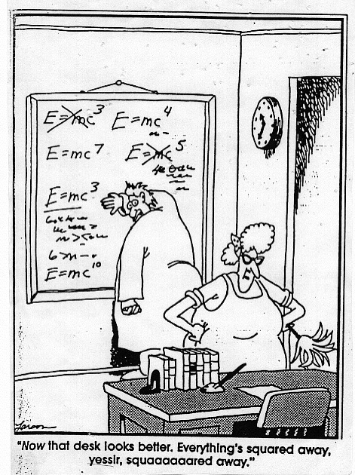

Slide 5
Key Features
“Career and College Readiness”
aligned
Aligned with college and work expectations
clear
Clear, understandable, and consistent
rigorous
Rigorous content and application of knowledge through higher-order skills
better
Built upon strengths and lessons of current state standards
Informed by other top-performing countries so that all students are prepared to succeed in the global economy
global
From CCSS website

Slide 6
CCSS for Mathematics
Grade-Level Standards
K-8 grade-by-grade standards organized by domain
9-12 high school standards organized by conceptual categories
Standards for Mathematical Practice
Describe mathematical “habits of mind”
Standards for mathematical proficiency: reasoning, problem solving, modeling, decision making, and engagement
Connect with content standards in each grade

Slide 7
Mathematics K-8
The K- 8 standards:
The K-5 standards provide students with a solid foundation in whole numbers, addition, subtraction, multiplication, division, fractions and decimals
The 6-8 standards describe robust learning in geometry, algebra, and probability and statistics
Modeled after the focus of standards from high-performing nations, the standards for grades 7 and 8 include significant algebra and geometry content
Students who have completed 7th grade and mastered the content and skills will be prepared for algebra, in 8th grade or after

Slide 8
Mathematics HS
The High School standards:
Call on students to practice applying mathematical ways of thinking to real world issues and challenges
Require students to develop a depth of understanding and ability to apply mathematics to novel situations, as college students and employees regularly are called to do
Emphasize mathematical modeling, the use of mathematics and statistics to analyze empirical situations, understand them better, and improve decisions
Identify the mathematics that all students should study in order to be college and career ready.

Slide 9
Compare a high-deductible versus a low-deductible automobile insurance policy using various, but reasonable, chances of having a minor or a major accident.

Slide 10
Compare a high-deductible versus a low-deductible automobile insurance policy using various, but reasonable, chances of having a minor or a major accident.

Slide 11
Courses in higher level mathematics: Precalculus, Calculus (upon completion of Precalculus), Advanced Statistics, Discrete Mathematics, Advanced Quantitative Reasoning, or other courses to be designed at a later date, such as additional career technical courses.
Algebra II
Mathematics III
Geometry
Mathematics II
Algebra I
Mathematics I

Slide 12
CCSS for ELA
College and Career Readiness (CCR) Standards
Overarching standards for each strand that are further defined by grade-specific standards
Grade-Level Standards in English Language Arts
K-8, grade-by-grade
9-10 and 11-12 grade bands for high school
Four strands: Reading, Writing, Speaking and Listening, and Language
Standards for Literacy
Standards are embedded at grades K-5
Content-specific literacy standards are provided for grades 6-8, 9-10, and 11-12

Slide 13
Reading Strand
Progressive development of reading comprehension; students gain more from what they read
Emphasize the importance of grade-level texts that are of appropriate difficulty and are increasingly sophisticated
Standards for Reading Foundational Skills (K-5)
Reading Standards for Literature (K-12)
Reading Standards for Informational Text (K-12)
Reading Standards for Literacy in History/Social Studies (6-12)
Reading Standards for Literacy in Science and Technical Subjects (6-12)

Slide 14
Being Deliberate About Reading Levels
Interquartile Ranges Shown (25% - 75%)
1600
1400
1200
Text Lexile Measure (L)
1000
800
600
High
School
Literature
College
Literature
High
School
Textbooks
College
Textbooks
Military
Personal
Use
Entry-Level
Occupations
SAT 1,
ACT,
AP*
From: Datametrics

Slide 15
Writing Strand
Writing
Expect students to compose arguments and opinions, informative/explanatory pieces, and narrative texts
Focus on the use of reason and evidence to substantiate an argument or claim
Emphasize ability to conduct research – short projects and sustained inquiry
Require students to incorporate technology as they create, refine, and collaborate on writing
Include student writing samples that illustrate the criteria required to meet the standards

Slide 16
Speaking and Listening Strand
Speaking and Listening
Focus on speaking and listening in a range of settings, both formal and informal – academic, small-group, whole-class discussions
Emphasize effective communication practices
Require interpretation and analysis of message as presented through oral, visual, or multimodal formats
Media and Technology are integrated throughout the standards.

Slide 17
Language Strand
Language
Include conventions for writing and speaking
Highlight the importance of vocabulary acquisition through a mix of conversation, direct instruction, and reading
To be addressed in context of reading, writing, speaking and listening
Media and Technology are integrated throughout the standards.

Slide 18
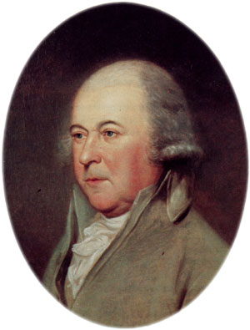
Students determine John Adams’ point of view in his “Letter on Thomas Jefferson” and analyze how he distinguishes his position from an alternative approach articulated by Thomas Jefferson.

Slide 19
Students determine John Adams’ point of view in his “Letter on Thomas Jefferson” and analyze how he distinguishes his position from an alternative approach articulated by Thomas Jefferson.
High School?

Slide 20
Students determine John Adams’ point of view in his “Letter on Thomas Jefferson” and analyze how he distinguishes his position from an alternative approach articulated by Thomas Jefferson. [RI.7.6]
Seventh Grade!

Slide 21
Key Advances
reading
Balance of literature and informational texts
Text complexity
writing
Emphasis on argument and informative/explanatory writing
Writing about sources
speaking
Inclusion of formal and informal talk
language
Stress on general academic and domain-specific vocabulary
technology
Media and technology are integrated throughout the standards.
From CCSS website

Slide 23
But wait…
There’s More!

Slide 24
CCSS for History/Social Studies, Science, and Technical Subjects
Reading
Knowledge of domain-specific vocabulary
Analyze, evaluate, and differentiate primary and secondary sources
Synthesize quantitative and technical information, including facts presented in maps, timelines, flowcharts, or diagrams
Writing
Write arguments on discipline-specific content and informative/explanatory texts
Use of data, evidence, and reason to support arguments and claims
Use of domain-specific vocabulary

Slide 26
Now what?
who
Who will do the realignment work and develop assessments?
what
What steps will be taken to align, implement, and assess?
when
When should you change, considering the assessment schedule
why
Why use the [forthcoming] state/consortia curricula?
how
How will this effect classrooms, assessments, adoption of resources, differentiation, etc.?
From CCSS website

Slide 28
Except for…
assessment…

Slide 29
Common Core State Standards
Getting to know the
Fall 2010

