Slide 1
BCIC Meeting
May, 2013

Slide 2
Welcome
Introductions
Overview of Agenda

Slide 3
SED Updates
Assessment
  PARCC
  Science 4/8 scoring

Slide 4
SED Updates
Standards
  Research
  Next Generation Science Standards
  Social Studies Frameworks

Slide 5
SED Updates
Local Assistance Plan
  Large gaps
  Failed to make AYP for three years for same subgroup
  Lowest among state and not making progress

Slide 6
SED Updates
Value Added
  Recommendation in June for this year
  Similar distribution
  20/20 to 25/15

Slide 7
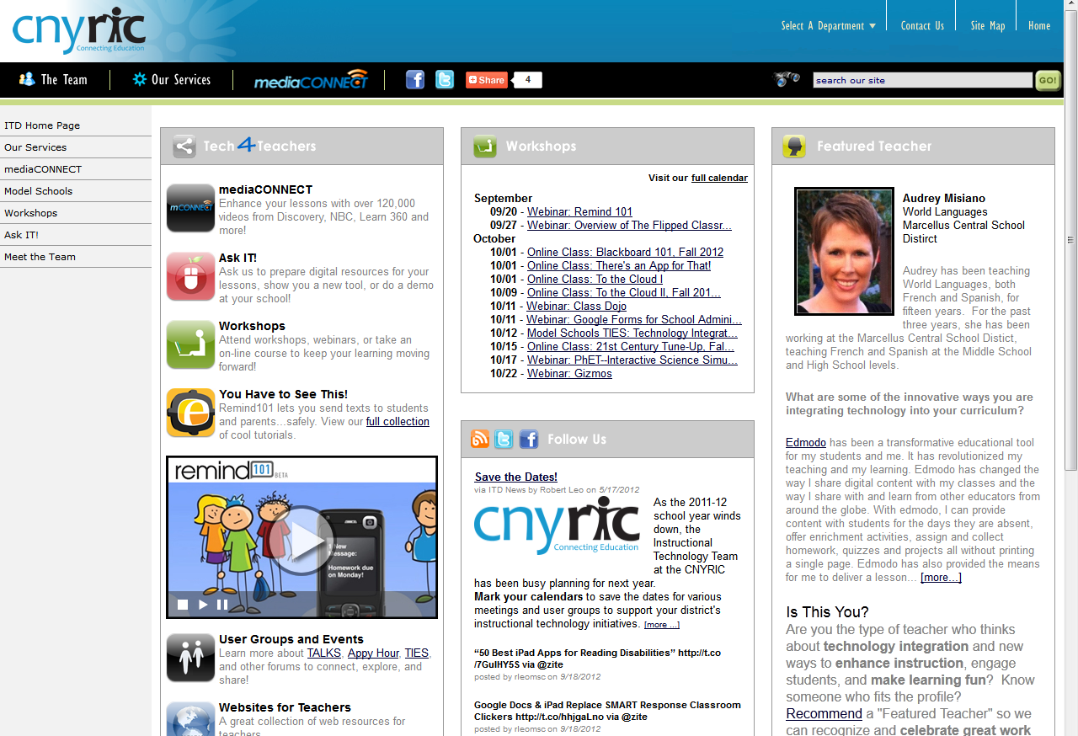
ITD

Slide 8
CI&A Reminders:
Summer Regional Events- register through June 17.
Survey for Regional Planning--- open until tomorrow!
Two new initiatives:
  Support for ELA 3-8 Modules—interest by June 1
  Pilot school for PBL PD and Coaching

Slide 9

Literacy Programs
Reading Recovery: I3 Grant for Initial Training-a value of about $16,000/teacher
Ongoing Support Network
Initial Training for K-2
Initial Training for 3-4 ( intermediate)

Slide 10
Teacher Centers

Slide 11

New Tech High
Leading and demonstrating a bigger pedagogical shift
Center for Professional Development
Higher Ed & Business Partnerships
Pre-service training
integration
Buck Institute and
PBL training

Slide 12
College, Career & Citizenship Readiness
Pre-Service Teacher Training
Early College and Dual Enrollment
Professional
Development
School:
Visitations
Observation
Training
(Buck Institute
and NTN)
Coaching
Co-teaching
New Tech Network Model
New Tech High School
Regional
OCM BOCES Programs
Alternative Education
Special Education
District/School-Based
Integrated PBL Courses
School-
within-a-School
Standards (CCLS, NGSS, SS Framework, NYS Teaching Standards, 4Cs, ISTE, etc.)
Business Partnerships

Slide 13
Race To The Top
(the Regents Reform Agenda)

Slide 14
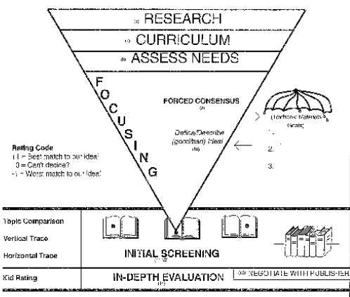

Slide 15
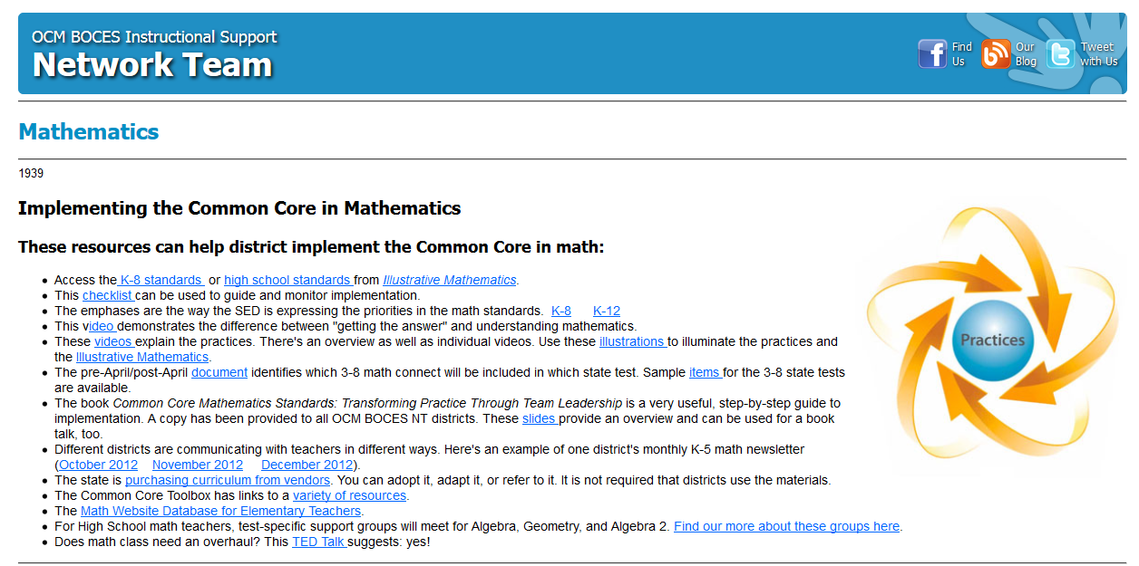
Math Resources

Slide 16
Math Modules
More were posted
BRIDGE plan

Slide 17
A1 Conversation
Support Group to continue
Is your district participating? Not too late
They have a shared google folder where they are archiving their work
Working to schedule a summer day w/ SUNY Cortland faculty about constructivism in A1 (stipended)

Slide 18
Next Generation
Science Standards
Six Shifts

Slide 19
Interconnected Nature of Science and the Real World
Given the importance of science and engineering in the 21st century, students require a sense of contextual understanding with regard to scientific knowledge, how it is acquired and applied, and how science is connected through a series of concepts that help further our understanding of the world around us. Student performance expectations have to include a student’s ability to apply a practice to content knowledge. Performance expectations thereby focus on understanding and application as opposed to memorization of facts devoid of context.

Slide 20
Interconnected Nature of Science and the Real World
Example: Onondaga Lake project
  Interconnectedness
  Inquiry based
  Science Practices: How acquired? How applied?
  Engineering Practices
  What is in the lake?
  Chemistry of the water
  Geology of the lake: limestone structure etc.
  Physics of the lake: designing barriers

Slide 21
Focus and Coherence
The same ideas or details are not covered each year. Rather, a progression of knowledge occurs from grade band to grade band that gives students the opportunity to learn more complex material, leading to an overall understanding of science by the end of high school. Historically, science education was taught as a set of disjointed and isolated facts. The Framework and the NGSS provide a more coherent progression aimed at overall scientific literacy with instruction focused on a smaller set of ideas and an eye on what the student should have already learned and what they will learn at the next level.

Slide 22
Focus and Coherence
NGSS are student performance expectations NOT curriculum.
K-12 progression of topics
NGSS automatically assume that previous material has been learned by the student. Choosing to omit content at any grade level or band will impact the success of the student in understanding the core ideas and put additional responsibilities on teachers later in the process

Slide 23
Deeper Understanding
It is important that teachers and curriculum/assessment developers understand that the focus is on the core ideas—not necessarily the facts that are associated with them. The facts and details are important evidence, but not the sole focus of instruction.

Slide 24
Deeper Understanding
Identifying core ideas in relation to the big picture
i.e. Relevance of Solar System vs. naming the planets.

Slide 25
Science and Engineering
Engineering and technology are integrated into the structure of science education. This integration is achieved by raising engineering design to the same level as scientific inquiry in classroom instruction when teaching science disciplines at all levels and by giving the core ideas of engineering and technology the same status as those in other major science disciplines.

Slide 26
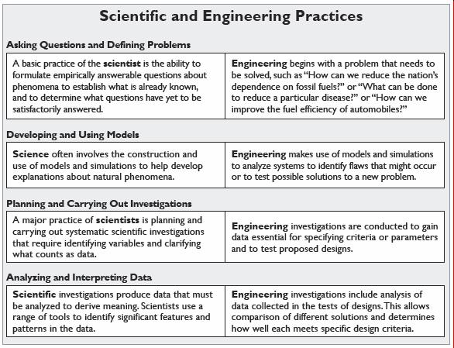
Science and Engineering

Slide 27
College, Career, and
Citizenship Readiness
There is no doubt that science and science education are central to the lives of all Americans. Never before has our world been so complex and science knowledge so critical to making sense of it all. When comprehending current events, choosing and using technology, or making informed decisions about one’s healthcare, understanding science is key. Science is also at the heart of the United States’ ability to continue to innovate, lead, and create the jobs of the future. All students, no matter what their future education and career path, must have a solid K–12 science education in order to be prepared for college, careers, and citizenship.

Slide 28
College, Career, and
Citizenship Readiness Explained
NGSS are focused on what ALL students need, NOT just college bound students.
Aid in the cultivation of a scientifically literate society
  i.e. health care, hydrofracking etc.

Slide 29
Alignment to the Common Core
The science standards and the Common Core Standards (math and ELA/Literacy) overlap in meaningful and substantive ways and offer an opportunity to give all students equitable access to learning standards.

Slide 30
Alignment to the Common Core
There is an opportunity for science to be part of a child’s comprehensive education.
The NGSS, Math, and ELA standards all overlap in meaningful and substantive ways and offer an opportunity to give all students equitable access to learning standards

Slide 31
NGSS Timeline: What we know today
The standards and the can be accessed at www.nextgenscience.org
Final Release – April 9, 2013
Not complete: model course mapping in middle and high school, connections to CCSS Math and connections to CCSS ELA Literacy. (In progress)

Slide 32
Timeline Continued…
NYSED will have to decide whether to adopt the NGSS
April 22, 2013: NGSS brought to the NYS Board of Regents
NYS Science Standards Evaluation Tool
  Various groups of stakeholders compare each set of standards (current and NGSS)
  Stakeholders are: statewide leadership team, science content advisory panel, NYS Science Education consortium.
  Prepare a recommendation for the Board of Regents to consider

Slide 33
Timeline Continued….
September: formal recommendation will be made to Board of Regents regarding adoption of NGSS and strategic plan for implementation
**Adoption does not mean implementation**

Slide 34
ELA

Slide 35
Research and Writing
Who has what?
Instructional Support action
What might be some next steps for us, regionally?

Slide 36
Expeditionary Learning
Expeditionary Learning (Drivers Village)
June 24-26th, 8:30am - 4:00pm
Teachers, $375
Can run stipends through OCM BOCES
NT subsidy of $100 per NT seat
June 27th, 8:30am - 4:00pm
Grades 3-5 & District Administrators, $125
NT subsidy of $50 per NT seat

Slide 37
Authentic Nonfiction
There are tentative plans for a two-day project for teacher librarians and HS content teachers about locating appropriate and authentic nonfiction w/ SUNY Cortland

Slide 38
Professional Practice

Slide 39
Professional Practice (APPR)
APPR 2.0 on June 12
June 12: The release of scores to parents. We will review the rules about the communication of score information to parents and then will try to build some regional consensus about how we will go about doing this in a way that is relatively consistent and manageable. A regional approach to this will help districts manage their requests and the means by which they respond. Also, SLOs, LATs, evidence collection and summative conversations. What did we learn from the SLOs and LATS that we need to change? What did we learn from the evidence collection process? What did we learn from the summative conversations with teachers? Register

Slide 40
Training (APPR)
Lead Evaluator Training
  Year one cohort
  Ongoing (3 days)
Principal Evaluator Training
  Ongoing (3 days)

Slide 41
End-of-the-Year (APPR)
End-of-the-Year Meeting planner
Timeline and explanation for End-of-the-Year process. This is an example of guidance for End-of-the-Year meetings. You can change it to make it match the particular requirements and deadlines of your district.
End-of-the-Year Meeting example (video)
Example of a slideshow that can be customized and used district-wide when consistent communication of expectations for End-of-the-Year procedures and meetings.

Slide 42
Culture

Slide 43
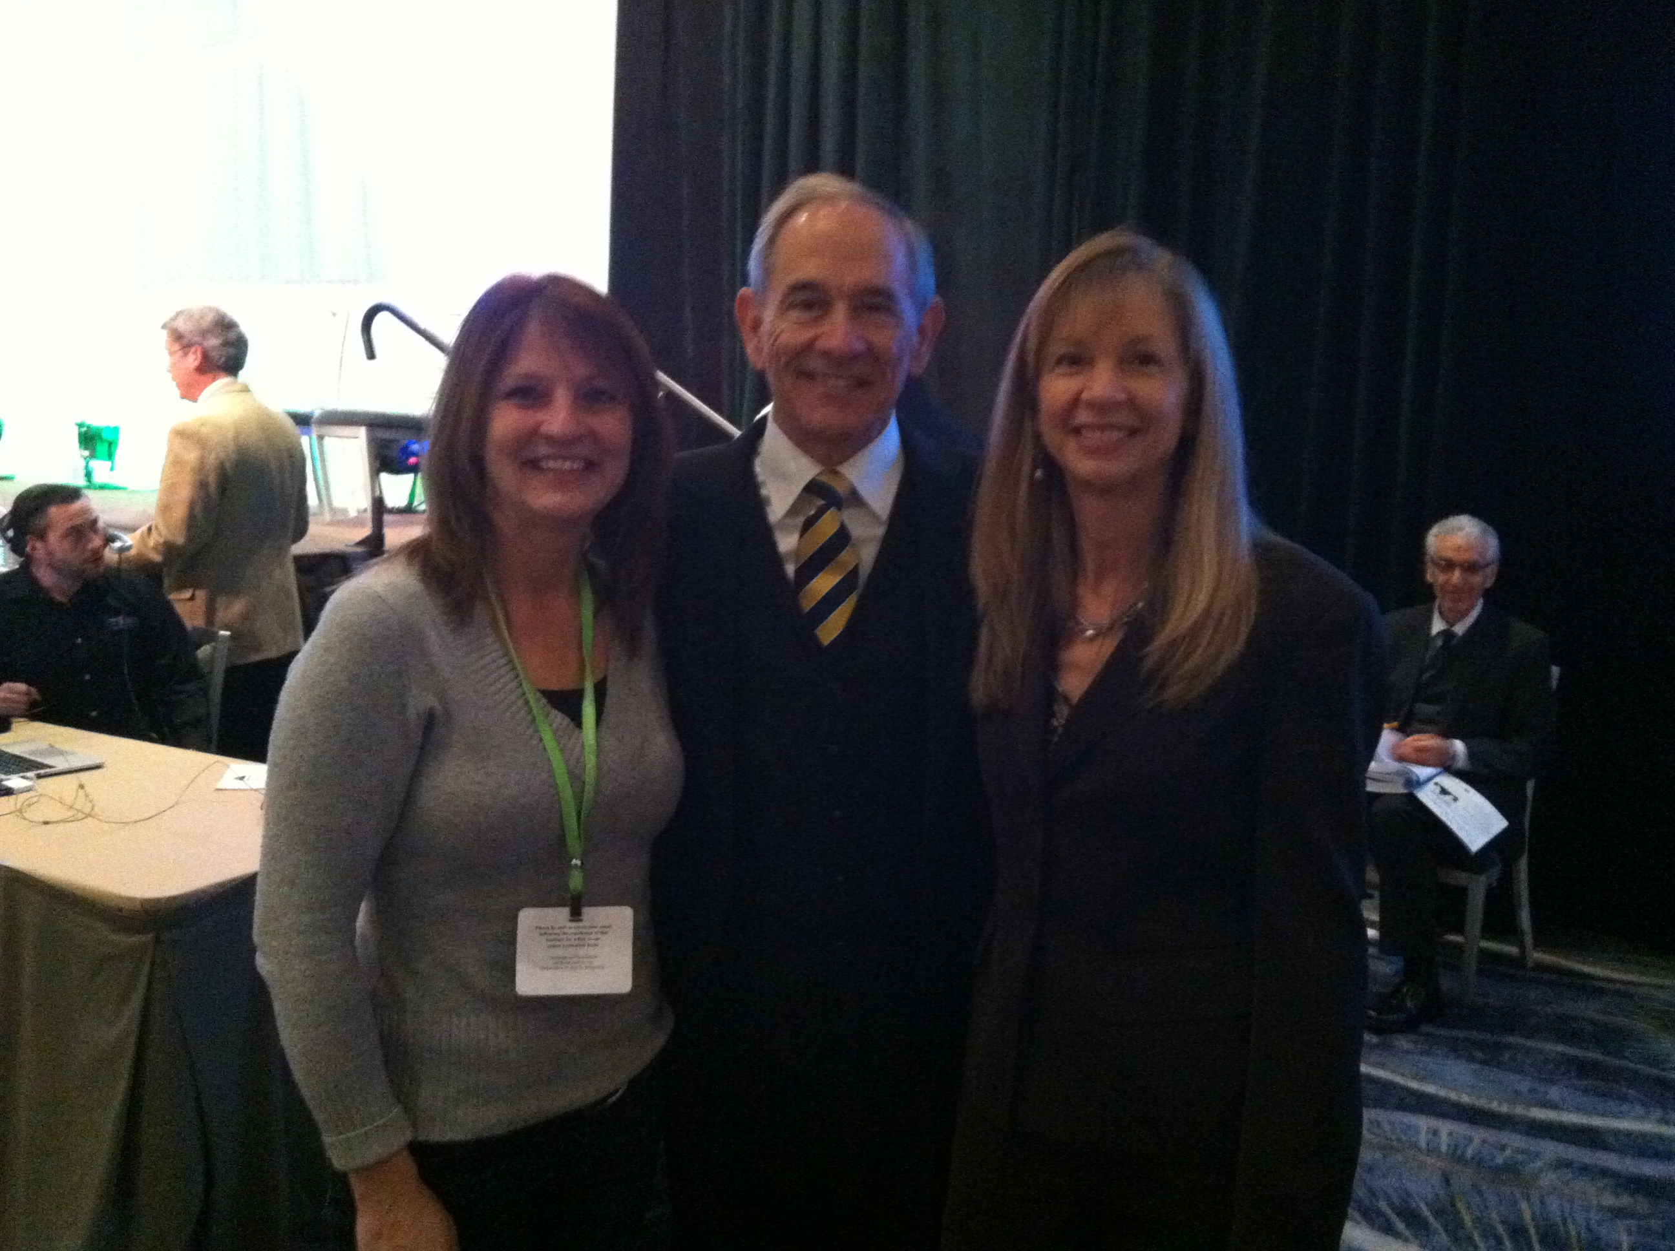
Culture

Slide 44
PLCs at WorkTM Summer Institute
July 24-26
OCM BOCES Henry Campus
Keynote speakers streamed live to our site (Richard DuFour, Rebecca DuFour, Mike Mattos)
All participants receive their own copy of Learning by Doing
Breakout presenters "live" and "on-site"
All Solution Tree handouts provided to all participants
Light breakfast and lunch included each day

Slide 45
Assessment

Slide 46

Thank you
Overall smooth scoring 3-8 season!
Tracking of expenses….

Slide 47
June 2013 Regents
Schedule was sent- with request for scorer names by May 21
Procedures and reminders sent:
  Earth Science lab portion answer key
  Tests delivered to Tully Jr-Sr High by 4:00 afternoon or 7:30 am the day of scoring
Need to discuss: Global and US scoring scheduling concerns

Slide 48

Next BCIC Meeting
June 20, 2013
WCNY

