Slide 1

Curriculum and Instruction Council
May, 2012

Slide 2
Welcome and Introductions

Slide 3
State Ed Update

Slide 4
Dignity Act
Requirements still look like:
Revised VADIR reporting
Trained point person for each building
Annual education requirements for teachers and students
Revisions to Codes of Conduct

Slide 5
Dignity Act
Support for schools available from Youth Development (new CoSer)
Sign up for “Advance” training on May 21st
Approx. 30 building signed up for service since last BCIC

Slide 6

Standards
The Next Generation Science Standards are due out in draft form tomorrow.
Ntnews is intro to Next Generation
BTW, Science Center will realign all units, update materials, emphasize content reading and writing, infuse
Discovery learning
resources

Slide 7
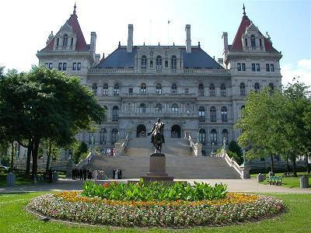


Legislative Updates

Slide 8
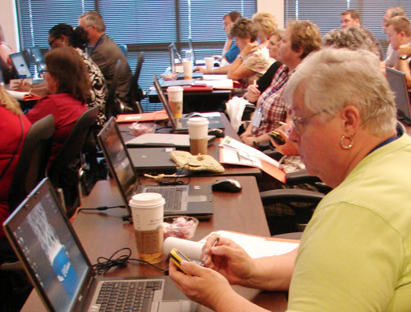
IT&D

Slide 9
CIA
Planning Survey: Please share and complete by May 25
Summer schedule is posted on MLP-registration is open through June 15
Teaching Struggling Readers- May 31

Slide 10

Teacher Centers

Slide 11
3-8 Scoring
Regional debrief next BCIC
Look ahead: What if we have to really have to randomize papers next year – how would we do that (and undo it) in the given window?
Look ahead: What if we had to regionally score Regents exams?

Slide 12

I think I can
I think I can…
Race To The Top

Slide 13
Math Solutions
K-8 teachers of math
K-2, 3-5, 6-8 bands (two groups each)
3 days; $625
Three NT slots per district
August 8, 9, 10 (Rodax/Henry)
NT slots released June 1st if not spoken for

Slide 14
Regional Assessment Development ???
CIA Survey
Do it like we did LOTE from across BOCES with whoever wants to collaborate?
Support geographic clusters of districts that want to work together?
Provide assessment development training and if districts wanted to come for training and work on their own they could?
Do nothing together? Something else?

Slide 15
RTTT Planning
This is year 2 of 4.
Are you ”mapped” out?
Deliverables and expectations?
Surveys end of this year to collect implementation data (teacher, principal, superintendent, and NT/NTE leader level)
Site visits from SED starting next year
Common planning time for all teachers in schedules?
PD days and half-days?
Meet?

Slide 16
SLO Example &
Bank Development
SLO bank is up!
70+ do far
Posted at State 20% in APPR microsite as well as at CNYTC site
Examples, not exemplars, will continue to be added

Slide 17
APPR Plans
VAM for 2012-2013 for 4-8 ELA and math (that means 25/15 for those teachers).
SLOs cannot be used within the locally-selected measures subcomponent for a teacher in any grade or subject where there is a growth or value-added model. Use LAT!

Slide 18
APPR Plans
If all 60% for principals is derived from the broad leadership assessment, ISLLC/rubric, then the 2/3 sources is not necessary. The 2/3 sources of evidence rule only applies when you are assigning separate points for goals.
It looks like high school principals will have VAM based on Regents scores next year (and not graduation rates).

Slide 19
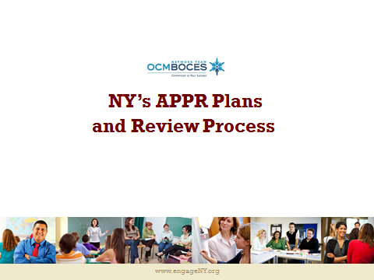
APPR Plans

Slide 20
Curriculum and Instruction Council
Next Meeting: June 14, 2012

