Slide 1
BCIC Meeting
April, 2013

Slide 2
Welcome
Introductions
Overview of Agenda

Slide 3
SED Updates
Assessment
  Common Core Regents Schedule
Assessment- Subject/Grade | 2012-2013 | 2013-2014 | 2014-2015 | 2015-2016 | 2016-2017 | 2017-2018
ELA
Grades 3-8 | Measures the Common Core |  | PARCC (if adopted by Board of Regents)
Grade 11 Regents | Measures the 2005 Standards (optional Common Core version available beginning 2013-2014) |  |  | Regents Exam Measures the Common Core or PARCC (if adopted by Board of Regents)
Assessment- Subject/Grade | 2012-2013 | 2013-2014 | 2014-2015 | 2015-2016 | 2016-2017 | 2017-2018
Math
Grades 3-8 | Measures the Common Core |  | PARCC (if adopted by Board of Regents)
Algebra I | Measures the 2005 Standards | Regents Exam Measures the Common Core | Regents Exam Measures the Common Core or PARCC (if adopted by Board of Regents)
Geometry | Measures the 2005 Standards |  | Regents Exam Measures the Common Core or PARCC (if adopted by Board of Regents)
Algebra II | Measures the 2005 Standards |  |  | Regents Exam Measures the Common Core or PARCC (if adopted by Board of Regents)

Slide 4
SED Updates
Standards
  Next Generation Science Standards
  Social Studies Frameworks

Slide 5
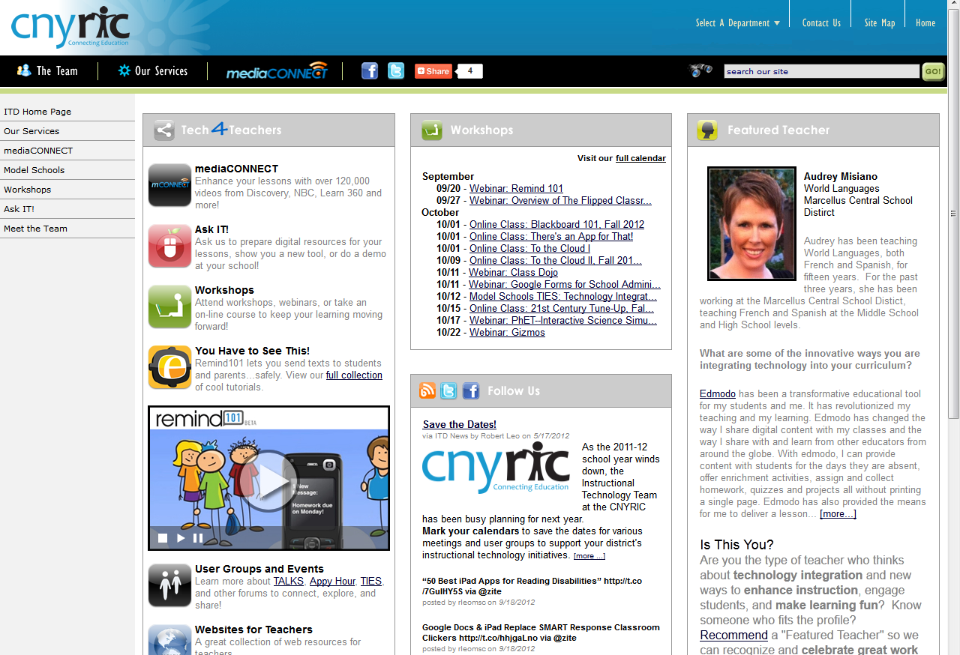
ITD

Slide 6

2013-14 CI&A Programming:
Please complete the brief survey
May 17

Slide 7
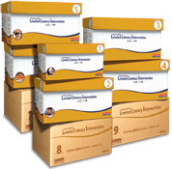
Leveled Literacy Intervention: New for 13-14
On-going Support:
  Price reduction-
  Still four meetings a year
Intermediate Gold Kit

Slide 8

CI&A Summer

Slide 9

Proposed for 2013-14:
If you are planning to adopt ELA Modules
Integrated professional development and resources approach
  Initial overview session
  Coaching, classroom visits, on-going technical assistance
  Facilitation of data team meetings
  Module overviews and lessons
  Student and teacher text
  Class sets of handouts

Slide 10
Logistical details
$1500/teacher for year one; $1000/teacher for subsequent years at same grade level
Materials- printing and texts at OCM BOCES cost
Participation confirmed by June 1 for 2013-14
Specific modules (within 2 and 3) confirmed by August

Slide 11
PBL^{NY}
PBL^{NY} Demonstration School
  16-24 Teachers receive 3 days of PBL 101 in the summer of 2013 (OCM BOCES’ Common Core PBL), including training materials
  Teachers will collaboratively develop a Common Core PBL unit for 2013
  Teachers will collaboratively develop a Common Core PBL unit for spring 2014
  Teachers will receive ½ day release time per month for planning purposes (and/or to meet with PBL^{NY} coach)
  Coaching for any additional units
  Units will be with other PBL^{NY} schools, in person and on-line archive
  PBL^{NY} coach will spend one day per week in the school building assisting teachers with their projects, offering resources for projects and helping with the implementation of projects.
  The cost of one year is $28,000, based on 40 days at $700 per day custom, on-site rate.

Slide 12
Final Requests
Due April 15
Please use realistic amounts for .030
Reminder- there are additional opportunities for coaching and levels of services and supports

Slide 13
Teacher Centers

Slide 14

New Tech High
Leading and demonstrating a bigger pedagogical shift
Center for Professional Development
Higher Ed & Business Partnerships
Pre-service training
integration
Buck Institute and
PBL training

Slide 15
Race To The Top
(the Regents Reform Agenda)

Slide 16
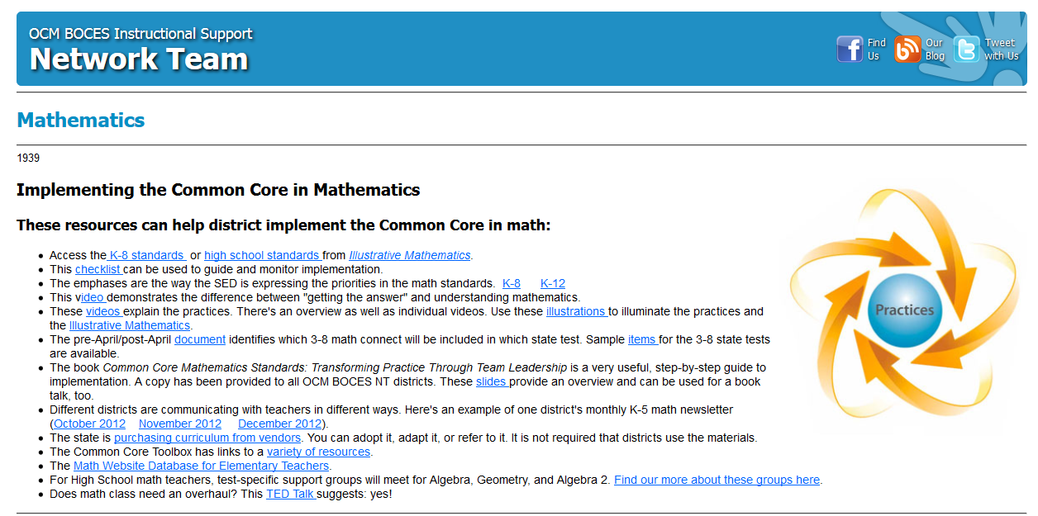
Math Resources

Slide 17
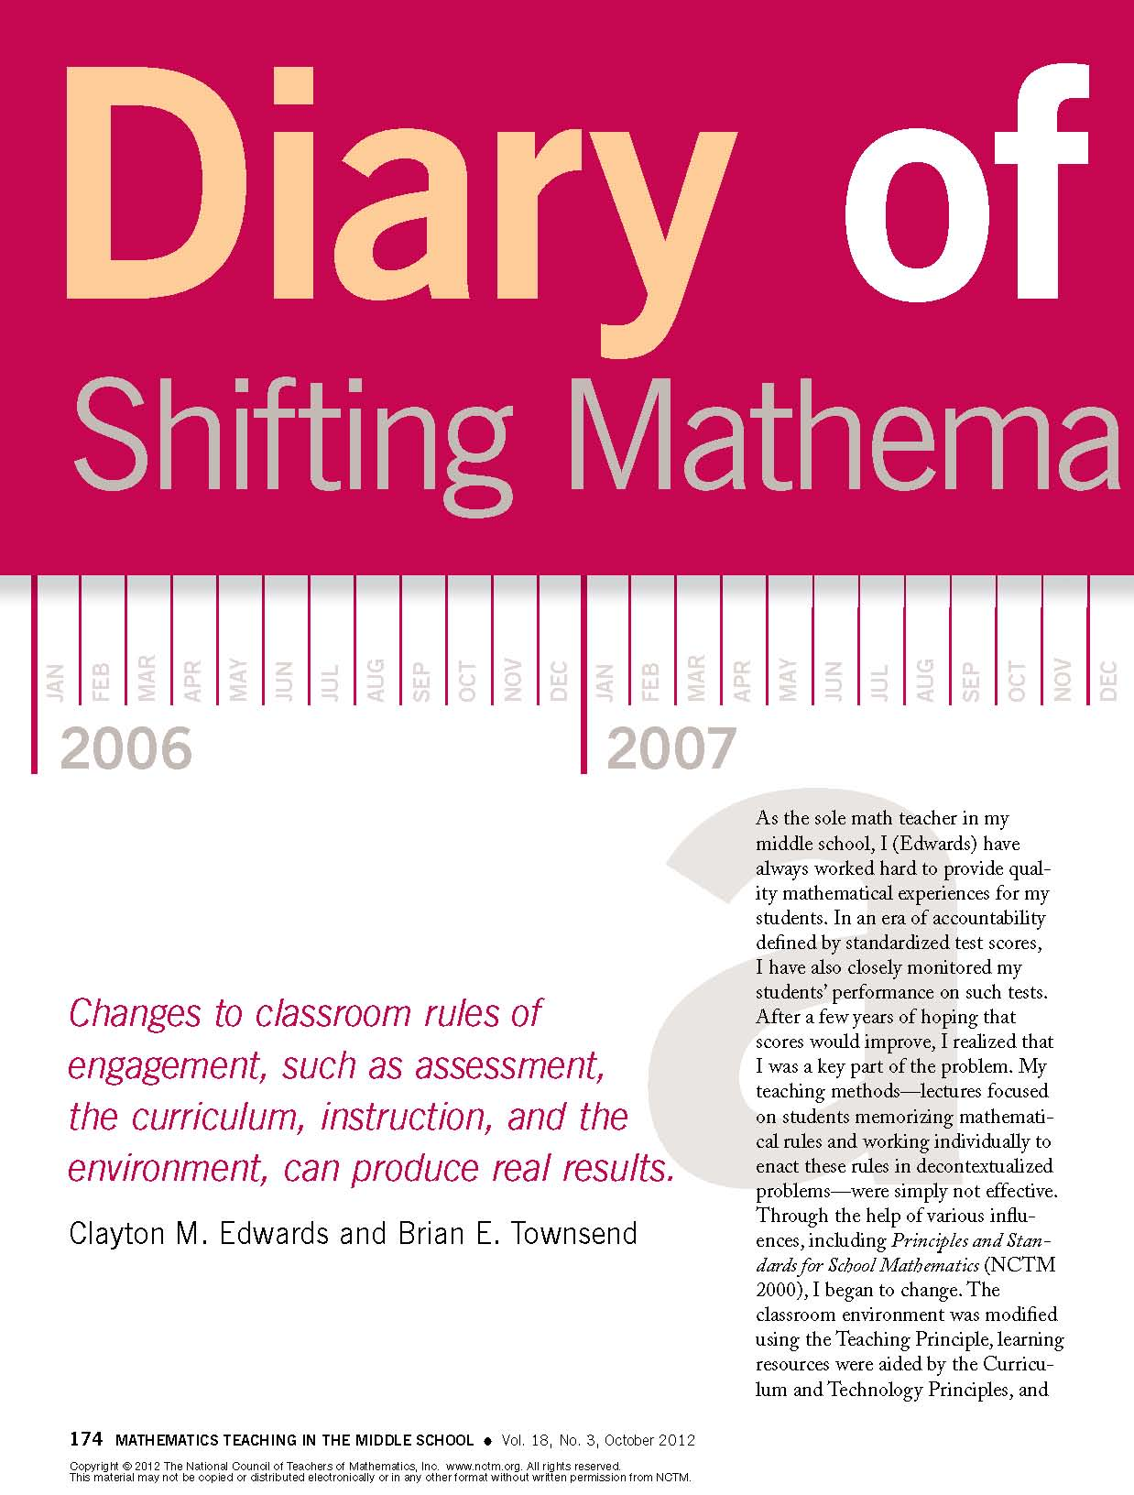
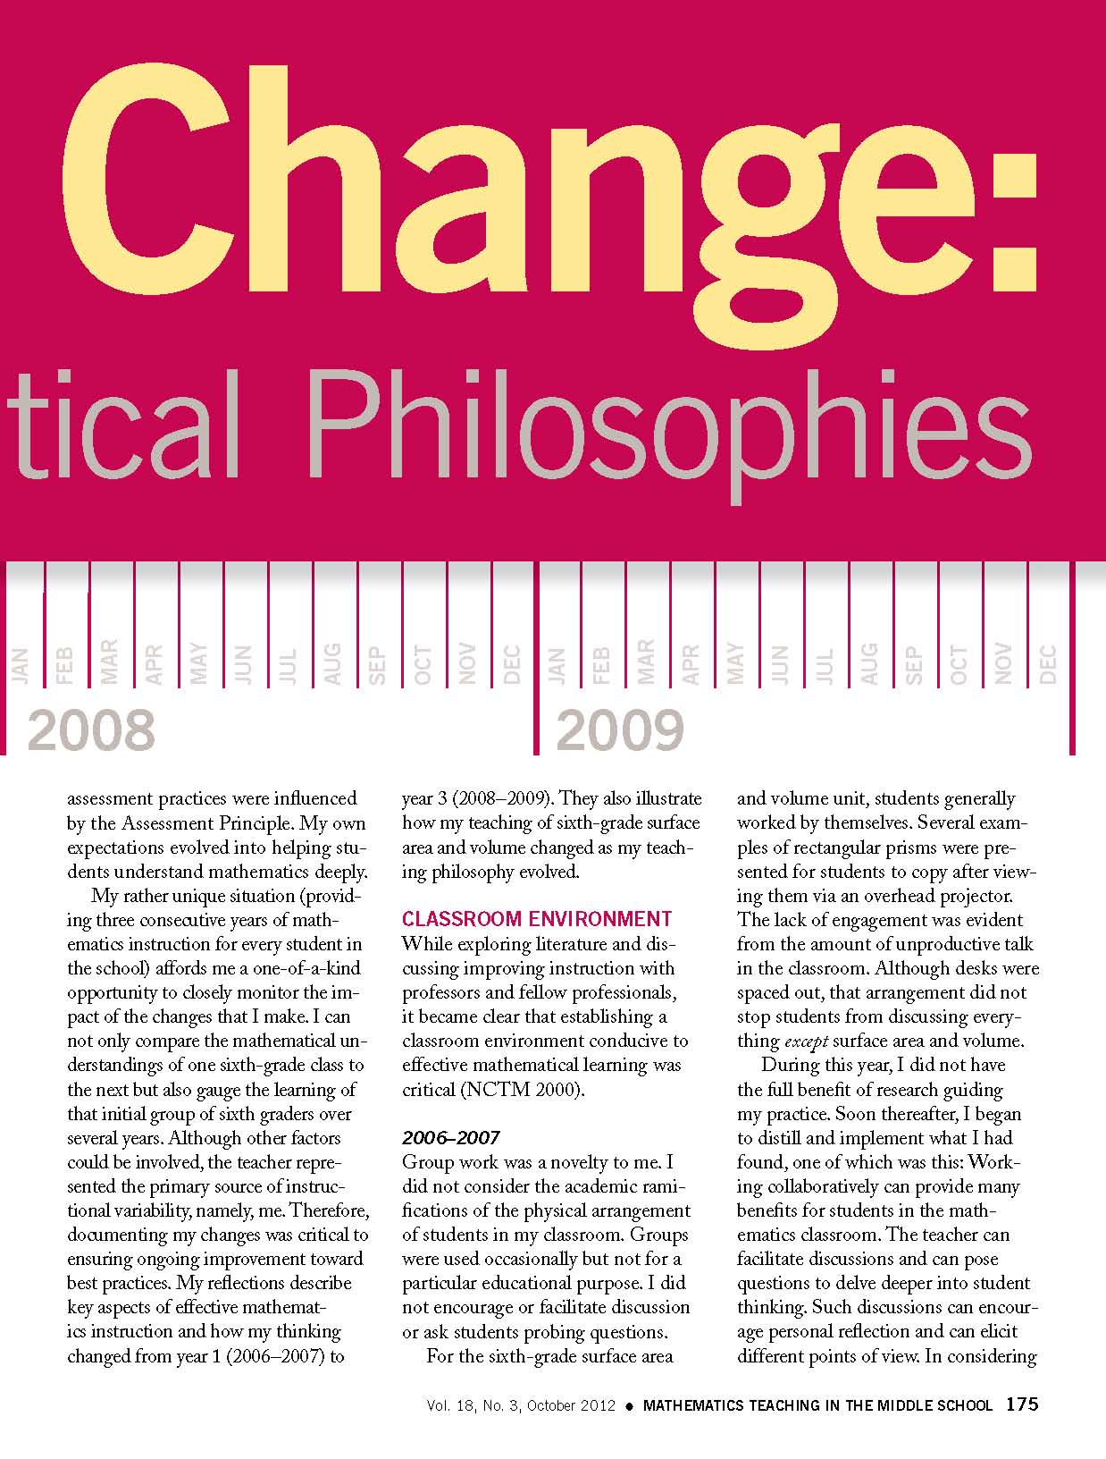
Math Article

Slide 18
May 10th Vendor Fair
CK-12
Connected Math
Connecting math concepts
Core-Plus Mathematics Project
Corrective math
Curriculum Associates
Digits
Envision
Everyday Math
Fast Math
Focus Math
Glencoe Algebra 1, Geometry, Algebra 2
Glencoe Math for grades 6-8 + new NY CCLS
Impact Math
Investigations
Marilyn Burns: Math Reads
Math 180
Math and Movement
Math labs
Math Navigator
Math Trailblazers [K-12]
Math Triumphs
Math Triumphs [intervention for below grade level]
My Math [PreK-5]
Number worlds
Singapore Math
Stepping Stones

Slide 19
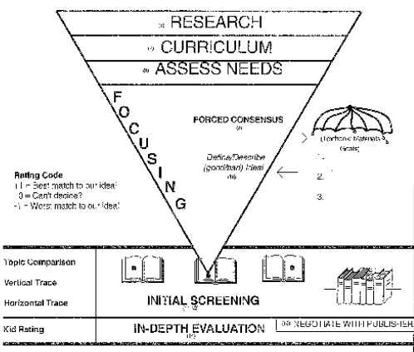

Slide 20
Math Modules
What do we “know”
What do we “need to know?”

Slide 21
Math Conversation
In groups, talk about what your thinking (and maybe plans) are for math
A quick report to the larger group

Slide 22
Expeditionary Learning
Expeditionary Learning (Drivers Village)
June 24-26th, 8:30am - 4:00pm
Teachers, $375
Can run stipends through OCM BOCES
NT subsidy of $100 per NT seat
June 27th, 8:30am - 4:00pm
Grades 3-5 & District Administrators, $125
NT subsidy of $50 per NT seat

Slide 23
ELA Conversation
In groups, talk about what your thinking (and maybe plans) are for ELA
A quick report to the larger group
Next time we will chat about math plans

Slide 24
Professional Practice

Slide 25
Professional Practice (APPR)
APPR 2.0 today and June 12
April 18: Where do we stand and what have we learned? Bring your present APPR plan. First, check in with the rule changes included in the budget with regard to APPR plans and submission. Second, we'll gather data about current practices in districts. Lastly, we'll identify the changes we think would improve our plans. Also, Forms and record keeping -- what do we really need? A lot of time is spent on forms. What do we need to do? How are the different electronic platforms faring? Register
June 12: The release of scores to parents. We will review the rules about the communication of score information to parents and then will try to build some regional consensus about how we will go about doing this in a way that is relatively consistent and manageable. A regional approach to this will help districts manage their requests and the means by which they respond. Also, SLOs, LATs, evidence collection and summative conversations. What did we learn from the SLOs and LATS that we need to change? What did we learn from the evidence collection process? What did we learn from the summative conversations with teachers? Register

Slide 26
Professional Practice (APPR)
G2: Can a teacher score his or her own students’ work for the purposes of the local portion of the teacher’s annual evaluation if the teacher is the only one in the district with the content expertise?
No. Because New York State’s teacher and principal evaluation policies are designed to make strong and equitable inferences about the effectiveness of our state’s educators, the Commissioner’s Regulations prohibit teachers and principals from scoring assessments where they have a vested interest in the outcome, even in cases where the teacher is the only one in the district with the specific content expertise. Teachers should not score their own students’ assessments, and a principal should not score the assessments that are part of their own evaluations.
Vested interest and speaking portions of LOTE exams

Slide 27
Professional Practice (APPR)
Vested interest and speaking portions of LOTE exams
D38: Can an SLO use a portion of a Regents exam as evidence of student learning? What if there are teachers where a school-wide goal is set using the Regents exam: can just the essay portion be used in the SLO for the group?
For courses that end in a Regents exam, the SLO must use the Regents exam, in its entirety, as evidence of student learning within the SLO. The entire Regents exam must be used whether it is in an individual SLO or a school- or BOCES-wide, group, or team result based on a Regents exam.

Slide 28
Culture

Slide 29
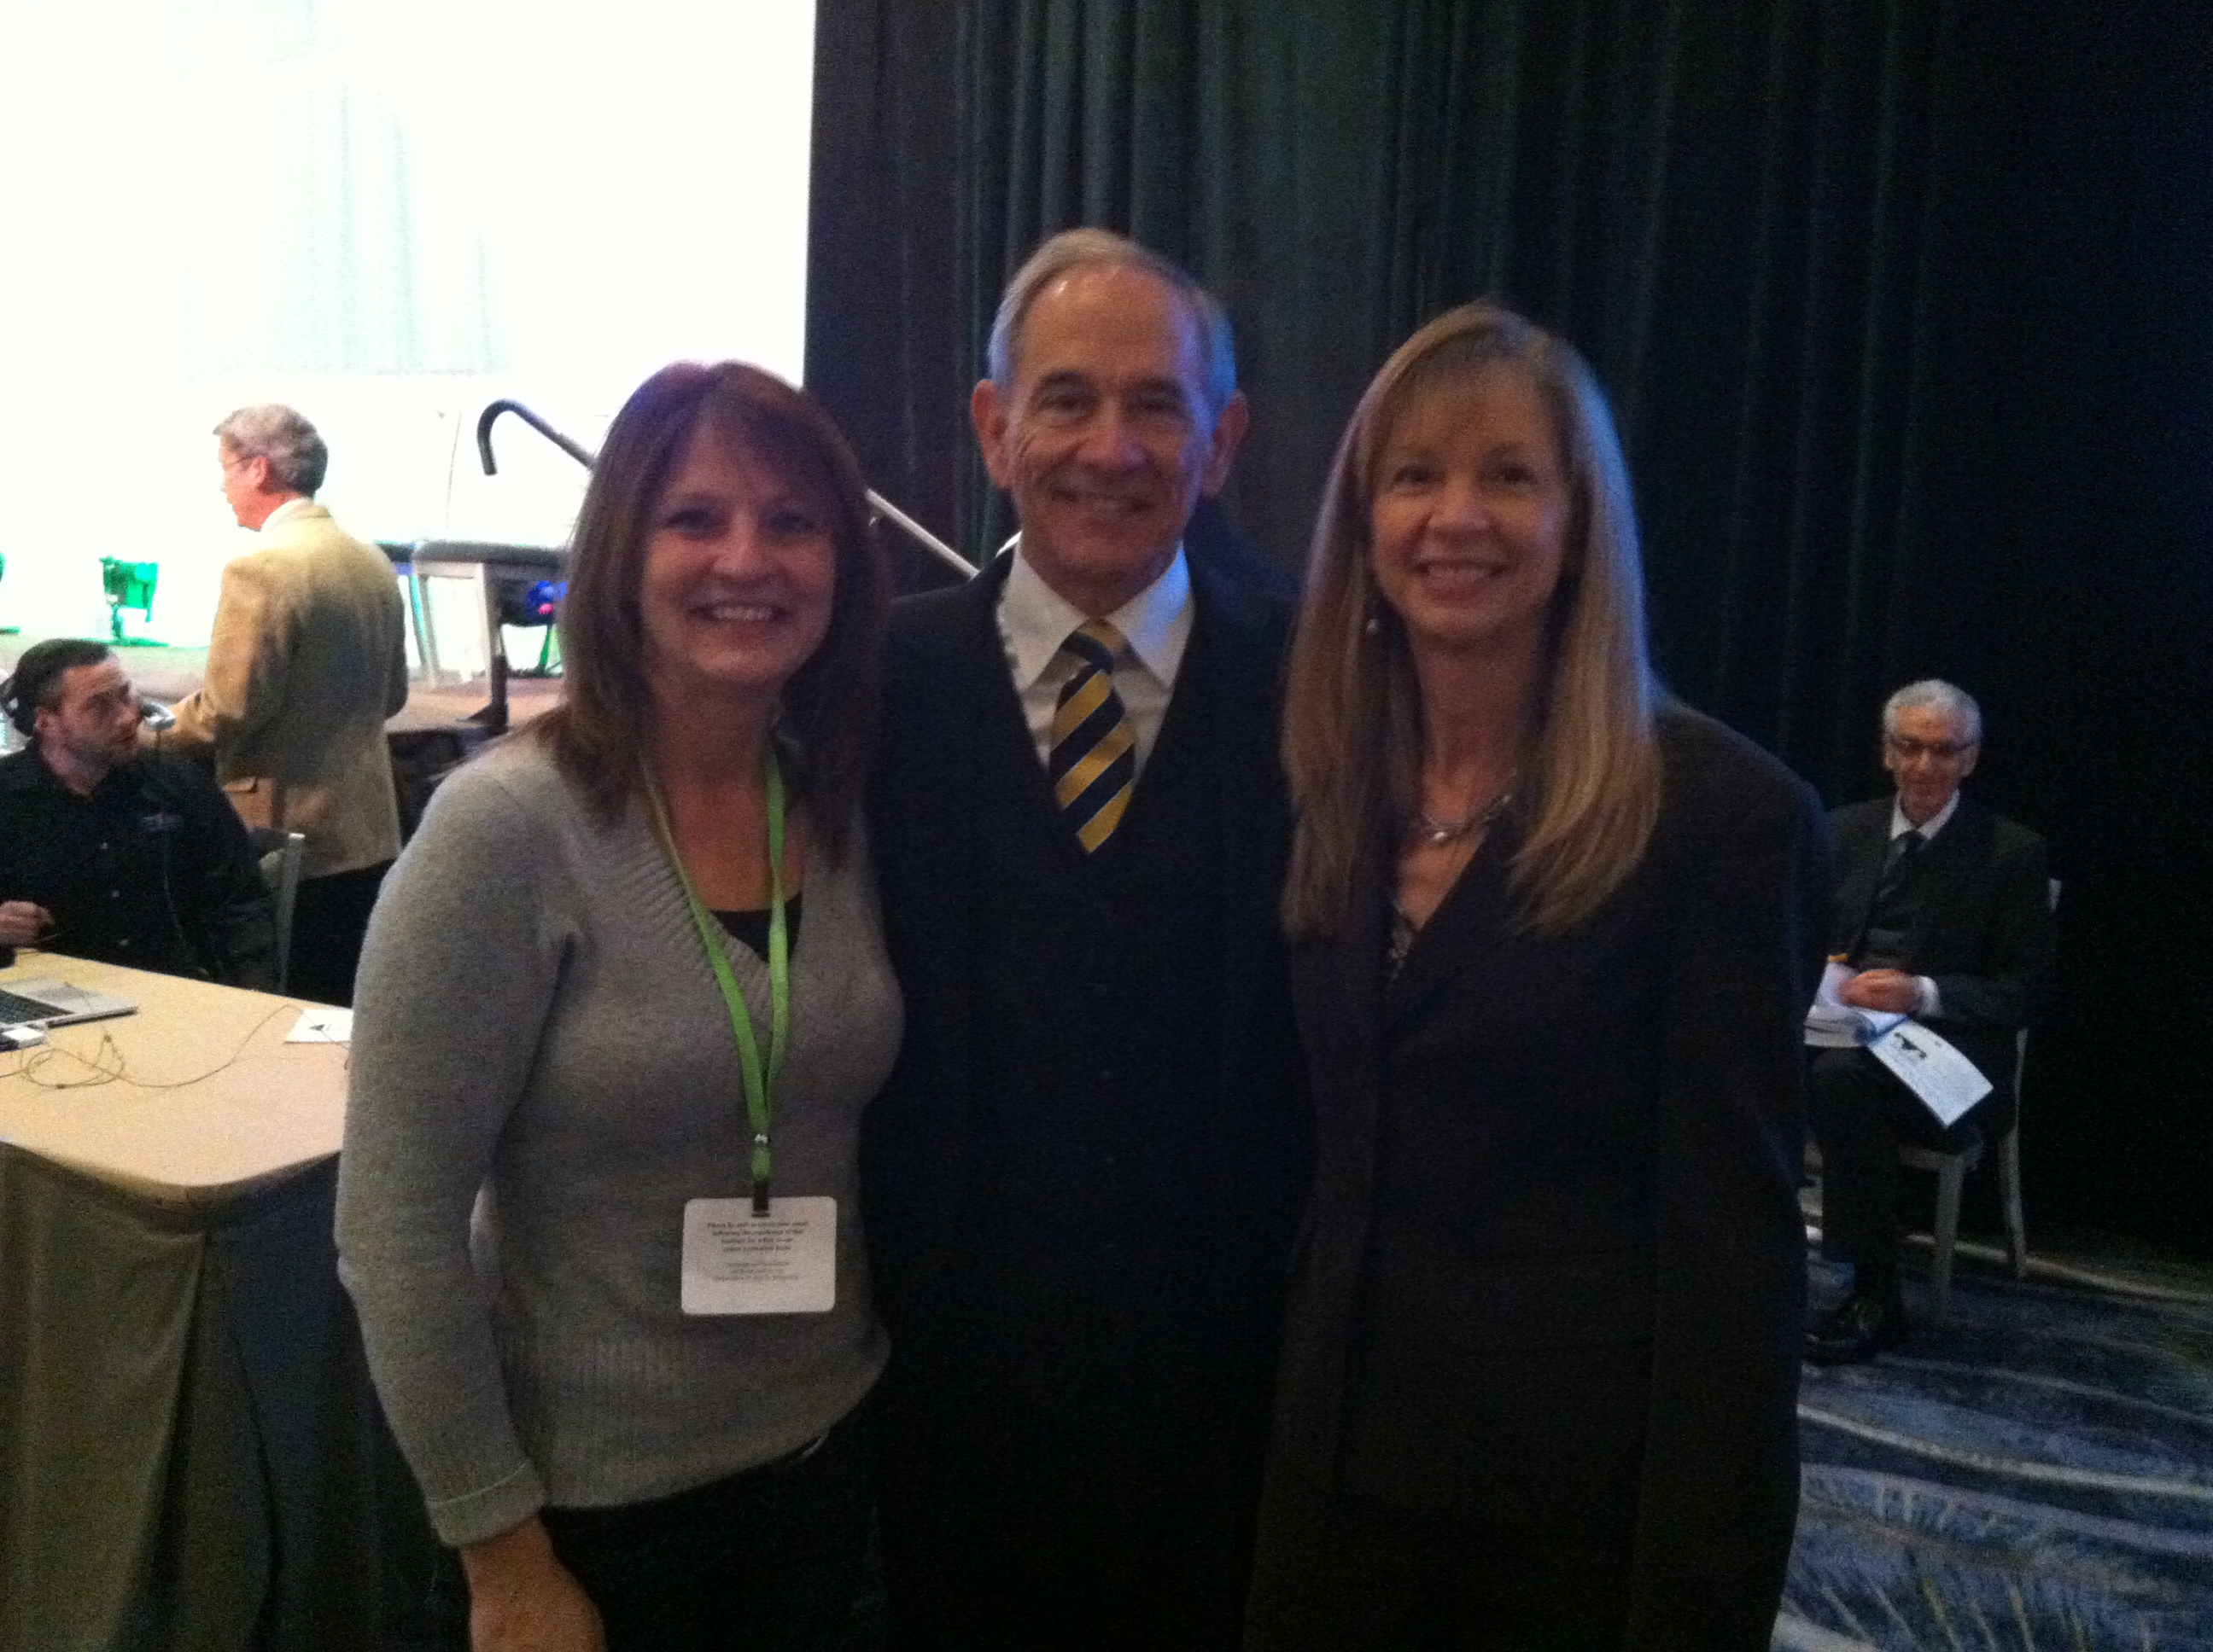
Culture

Slide 30
PLCs at WorkTM Summer Institute
July 24-26
OCM BOCES Henry Campus
Keynote speakers streamed live to our site (Richard DuFour, Rebecca DuFour, Mike Mattos)
All participants receive their own copy of Learning by Doing
Breakout presenters "live" and "on-site"
All Solution Tree handouts provided to all participants
Light breakfast and lunch included each day

Slide 31
Assessment

Slide 32
3-8 Scoring
In the midst of everything
  Track expenses
  Track time demands

Slide 33
Next BCIC Meeting
May 16, 2013
Distance Learning Center

