Slide 1
BCIC Meeting
January, 2013

Slide 2
Welcome
Introductions
Overview of Agenda

Slide 3
SED Updates
Assessment
  NYSED Guidance Memo on parents wishing to opt out of state tests will be resent shortly.
  No new information, just talking points
  Assessments and field testing are part of the larger instructional and accountability structures - memo will be resent shortly
  PARCC tech requirements issued

Slide 4
SED Updates
Curriculum
  Global split possibly worked out @1750… but Regents still mulling thematic option
  Frameworks will go out again
  Regents decide in April?

Slide 5
SED Updates
Virtual AP Project
  Art History and Statistics
  Collecting letters from eligible district that want to participate
  Hiring director as a JMT
  Will then hire the OCM shepherd (guidance counselor)

Slide 6
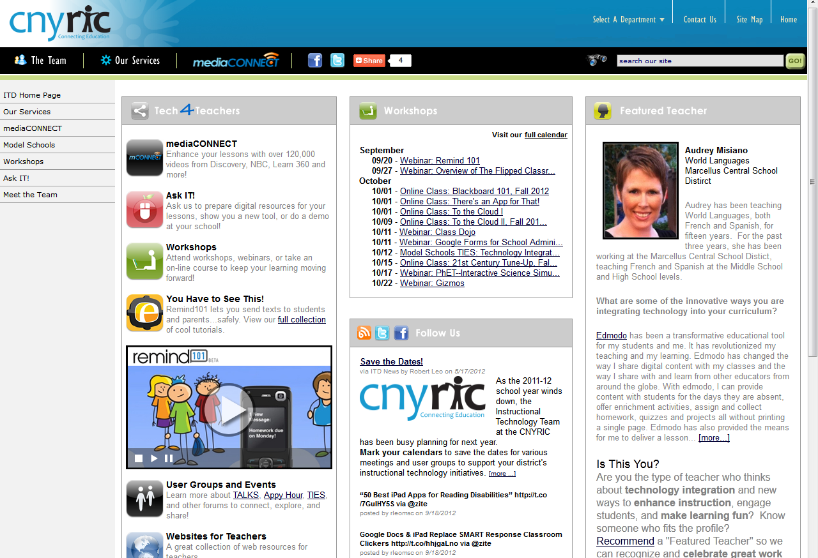
ITD

Slide 7

Meeting the Needs of Diverse Learners
Jan 30,31, Feb 13,14: Registration open now
Relates closely to Teacher Rubrics
NYSUT: Elements 1.2,1.3,2.3, 2.4, 2.5,2.6,3.1, 3.4, 3.6, 4.1, 5.2
Danielson: Domains
1B, 1E, 1F, 2B, 3C, 3D, 3E, 4F
It is standards based planning and instruction beginning with articulated standard, looking at formative assessment and design of learning experiences

Slide 8
CI&A: January
Project Based Learning: Jan 24
Meeting Needs of Diverse Learners: Jan 30
Formative Assessment to Differentiated Instruction: Feb 5
CCLS for Content Literacy: Secondary: Feb 6
Responsive Classroom-Part Two: Feb 6
Power of their Words: Feb 15

Slide 9

CI&A: LOTE Drawing

Slide 10
Teacher Centers
Cortland Educators’ Conference is Saturday, March 16th
Celebration of Excellence is scheduled for March 18th

Slide 11
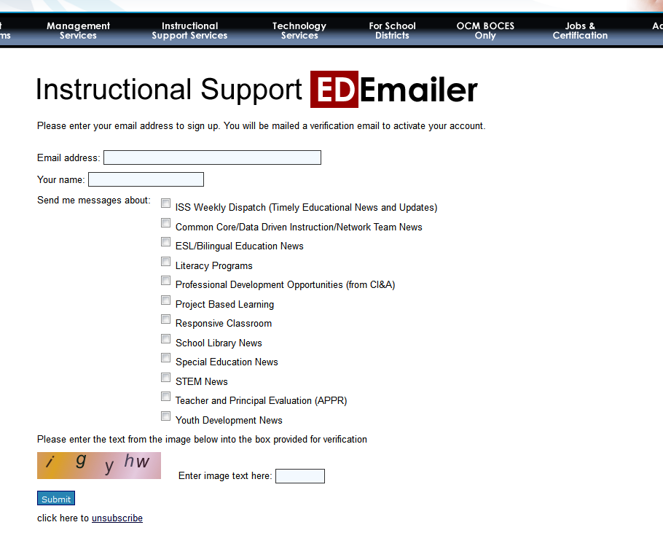

Slide 12
SLS Update
Cybersmarts and Teen Cybersmarts
  These on-line resources have been collaboratively purchased for all OCM BOCES districts. They are great for teaching digital citizenship.
  Demonstration available
  Access it here (id and password are both “ocm”)

Slide 13



Social Media and ISS
???

Slide 14


Slide 15
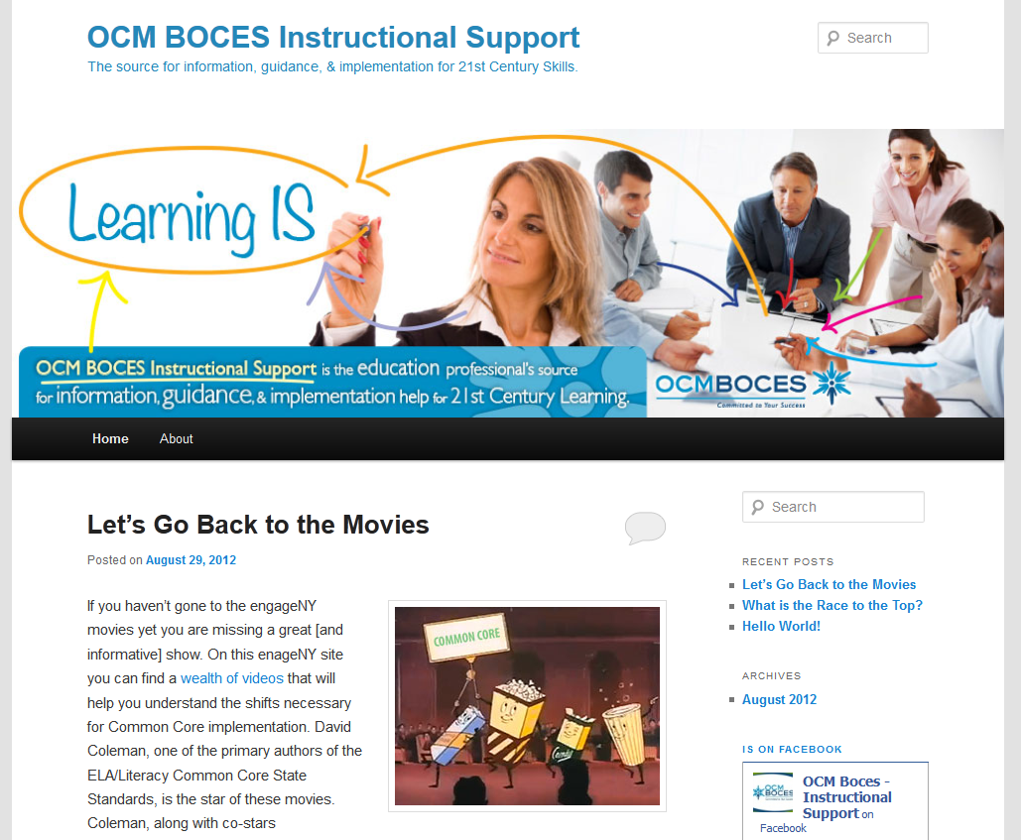

Slide 16
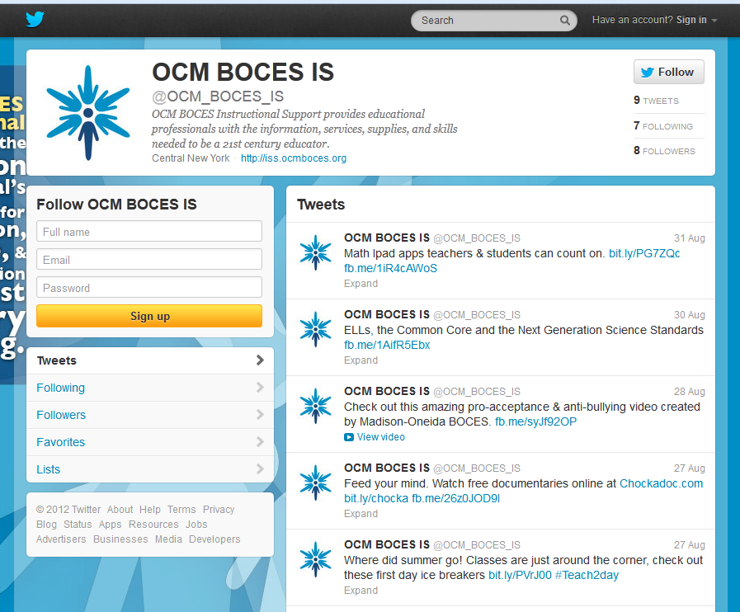

Slide 17
Race To The Top
(the Regents Reform Agenda)

Slide 18
Math
FIRST address preApril/postApril
CONTNUE to build understanding about what kids are now expected to be able to do
BE CAREFUL about rushing to adopt programs, buy series, or take things from engageNY –
VENDOR FAIR: MAY 10th

Slide 19

Math
University of Arizona Common Core Math Institute
  March 1-3 (Friday Night, Saturday, Sunday)
  For the Northeast
  Doubletree
  Bill McCallum-led
  Plenary and grade-band sessions
  Participants do work and
  create shared products

Slide 20
Math
Special Session for administrators March 1st, AM half-day, Doubletree Hotel
Math vertical Trace March 6th PM ½ day
A1 support group starts March 7th 1:30p
G support group starts March 14th 1:30p
A2 support group starts NEXT spring
Vendor Fair May 10th

Slide 21
Math
Course idea
Math and ELA?
A week in the summer
One day per month following year
Cluster work and visits
Coaching

Slide 22

NYS ELA & Math Module Overview
Syracuse Sessions & Cortland Sessions
Register through MLP
Districts send teams
Part I = Overview of the module materials
Part II = Time as a team to discuss “adopt, adapt, or refer”
½ day sessions for the following:
  PK-2 ELA March 8th AM
  3-5 ELA March 12th AM
  6-12 ELA March 12th PM
  PK-8 Math & High School March 8th PM

Slide 23
ELA
Vertical Trace (Onondaga County)
  March 6th
  AM ½ day

Slide 24
ELA
Vision of what we need to do is clearer
  Balancing Informational & Literary Text
  Knowledge in the Disciplines
  Staircase of Complexity
  Text-based Answers
  Writing for Sources
  Academic Vocabulary
Expeditionary Learning here during last week in June? $$$$$

Slide 25

The Next Generation Science Standards
OCM BOCES Science Center
Dana Corcoran
dcorcoran@ocmboces.org

Slide 26
NGSS Public Release II/Timeline
Goal: To distribute and receive feedback from interested stakeholders and continue the development process to enable states to prepare for consideration of NGSS
The standards opened for review at 3:00 p.m. EST on January 8, 2013.
The review period will end on January 29, 2013.
The standards and the survey can be accessed at www.nextgenscience.org
Final Release – March of 2013
NYSED will have to decide whether to adopt the NGSS
**Adoption does not mean implementation**

Slide 27
What’s Different About the Next Generation Science Standards?

Slide 28
Conceptual Shifts in the NGSS
K-12 Science Education Should Reflect the Interconnected Nature of Science as it is Practiced and Experienced in the Real World.
The Next Generation Science Standards are student performance expectations – NOT curriculum.
The science concepts build coherently from K-12.
The NGSS Focus on Deeper Understanding of Content as well as Application of Content.
Science and Engineering are Integrated in the NGSS from K–12.
The NGSS and Common Core State Standards (English Language Arts and Mathematics) are Aligned.

Slide 29
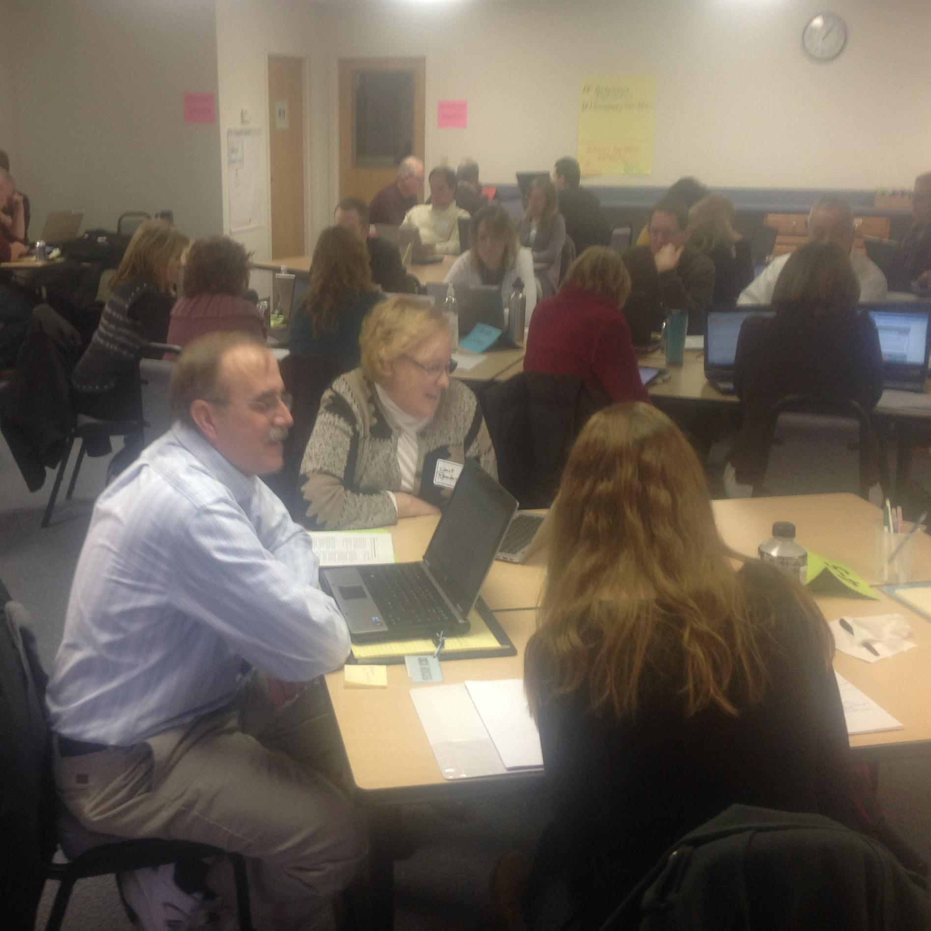
OCM BOCES Science Center
January 11: Next Generation Science Standards (NGSS) work session was held
This session gave about forty participants the opportunity to get together and discuss the standards, explore the performance indicators, and cross cutting concepts, as well as key vocabulary included within the standards.
Goals were to familiarize teachers with
the NGSS and to obtain feedback on the
second draft version. An interface was
created by the Science Center to collect
feedback comments using focused criteria.
The feedback will be shared with Achieve
(the company leading the writing of the
new standards) as well as NYSED.

Slide 30
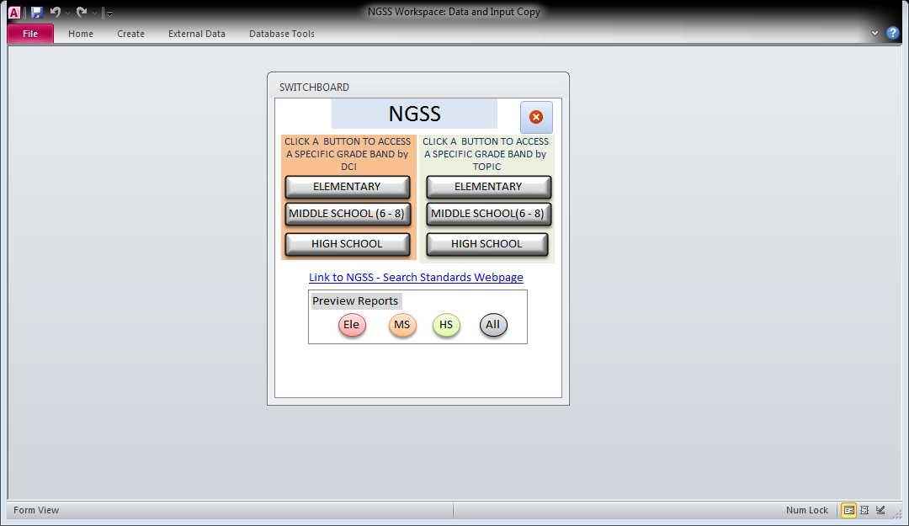

Slide 31
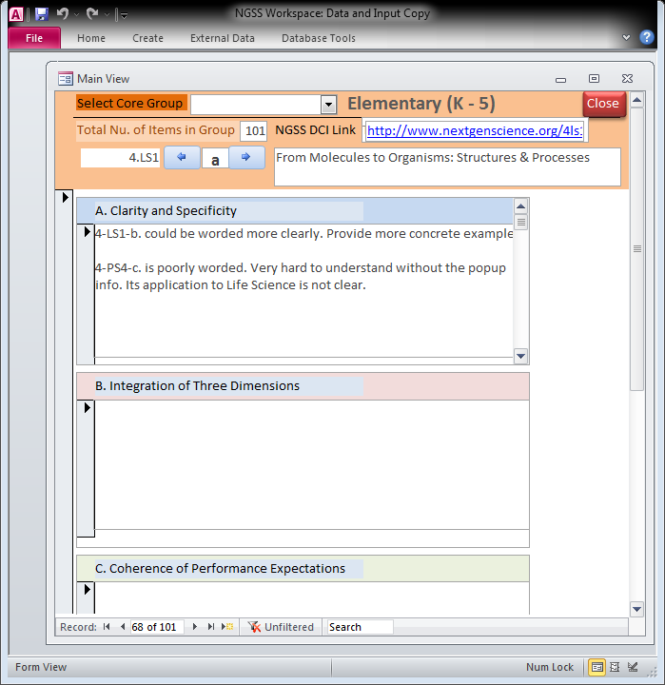

Slide 32
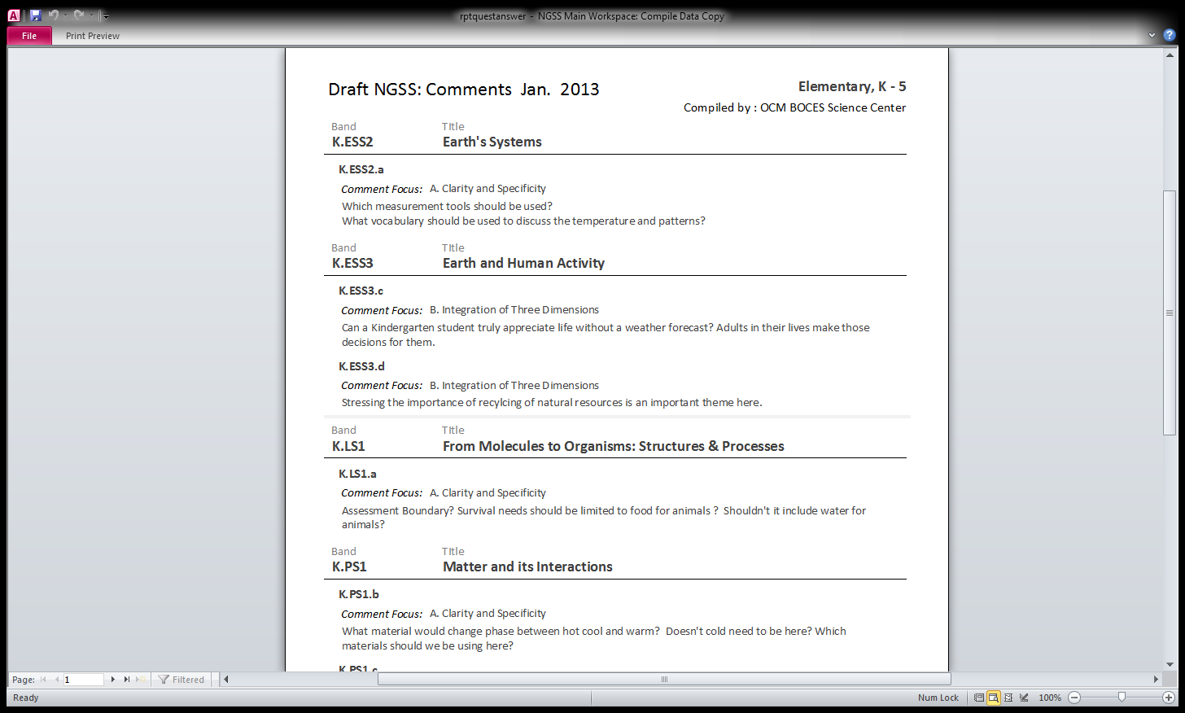

Slide 33
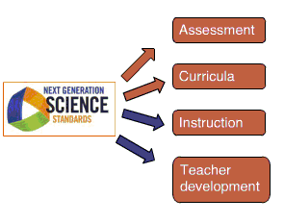
Next Steps

Slide 34
Professional Practice (APPR)
SLO Summative Resources
Long-term absence discussion
Crash Course added

Slide 35
Culture
PLCs at Work Summit
  Keynotes streamed
  Quick responses to our questions
  One breakout streamed, second would be recorded (both facilitated)
  We could run our own breakouts, too
  $225+ for two-day event (+ is for facilities, food, and additional facilitator)
  July 17-19, July 24-26, or August 5-7 available

Slide 36
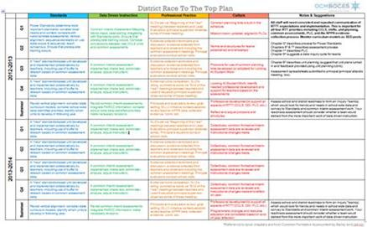
Long-term Planning
How’s it going? Can we help?

Slide 37
Some Hard Questions
How do you know what messages and resources your teachers are getting?
Have your teachers worked with the mathematical practices?
Have your 3-8 teachers seen the sample items?
Have you used the math checklist?

Slide 38
Assessment

Slide 39
3-8 Assessment
Work with site coordinator to finalize logistics (schedules, locations, food )
Training for scoring leaders will be scheduled for March
Note all the site coordinators will be attending the turn key training provided by Pearson and SED scheduled for late February

Slide 40
Exploration of electronic scoring
Met with representative from Strategic Measurement and Evaluation
Level One: Similar to current practices at cost of $7-9/test
  Upside is that would need about 30-40% fewer scorers
  Downside is that scoring window likely to be shorter--- which could negate the upside!
Level Two: Includes outside scorers at cost of $11-13/test

Slide 41
January Regents
Updated spread sheet
Last check that all participating districts are recorded correctly for number of exams, number of scorers and who the scoring trainer/leaders are
Gather user code for verification and emergency contact numbers
June planning is right around the corner

Slide 42
Regents Scoring
Will meet after BCIC today

Slide 43
Next BCIC Meeting
February 17, 2013
Distance Learning Center

